Slide 1
WaSP
(Wafer Scale camera for Prime focus)
Camera Review
June 21st 2013
1

Slide 2
Review Participants
Review Board Convened by R. Dekany
Chair – Mark Lysek, (JPL)
Andy Boden (COO)
Randy Bartos (JPL)
James Bauer (JPL)
Presenters: Stefan Martin, Eric Bellm, Tim Goodsall, Randy Hein, Roger Smith
Attending
S. Nikzad, J. Henning, C. Heffner, A. Ramaprakash
2

Slide 3
Review Charter
The convening authority is Richard Dekany (Caltech Optical Observatories) (COO).
The responsible individual for JPL is Stefan Martin. He will define the review agenda and prior to the review discuss it with COO.
COO and JPL will recommend review board members.
The review board Chair will prepare a report and recommendations.
Review board members will be drawn from JPL and COO.
Other invitees will be drawn from JPL, COO and COO Palomar Observatory
Review materials will be provided to the review board at least one day in advance of the review.
Some review elements may be informal with hand sketches, drawings rolled out, documents with relevant sections highlighted, etc.
3

Slide 4
Review Objectives
Determine that the design will meet the requirements.
Determine that camera can be integrated into Hale telescope.
Assess whether risks are being adequately mitigated.
Determine that the test plans are appropriate.
Assess whether the plan can meet the cost and schedule constraints.
Determine the readiness to begin hardware fabrication and procurement.
4

Slide 5
Agenda
8:30 Coffee
9:00 Project Introduction and Requirements - E. Bellm
  9:20 Cryostat
  Optical Design - S. Martin
  Mechanical Design - R. Hein
  Handling - T. Goodsall
  Thermal Design - R. Smith
  Window Demister - R. Smith
10:35 Break
10:45 Interfaces
  Vacuum Interface Board - T. Goodsall
  Guider Interface - T. Goodsall
  External Electronics - R. Smith
11:10 Management Plan - S. Martin
  Electronics I&T Planning - T. Goodsall
11:30 Discussion
12:00 Adjourn
5

Slide 6
Project introduction-
Eric Bellm
6

Slide 7

WaSP Overview and Requirements
Eric Bellm
On behalf of the WaSP Science Team:
Eric Bellm, Shri Kulkarni, Tom Prince
Mike Brown, Judy Cohen, George Djorgovski, Carl Grillmair, John Johnson, Paul Weissman, Lin Yan
7

Slide 8
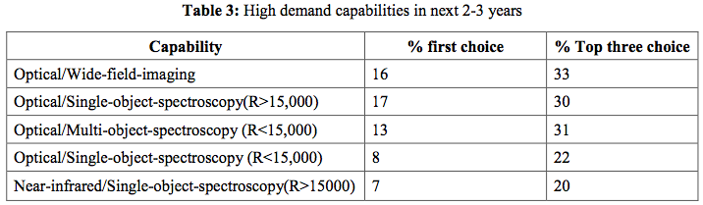
Wide-field imaging is one of the workhorse capabilities of optical astronomy
2009 ALTAIR report
Selected science use cases:
deep imaging of faint transients
identification of structures and stellar populations in galaxies
  Studies of color and morphology of solar system bodies
Wide range of filters used: both broadband and narrowband (Halpha, Si II)
8
Notes:
Share of telescope time could be higher if performance improved

Slide 9
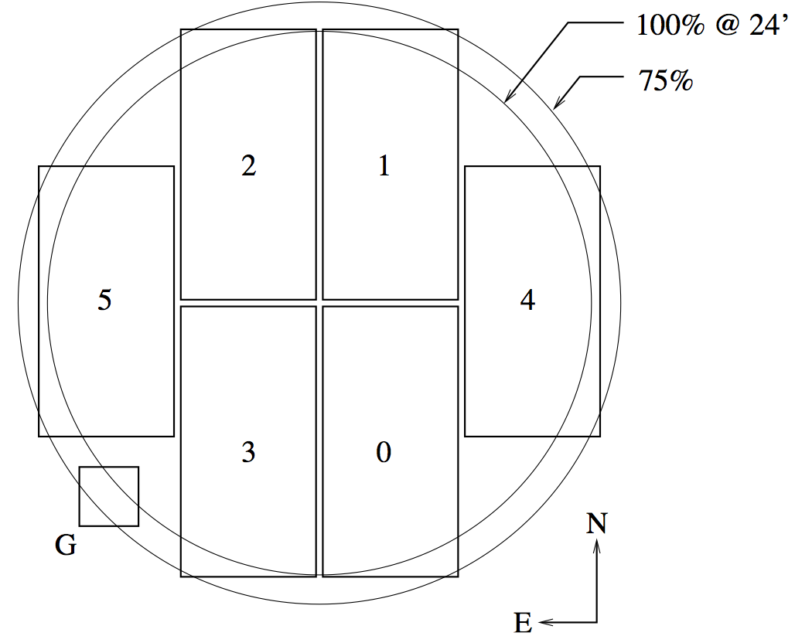
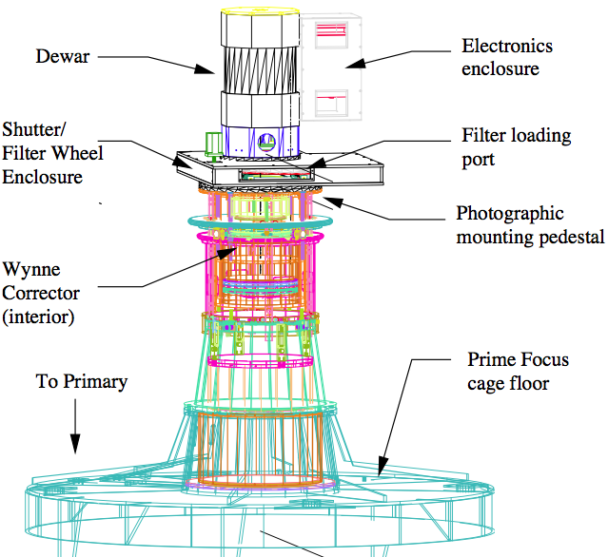
The LFC is the current optical imager at Prime Focus for P200.
Focal Plane Layout
LFC in use for ~1/5 of P200 nights
9
Instrument Configuration
Notes:
Wide field prime focus imager on P200
24’ x 24’ field of view
Built in 2000 by Mark Metzger, Rob Simcoe, et al.
Science: imaging and photometry. Extragalactic and galactic, broad and narrowband. Galaxies, transients, and solar-system objects.

Slide 10
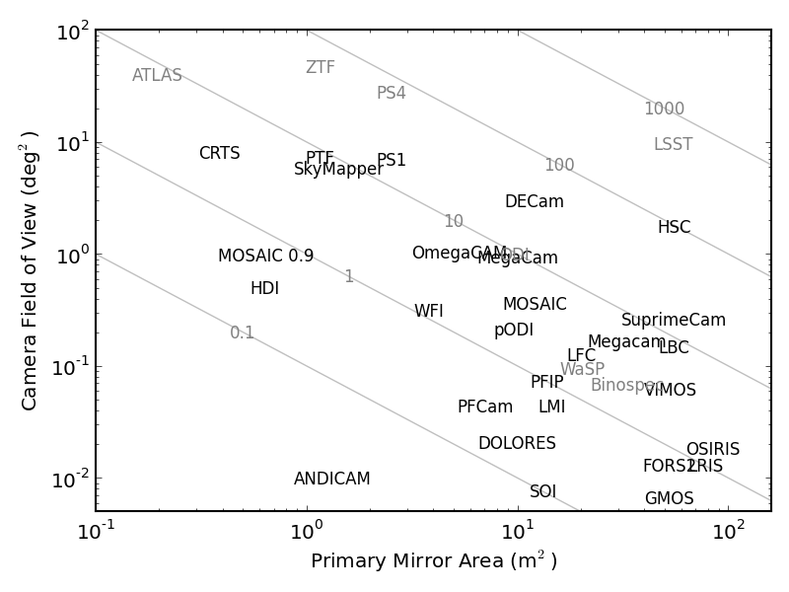
The P200 prime focus provides commodity
imaging capabilities.
10
Notes:
Omits important factors like obscuration & transmission, DIQ and site seeing, weather, sky background, readout speed, software/reduction infrastructure, available time, etc.

Slide 11
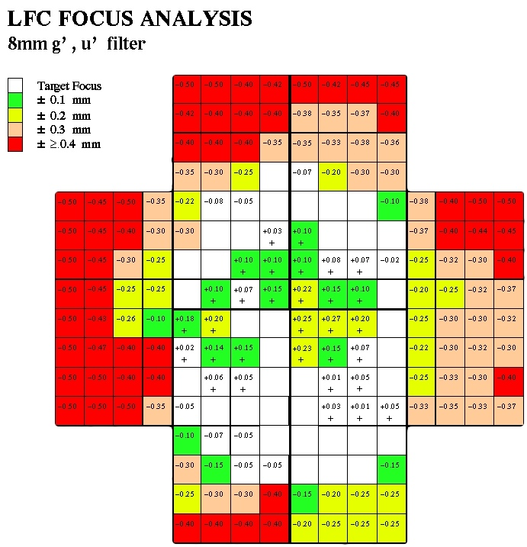
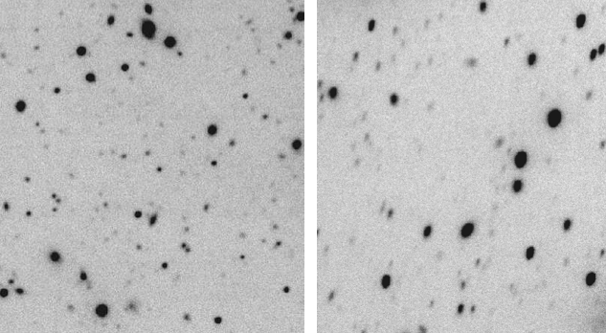
A replacement can address some of LFC’s shortcomings.
Challenges:
Slow readout (93 seconds)
Instrument crashes and freezes,
chip failures
Shutter/filter homing problems
Slow focusing
Small guider field of view
Chip gaps in primary field
Unfriendly control and reduction software
Focus changes through the field
PSF & astrometric distortion at field edges
Opportunity:
Combine development work for ZTF
Potentially standardize a controller/software stack for the next decade at Palomar
11
Notes:
LFC is a workhorse instrument, but lots of little problems
Confluence with another project in development, PTF-2

Slide 12
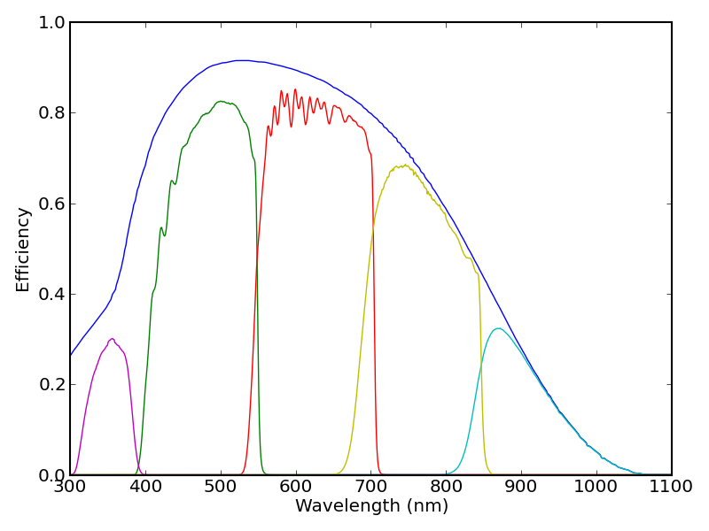
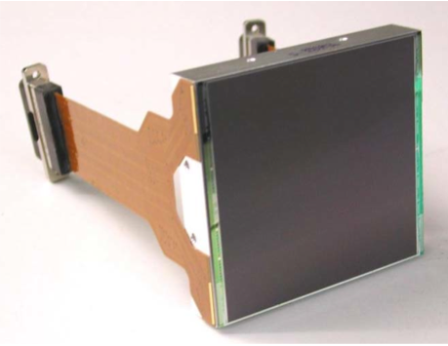
WaSP will use a single wafer-scale CCD.
 | LFC | WASP
CCDs | six 2k x 4k | single 6k x 6k
Field dimensions | 24’ x 24’ | 18.4’ x 18.4’
Pixel scale | 0.18”/pixel | 0.18”/pixel
WaSP
LFC
12
e2v
Notes:
Fills 75% of unvignetted field.
Prototype CCD and electronic stack for ZTF moscaic.

Slide 13
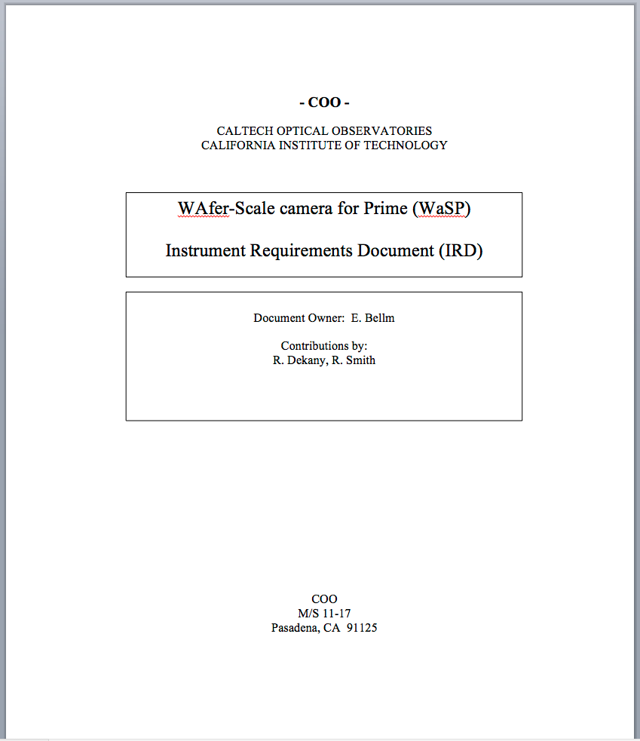
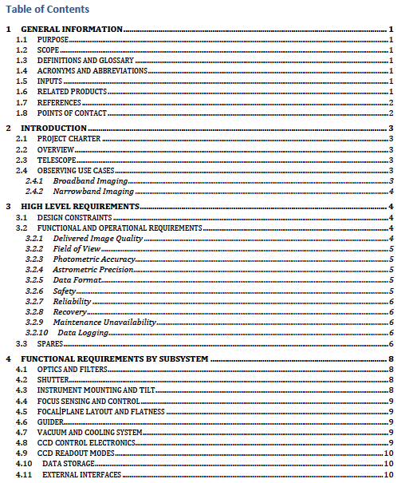
WaSP requirements are contained in an
Instrument Requirements Document (IRD, currently v0.4)
Project Charter is to develop a reliable, affordable replacement for LFC that also serves as a pilot for ZTF.
  Performance improvements
  at low cost should be considered along the way.
  Narrow and broadband imaging from
  u’ Sloan to ZUKIDSS filters (l = 352 – 942 nm)
Companion Delivered Image Quality (DIQ) Budget allocates high-level requirements to subsystem
13

Slide 14
Project assumptions include several constraints on scope.
Significant reuse of the Wynne Corrector. This determines:
  Plate scale = 12”/mm
  Field vignetting beyond 12 arcmin radius
  Residual field curvature
  PSF and astrometric distortions at the edges
Significant reuse of the LFC shutter and filter assembly. This determines:
  Four filters are available to the camera at any time.
  Minimum exposure = 0.6 seconds
Use of a ZTF-selected CCD
  Wafer scale, ~9.2 x ~9.2 cm
  15 micron pixels
Use of a ZTF-relevant controller
  The IFPAC controller provided by IUCAA as part of the ZTF partnership
The instrument shall be installed and used as a facility instrument on the Hale Telescope without telescope modifications.
14

Slide 15
Other requirements are set by science performance.
Optical
  FoV: ~18’ x 18’ arcmin, set by ZTF-relevant CCD size
  Pixel Scale = 0.18 arcsec/pix
  Antireflection coated window
Photometric Accuracy < 2%, calibrated to standards
  1% allocable to shutter timing variation
Astrometric Precision < 10 mas, relative
Reliability
  MTBF > 40 hrs (TBC)
  This implies 95% confidence of no loss of data in an 8-hour night consisting of 16 30-minute exposures (TBC)
  Fault recovery
    Software reboot < 30 seconds (20 sec goal)
    Full hardware + software reboot < 60 seconds (30 sec goal) (TBC)
Autoguider/Autofocuser shall have sufficient field to:
  Track with blurring < 0.1” FWHM
  (about 0.16” P-V)
  Autofocus to < 0.22” FWHM
  (See Delivered Image Quality Budget)
Cadence
  Full-frame readout time < 20 seconds (<10 sec goal, < 5 sec stretch goal), driven by ZTF
15

Slide 16
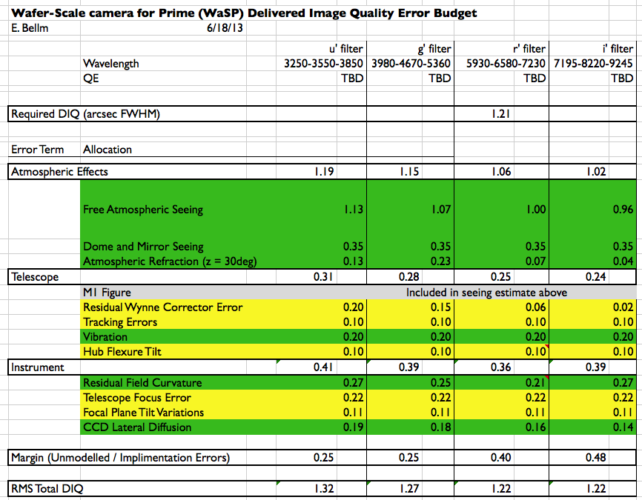
Delivered Image Quality Budget
16

Slide 17
Other requirements are set by operations goals.
Operability
  No modifications to P200 telescope
  No window condensation during normal operations
  Cryotank hold time > 30 hours
  Vacuum pumping < 1 per month (< 1 per 3 months goal)
  Shutter maintenance interval > 9,000 cycles
    > about 90 nights of ‘typical’ operation
  Exposure times between 0.6 seconds and tens of minutes
  Data storage > ~150 GB
Detector Readout Modes
  Readable with either 1, 2, or 4 readout amplifiers.
  Readable with arbitrary binning through a single readout-amplifier.
  Readable in a band of interest (BoI) mode that reads the range of full rows in each of 1, 2, and 4-readout amplifier modes.
  Readable with rectangular region of interest (RoI) through a single readout amplifier (goal).
Science detector QE, other parameters, subject to sensitivity trades as part of procurement process (no fixed IRD requirement)
17

Slide 18
CRYOSTAT Optical design-
Stefan Martin
18

Slide 19
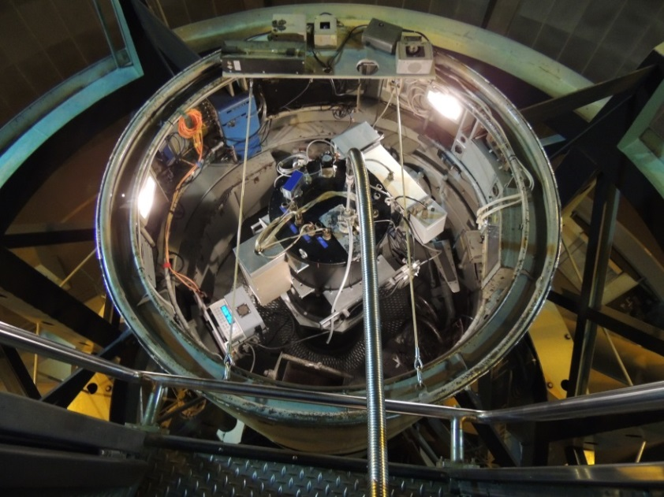
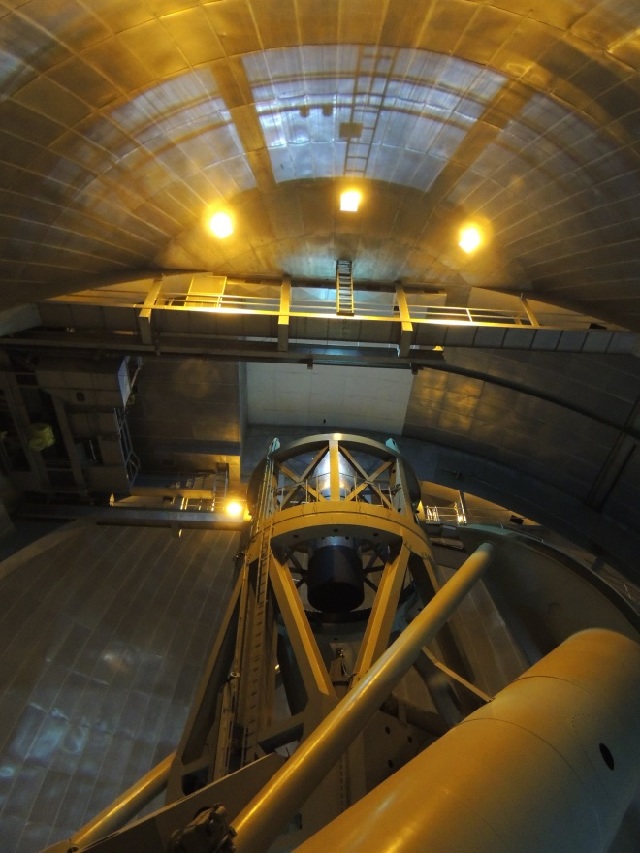
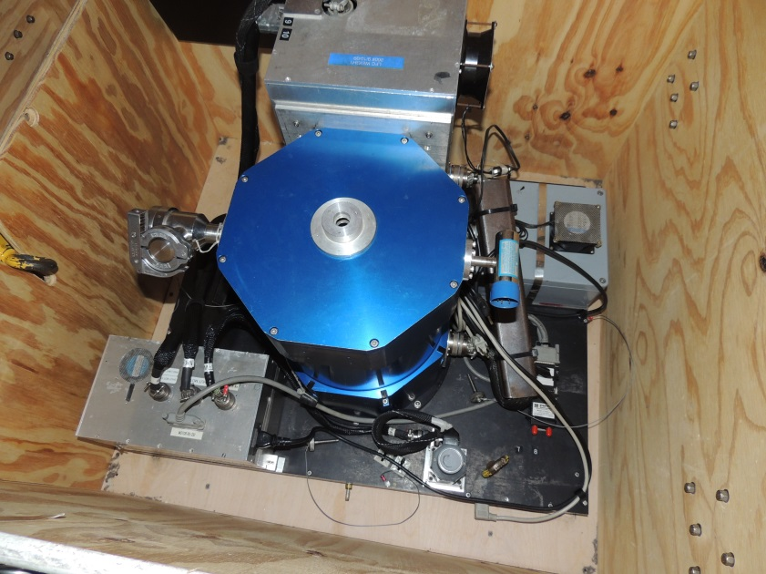
Hale telescope prime focus cage
WIRC in place at prime focus
19
Hale telescope prime focus cage
LFC in place on filter/shutter box

Slide 20
Location
WaSP to be located at the P200 Prime Focus
Will reuse existing LFC filter/shutter box
Form will fit around existing structures on that box
Schematic of working position for LFC
LFC in position on filter/shutter box
20
Notes:
Wide field prime focus imager on P200
24’ x 24’ field of view
Built in 2000 by Mark Metzger, Rob Simcoe, et al.
Science: imaging and photometry. Extragalactic and galactic, broad and narrowband. Galaxies, transients, and solar-system objects.

Slide 21
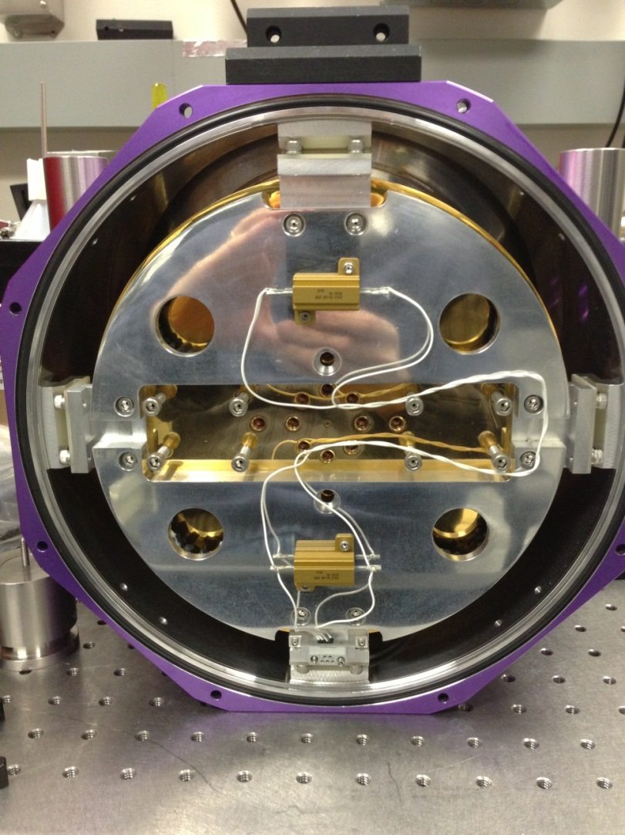
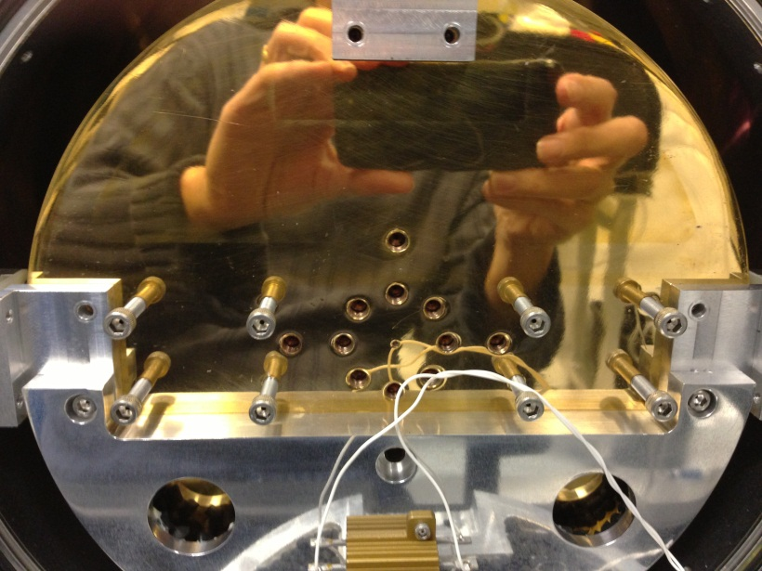
CFH12K Dewar supplied by COO
Remove getter assemblies and replace with thinner units
Rotate can by 45 degrees to bring vacuum ports to desired orientation
Replace heaters with TO2 style. Add thermal fuse.
Temperature sensor on tank and CCD
Add vacuum interface board (VIB) for feed-through wiring.
VIB apertures clear flexures.
CCD orientation
21

Slide 22
Optics
The Palomar Hale Telescope has a paraboloidal primary mirror with collecting aperture of 200 inches, operating at f/3.34 at prime focus.
  The Wynne Prime Focus Corrector (Wynne 1967) corrects field aberration to ~0.3 arc sec or better out to a field of ~15 arc minutes.
  The resulting beam is f/3.50 at 11.5 arc sec/mm plate scale.
The imaging field is unvignetted to 12.4 arc min radius (132 mm φ )
  50% transmission at 13.6 arc min (145 mm φ at focal plane)
  PSF and astrometric distortions appear at the field edges.
The plane of best focus is slightly curved
  deviation of ~-0.05 mm at the outer edge of the field relative to the center.
  The effective focal length is 17.874 m
The pixel size corresponds to a ~0.173 arc sec square field.
22

Slide 23
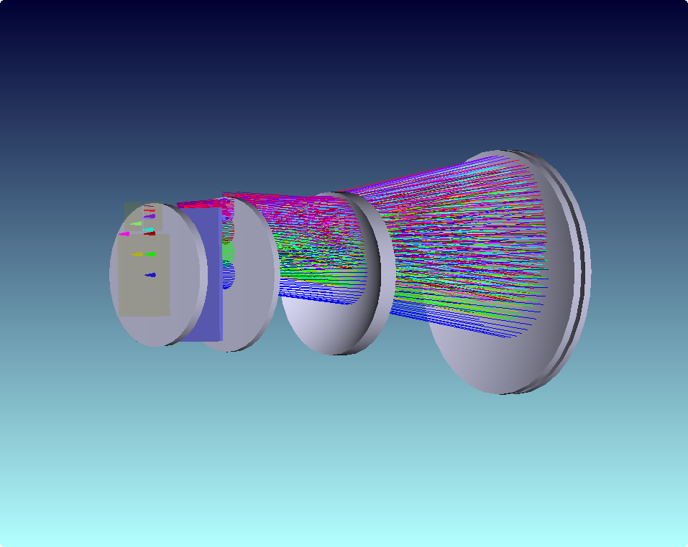
Optical layout
Wynne corrector through to focal plane
Elements 1&2
Elements 3&4
Telescope primary mirror
Filter, dewar window and focal planes
23

Slide 24
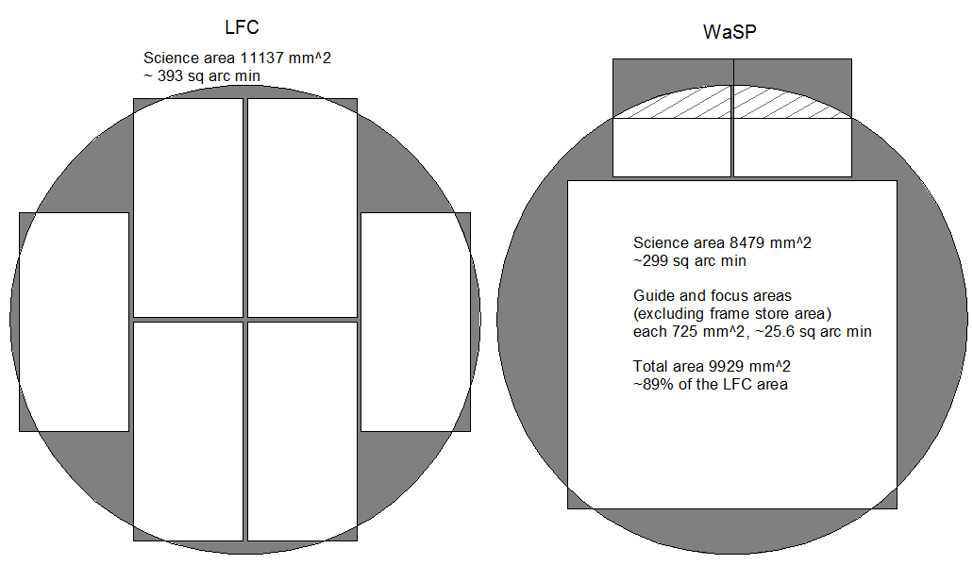
CCD selection
WaSP will use JPL-packaged CCDs for guide and focus based on STA3600 CCDs
The CCD is grown on high-resistivity silicon and thinned to 200um to enhance the red sensitivity. The design allows for full-depletion of the silicon substrate to meet the charge diffusion (MTF) requirements.
The wafer is delta-doped prior to dicing and packaging to enhance the blue response short ward of 350nm.
These will also be deployed on ZTF.
2048(H) x 2048V) pixels, 15 μm square, image area 30.7 mm x 30.7 mm
  Package size TBD
  WaSP may use half the area as a frame store (hatched area + exterior area)
WaSP will use same science CCD as ZTF; e2v CCD 231-C6
  6144(H) x 6160(V) pixels, 15 μm square, image area 92.2 mm x 92.4 mm
  Package size 98.5 x 93.7 mm
  Readout noise 5 e⁻ at 1 MHz, 2 e⁻ at 50 kHz
  Pixel full well 350,000 e⁻
  Dark signal 3 e⁻/pixel/hour (at –100 C)
Edges of package are at ~8.6 arc min, corners at 12.2 arc min.
WaSP science area is 75% of LFC science area, but is contiguous. Total WaSP CCD area is 90% of LFC.

Slide 25
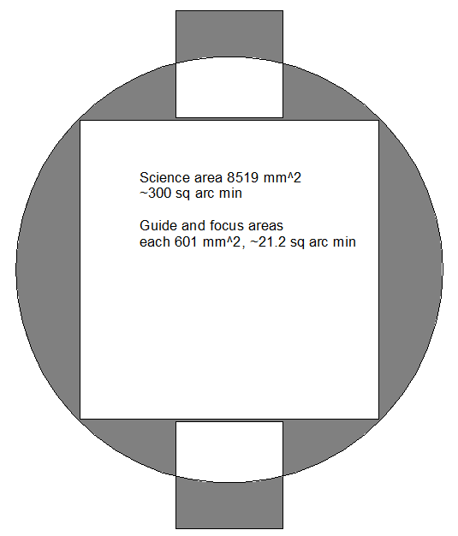
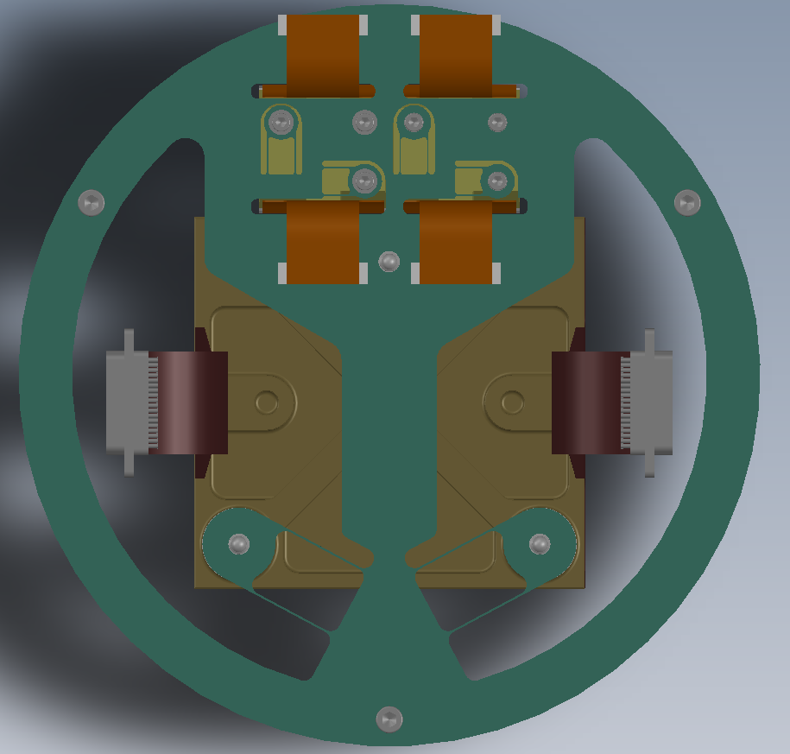
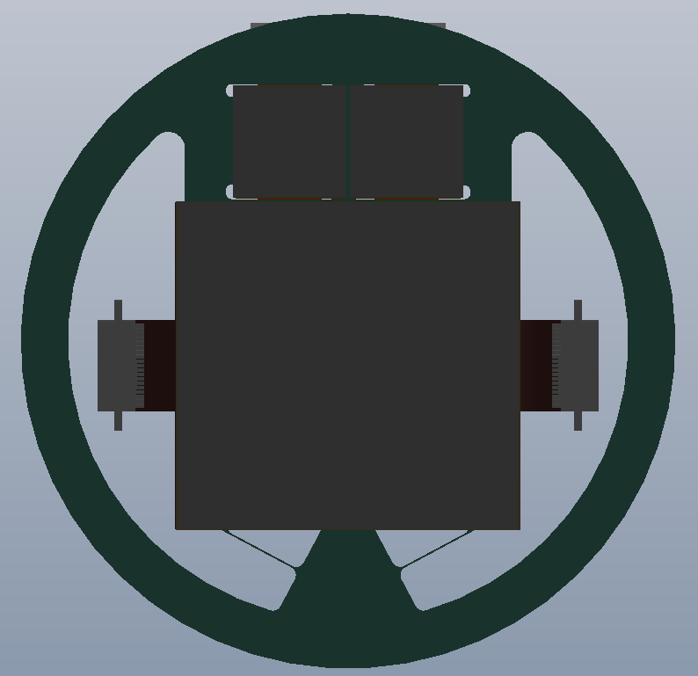
CCD layout
Simple layout
Most obvious layout creates difficulties either with mounting flexures or with science CCD cables
Side-by-side layout has guide/focus cables very close to edge of mounting structures
Side-by-side layout plus a small translation better accommodates cables into the structure and enlarges guide and focus CCD areas. Only ~1% of science CCD is in partially vignetted area.
Side-by-side layout

Slide 26
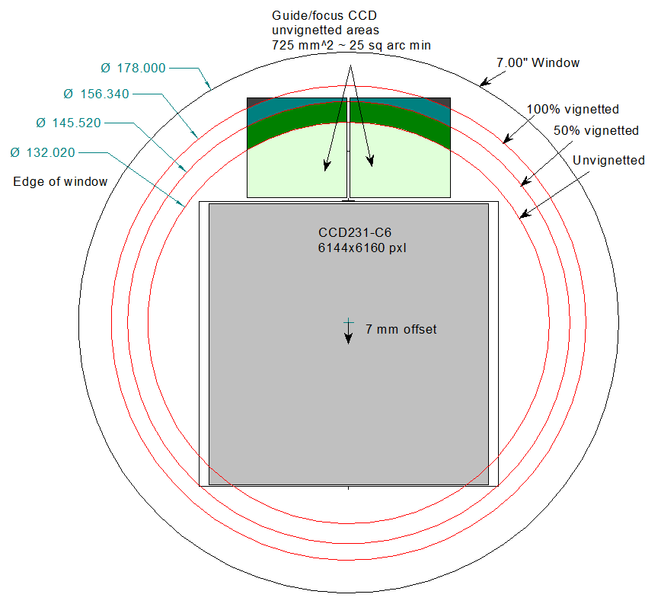
Fields of view
26
1

Slide 27
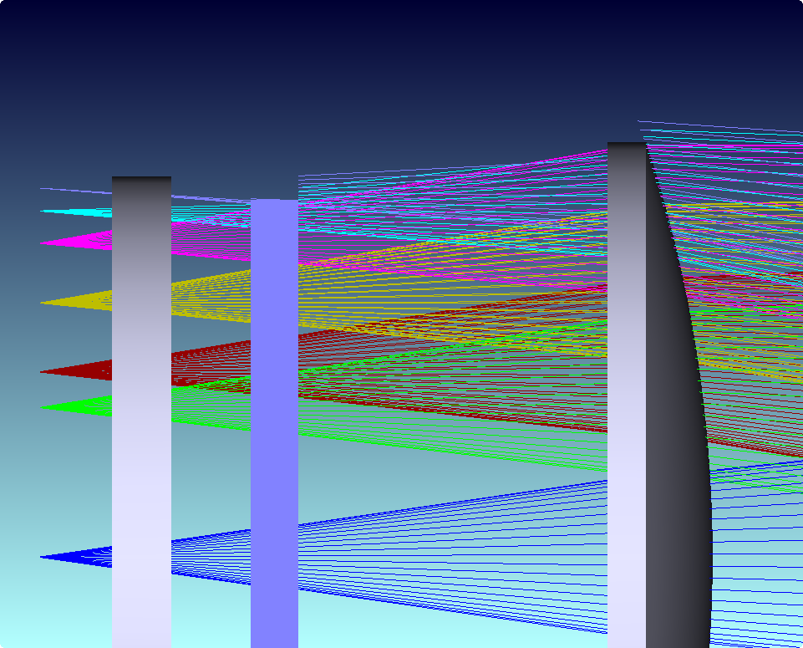
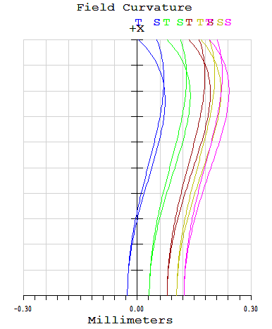
Dewar window
Clear aperture of window exceeds 50% vignetted field (field #10) by 2mm.
Clear aperture is 156 mm (6.18 inch).
Window is 178 mm diameter (7.00 inch).
Window is not the aperture limit even at large fields: filter box limits.
Window
Filter
27
Field curvature out to center of focus CCD area

Slide 28
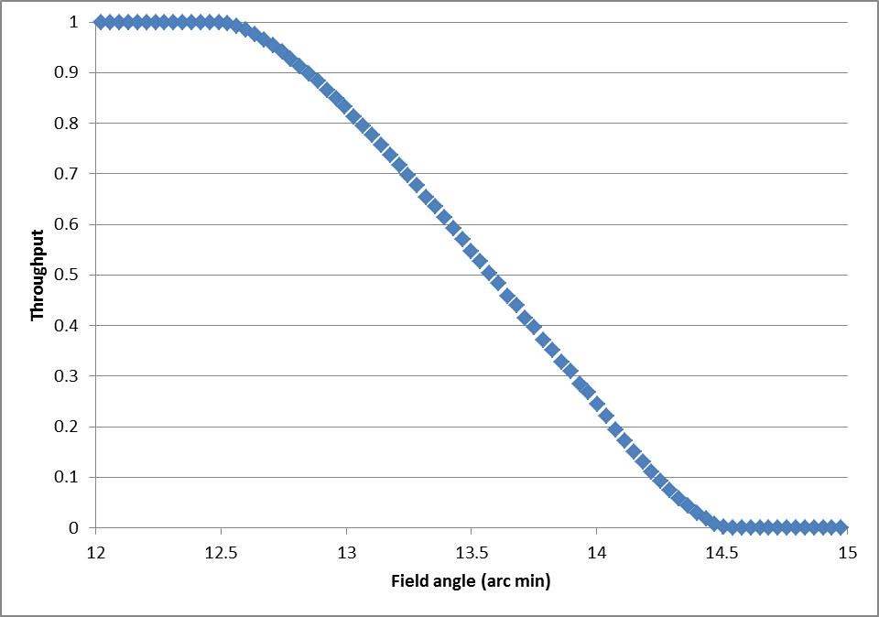
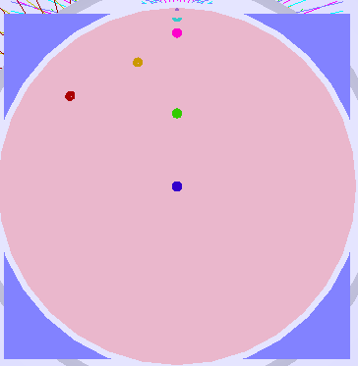
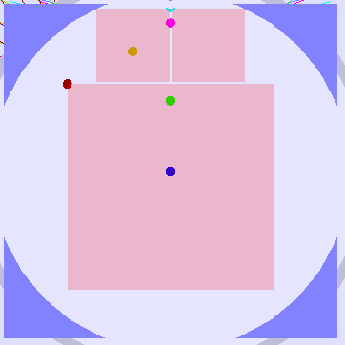
Focal planes
Fields:
1: Zero field on sky
2: Typical field on science CCD
3: Corner of science CCD
4: Center of guide/focus unvignetted area
5: Edge of unvignetted
6: 50% vignetted
7: 100% vignetted
Vignetting of rays with field angle
Fields used for analysis
7
6
5
4
Vignetting occurs at Wynne corrector element 1 (~12.6 arcmin) ,
then at filter box (~14.3 arcmin).
3
2
1
28
1

Slide 29
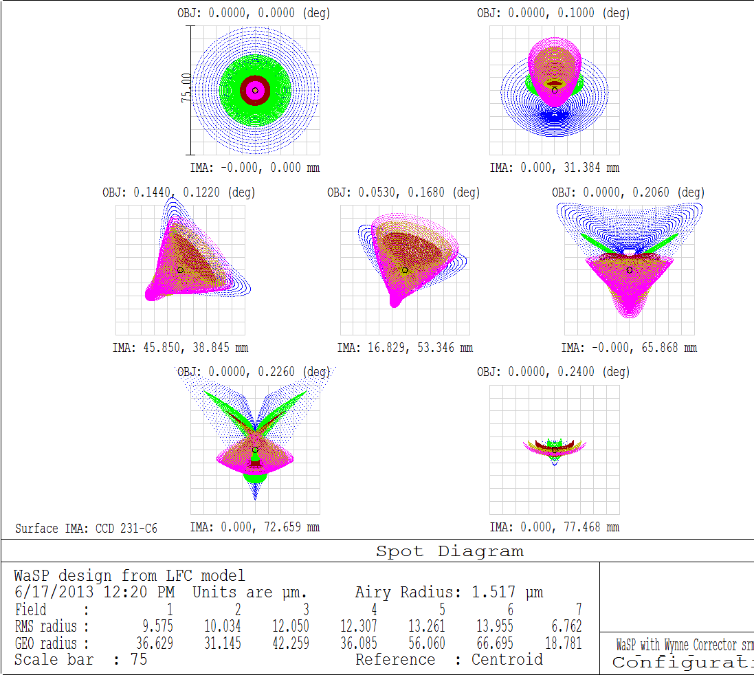
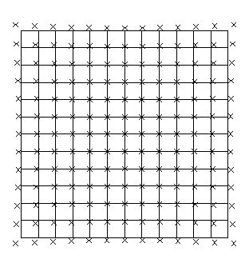
Focal planes (2)
Spot diagrams for fields 1 through 7
Gridded areas are 5x5 pixels: ~ 0.95 arc sec
Grid distortion to edge of unvignetted field- max 5.6%
This field is strongly vignetted
Fields (left to right from top):
1: Zero field on sky
2: Typical field on science CCD
3: Corner of science CCD
4: Center of guide/focus unvignetted area
5: Edge of unvignetted
6: 50% vignetted
7: 100% vignetted
Required RMS spot radii (excluding seeing) that meet requirements are
25 μm at field edge, 11 μm at field center. So these foci meet requirements.
    (From instrumental error budget of 0.55” FWHM at the field edges, 0.25” FWHM at the field center)
29
1

Slide 30
Window strength
WaSP window is 178 mm diameter (7.00 inch).
LFC window is 203.2 mm diameter (8.00 inch).
WaSP window has greater safety margin than LFC window.
30
1

Slide 31
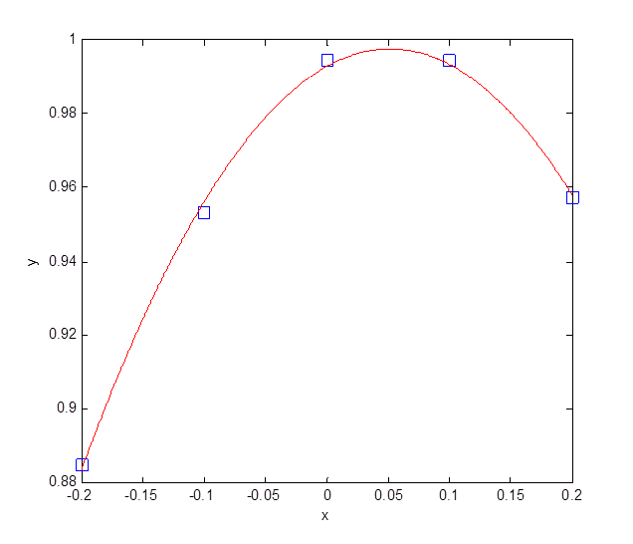
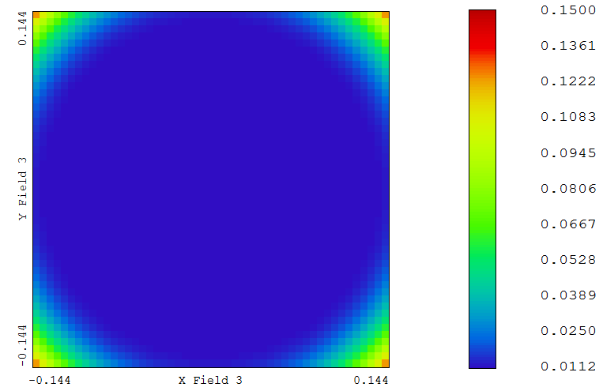
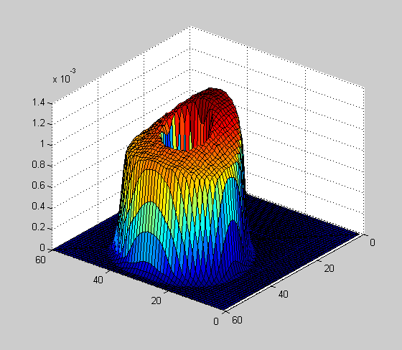
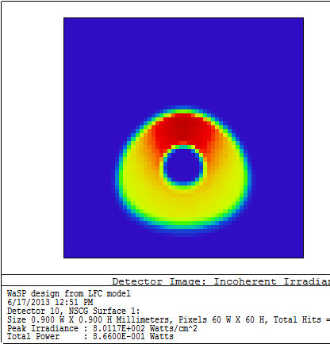
Focus estimator
Correlation of defocused spot against templates
Assumed a 1.5 mm offset of the focus CCD from the science focal plane
Modeled the focus detector surface with sixty 15 μm pixels.
Took five images of a star at field #4 with different focus offsets (-200 to 200 μm) to act as templates.
Took another image with a focus offset of 50 μm to act as the test case.
Calculated the 2D correlation function of the templates with the offset focus image
Graph shows quadratic curve fit to correlations
  Location of focus is apparent
Model will be enhanced to include noise and displacement of the centroid
Will then be able to test at different stellar magnitudes and determine an optimal focal plane offset for the focus CCD.
Nominal focus position x = 0 mm
Focus offset to x = 0.05 mm
Boxes show correlations, curve is a quadratic fit.
Peak of curve is at x = 49.4 um, correlation = 0.997
RMS spot radius (mm) across the science CCD near optimum focus
Surface map of image of
defocused star
Pixelated broadband defocused
image of star

Slide 32
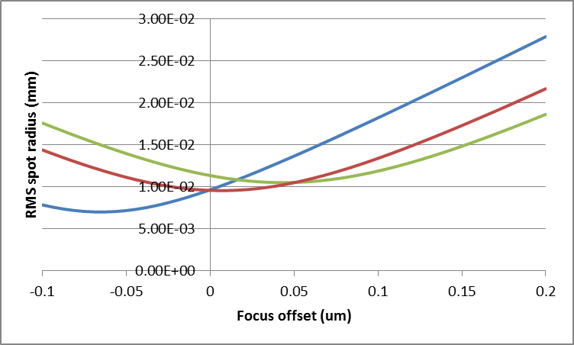
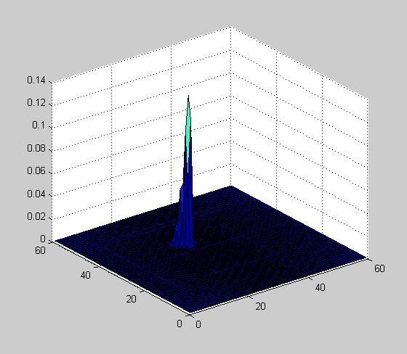
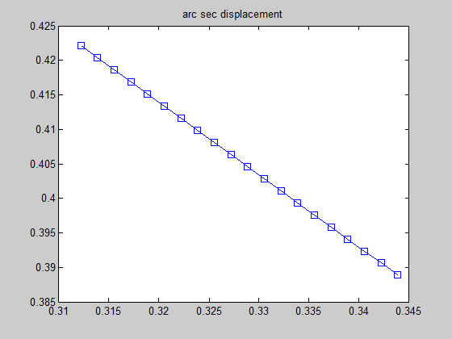
Guider model
Model the guider detector surface with sixty 15 μm pixels.
Track the centroid of the focused star image while adjusting the field
  rms spot diameter ~ 22 μm
  Standard deviation of displacement is ~4e-6 arc sec
Model will be enhanced to include noise and defocus
Will verify guide CCD can meet requirements of tracking to < 0.1” FWHM (about 0.16” P-V)
Guider will be positioned slightly (~50 μm) less deep into dewar than main CCD
Polychromatic spot radius against focus offset for fields 1 (blue), 2 (red) and 3 (green)
Measured centroid of spot (only about 1000 e- per frame, but effectively noise-free) for a monotonic position change of the star
Surface map of star image on guide CCD

Slide 33
On-sky alignment plan
In lab, use traveling microscope to measure alignment of CCD with dewar baseplate.
  If necessary, adjust by shimming at three points under spacer
On sky, at or near zenith, test focus on a target star at a series of focus positions.
  Use similar algorithm as for autofocus
Run focus tests with star near four corners of science CCD
  Determine tilt of CCD plane wrt telescope focal plane.
Calculate required shims to correct tilt
  Loosen camera attachment to filter box.
  Use jacking screws on dewar to raise dewar off filter box
  Place shims
  Re-tighten dewar to filter box
Repeat measurement and adjustment cycle as necessary.
  A shim of 2/1000” across 10.5” corresponds to tilt of 18 um across the science CCD
Permanent fix of the tilt
A permanent correction can be made using a hard annular shim placed between the camera and the filter box.
Thickness ~ 1mm, ~12.6” OD, 10” ID
Once correct shims have been determined, grind annular shim to known angle and permanently attach to base of camera.
Alignment feature

Slide 34
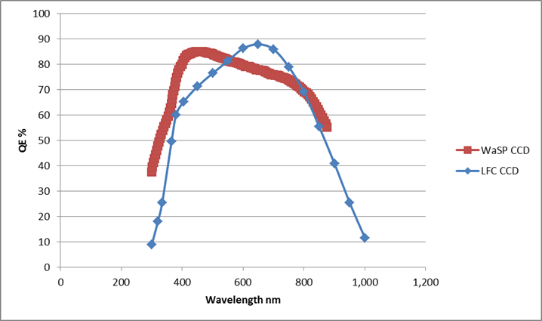
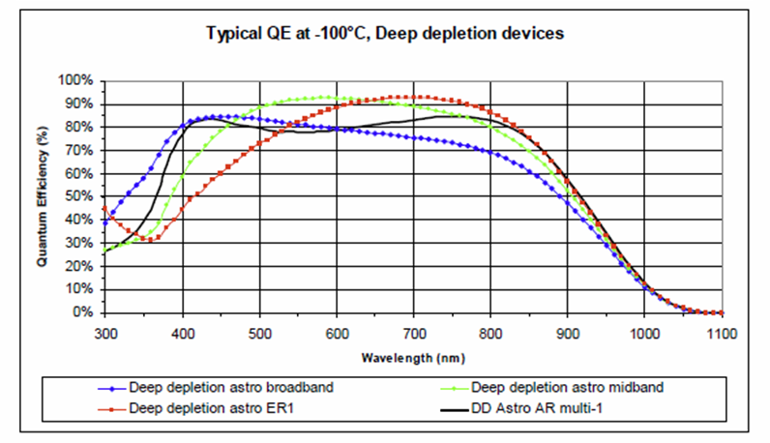
Window ghosts
Window to CCD distance is 8.06 mm. Roundtrip is 16.12 mm.
F# is 3.50. Diameter of ghost is 4.6 mm; 53 arc sec.
Assume reflectance of CCD is 20%
Assume reflectance of window is 1%
Intensity of ghost in 1.1 arc sec seeing compared with star is 0.2*0.01*(1.1/53)² = 8.6 x 10⁻⁷. ΔM = 15.2
Double reflection ghost from a 3mm thick filter, uncoated is 0.04²*(1.1/30)² = 2.2 x 10⁻⁶. ΔM = 14.1
Window specifications
Fused silica for best near UV performance and low radioactivity; BK7 transmission falls off ~350nm
AR coated (better than 1%) for imaging from u’ Sloan to ZUKIDSS filters (l from 352 to 942 nm)
CCD 231 has much better UV QE compared to LFC CCDs
Graph (left, below) shows deep depletion astro broadband version (red) and LFC (blue)
34
1

Slide 35
Requirements check list
Requirement | Value | Comment | Status
Delivered Image Quality |  | Dominated by Palomar seeing | Optical window thickness weakly affects
Field of view | ~18*18 arc min | Determined by CCD size | 17.3 arc min square
Photometric accuracy | 2% in broadband filters | Determined by existing LFC filter box shutter | Calibratable to standards
Astrometric precision | < 10 mas | Determined by distortions of Wynne corrector | Calculable and calibratable down to gravity and thermal effects
AR coated window |  | u’ g’ r’ i’ Z bands | BB OTS coating, eg Rainbow Optics
Autoguide | 0.10” FWHM |  | Looks ok. Model to be completed
Autofocus | 0.22” FWHM | ~19 um. Assume this means ~70 um focus offset maximum. | Looks ok. Model to be completed
Full frame readout | < 20 s |  | Outside scope of this review
No mods to P200 |  |  | Check
No window condensation |  | Will provide dry N₂ flow across window or into filter box
Cryo hold time | > 30 hours |  | Check: > 28 hours expected.
Vacuum hold time | < 1 per month |  | Check- 0.11 Torr per month
Exposure times |  | Determined by existing filter box shutter | Outside scope of this review
Safe against internal pressurization |  | Will have pressure relief valve on vacuum port | Check
Robust window coating |  | Unexpected condensation eg when dismounting | To be negotiated with vendor
Tilt adjustment |  | Manual/ one time per mounting | Will be permanently set during integration phase
35

Slide 36
CRYOSTAT Mechanical design- randy hein
36

Slide 37
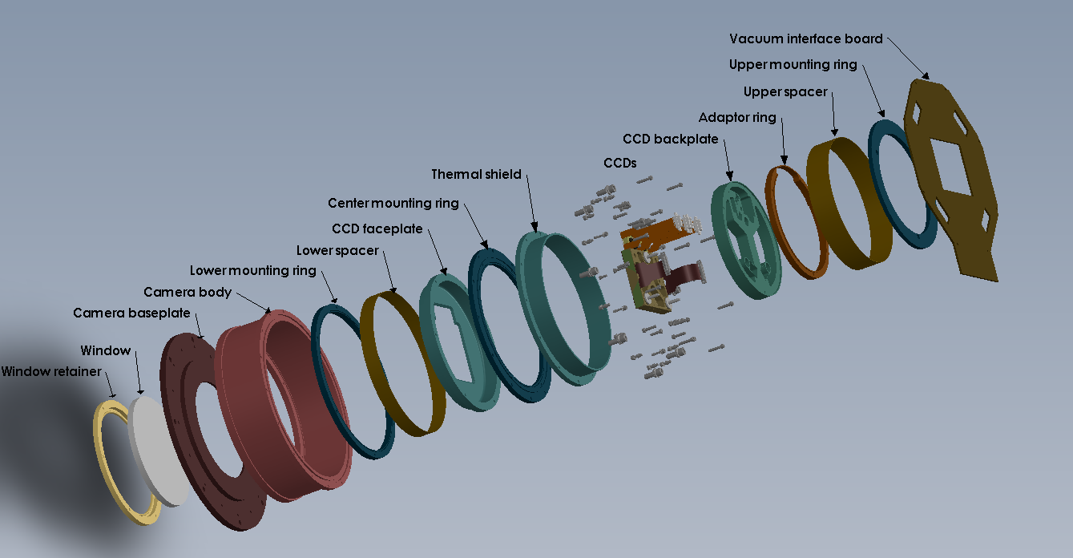
Principal components
37

Slide 38
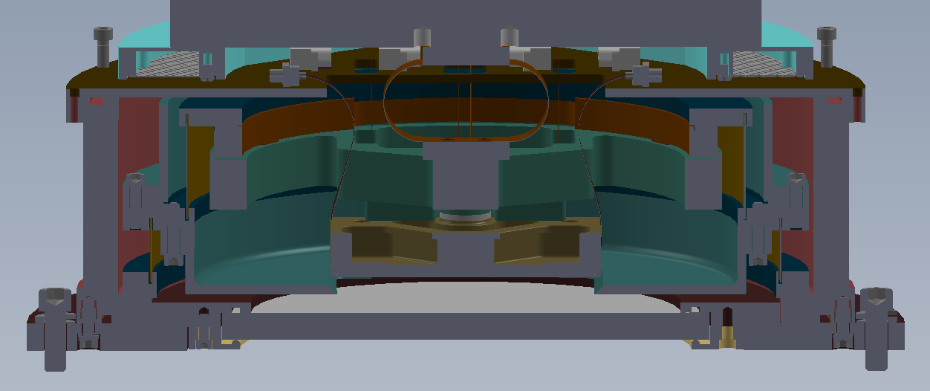
Cross sectional view
Cold finger
Getter
Tank
Cold shield
Spacer
Backplate
Cold shield
Science CCD
Window

Slide 39
Drivers for WaSP camera packaging
Fixed distance from Filter Box deck to detector (27mm).
Length of Science CCD flex cables (98.80mm).
39

Slide 40
Fixed distance from Filter Box deck to detector (27mm)
40

Slide 41
Length of Science CCD flex cables (98.80mm).
41

Slide 42
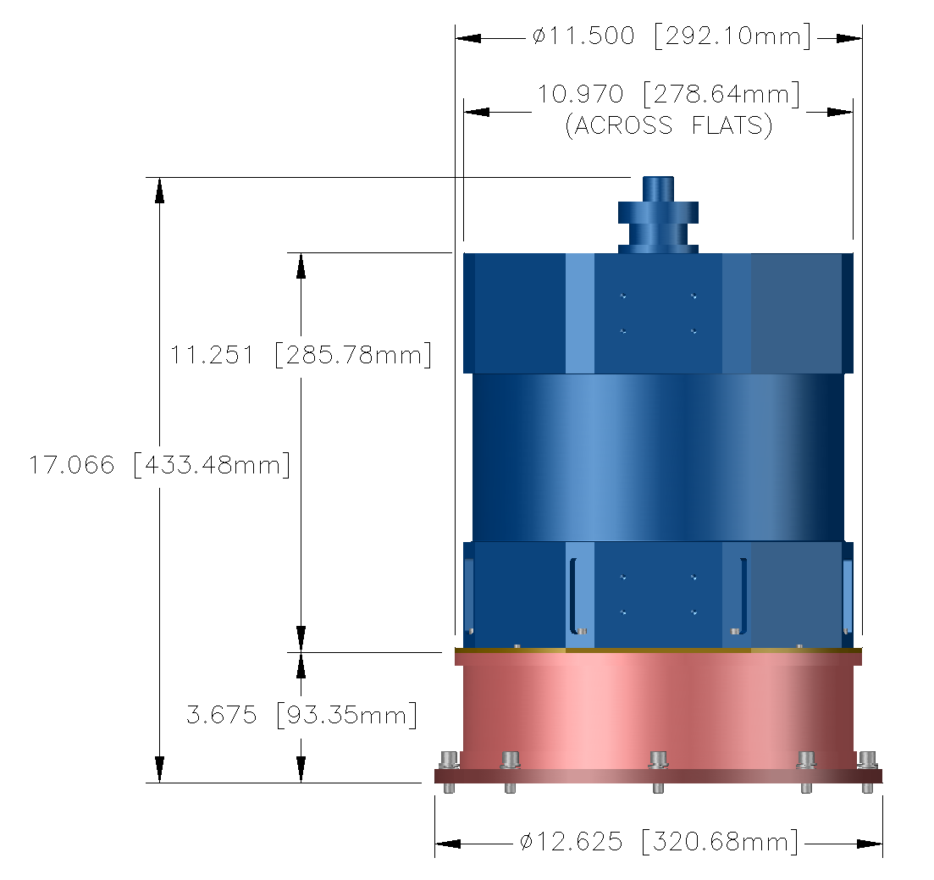
WaSP dimensions
Estimated mass: 19.53kg
42

Slide 43
WaSP Camera
Thermal Link
CCD Backplate
Getter
Upper Mounting Ring
Adapter Ring
Upper Spacer
Thermal Shield
Center Mounting Ring
Lower Spacer
Lower Mounting Ring
Camera Body
Window
CCD Faceplate
43
Camera Baseplate
Window Retainer
Science CCD

Slide 44
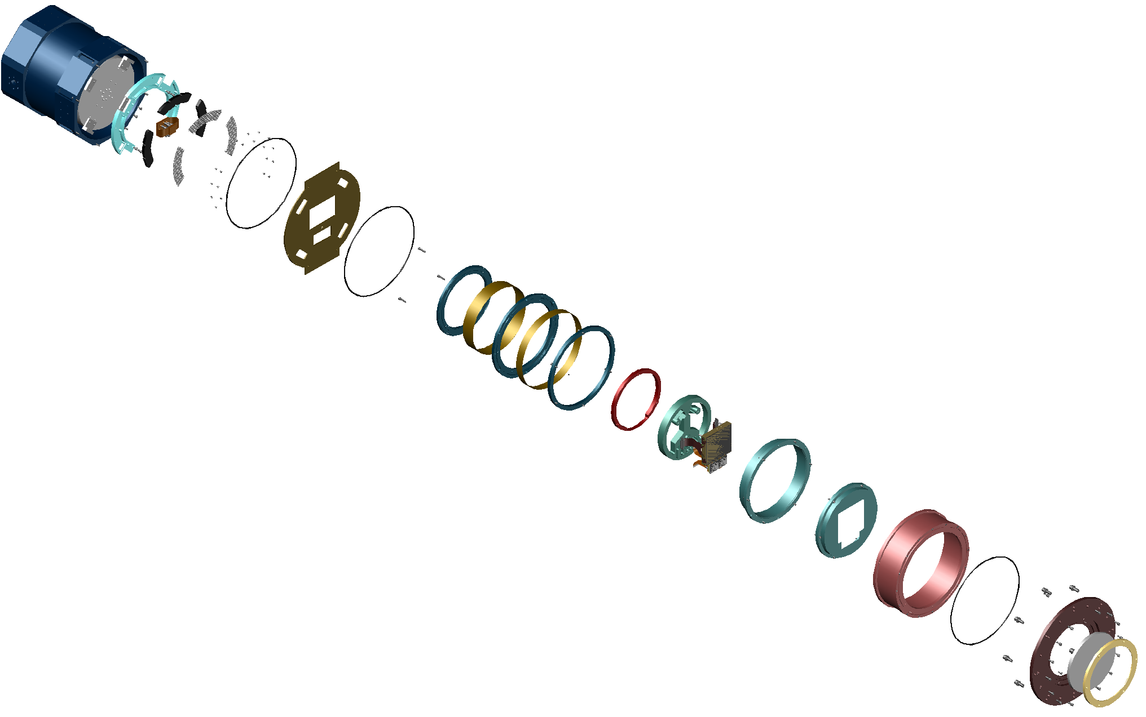
WaSP Camera Components
Thermal Link
O- Ring
Upper Mounting Ring
Getter
Upper Spacer
Vacuum Interface
Board (VIB)
Center Mounting Ring
Adapter Ring
Lower Spacer
Thermal Shield
Lower Mounting Ring
CCD Backplate
Camera Body
CCD’s
O- Ring
CCD Faceplate
Camera Baseplate
Window
Window Retainer

Slide 45
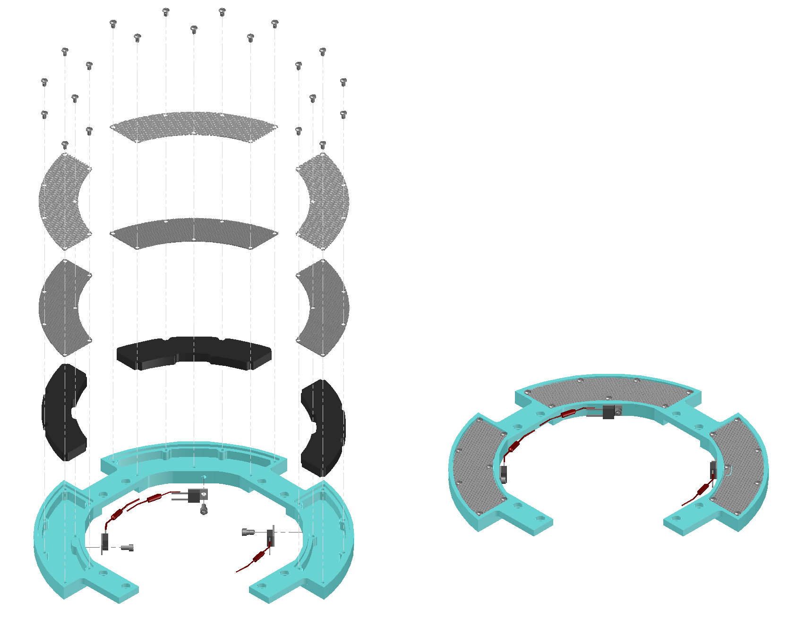
Getter Assembly
Retaining Screws
Getter Material Retainer
(perforated sheet)
Dutch Cloth
Getter material (charcoal?)
Getter Body
45
Heater w/ Thermal Cutoff Fuse
Soldered to lead

Slide 46
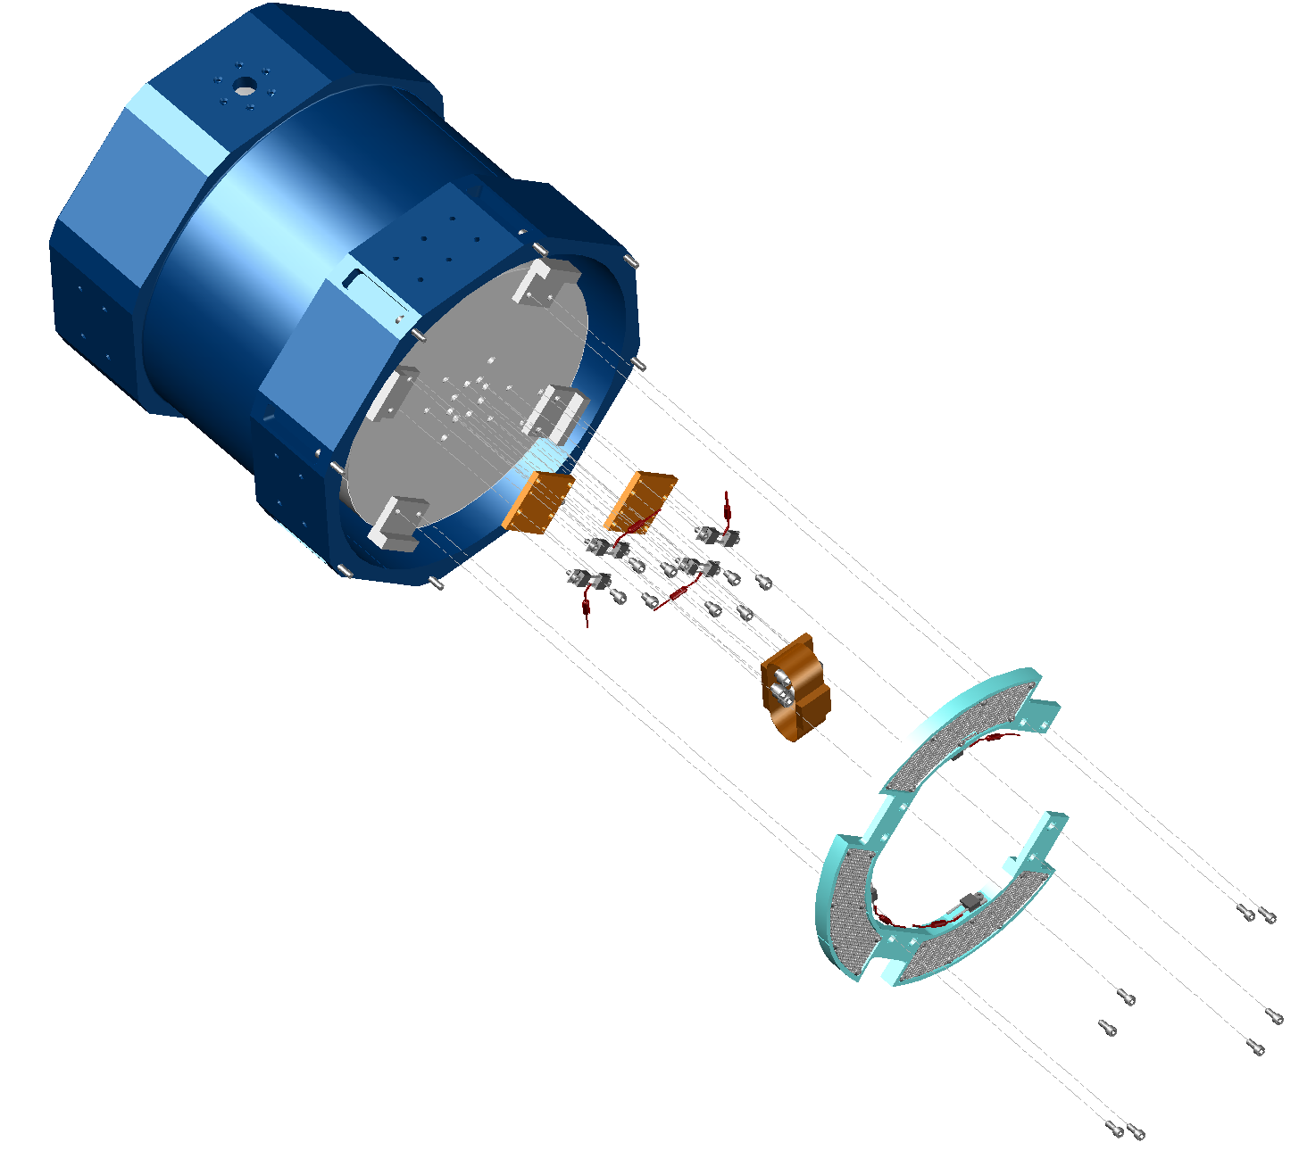
Dewar mounted to Camera Baseplate (with VIB in between)
Dewar
Heater Mounting Plate
Heaters (paired with Thermal
Cutoff Fuse soldered to lead)
Thermal Link
46
Getter

Slide 47
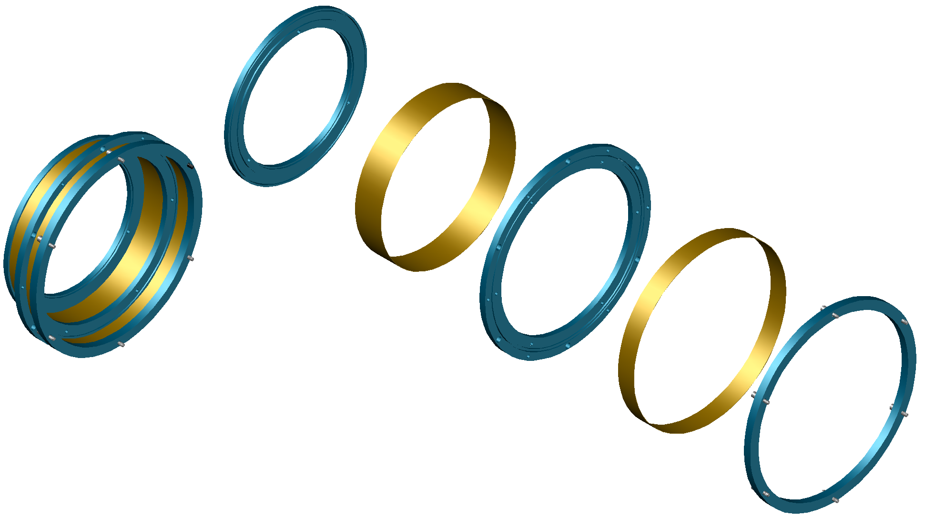
Thermal Isolator Assembly
Upper Mounting Ring
Upper Spacer
Bond Spacers
into grooves
Center Mounting Ring
Lower Spacer
Vented Captive Screw
(removable)
Lower Mounting Ring

Slide 48
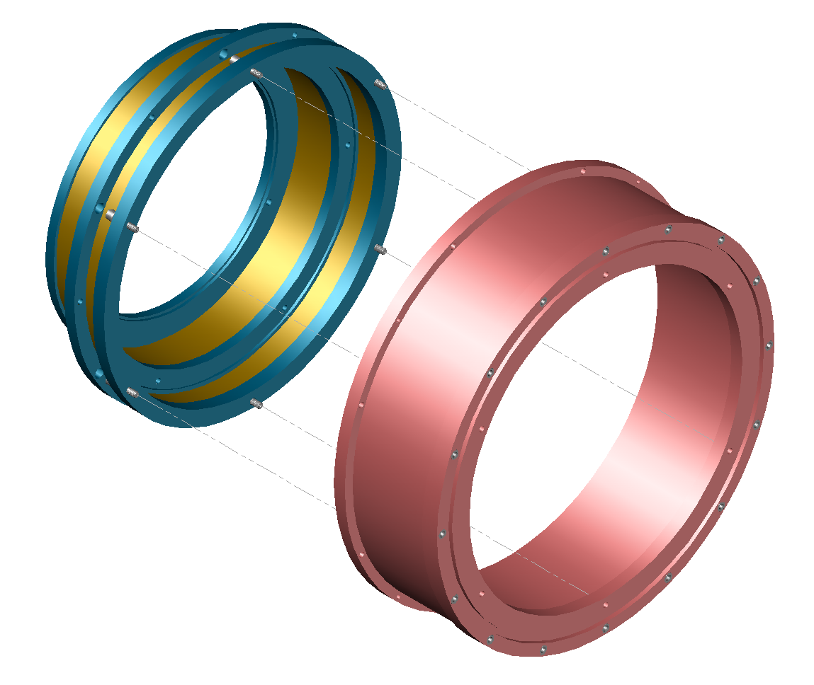
Thermal Isolator Assembly assembled to Camera Body
Thermal Isolator Assembly
Camera Body
48

Slide 49
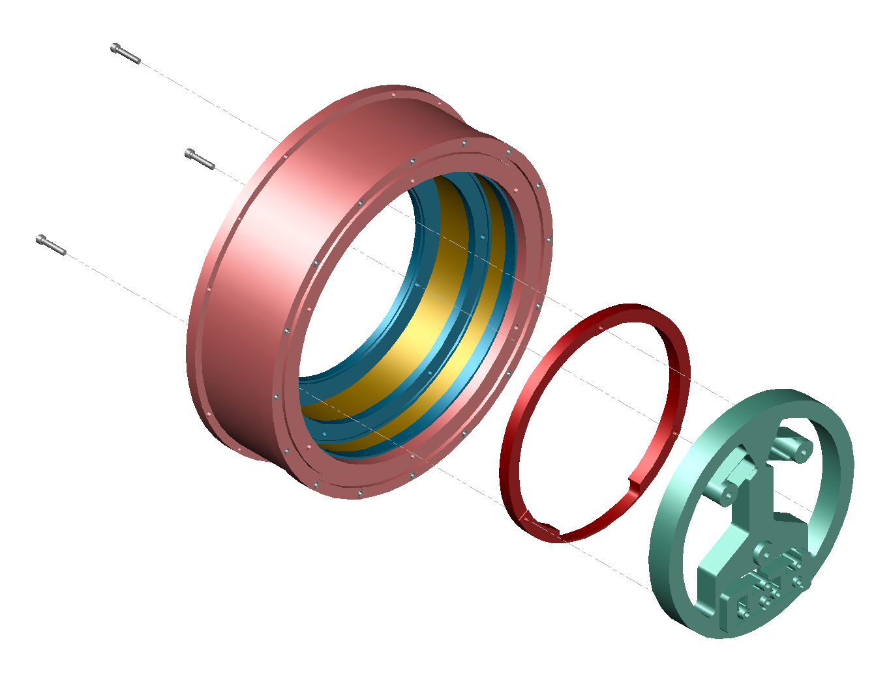
Adapter Ring and CCD Backplate assembled to Thermal Isolator Assembly
Thermal Isolator Assembly
3 mounting pads will be
machined or replaced with
shims to adjust tip & tilt
Adapter Ring
49
CCD Backplate

Slide 50
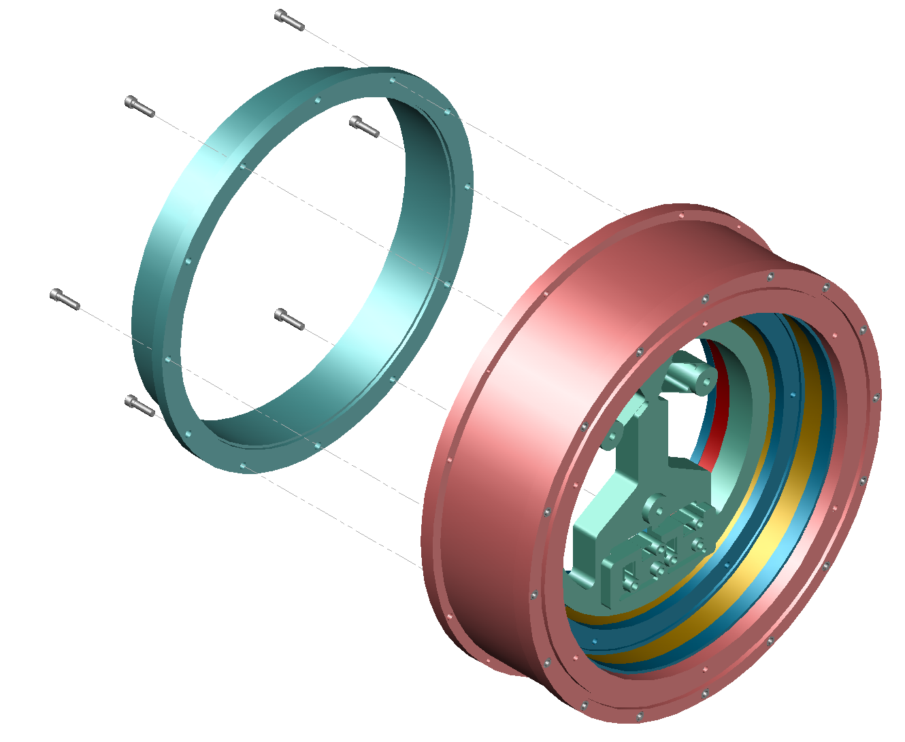
Thermal Shield assembled to Thermal Isolator Assembly
Thermal Shield
50
Thermal Isolator Assembly

Slide 51
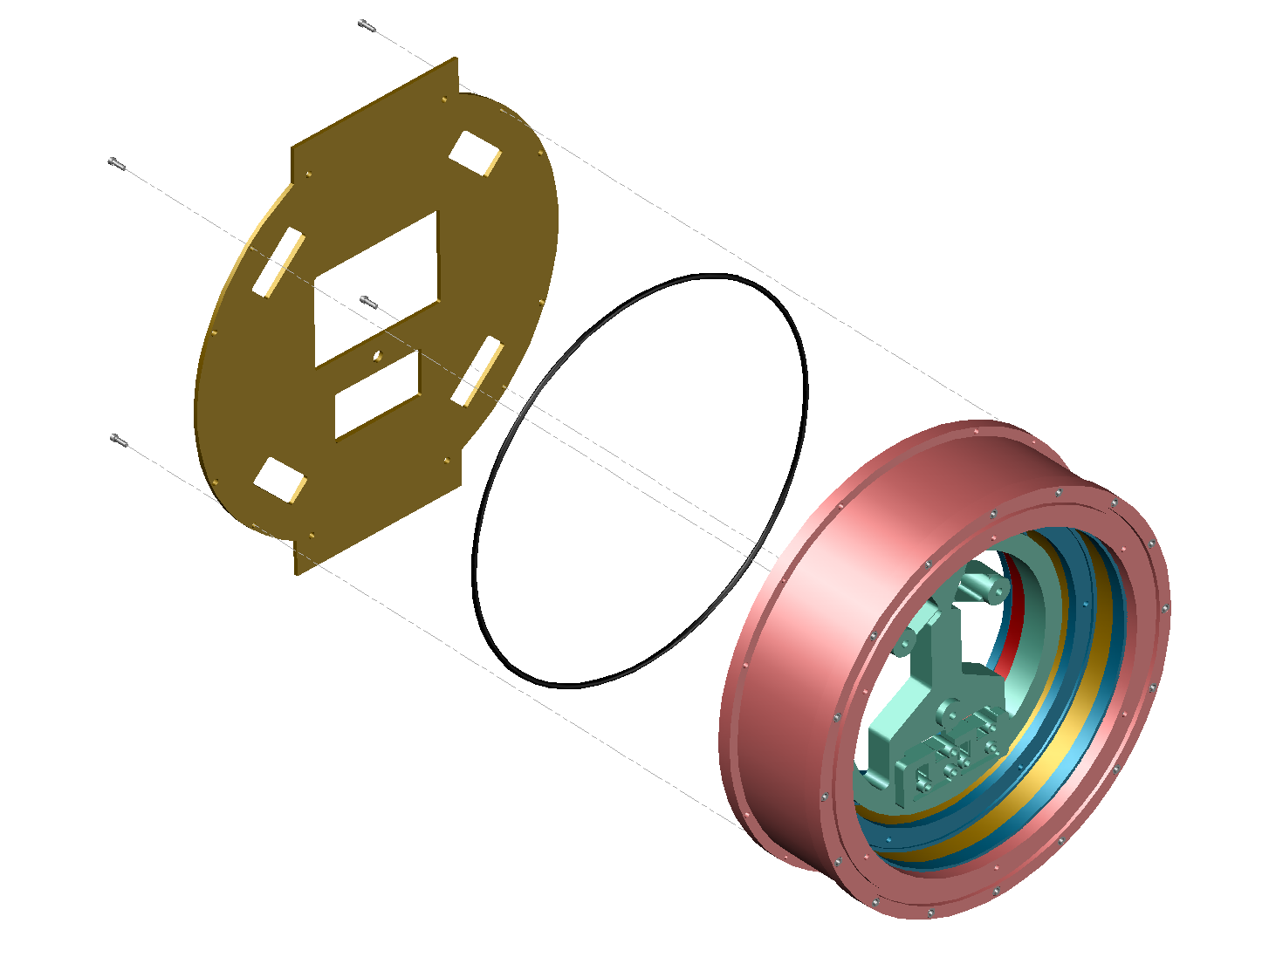
VIB mounted to Camera Body
VIB
O-Ring
Camera Body
51
51

Slide 52
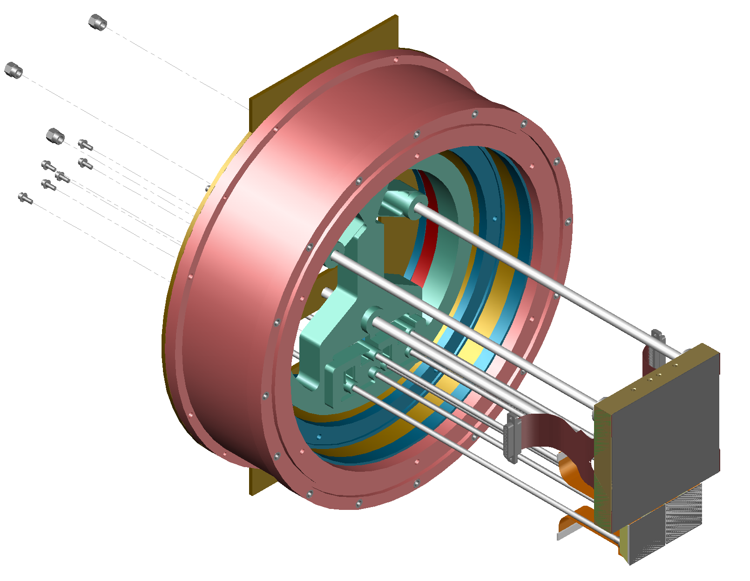
Detectors mounted to CCD Backplate
CCD Backplate
Assembly Guide Rods
Science CCD
52
Guide CCD
Focus CCD

Slide 53

Detectors mounted to CCD Backplate
(reverse angle)
53

Slide 54

CCD Faceplate mounted to Thermal Isolator Assembly
Thermal Isolator Assembly
Captive Screws
Assembly Guide Rods
54
CCD Faceplate

Slide 55

Window assembled to Camera Baseplate
Camera Baseplate
O-Ring`
Window
55
Window Retainer

Slide 56

Camera Baseplate mounted to Camera Body
Camera Body
O-Ring
Camera Baseplate
56

Slide 57

Dewar mounted to Camera Baseplate (with VIB in between)
Dewar`
O-Ring
(VIB)
57
Camera

Slide 58

WaSP installed on filter box
58

Slide 59
handling- tim goodsall
59
59

Slide 60

Handling
Safe handling of detectors to avoid:
  Mechanical damage
  ESD
Control of package, flex and connector movements during assembly to avoid collisions with installed detectors
60

Slide 61
Handling rods
Allow removal of detector from container and insertion into dewar without touching package
Provide control of flex and connector movements to avoid hitting already installed devices
61

Slide 62
Detectors mounted to CCD Backplate
CCD Backplate
Assembly Guide Rods
Science CCD
62
Guide CCD
Focus CCD

Slide 63
Detectors mounted to CCD Backplate
(reverse angle)
63

Slide 64

CCD Faceplate mounted to Thermal Isolator Assembly
Thermal Isolator Assembly
Assembly Guide Rods
CCD Faceplate

Slide 65
CCD Faceplate mounted to Thermal Isolator Assembly
Thermal Isolator Assembly
Assembly Guide Rods
CCD Faceplate
65

Slide 66
Installation animation
66
Notes:
Show installation of science CCD first, followed by guide/focus CCDs in succession. Will also show flex cable handling fixtures. Show fasteners and tools.

Slide 67
Thermal design and demister- roger smith
67

Slide 68
Thermal model
Spreadsheet = http://www.oir.caltech.edu/twiki_oir/bin/viewfile/Palomar/WaSP/WebHome?rev=1;filename=WaSP_thermal.xls)
By using electronics to heat dewar wall (as in LFC) we reduce likelihood of dewar getting this cold.
 |  | Typ. | Min. | Max.
Ambient Tempertaure (operation) |  | 285 | 263 | 300 | K
Sheild Temperature in dewar base |  | 233 | 229 | 238 | K
Detector Temperture |  | 173 | 173 | 173 | K
 |  | Typ. Load | Min.Load | Max Load | units
Conduction in Detector standoff |  | 0.16 | 0.15 | 0.18 | W
Tank Support conduction and radiation |  | 2.92 | 2.34 | 3.31 | W
Hold time, tank only, upright. (guess) | 96 |  |  |  | hours
Conduction in wiring |  | 0.45 | 0.36 | 0.51 | W
Thermal resistance | 249 |  |  |  | K/W
Radiation from VIB |  | 0.58 | 0.41 | 0.72 | W
Radiation: window-CCD (typical) |  | 3.86 | 2.63 | 4.88 | W
Radiation from shield to detector mount |  | 0.16 | 0.14 | 0.18 | W
CCD heater
Total load into CCD apart from heater |  | 4.63 | 3.29 | 5.75 | W
Heater power |  | 1.37 | 2.71 | 0.25 | W
thermal resistance detector to LN2 | 16.0 |  |  |  | K/W
final detector temperature at zero power |  | 151 | 130 | 169 | K
Time to Coool fm ambient to operating |  | 6.4 | 4.0 | 12.3 | hour
Total thermal load |  | 9.5 | 8.8 | 10.0 | W
Hold time |  | 29.5 | 32.0 | 27.9 | hours
68
Recent news: e2v now specifies storage temperature > 148K to avoid flex delamination

Slide 69


Sensor and heaters
Tank sensor and heater will be wired to hermetic connector in side wall flats or top plate (TBD), so that wiring goes with top section when separated from base. Cabled to Lakeshore 336.
  Tank sensor (diode is ok); use spare holes in tank.
  Tank heater resistors (TO-220, single mounting hole paired in parallel then pairs place in series). Use spare holes in tank.
Detector heater and sensors will be wired flying leads soldered to VIB. Separate connector on VIB exterior will go to the Lakeshore 336.
  Detector cold plate heaters (TO-220 resistors in series-parallel combination, both side so thermal link)
  Cold plate sensor (RTD)
  Shield sensor (diode is ok), close to center.
  Vacuum side wall sensor (diode is ok).
69

Slide 70

Tank heater, sensor, getter
Ample getter volume >> 50ml
Large inlet area allows fine mesh to be used: dutch weave SS cloth retained by rigid perforated sheet.
Mounts onto existing flexure supports
Heater resistors
Heater wiring
Temperature sensor
Will extend tab to use both bolts
70

Slide 71



Heaters and Thermal Protection
Thermal cutoff to be placed on CCD mounting plate next to heater.
Lowest maximum opening temperature of this selection is 72 C
TO-220 type
Hermetically sealed resistors (Vishay)
Resistors in parallel
Thermal cutoff
71

Slide 72



Vacuum and cryo systems
Pfeiffer Pirani/cold cathode gauge on one side.
  sensitive to 3.75 x10⁻⁹ Torr
Activated carbon getter installed in contact with tank
Could add a warm zeolite dessicant externally via KF flange to dry out dewar over a long period (TBD).
72

Slide 73



Pressure relief valve
Primary overpressure relief valve.
Available with KF flanges.
Alternative types
73

Slide 74

Vacuum leak rate estimate
Estimated pressure increase per month is 0.11 Torr
A Viton/Fluorel or Chemraz/kalrez or-ring would be preferred owing to lower outgassing rate.
  (Similar leak rate)
Charcoal getter volume ~30ml (TBC), can pump down from >> 15 Torr, so pumping interval > 10 years (if no leaks).
74

Slide 75
Demister
Window demisting:
  Very dry gas produced by LN2 boiloff will the routed through a simple heat exchanger attached to dewar and thence to the space in front of the window. It will escape around the shutter and the filter which are not air tight.
  Readout electronics (~40W for two controllers) will use the dewar and filter assembly as a heat sink.
    (Over)compensates for 8W radiated/conducted into the interior.
    Raises dewar wall and thus window temperature, by an amount TBD to thermal resistance to the filter box, ambient air (etc.). Probably only modest.
The following slides present an idea for the dry N₂ ducting.
75

Slide 76
Dry N2 ducting requirements
Need easy access for LN2 fills.
Must never block (explosion risk): keep moisture out.
Must not produce condensation on exterior.
Exit gas must be close to dewar temperature.
76

Slide 77

Dry N₂ ducting
Tethered, removable plug for LN2 fills: lies outside N2 flow to minimize cooling of plug.
Duct bolted to dewar.
To eliminate condensation exterior is conductive and thermally well connected to dewar, while interior is insulated to eliminate cold spots on exterior surface.
To assure thermal equilibration of gas, there is a serpentine path within enclosure, in areas well coupled to dewar.
Uninsulated plastic hose can be used at exit.
77

Slide 78

Dry N₂ ducting (2)
Nipple for hose from electronics box
78
Through hole meets channel in front surface of front plate

Slide 79

Dry N₂ ducting (3)
Bottom view of dewar
Through hole for nipple
Channel milled into front surface
Recess in delrin window retainer to provide channel for dry N2 flow
Slots in delrin window retainer to provide exit path for dry N2 across window
79

Slide 80
break
80

Slide 81
vacuum interface board- tim goodsall
81

Slide 82

Vacuum Interface Board (VIB)
Sits between camera head and cryo-side case sections
Simplifies internal cabling arrangement by combining pre-amplification and signal routing to external connectors
CCD readout electronics can be mounted on dewar and connected directly to VIB with short external cabling
Separate connectors for Lakeshore temperature controller.
Gold coated annular region provides smooth surface for vacuum seal
Polyimide, overlay and masks chosen for minimal outgassing.
Fiberglass board material achieves low thermal conductivity which ensures low heat load internal to dewar
Comparable cost to cabling ($3k estimate plus ~$1k in parts)
Unused area will be cut out to reduce emissive surfaces when layout work concludes
82
Provisional connector layout

Slide 83

PCB Layout
Initial PCB layout has started
  Will use ZTF pre-amplifiers for science CCD – awaiting final design
  Can combine pre-amplifiers for science and guide/focus CCDs, if desired, into a signal multi-layer board
  Use single plane for output drain – selectable using jumpers
  Separate layers for: video, bias, clocks, output drain, +5/-5 power, ground planes
  Separate science and guide/focus CCD output regions allow for easier routing and reduce number of layers
Breadboard layout of pre-amp design before end of FY13
Major design effort to be completed at start of FY14
83

Slide 84
Guider/FOCUS CCDs - tim goodsall
84

Slide 85
Overview
WaSP will have dedicated guide and focus CCDs
  Guider will provide tracking information to TCS
  Focus measurement simultaneously with science exposures
JPL is providing a guide and focus CCD for WaSP funded by internal RTD funds
  Purpose is to promote JPL’s delta-doping technology and AR-coating capabilities
  Initial phase of funding started in May 2013
  Delivery of two CCDs scheduled for end of March 2014
Detectors will be STA3600 fully-depleted CCDs which will provide high broadband QE response from 320 to 1050nm

Slide 86
Requirements
Detector requirements:
  QE optimized to provide optimal broadband sensitivity integrated from atmospheric to detector cut-off (320-1050nm)
  No dark current and read noise specs at present (best effort basis)
  Guide rate sufficiently fast that dark current not an issue
  Read noise ~5e⁻ should be achievable
Guide and focus requirements
  Guider will supply tracking corrections to the TCS at rates 1- 0.015 Hz with accuracy determined by the DIQ budget.
  ROI and frame-store modes for high speed readout
  The guide camera shall have sufficient field and sensitivity to track one or more stars in a given pointing with 1-60 sec integrations in all filters at full moon at an airmass of 2.

Slide 87

Readout Modes
Half of the guide and focus CCDs are masked by heat shield
Two modes of operation
  Frame-store for reading out full (1/2) frame while still exposing
  Region-of-interest (ROI) mode for guiding on single star
Former useful for guide star acquisition and improved guide performance when frame-rate allows
ROI method best when faster tracking required and suitable bright stars available

Slide 88
AR-coating

Slide 89

Packaging concept
Silicon detector die bonded to aluminium nitride support planks
Invar studs provide mechanical interface
Tolerances met in assembly
Flex cables combined with ‘round-the-bend’ wire bonding allow multi-side buttability
Demonstrated excellent flatness with current bonding techniques – extending to more complex packaging

Slide 90
Current Status
Design and Modeling
  FEA analysis of design beginning to understand thermal gradients and stresses in package at operating temperature
  Epoxy type and thickness to be optimized accordingly
  Aluminium nitride composition to be selected (lower yttria content means lower thermal conductivity, but also lower UV fluorescence!)
Epoxy
  Precision fixtures for epoxying of package parts under design
Wire-bonding
  ‘Round-the-bend’ concept demonstrated
AR-coating
  Multiple broad-band models developed and test depositions made
  Currently under-going reflectivity measurements

Slide 91
external electronics- roger smith
91

Slide 92
Electronics Overview
Two single board, 4ch CCD controllers
  Science CCD read through dedicated 4ch controller.
  2nd controller drives both guider and focus CCD, alternately not concurrently.
Guide and focus CCDs operate in frame transfer mode: frame store boundary is at edge of 120mm FoV.
IFPAC (Indian Focal Plan Array Controller)
  Currently under development. To be customized for Palomar.
  Low profile mounting on dewar, plugging directly into VIB: no cables !
  Each board provides 16 clocks, 13 biases, >2 LVDS, 4 video.
  Differential signals all the way from CCD to differential ADC.
  Preamps on VIB, close to flex cable connectors.
92

Slide 93

Electronics location
125mm ?
Controller
If we go with two 4ch single board controllers, there is the option of placing the boards side by side along the circumference. (Leach controller boards are 100mm wide * 230mm deep)
Advantages:
Easier trace routing through VIB
Direct heat sinking to dewar for all boards.
Very compact.
Disadvantages ?
Unusual enclosure topology? Is this really a problem?
92 mm
114 mm
Shared Plug in Power Supply
Controller
93
Board area ~ 30,000 mm², e.g. 160 * 220 mm

Slide 94

Board size
Non standard outline:
Does not matter since enclosures will always be custom.
Board is narrower than 6U to lie within dewar profile but standard 3U = 100mm makes board to deep (320mm) to get area needed
Single Board Controller
125mm * 250mm
282 mm
Controller board plugs directly into VIB … no cables
94
75 mm
Tool access space …ok

Slide 95
Single Board Controller Layout
Front Panel
Card ejectors
USB
Digital
DCDS Fast FPGA
Sequencer
Dense FPGA
TBD whether FPGAs are same device or separate.
ADC
ADC
ADC
Four ground planes join here:
Digital
Analog supply return
Analog reference (not shown)
Clock (high current analog)
ADC
Clock DACs
ADC buffers
Clock Switches
Bias DACs
Clock Drivers
Bias Drivers
Power planes mimic grounds.
Need low impedance paths to connector
95
Connector

Slide 96

Space allocation for electronics
Leach controller is replaced
New power supply mounted on dewar
Leach power will be left in place
LFC
New CCD controllers
N2 duct will be located on one of the 5 unoccupied facets
96
Filter controller is retained

Slide 97
management plan- stefan martin
97

Slide 98
Development plan
FY13:
  Peer review of the design
  Procurement and fabrication of most parts (JPL or Caltech machine shops)
  Assembly, testing and troubleshooting of the cryostat, without CCD.
  Breadboarding of the electronics interface toward the end of the FY.
FY14.
  December FY14, the science CCD arrives.
  Mid FY14, guide/focus CCDs from JPL.
  Completion and testing of the electronics for the VIB will occur prior to mid-year.
  Tests of operation with the camera controller at temperature.
  Integration and set up of the camera on the filter box at prime focus, enabling on-sky testing and adjustments.
Other major elements of the camera development:
  CCD characterization, software development and integration are to be handled separately by COO.
  Funds are allocated funds for the purchase and test of a commercial camera controller, but since IUCAA is also developing a set of controllers specifically for the same CCD, it is possible that a spare IUCAA controller will become available. If this becomes the case, some funds will likely be available for return to JPL’s R&TD program. The decision point for this will be early in the second quarter of FY14.

Slide 99

Plan for FY2013
Design close to completion
  Remaining details to be resolved by early July
Next is production of drawings, then bidding phase, and procurement.
  Should have procured all parts required for assembly/testing by mid August.
Testing/troubleshooting of basic dewar will run through September.
  No CCD/ no window/ dummy VIB
  Will show control of temperature and satisfactory vacuum operation
Final development in 2014
  Final VIB
  Tests with window
  Testing with electronics controller (cold)
  Tests with CCDs scheduled later in FY2014
  Initial on-sky setup

Slide 100
electronics i&T plan– tim goodsall
100

Slide 101
Electronics
Finish VIB final design
  Complete layout (using ZTF pre-amp design) and send out for manufacture
VIB testing
  Mechanical/vacuum/cryo testing in dewar
  Bench testing of assembled VIB to check functionality and noise performance
  Test in dewar to measure noise performance under load using loopback tests
  Verification of CCD bias and clock voltages at connectors
  Identify and eliminate any ground-loops and other possible sources of EMI
Detector Testing
  Lab characterization of guide & focus CCDs at JPL
    QE, dark current, read noise, flatness, image quality
    Prior to delivery to Caltech
  Bench characterization and operation of science CCD?
Assembly Testing
  Trial-run of focal plane assembly to ensure handling hardware is adequate
Integrated testing
  Separate testing of science and guide CCDs when installed on VIB (in dewar) to measure noise performance and perform final optimization of CCD waveforms if required
  Testing of full focal plane assembly after installation of science and guide/focus CCDs. Measurement of noise performance, cross-talk and overall system performance
101

Slide 102
I&T Plan
VIB testing (3 weeks)
Test installed science CCD (3 weeks)
  Install science CCD and test assembly procedure
  Electrical testing of CCD
Test installed guide & focus CCDs (2 weeks)
Test fully assembled FPA (4 weeks)
Troubleshoot (4 weeks)
102

Slide 103
discussion
103

