Slide 1

First observations of TMAS With the Hale telescope
Sergi R. Hildebrandt
Palomar Science Meeting, Caltech, 11/16/2012

Slide 2
WHAT’s tmas?
TMAS ("Thomas") is a simple visible-light imager system to enable high-angular-resolution science with PALM-3000.
I mean: F/26.392; f = 134.072m; 10 mas / pixel = 10 mas / 6.5 μm = 1.5385 mas/μm = 1.5385 "/mm or 0.65 mm/ “. Nyquist at λ= 492nm; FoV = 25.6" x 21.6”
Palomar Science Meeting, 11/16/2012. Sergi R. Hildebrandt

Slide 3


WHO’s tmas?
Richard G. Dekany: PI
Jennifer W. Milburn: Software engineer
Sergi R. Hildebrandt: PI
The
Speaker*
(*) 3rd floor-postdoc. OBSCOS. CMB, Prof.Jamie Bock
Palomar Science Meeting, 11/16/2012. Sergi R. Hildebrandt

Slide 4
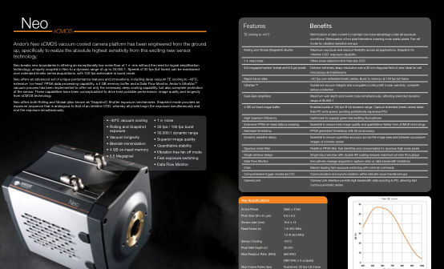
tmas brain
Palomar Science Meeting, 11/16/2012. Sergi R. Hildebrandt

Slide 5
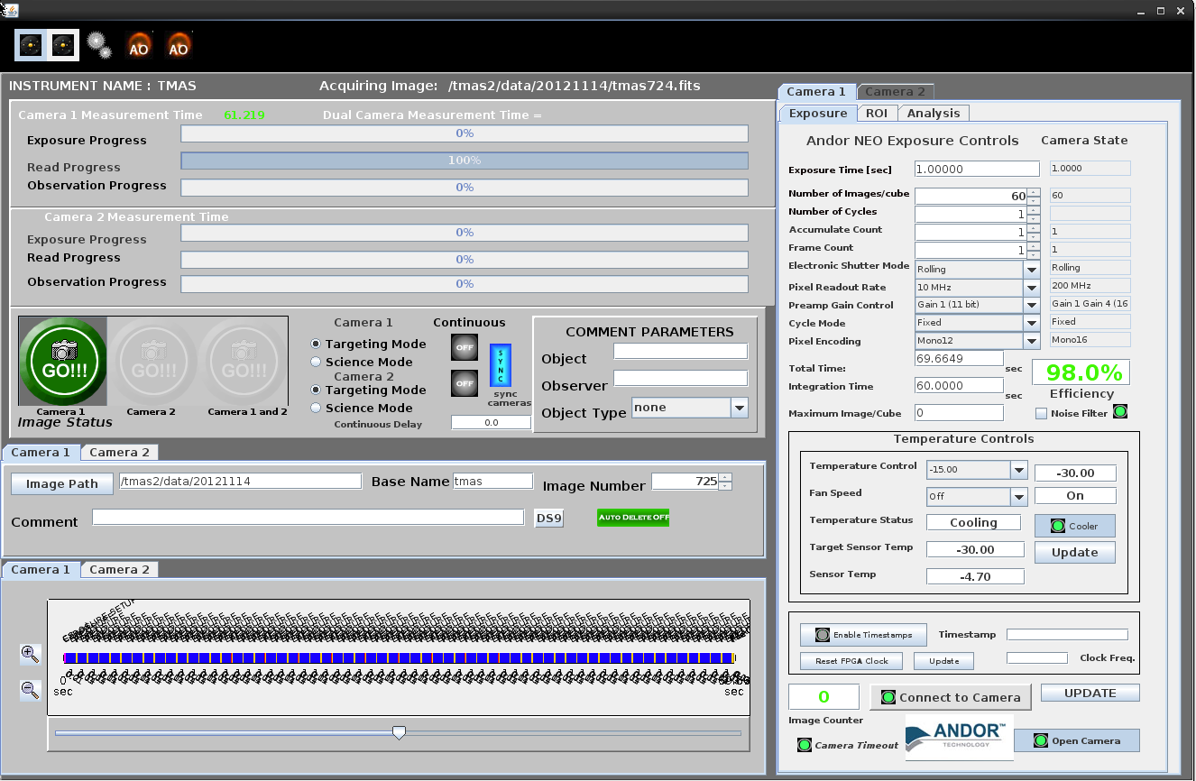
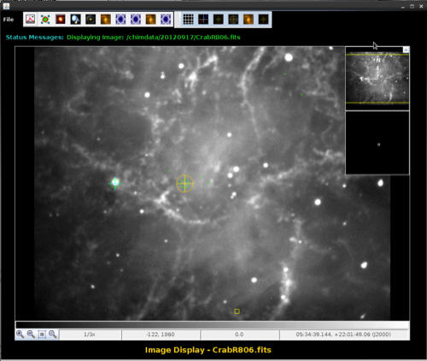
tmas Face
A complete, custom, Linux based user interface (Java/Cuda/C/C++).
Palomar Science Meeting, 11/16/2012. Sergi R. Hildebrandt

Slide 6
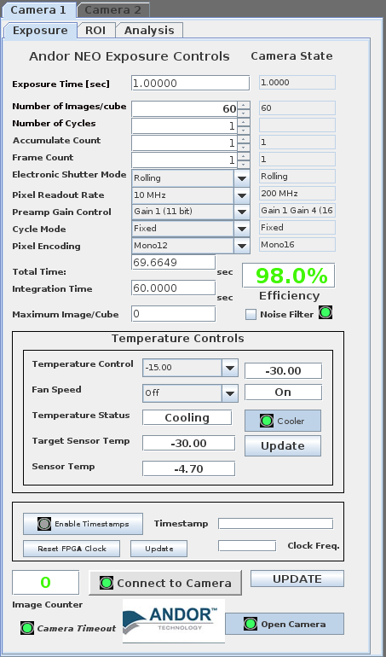
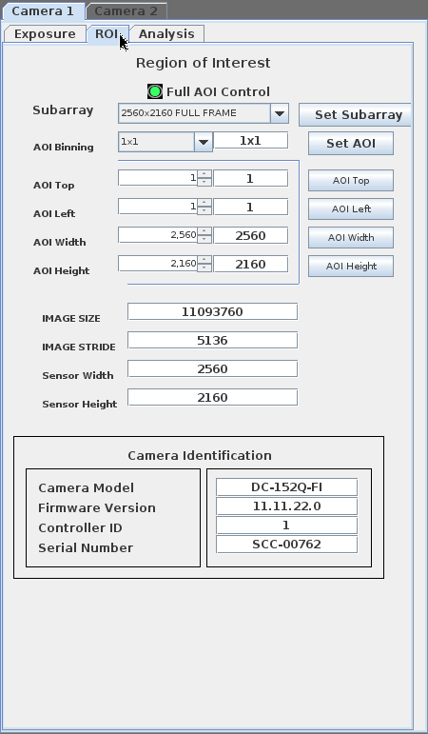
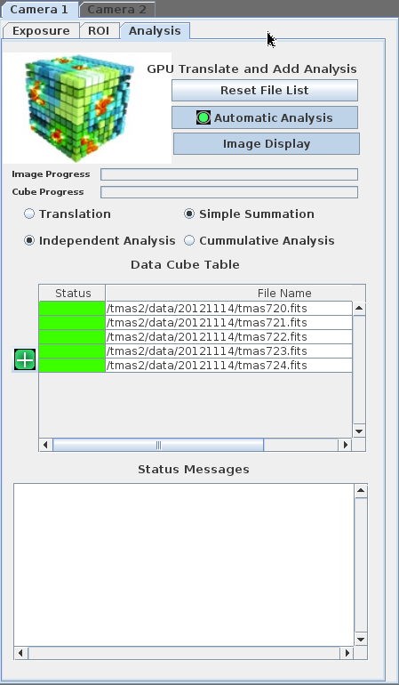
tmas Face
Palomar Science Meeting, 11/16/2012. Sergi R. Hildebrandt

Slide 7
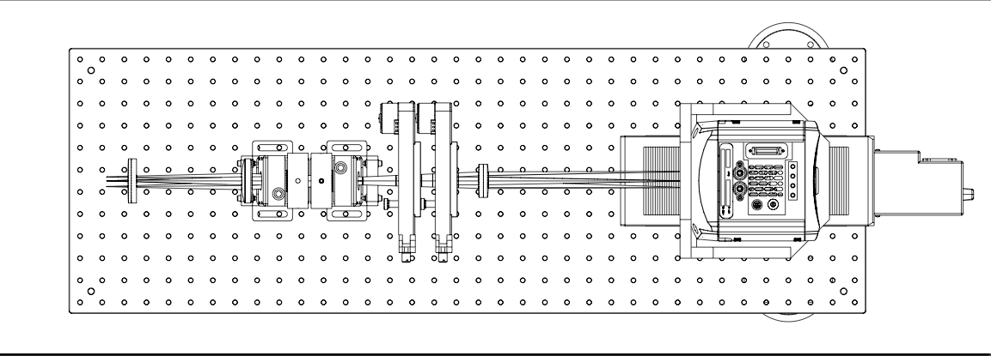
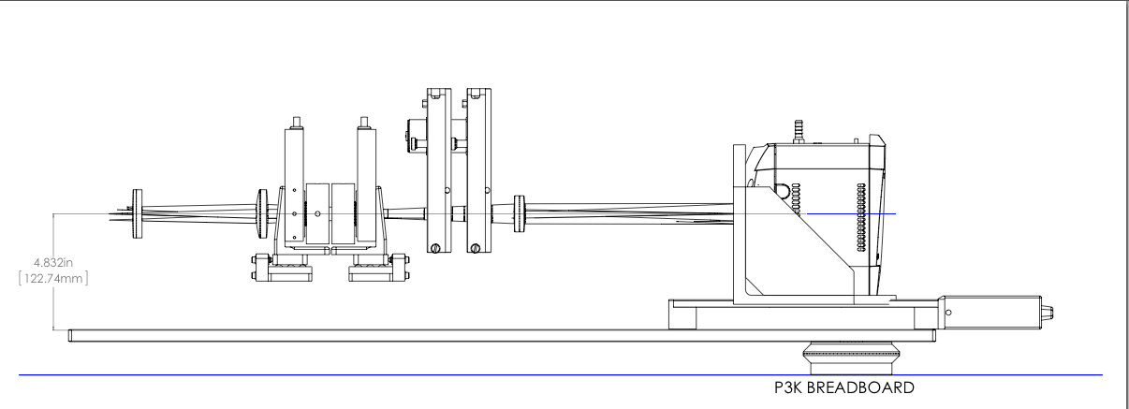
Tmas INTERIOR
Palomar Science Meeting, 11/16/2012. Sergi R. Hildebrandt

Slide 8
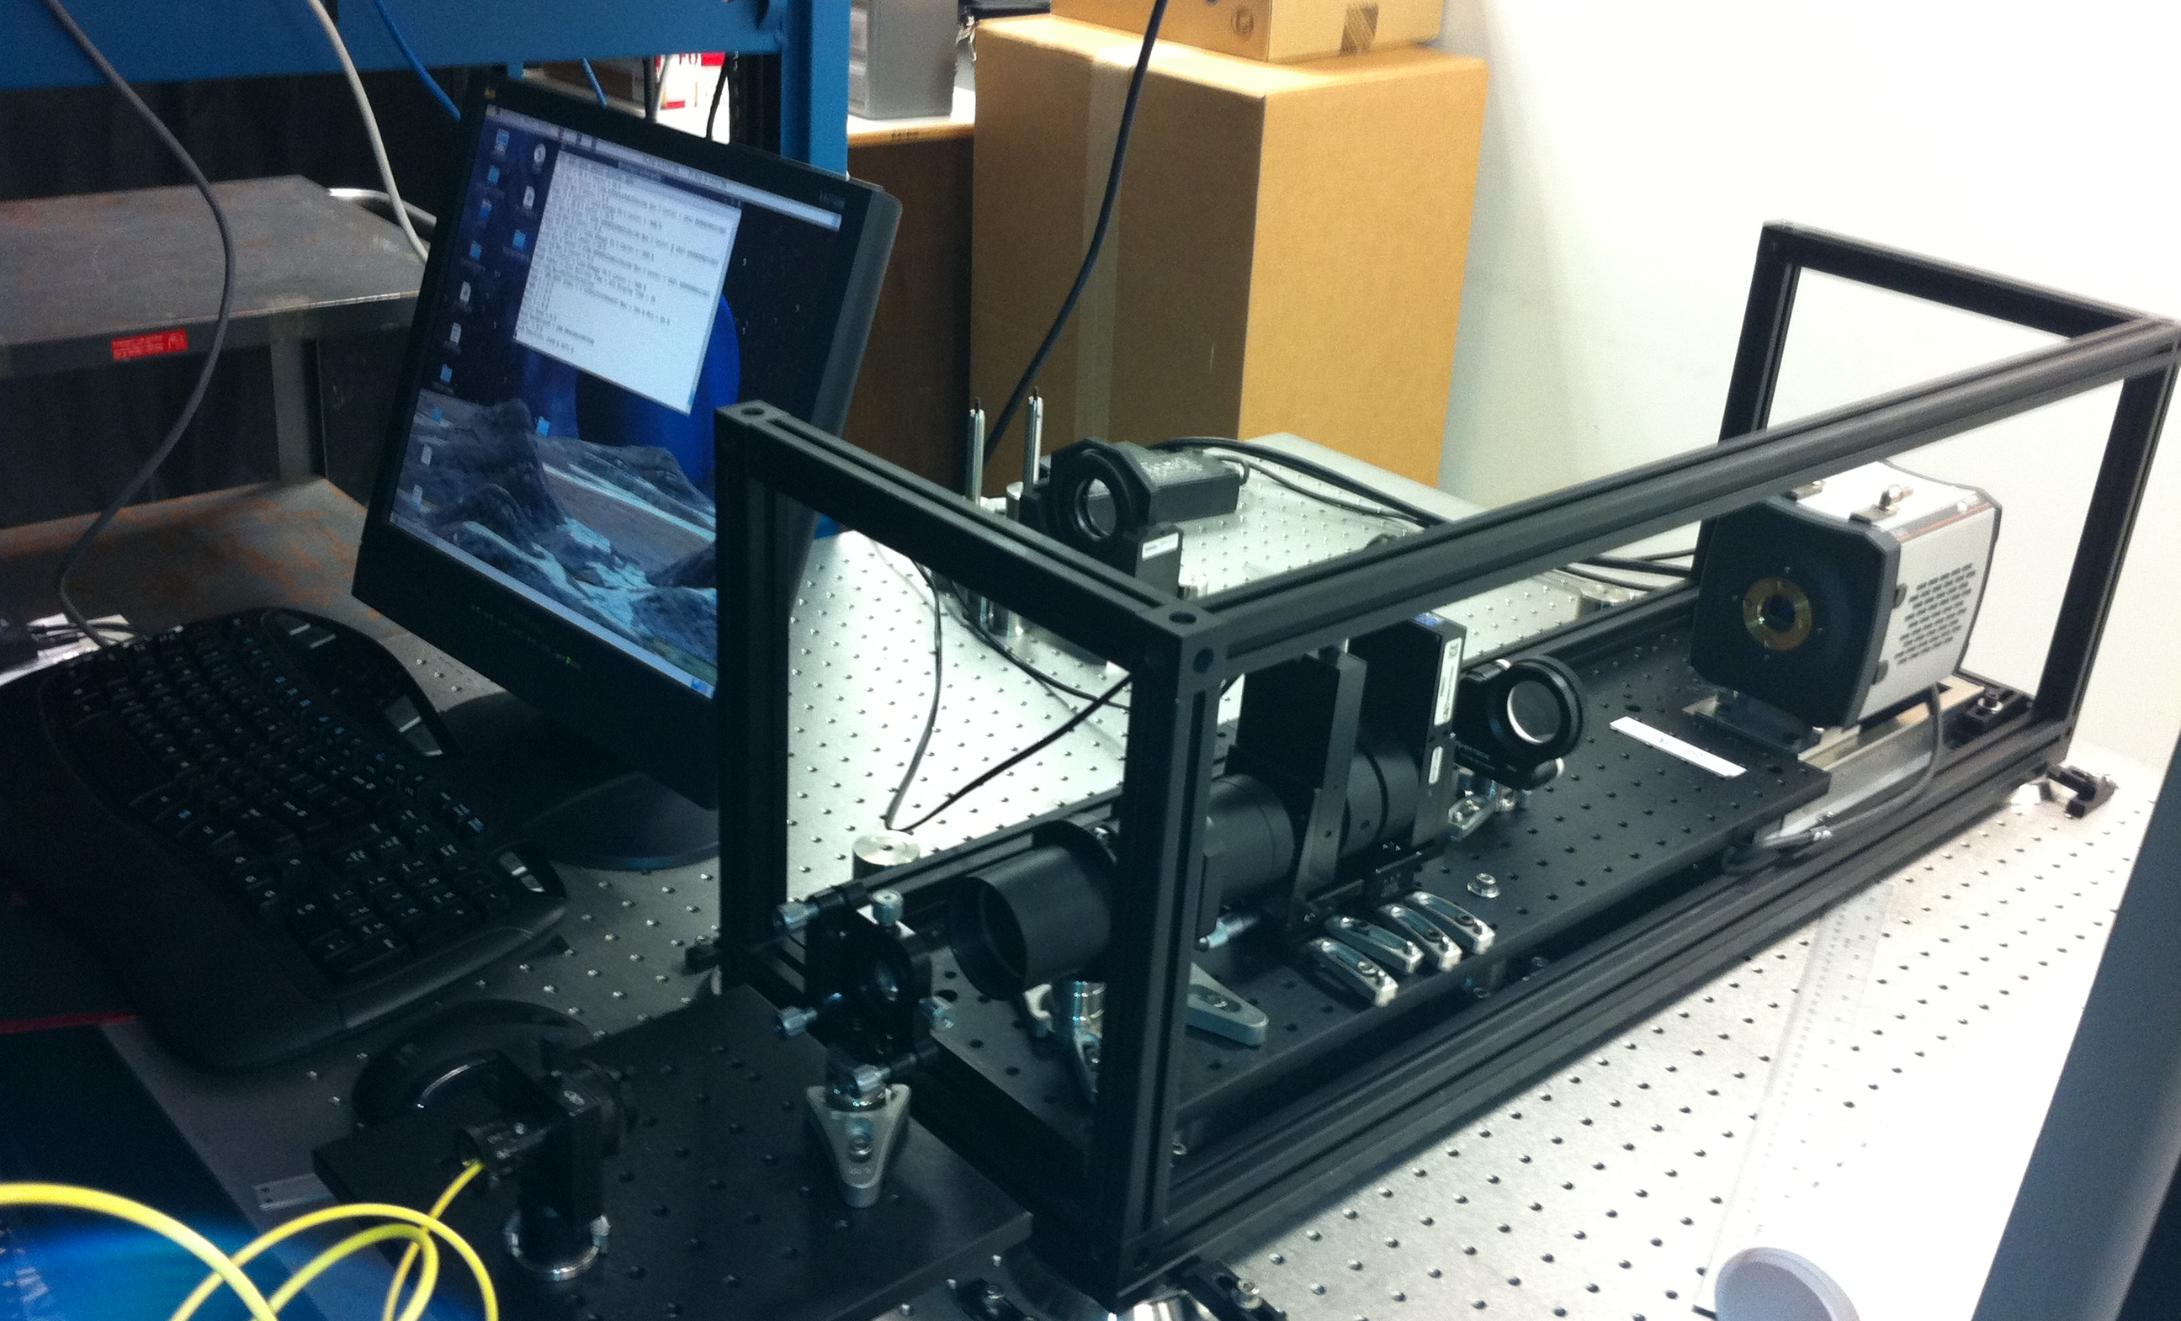
ASSEMBLING tmas
Palomar Science Meeting, 11/16/2012. Sergi R. Hildebrandt

Slide 9
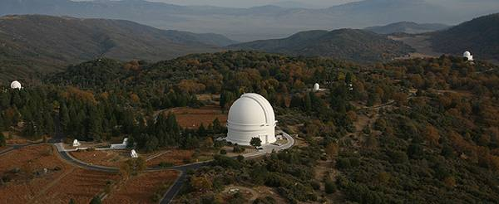
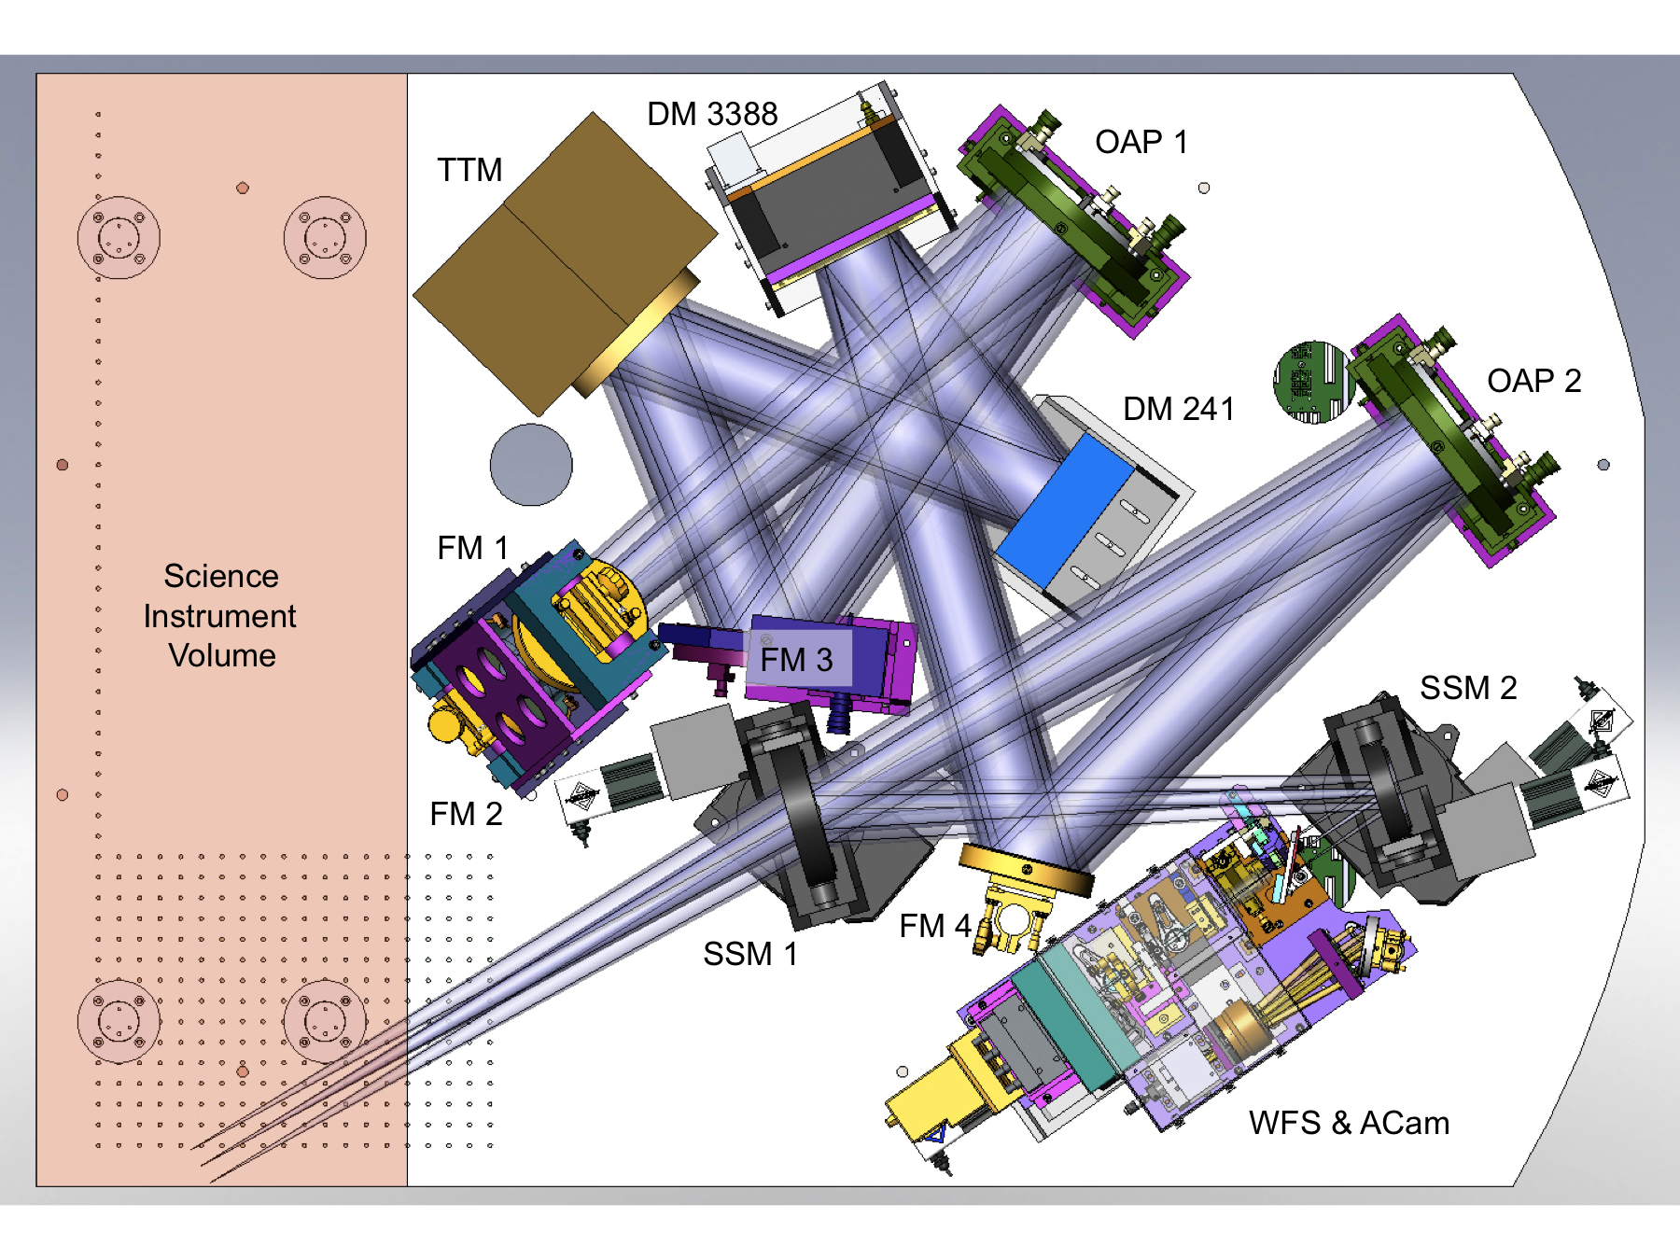
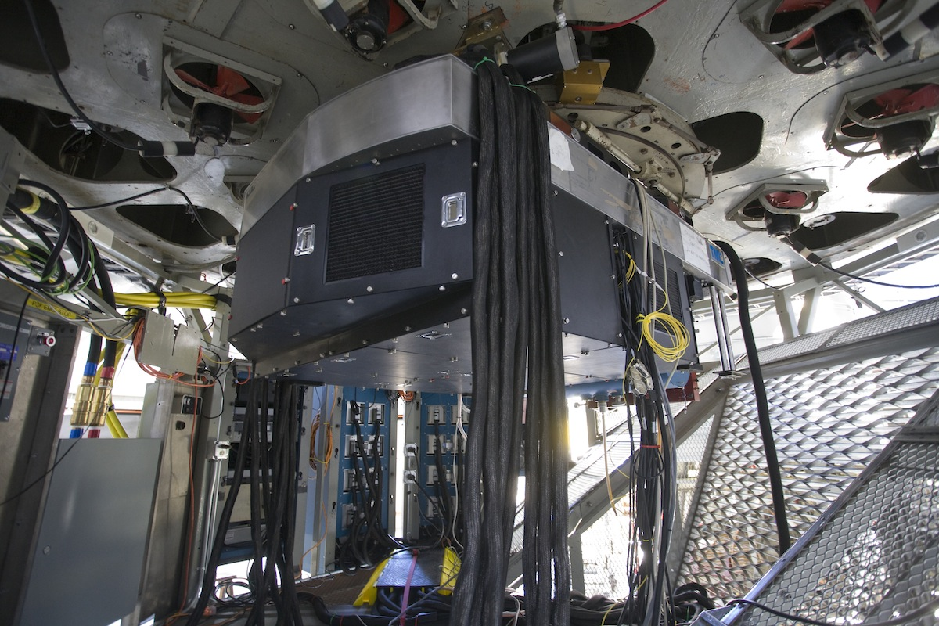
Tmas HOME: Hale’s Place
PALM-3000
PI: R. G. Dekany, CIT
Palomar Science Meeting, 11/16/2012. Sergi R. Hildebrandt

Slide 10
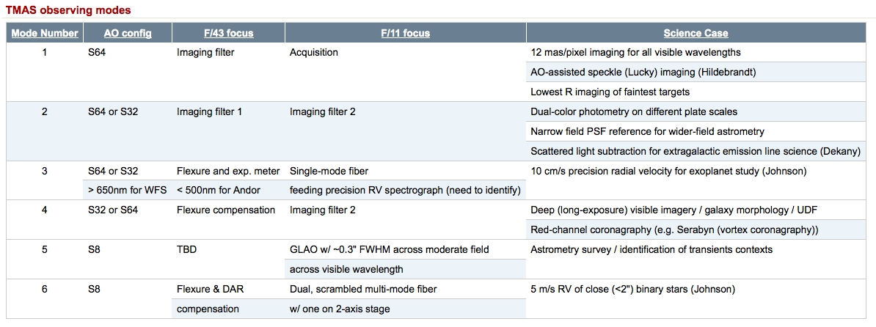
tmas WISH LIST
Palomar Science Meeting, 11/16/2012. Sergi R. Hildebrandt

Slide 11
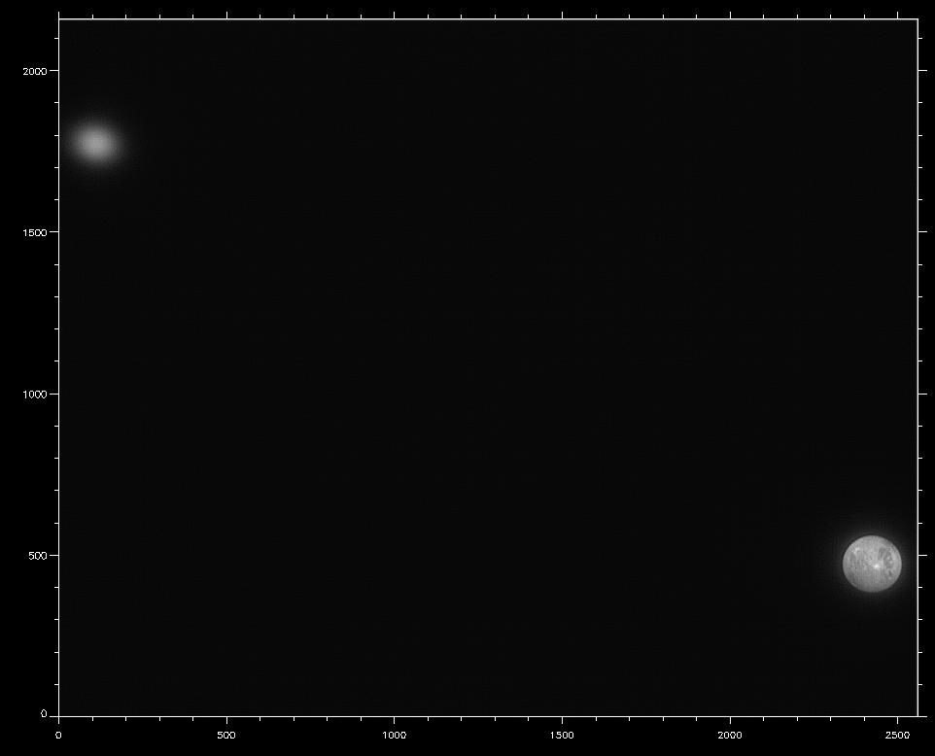
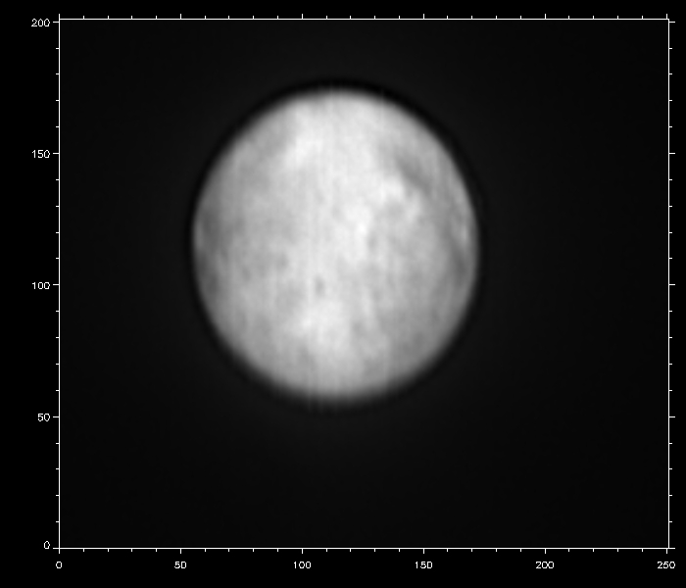
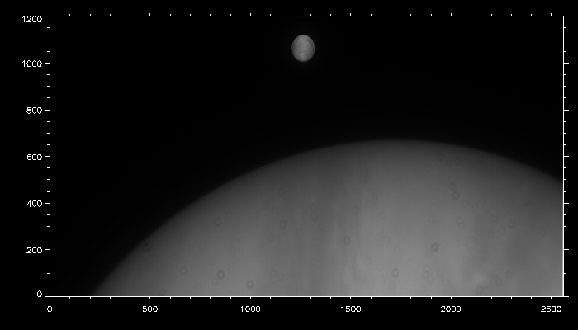
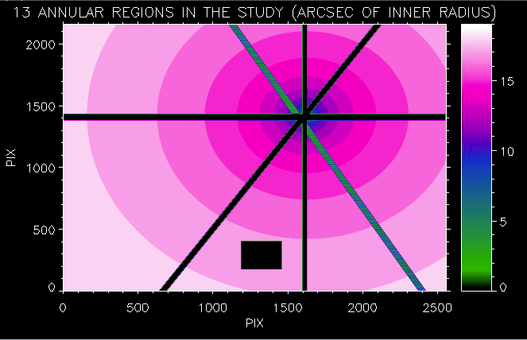
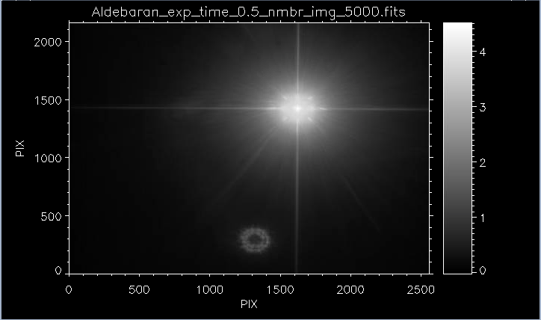
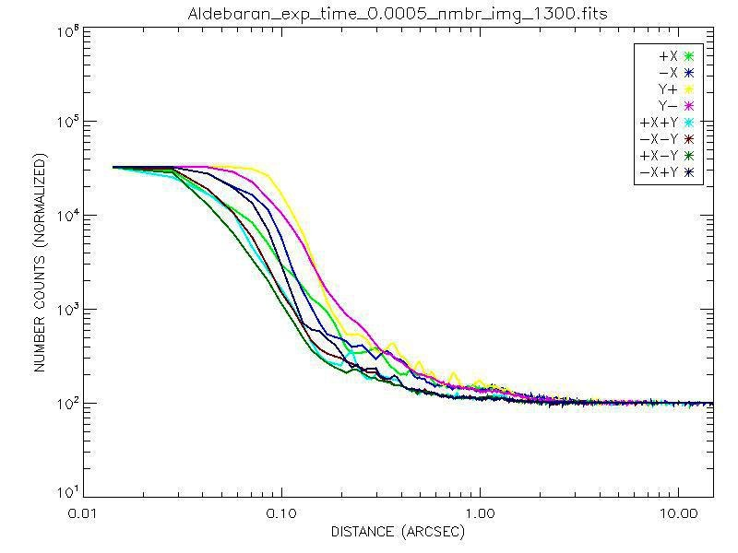
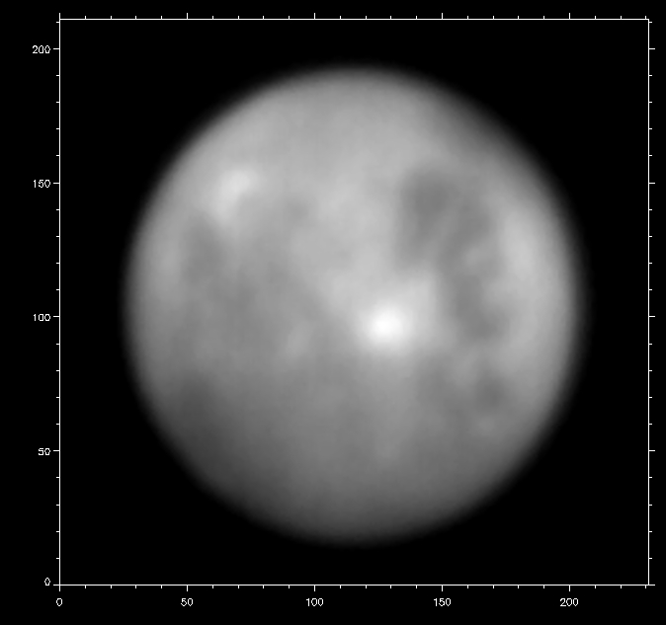
tmas FIRST LIGHT:
CONCEPT PROOF
Io: R band.
20 images, 50 ms
Europa (blurred) and Ganymede: R band.
20 images, 50 ms
…
Aldebaran: I band.
7200 frames, 0.5s
Data to be processed: 1000s images of Io, Jupiter, Callisto, Europa, Ganymede, extragalactic program, binaries, Trapezium, very fast framing for AO correction in V, R, I band and even IO at 360 nm. Would you like to help?
Palomar Science Meeting, 11/16/2012. Sergi R. Hildebrandt

Slide 12
Tmas Career
Second camera: L3CCD (Robo-AO), Zyla (faster version of Neo in TMAS)
Fiber optics (col. Dr. P. Muirhead, Michael Bottom)
P3K engineering instrument (col. Dr. R. Burruss)
Coronagraph (col. Dr. G. Serabyn)
Simultaneous observations of IO with Keck (col. Prof. I. De Pate, UCB)
Yours
Palomar Science Meeting, 11/16/2012. Sergi R. Hildebrandt

Slide 13
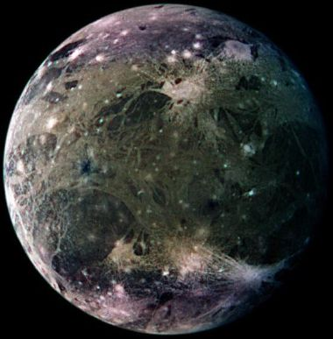
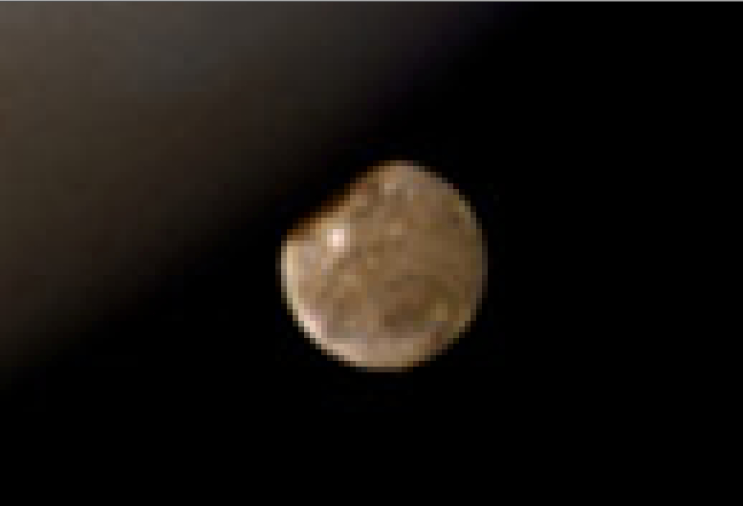
IS TMAS THAT good?
HST WFPC2
SHARPEST IMAGE FROM EARTH DISTANCE
JPL Galileo mission (1995-2003)
Resolution~2 miles in the image
Palomar Science Meeting, 11/16/2012. Sergi R. Hildebrandt

Slide 14
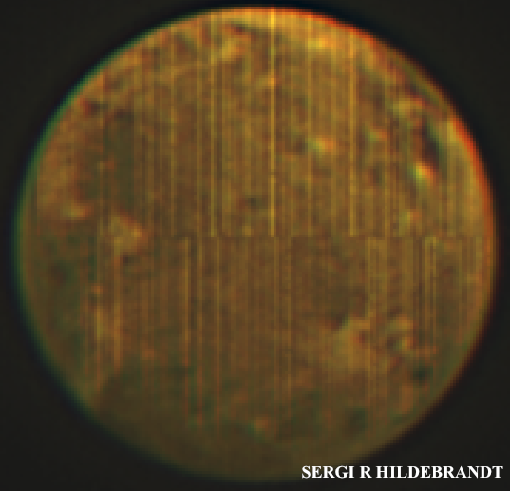
IS TMAS THAT good?
1 pix = 20 miles!
D=160 pixel = 1.6’’
JPL Galileo mission (1995-2003)
Resolution~2 miles in the image
100 frames, 2Hz, 50s
VRI image
Palomar Science Meeting, 11/16/2012. Sergi R. Hildebrandt

Slide 15
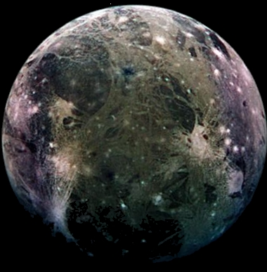
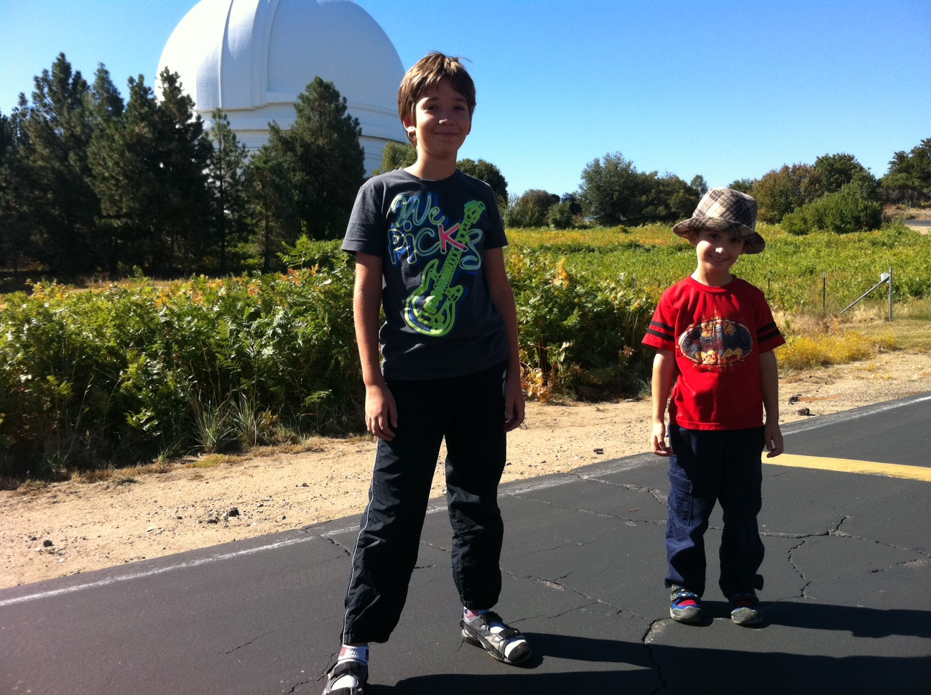
IS TMAS THAT good?
JPL Galileo mission (1995-2003)
Resolution~2 miles in the image
100 frames, 2Hz, 50s
VRI image
Palomar Science Meeting, 11/16/2012. Sergi R. Hildebrandt

Slide 16
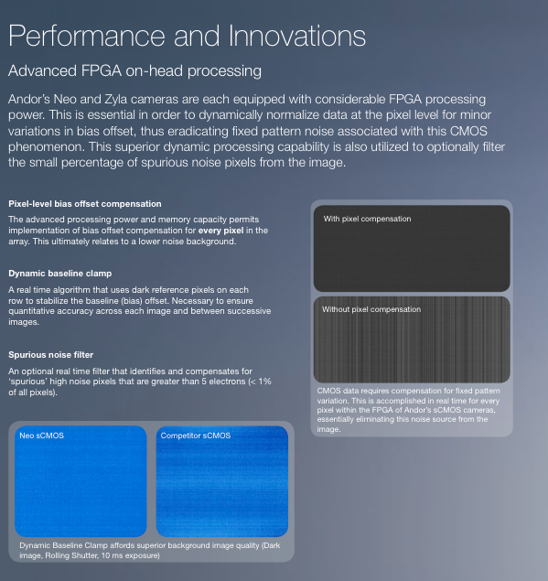
ANDOR … 4 months after the purchase
WE WANT TO UNDERSTAND
BUT IT MAY BE HELPLESS NOW. THEN …
Palomar Science Meeting, 11/16/2012. Sergi R. Hildebrandt

Slide 17

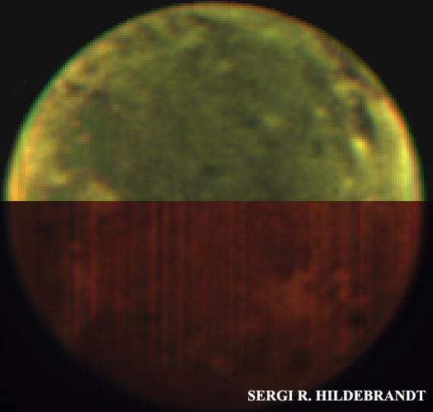
We have an alternative
NEW SHARPEST IMAGE FROM EARTH DISTANCE
The whole picture in a PR … STAY TUNED!
Palomar Science Meeting, 11/16/2012. Sergi R. Hildebrandt

Slide 18
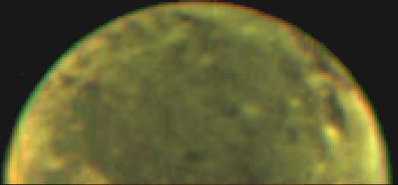
TMAS@PALOMAR
PI: Richard G. Dekany and Sergi R. Hildebrandt
SW: Jennifer W. Milburn
ACKNOWLEDGEMENT:
COO
Christoph Baranec
Reed Riddle
Shrisharsh Tendulkar
Roger Smith
Andy Boden
Phil Muirhead
Michael Bottom
OBSCOS
Jamie Bock
JPL
Chris Shelton
Gene Serabyn
Rick Burruss
Palomar Crew:
Dan McKenna
Kajsa Peffer
Steven Kunsman
Kevin Rykoski
Carolyn Heffner
If interested in TMAS. Good. Help wanted ;)
THANKS!!
Palomar Science Meeting, 11/16/2012. Sergi R. Hildebrandt

Slide 19
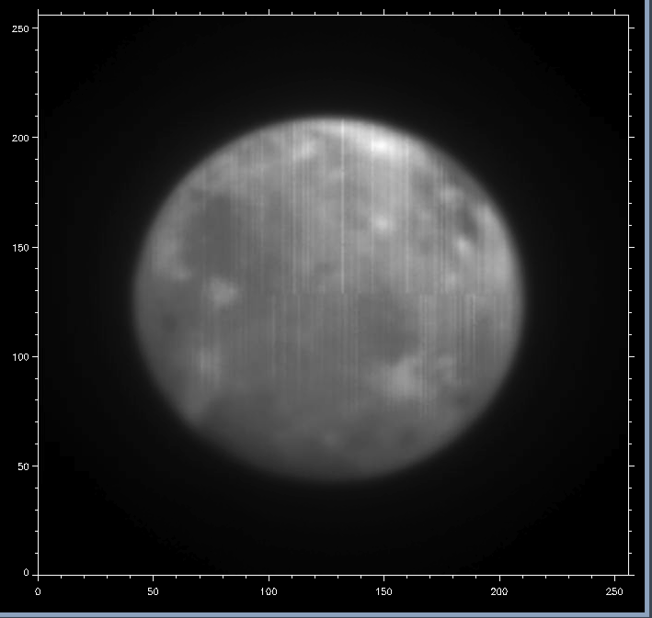

Slide 20
