Slide 1
SED Machine: Summary of Potential Mechanical Improvements
November 7, 2016
Reston Nash

Slide 2
Primary Objectives of Upgrade
Stabilize the IFU Lens Barrel.
Move electronics/cabling outside enclosure.
“Seal” the enclosure.
Reinstate IFU camera focus stage.

Slide 3
Secondary Objectives of Upgrade
Add kinematic features to the cameras.
Repeatably mount them.
Clean optics.
Add baffling.

Slide 4
General Strategy
Work with what we have.
Retrofits not new design.
Assume no further upgrades will be done.
Try not to leave anything on the wish list.
Don’t plan on breaking the alignment.
If we do then we can switch one of the lenses.

Slide 5
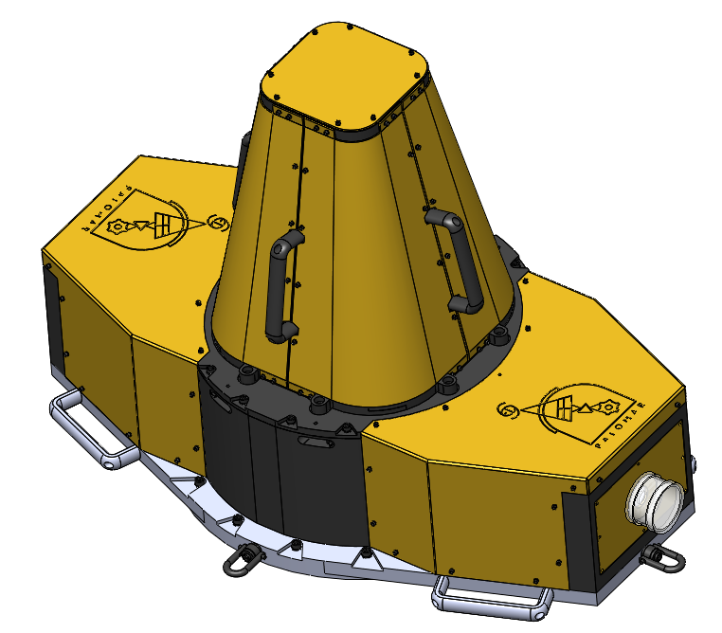
Background
CAD file seems pretty representative.

Slide 6
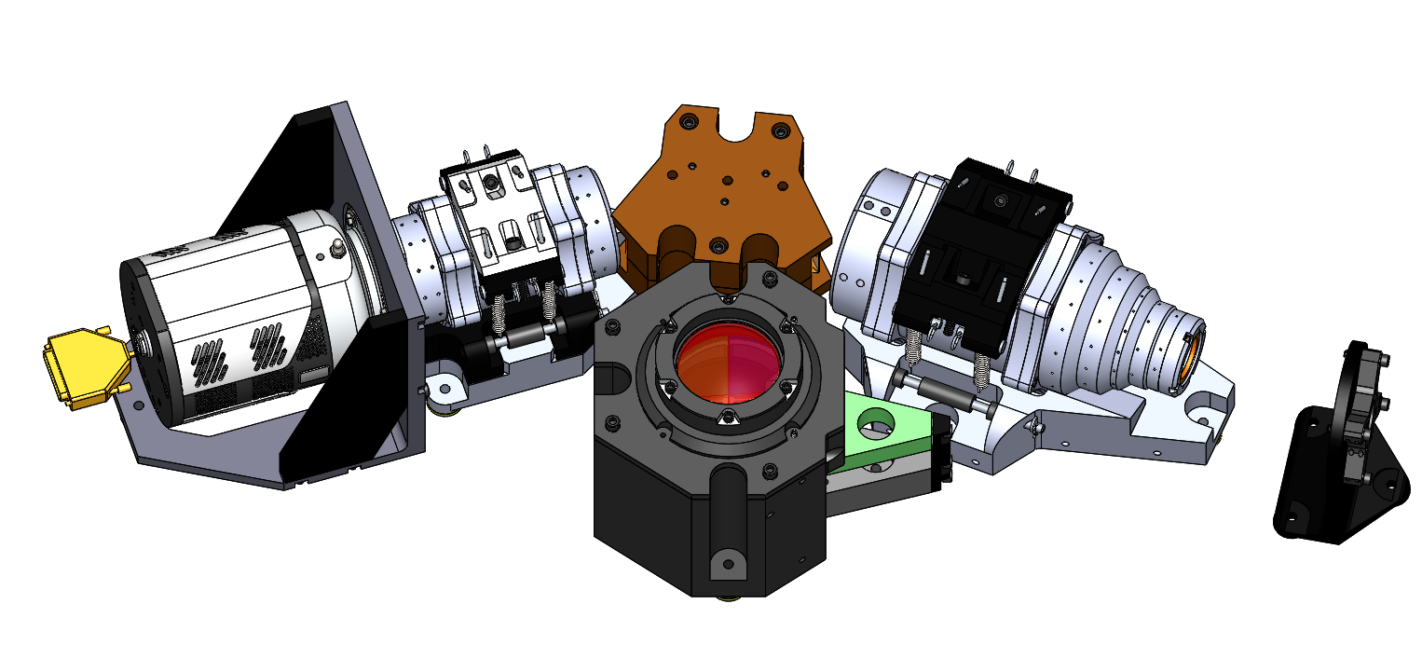
Background
Prism
IFU Barrel
Lenslet Barrel

Slide 7
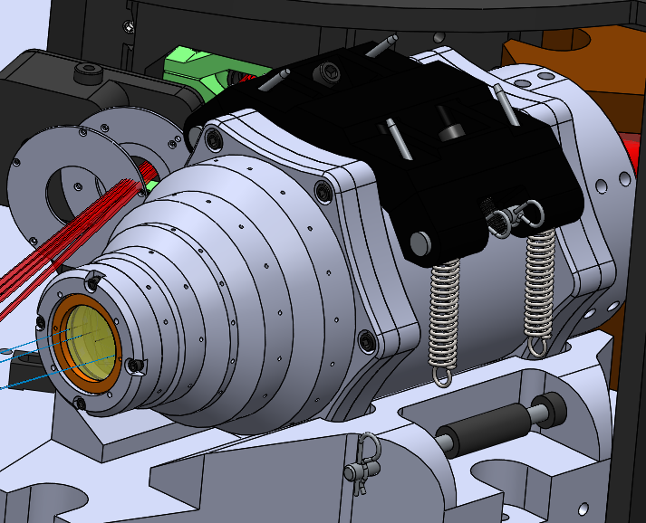
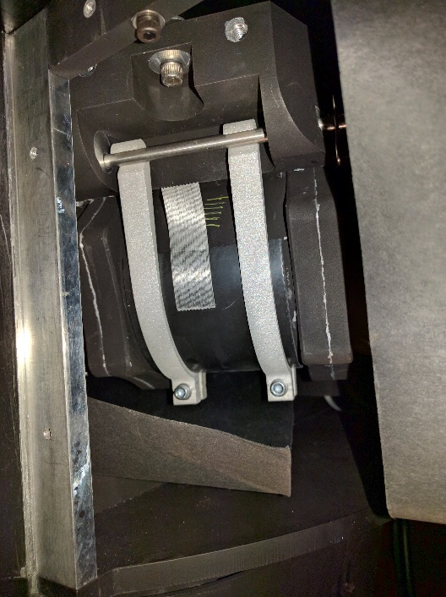
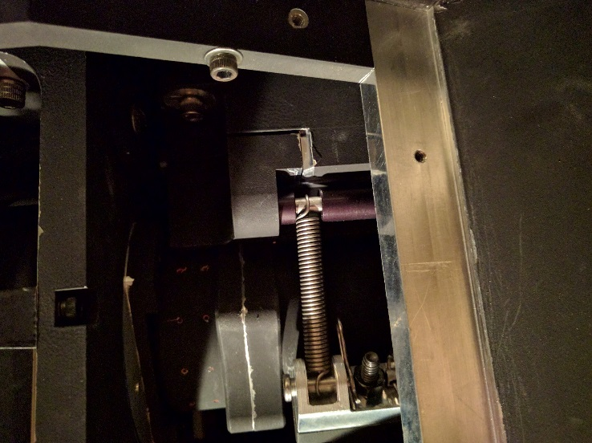
1) Optical Stability
Both lens barrels should be rigidly clamped.
Current springs are too flimsy.
Currently: Springs are clearly not very tense
CAD Model
Rigid clamps on IFU Barrel

Slide 8
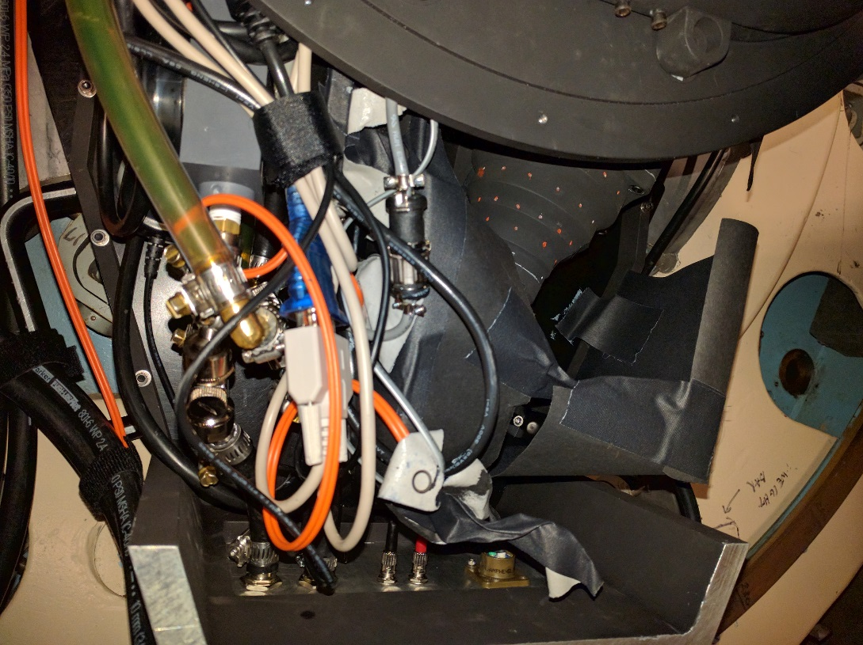
2) Electronics
The electronics were designed to be inside the enclosure.
This leads to a big mess, no matter how hard you try.

Slide 9
3) “Seal” the enclosure
Currently there are a lot of holes in the enclosure, so the instrument is fairly exposed.
Making an airtight seal is almost impossible.
Usually fancy instruments flow dry air or nitrogen through the volume, but that could be a lot of effort.
The enclosure should be made as air tight as possible, then use a desiccant and see how long it takes to saturate.

Slide 10
“Seal” the enclosure
etc.
Most enclosure mounting holes are unused.

Slide 11
4) Focusing Strategy
The tracking (RC) camera and the IFU camera need to both be in focus.
Ideally, M2 would be used to focus the RC camera,
Then the IFU focus stage would focus the IFU camera.
Currently IFU focus stage is loaded by gravity (?), and not springs.

Slide 12
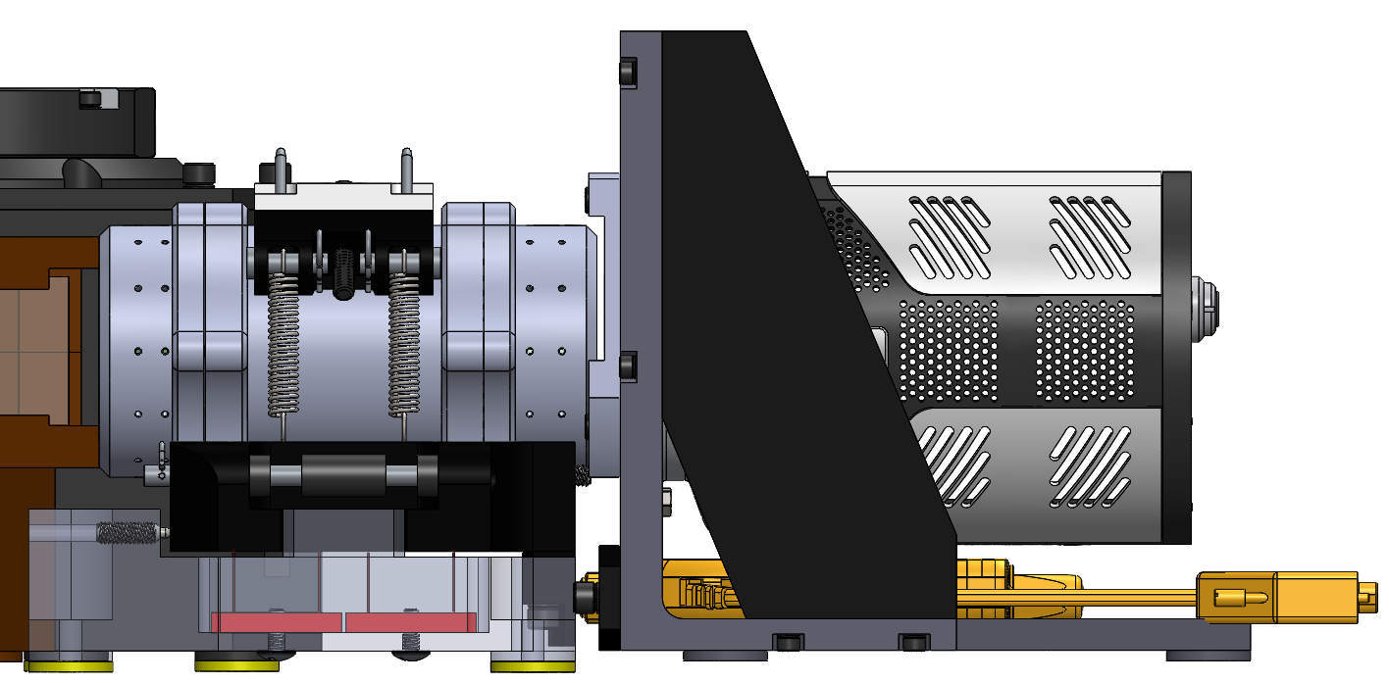
Camera Focus Mechanisms
IFU Lens Barrel
IFU Camera
Stage springs
Flexures
Motorized Nudger

Slide 13
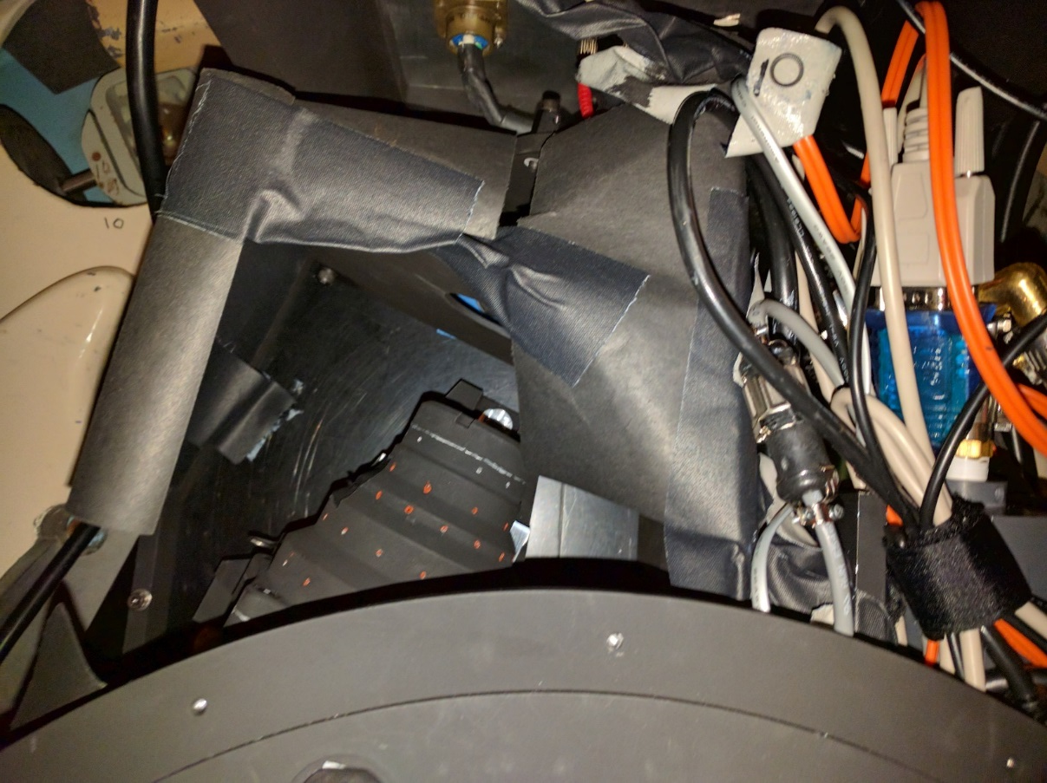
Baffling
Mixtures of plates, paper, and tape.

Slide 14
Open Questions
What is the point of the RC camera enclosure? (Safety, likely not required to make light tight)
Do we want to redo the focus mechanism. (no, keep it and just add springs. It doesn’t have to be pretty)

Slide 15
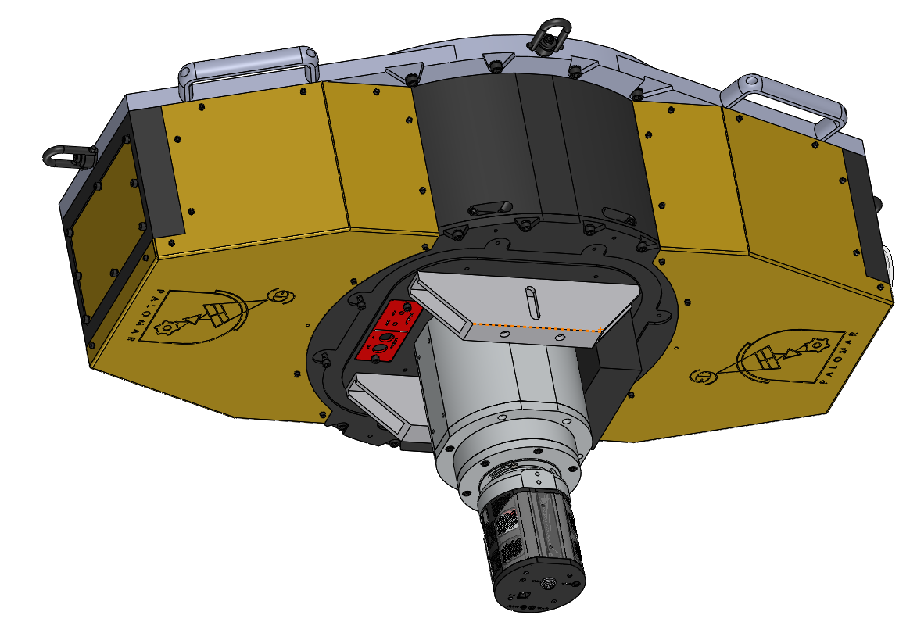
RC Camera Enclosure
Seems light tight
Seems unnecessary

Slide 16
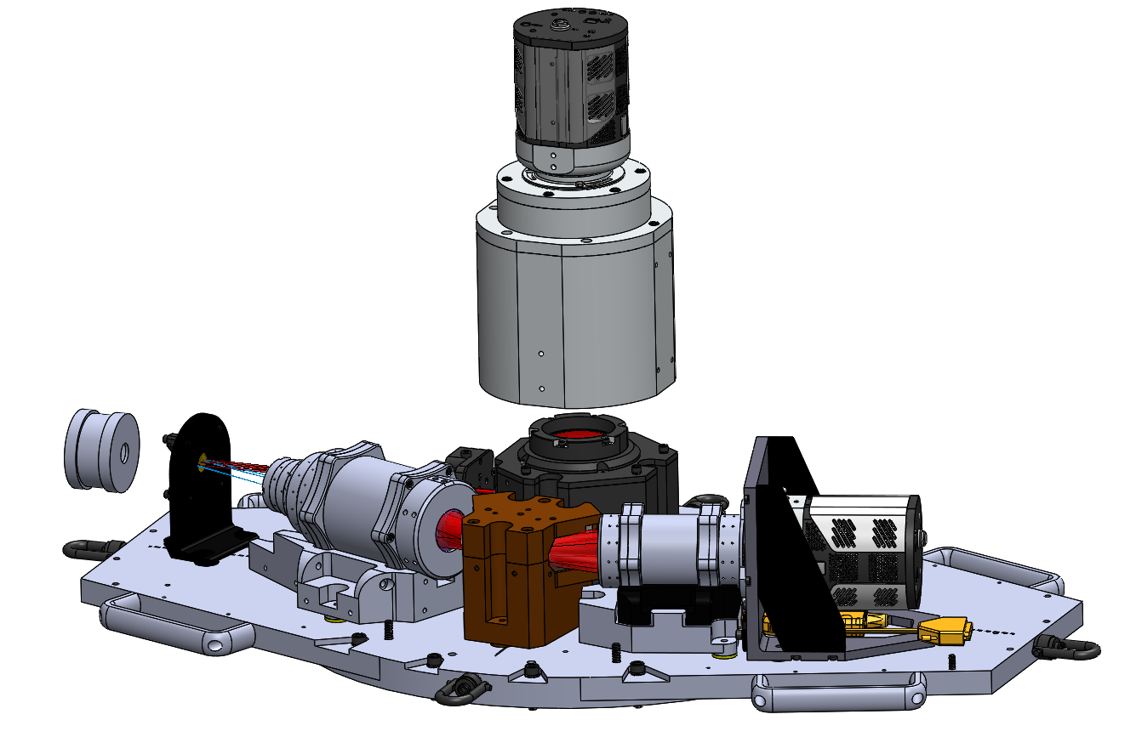
Minimum Parts to keep:
The enclosure should be redone.
A lot of the structure seems unnecessary.

Slide 17
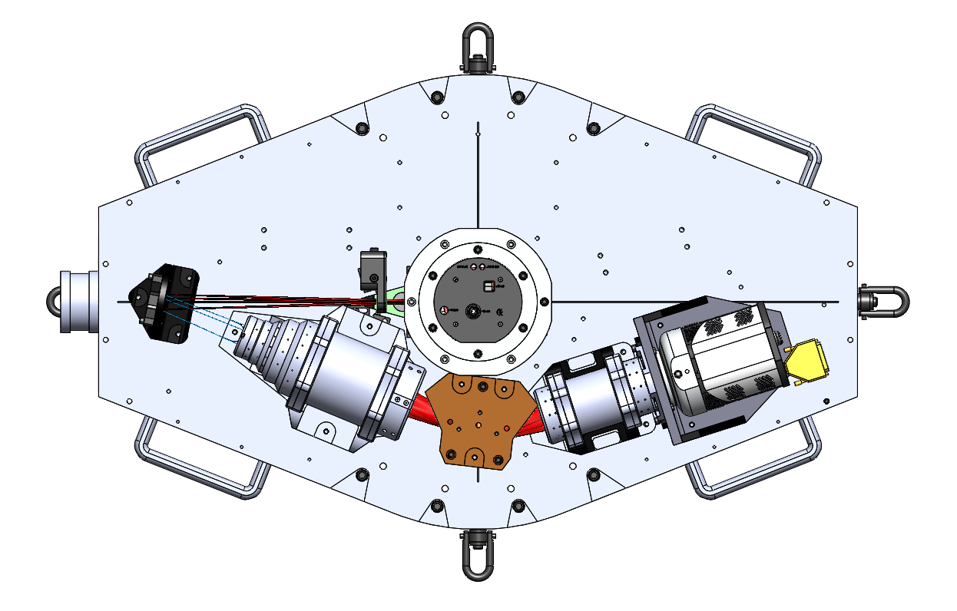
Potential New Enclosure Geometry
Electronics

Slide 18
Next Steps
The CAD design for any upgrades shouldn’t take very long.
New enclosure, new focus stage, some cabling and electronics mounting plates.
Need to decide the functionality we want.
Schedule is driven by ZTF downtime.
6 weeks (?), seems like a comfortable amount of time.

