Slide 1
MOSAIC focal plane leveling
V. Velur
Caltech Optical Observatories
01/22/2008

Slide 2
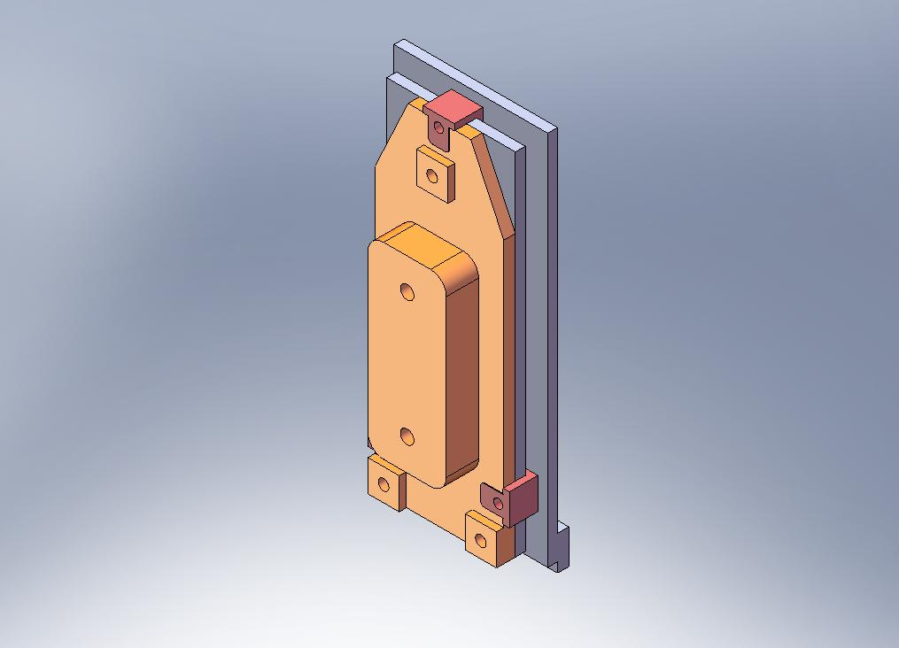
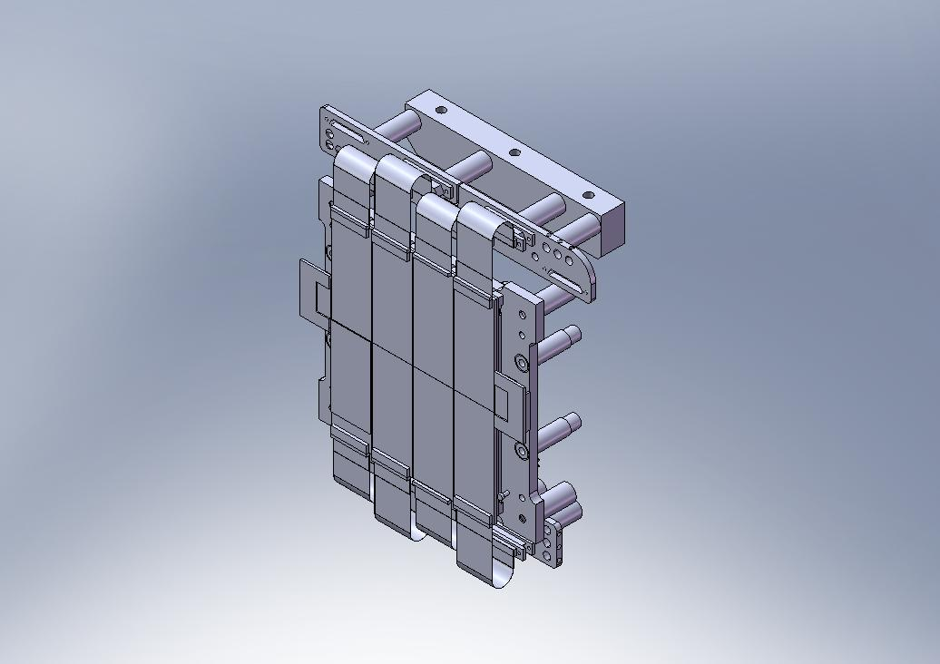
Aim
Level focal plane to better than 5 um RMS over the ~125 x 200 mm array. (current RMS flatness is ~10 um)

Slide 3
Unknowns
How to polish TZM (Moly) boats – use current make new pieces?
How the CFH (INVAR) back plate behaves at cold temperatures.
The clip mechanism
Chip (AlN)-TZM interface (need Indium?, if so how to level?)

Slide 4
Tools
Non-contact profilometer
Metrology of individual TZM boats
Definition of reference plane
Definition of Detector plane

Slide 5
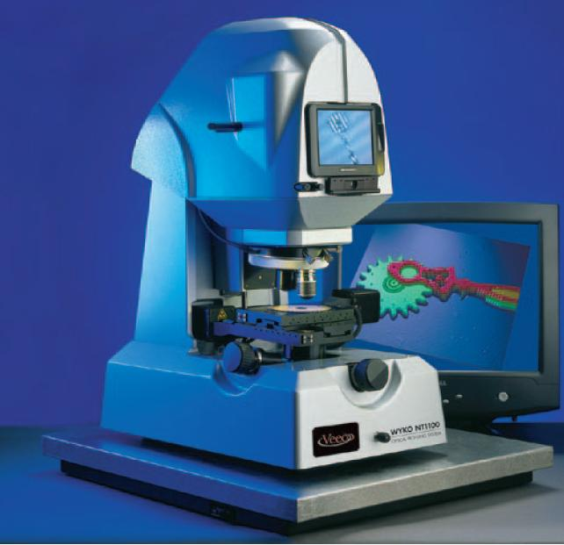
Profilometer options (Zygo, Veeco, Micromap etc.) – cost $70-170K

Slide 6
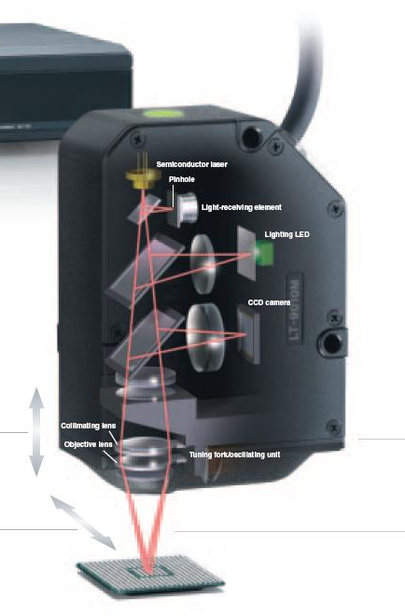
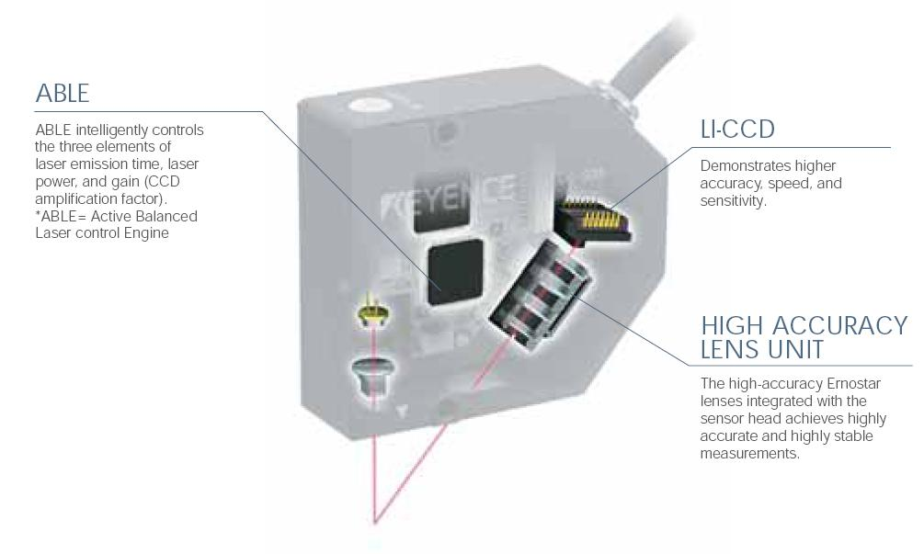
Profilometer
Confocal ($22K)
Triangulation ($10K) 0.1 um, 10 Hz

Slide 7
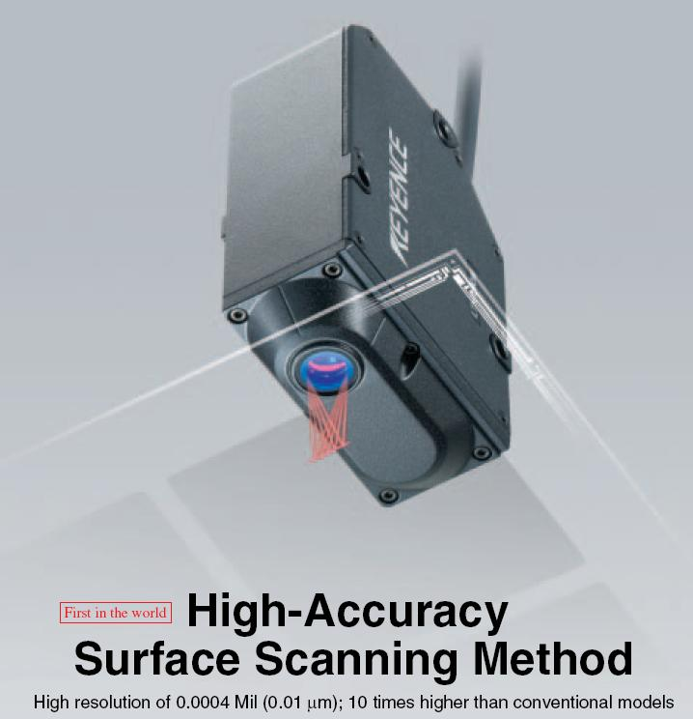
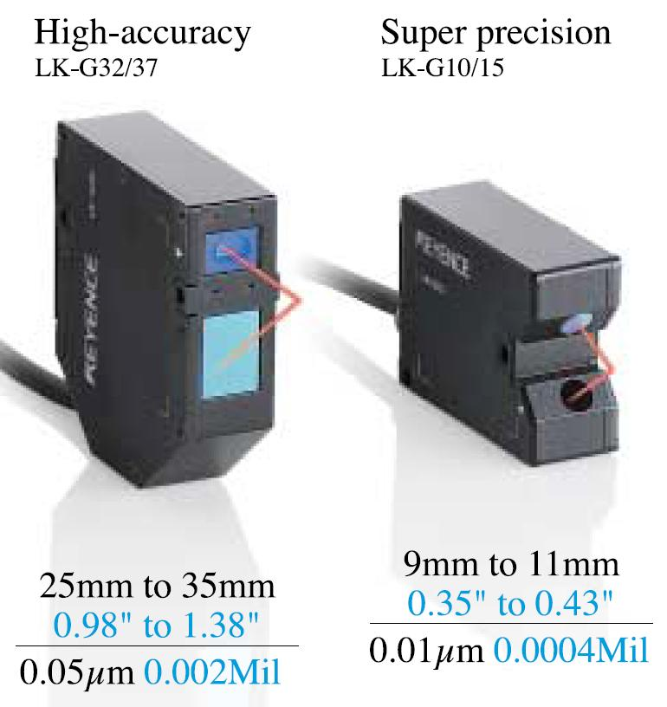
More info.
Confocal sensor
Triangulation sensor

Slide 8
Our own profilometer?
One big XYZ stage with a bracket for sensor.
Working distance is 30 mm.
Will move the sensor (constant load).
Can be used to characterize detectors – charge diffusion, intra-pixel scans.
Available wavelengths – 670 nm, 780 nm diode lasers
Need to write some S/W to map XYZ co-ordinates (but that can’t be so hard).
Stage cost $12,000 (including controller, cables, encoders, RS232 interface etc.)

Slide 9
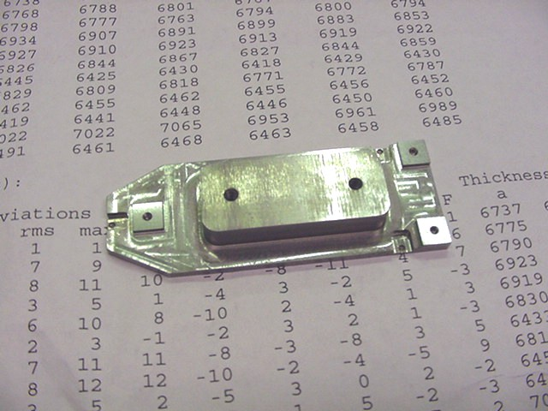
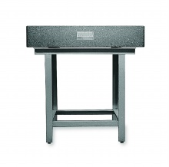
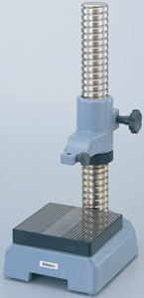
Testing tools (sans profilometer)
Accuracy of indicator = 0.0015 mm, resolution = 0.0005 mm

Slide 10
Tentative FPA leveling procedure
Get an accurate model of the back plate. (Hal)
Order profilometer parts (keyence sensor, XYZ stages with encoders), take delivery, build profilometer, write software and calibrate. (2 man-weeks from delivery of all parts). Buy Mitutoyo test indicator with mount and granite baseplate.
Learn how to polish TZM @ 0.2 um level. (1 wk)
Build fixtures to repetitively measure boats.(1 wk shop time)
Make a make shift back plate – heat treat along with MOSFIRE parts. Also make fixtures to handle CCID20s (PTFE threaded rods, slotted storage pieces etc.) (2 weeks – shop time)
Obtain dead chips. Make 3 or 4 boats (and 12 clamps) out of TZM and align using fixture – learn how to handle chips and align them. (2 weeks shop time)
Take the CFH back-plate assembly out and put in storage, try some thermal tests with the make-shift backplate. Check for flatness in cryogenic temperatures. (4 weeks)
Take off chips from CFH back plate and measure the boats individually and polish as necessary. Mount all chips on the Caltech back plate. (4 weeks)
Repeat profilometry and repeat latter part of step 8. (2 weeks)
Do cold tests. (2 weeks)
Cold path optimization – if needed (graphite straps, Indium bits, Mylar insulation?)
Total : 20 weeks!

Slide 11
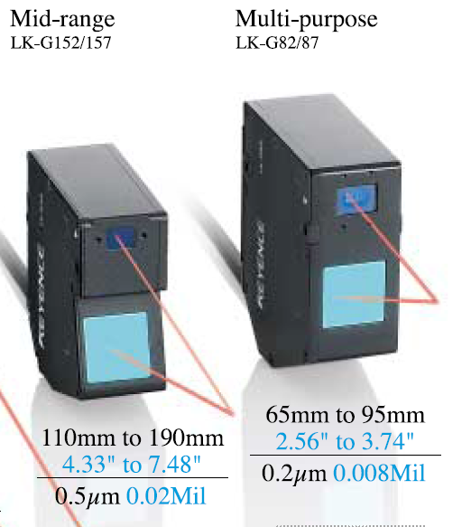
Recommendation:
Buy Keyence triangulation sensor and build our own profilometer. This gives us a versatile platform to do other detector tests in the future, even though this requires more COO than-power than buying a commercial product. Making it ourselves makes it cheaper and enables us to test inter pixel and intra-pixel charge diffusion, pixel-to-pixel intensity variation etc.

