Slide 1
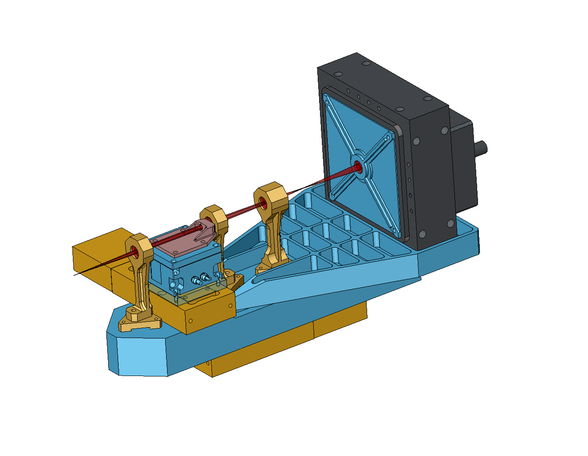
NGAO NGS WFS design review
Caltech Optical Observatories
1st April2010

Slide 2
NGS WFS Requirements
Modes of operation (FR-3247 and FR-3445)
  60 x 60 subapertures….
  5 x 5 subapertures
  Pupil imaging mode
Operating wavelengths (FR-203)
  500 to 900 nm
Patrol Field of Regard (FR-127)
  40 x 60 arcsec rectangle (limited by narrow field relay)
  NGS WFS Field Steering Mirror Ass’ly based pick-off design
WFS FoV
  4 arcseconds in 60 x 60 mode (FR-131)
NGS WFS operates with no ADC (B2C decision)

Slide 3
Motion control requirements
Field steering mirrors – need to be able to pick any star in a 60x40 arcsecond Field of Regard
Whole WFS motion – The WFS must work with and without the IF dichoric
Lenslet XY motion & Post-lenslet relay and camera focus – The WFS needs to operate in 63x63, 5x5 and pupil imaging modes.

Slide 4
NGAO optical relay – the packaging problem
Sci. Int. 1
NGS WFS
Sci. Int. 2
IF
LGS WFS

Slide 5
Context diagram of the NGS WFS
AO control
Config
Status
Optical
AO relay and Optical bench
NGS WFS
Mechanical
Data
The AO (supervisory) control can configure (FSM motion, lenslets, read-out mode etc.) and access status signals from the NGSWFS sub-system.
NGS WFS needs to interface mechanically and optically to the AO relay/ optical bench.
NGSWFS needs to send pixel data to the RTC.
Note that the RTC has no control path to the sensor (unlike the LGSWFS where there is a TT mirror control).
RTC

Slide 6
Input to the NGS sensor
Design characteristics:
NGS light is picked off in collimated space and focused using a (BASF2-N15-BASF2) triplet
F/# = 20.012
Plate scale = 1.063 mm/”

Slide 7
Input to the NGS sensor – spot diagram at the NGS sensor pick-off focal plane

Slide 8
Ray fans at the NGS sensor pick-off focal plane

Slide 9
Grid distortion at the NGS WFS input

Slide 10
Effect of atmospheric dispersion
Residual dispersion (mas)
Zenith Angle (deg.)
Max. dispersion introduced by the atmosphere between 500-900 nm = 29 mas at 45 degree zenith angle – results in negligible change in sub-aperture pot size

Slide 11
What’s the implication for the NGS WFS?
Wavefront error on input beam is 1.15 waves RMS (6 waves P-V) @ 600 nm at the extreme (and worst case) field points. This is mostly astigmatism.
As per KAON 685 we know that this corresponds to (y = ar^2 -> 0.69 *10^(-6) = 25 * a -> a = .276*10^(-7); dy/dr = 2*a*r ->dy/dr=0.2*10^(-6) ) [c.f. Figure 13 in the KAON]
KAON 692 Figures 9 and 10 along with corresponding analysis also indicate that for a large # of sub-apertures (60 in our case) the sub-ap spot size due to input aberration is going to be of the order of 2 um (RMS).

Slide 12
Analysis result
Impact of input aberrations
  Negligible impact on NGS WFS subaperture spot size
  Acceptable centroid offsets (~0.1 pixel worst case)
  Small amount of distortion (0.13%) will be calibrated using ACQ system
  Chromatic aberrations acceptable (TBC?)
Atmospheric dispersion introduces ~30 mas of spot blurring.

Slide 13
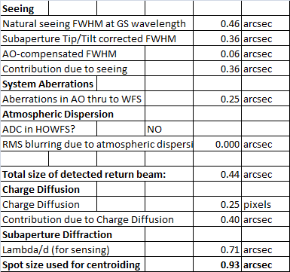
NGS WFS parameters
Following Keck Drawing Drawing #1410-CM0010 Rev. 1, we have 59 (+1/2+1/2) WFS sub-apertures across the a circle that inscribes the Keck primary mirror. We also support another calibration mode with 5x5 pupil samples across the Keck primary mirror.
The WFS FoV is 4” because the sensor needs to track extended objects that are 4” in diameter. One could also work out the spot size.

Slide 14
Modes of operation
63x63 sub-ap. mode of operation
  We use 4 physical pixels per sub-ap. Which can be binned on chip and read as 2x2 pixels/sub-aperture with almost zero read noise penalty. This gives us the flexibility of 2 modes, one with high linearity and another with lower read noise.
  Only 59x59 sub-apertures are lit by NGS star light at any time. The pupil imaged by the WFS nutates around the 63x63 sub-apertures.
5x5 mode of operation
  to simply the size of moving parts while facilitating the two pupil sampling modes, we use the same collimator and post-lenslet relay for both the 63 and 5 sub-ap mode of operation.
  We choose 48 pixels/sub-aperture (instead of 50 pixels/sub-ap) to enable 4x4 binned pixel/sub-aperture operation with standard centroiding algorithms.
  A small fraction of light will be lost from the outer-most sub-apertures due to pupil nutation.
Pupil imaging mode – The NGS WFS can image the pupil using the WFS camera.

Slide 15
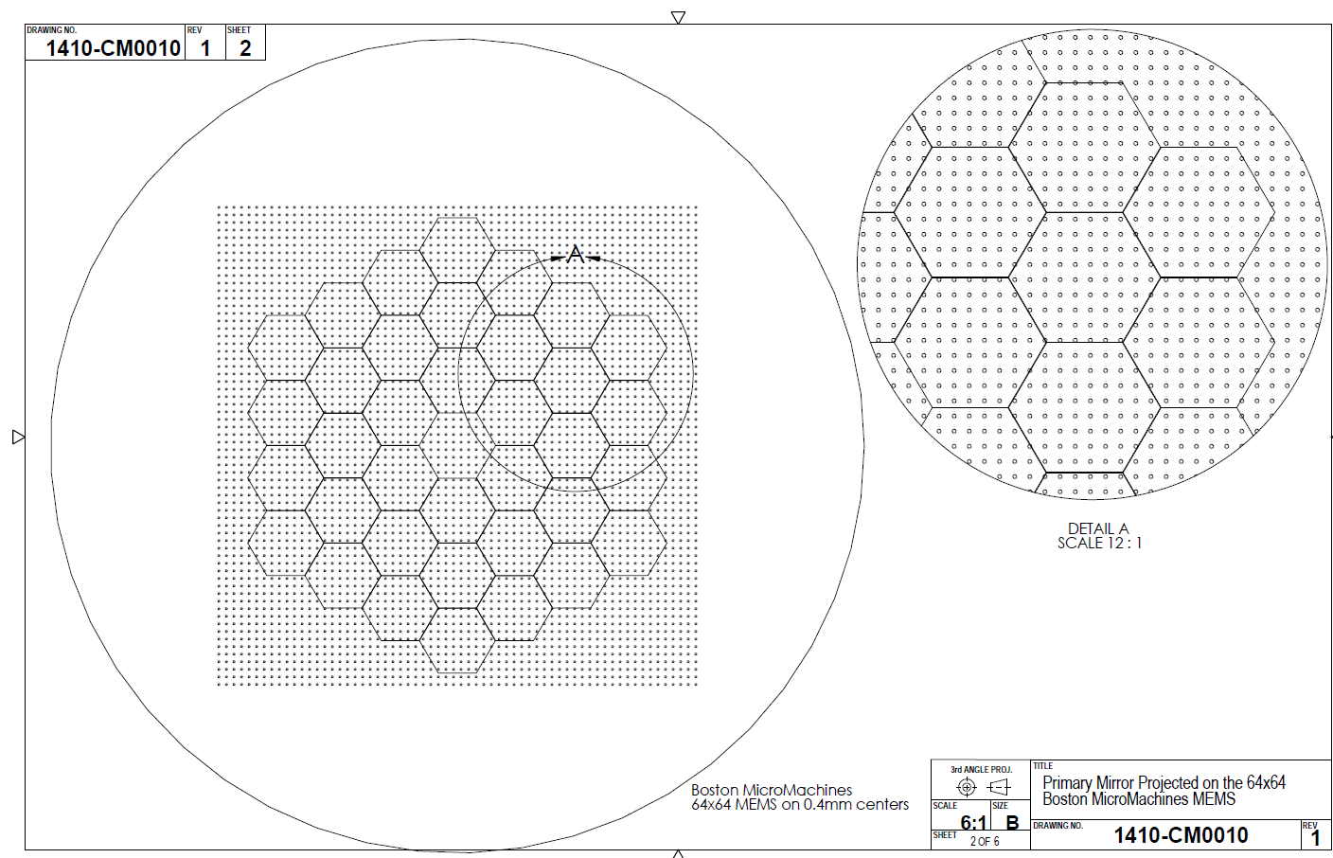
Keck primary projected on the 64x64 actuator BMM HODM
Envelope over which the pupil wobbles (nutates)

Slide 16
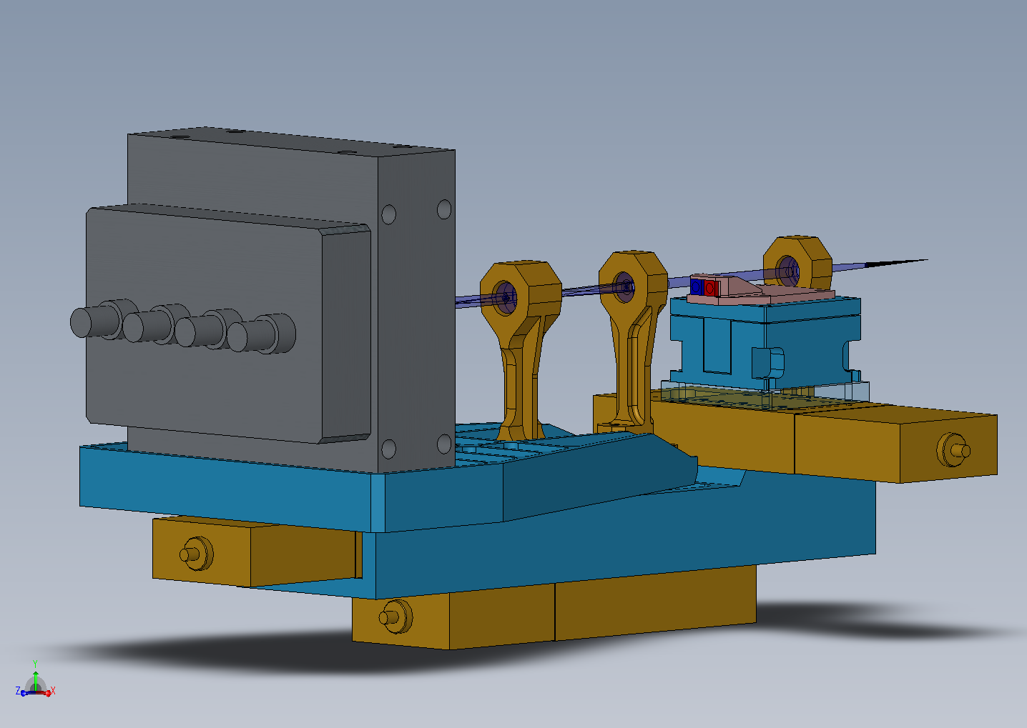
Motion control
Lenslet 1
Lenslet 2
Lenslet X & Y motion
Post-lenslet relay and camera focus
Whole WFS translation

Slide 17
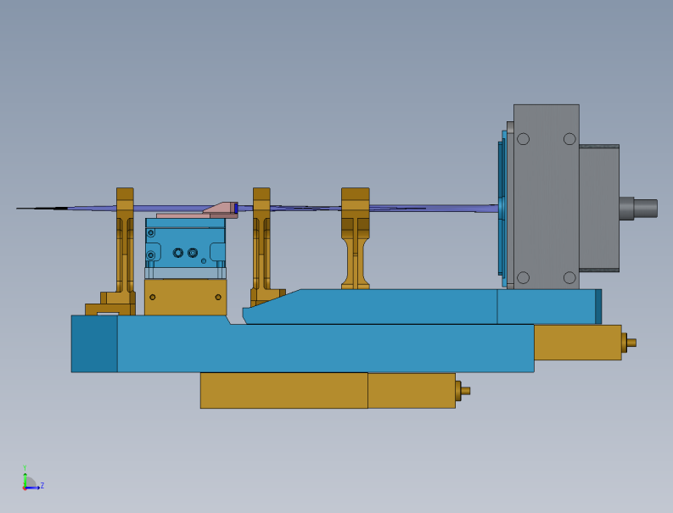
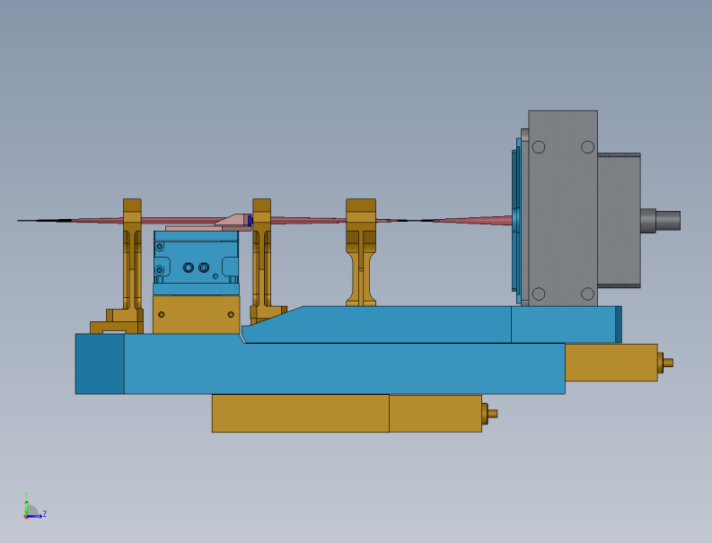

Modes of operation cont’d
Modes(Clockwise from top): 5x5, 63x63 and pupil imaging modes

Slide 18
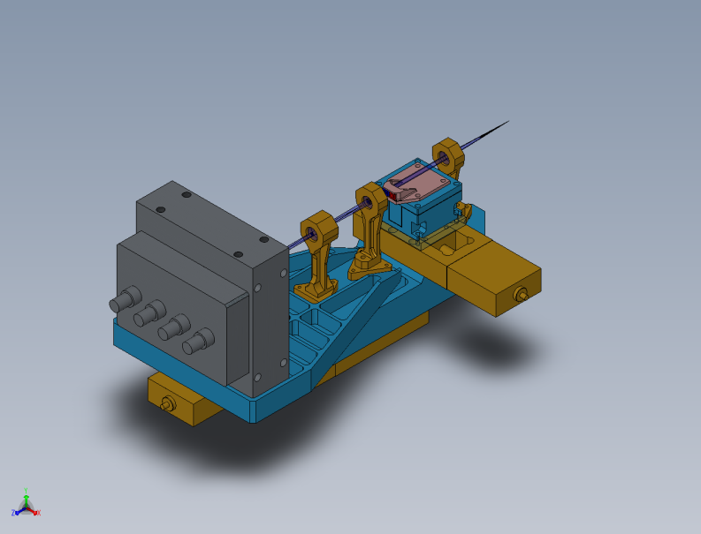
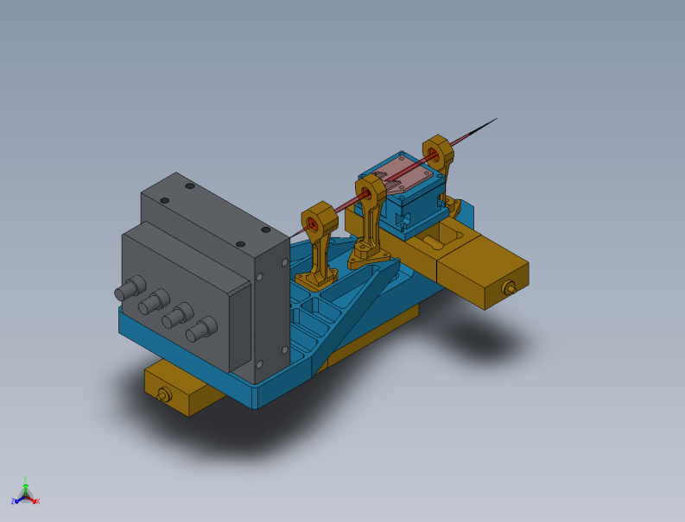
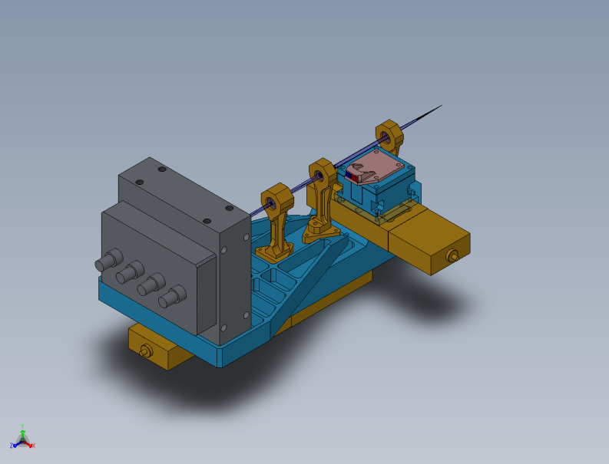
Modes of operation cont’d
Modes(Clockwise from top): 5x5, 63x63 and pupil imaging modes

Slide 19
Pupil mapping between NGSWFS-DM and primary mirror
As per Drawing #1410-CM0010 Rev. 1, :
The whole DM would be mapped by using a pupil that is 25.2 mm/24 mm * 10.949 = 11.49645 m and has the same focal length (149.583 m). This corresponds to an F/# = 13.01123.
Plate scale = 13.01123*11.49645/(180/pi*3600) = 725.1979 um/” at the telescope focal plane
The apparent plate scale at the NGS pick off focal plane is 19.06163 (instead of 20.012). The plate scale is 1.0623 mm/”.

Slide 20
WFS design parameters
Parameter | 60x60 mode | 5x5 mode | units
f_collimator | 60 | 60 | mm
Input plate scale | 1.0623 | 1.0623 | mm/"
Binned pixel size (# of pixels) | 1 | 12 | pixels
Detector plate scale (mm/") | 0.0210 | 0.2520 | mm/"
Plate scale ratio (IPS/DPS) | 50.58 | 4.22
input f/# | 19.06 | 19.06
pupil sampling | 63 | 5 | sub-aps across pupil
d_lenslet | 0.05 | 0.60 | mm
de-magnification (m) | 1.68 | 1.68
f_lenslet | 0.71 | 8.47 | mm
f# lenslet | 14.12 | 14.12
wavelength (for worst case FN calc.) | 0.90 | 0.90 | um
fresnel # | 0.98 | 11.80
radius of curvature of lenslet | 0.36 | 4.38 | mm

Slide 21
63x63 NGS WFS layout
Total relay length = 262 mm
Components from (left to right) –collimating doublet, lenslet array, field singlet, focusing doublet followed by the window and the detector.
Wavelength of operation – 500-900 nm

Slide 22
63x63 sub-aperture NGS WFS spots
21 um pixel detector with 63 spots with 4x4 pixels/sub-aperture.

Slide 23
63x63 NGS WFS layout

Slide 24
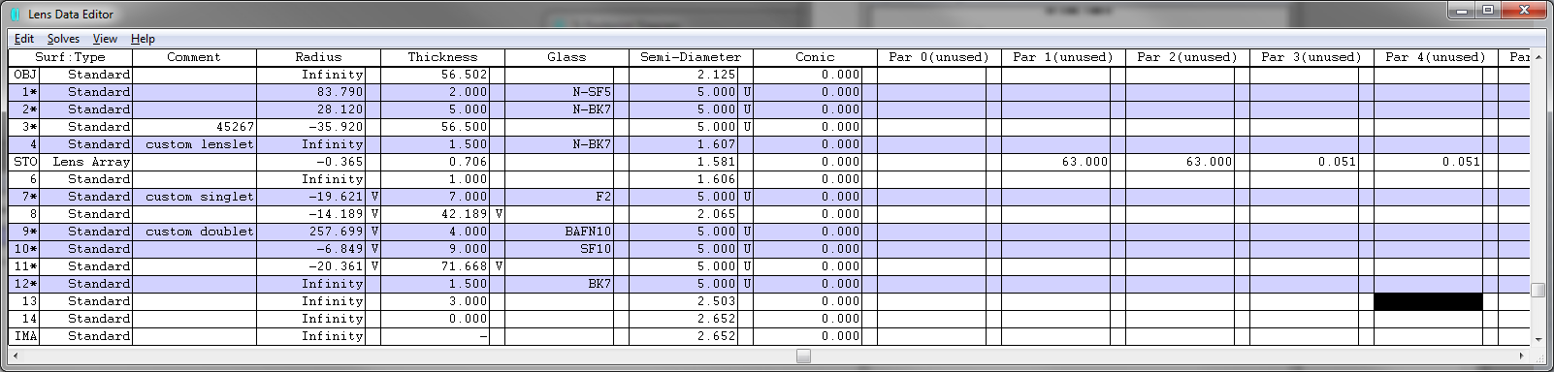
63x63 NGS WFS layout

Slide 25
63x63 NGS WFS post lenslet relay
Mag. = 1.681
Total relay length = 139 mm

Slide 26
Post lenslet relay – spots delivered by the relay
(Huygen’s) PSF Strehl = 97% at worst field point.

Slide 27
Post lenslet relay – grid distortion

Slide 28
5x5 NGS (calibration) WFS layout
Total relay length = 269 mm
Components from (left to right) –collimating doublet, lenslet array, field singlet, focusing doublet followed by the window and the detector.
Wavelength of operation – 500-900 nm

Slide 29
5x5 NGS WFS layout
5040 um detector with 5 spots across the pupil with 4x4 (binned) pixels/sub-aperture [48x48 physical pixels/sub-aperture]

Slide 30
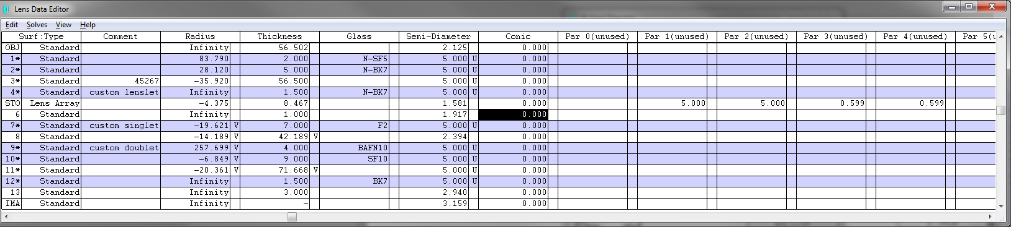
5x5 NGS WFS layout
Reminder: The 5x5 and the 63x63 modes use the same post-lenslet relay

Slide 31
NGS WFS behind the NGAO optical relay

Slide 32
NGS WFS spots showing 59 ‘lit’ sub-apertures

Slide 33
Post lenslet relay – magnified view
Magnified view of the WFS focal plane. 168 um correspond to 8 pixels.

Slide 34
Other issues
For B2C we ruled out an ADC in the NGS WFS
  What is the implication of this?
What about pupil imaging mode?
What are the mechanical stage, etc. requirements?
Alignment issues
  Anything unusual? Fixtures, etc. Is this really the same as any other NGS WFS ever built?
  Manufacturing / alignment tolerances
Thermal issues
  -15C operation (does this matter?)
Stray light
  Baffles / filters (unnecessary?)
  Ghosts (usually not an issue of NGS WFS, but for PDR mention for completeness)

Slide 35
Detector choice and performance
NGAO envisages the use of 256x256 pixel CCID74 detector with 21 um pixels that is under development at Lincoln Labs for wavefront sensing.

Slide 36
Predicted Quantum efficiency
(based on 75 micron substrate, Bodacious Black AR coating on Pan-STARRS CCID-58)

Slide 37
Read noise [predicted and measured]

