Slide 1
NGAO NGS WFS design review
Caltech Optical Observatories
31st March 2010

Slide 2
Input to the NGS sensor
Design characteristics:
NGS light is picked off in collimated space and focused using a (BASF2-N15-BASF2) triplet
Output f/# - 20.012
Plate scale = 1.063 mm/”

Slide 3
Input to the NGS sensor – spot diagram at the NGS sensor pick-off focal plane

Slide 4
Ray fans at the NGS sensor pick-off focal plane

Slide 5
Grid distortion at the NGS WFS input

Slide 6
What’s the implication on the NGS sensor?
Wavefront error is 1.15 waves RMS (6 waves P-V) @ 600 nm at the extreme (and worst case) field points. This is mostly astigmatism.
As per KAONs 685 we know that this corresponds to (y = ar^2 -> 0.69 *10^(-6) = 25 * a -> a = .276*10^(-7); dy/dr = 2*a*r -> ) [c.f. Figure 13 in the KAON]
Figures 9 and 10 along with corresponding analysis also indicate that for a large # of sub-apertures (60 in our case) the sub-ap. Spot size due to input aberration is going to be of the order of 2 um (RMS).

Slide 7
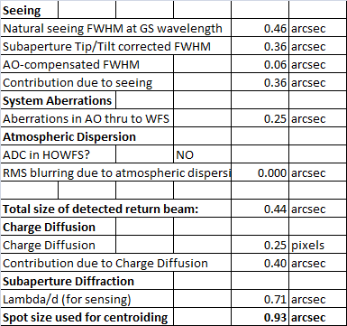
NGS wavefront sensor parameters
Based on the pupil geometry, we design the sensor to have 60 sub-apertures across the a circle that inscribes the Keck primary mirror. We also support another calibration mode with 5x5 pupil samples across the Keck primary mirror.
The detector plate scale is 4” because the sensor needs to track extended objects that are 4” in diameter. One could also work out the spot size.

Slide 8
Modes of operation
60x60 mode of operation - since all the visible wavefront sensing detectors are identical (for spares and cost consideration in procurement and software development) in the NGAO we use 4 physical pixels per sub-ap. Which can be binned on chip and read as 2x2 pixels/sub-aperture with almost zero read noise penalty. This gives us the flexibility of 2 modes, one with high linearity and another with lower read noise.
5x5 mode of operation – to simply the size of moving parts while facilitating the two pupil sampling modes, we use the same collimator for both configurations. The table in the next page summaries all the design parameters.

Slide 9
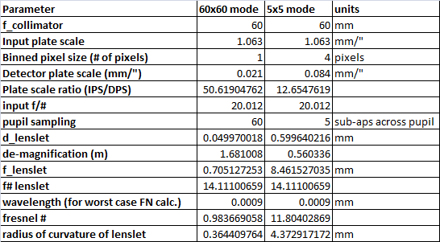
WFS design parameters

Slide 10
60x60 NGS WFS layout
Total relay length = 285 mm
Components from (left to right) – doublet collimator, lenslet, field lens, doublet focusing lens followed by the window and the detector.
Wavelength of operation – 500-900 nm

Slide 11
60x60 NGS WFS layout
21 um pixel detector with 60 spots with 4x4 pixels/sub-aperture.

Slide 12
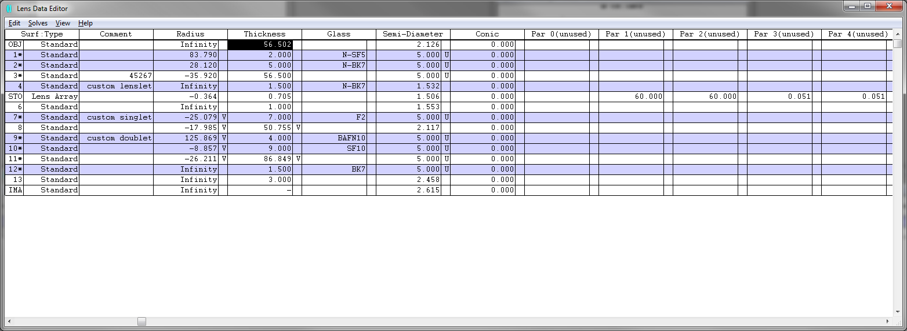
60x60 NGS WFS layout

Slide 13
60x60 NGS WFS post lenslet relay
Mag. = 1.681
Total relay length = 164 mm

Slide 14
Post lenslet relay – spots delivered by the relay
(Huygen’s) PSF Strehl = 99.2% at worst field point.

Slide 15
Post lenslet relay – grid distortion
700 nm is the central wavelength, GD at 500 nm is 0.047% and GD at 900 nm is 0.013%

Slide 16
5x5 NGS (calibration) WFS layout
Total relay length = 265 mm
Components from (left to right) – doublet collimator, lenslet, field lens, doublet focusing lens followed a field flattener detector window and the focal plane array.
Wavelength of operation – 500-900 nm

Slide 17
5x5 NGS WFS layout
21 um pixel detector with 5 spots across the pupil with 4x4 (binned) pixels/sub-aperture [16x16 physical pixels/sub-aperture]

Slide 18
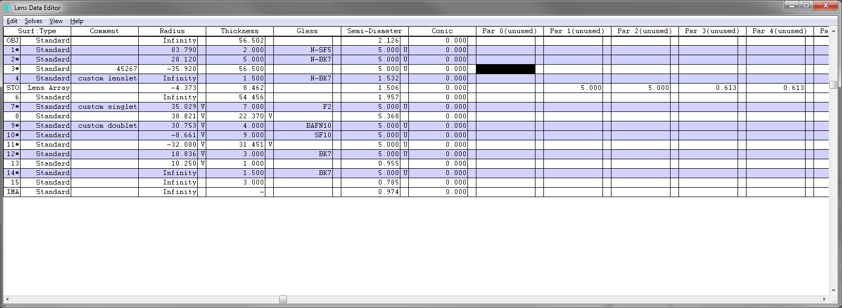
5x5 NGS WFS layout

Slide 19
5x5 NGS WFS post lenslet relay
Mag. = -0.560
Total relay length = 137 mm

Slide 20
Post lenslet relay – spots delivered by the relay
(Huygen’s) PSF Strehl = 95% at worst field point.

Slide 21
Post lenslet relay – grid distortion
700 nm is the central wavelength, GD at 500 nm is 0.015% and GD at 900 nm is 0.016%

