Slide 1
NIRTTS Cool Down #5
TEMPERATURE SENSOR LOCATIONS

Slide 2
Temperature Sensor Locations
LakeShore | Diode | Location
C1 | K05 | Optical Bench
C2 | K14 | Cold Head
C3 | K02 | Thermal Link #1 cold head side
C4 | K10 | Thermal Link #1 optical bench side
D1 | K04 | Cryo Cooler Interface
D2 | K09 | Lens Tube/Corset
D3 | K07 | Rear Radiation Shield
D4 | K12 | Thermal Link #2 optical bench side
Resistance | 19.8Ω | Mounted to the optical bench

Slide 3
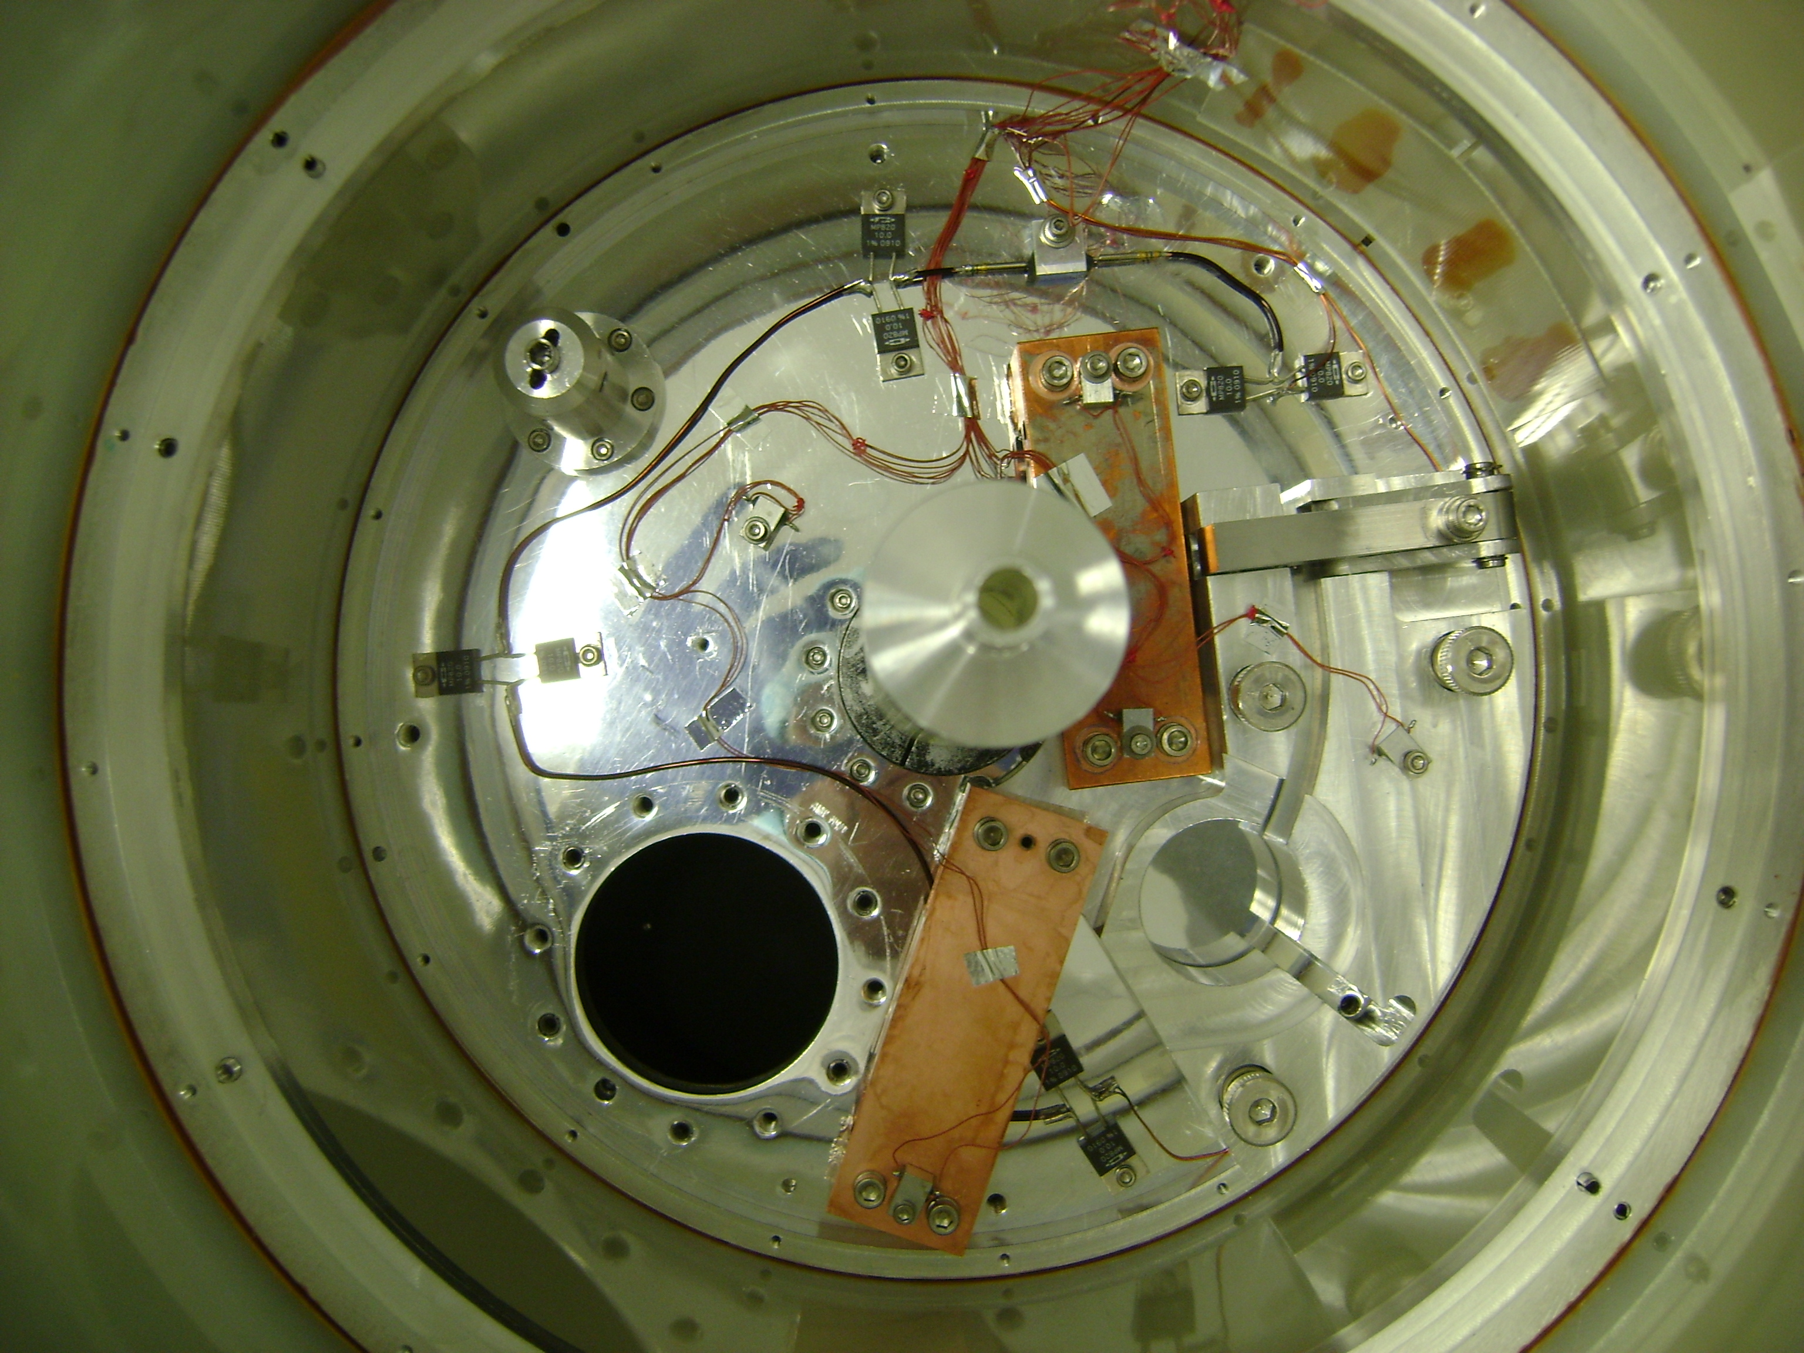
Temperature Sensor Layout
K05
K10
Thermal Link #1
K02
K4
Thermal Link #2
K12

Slide 4
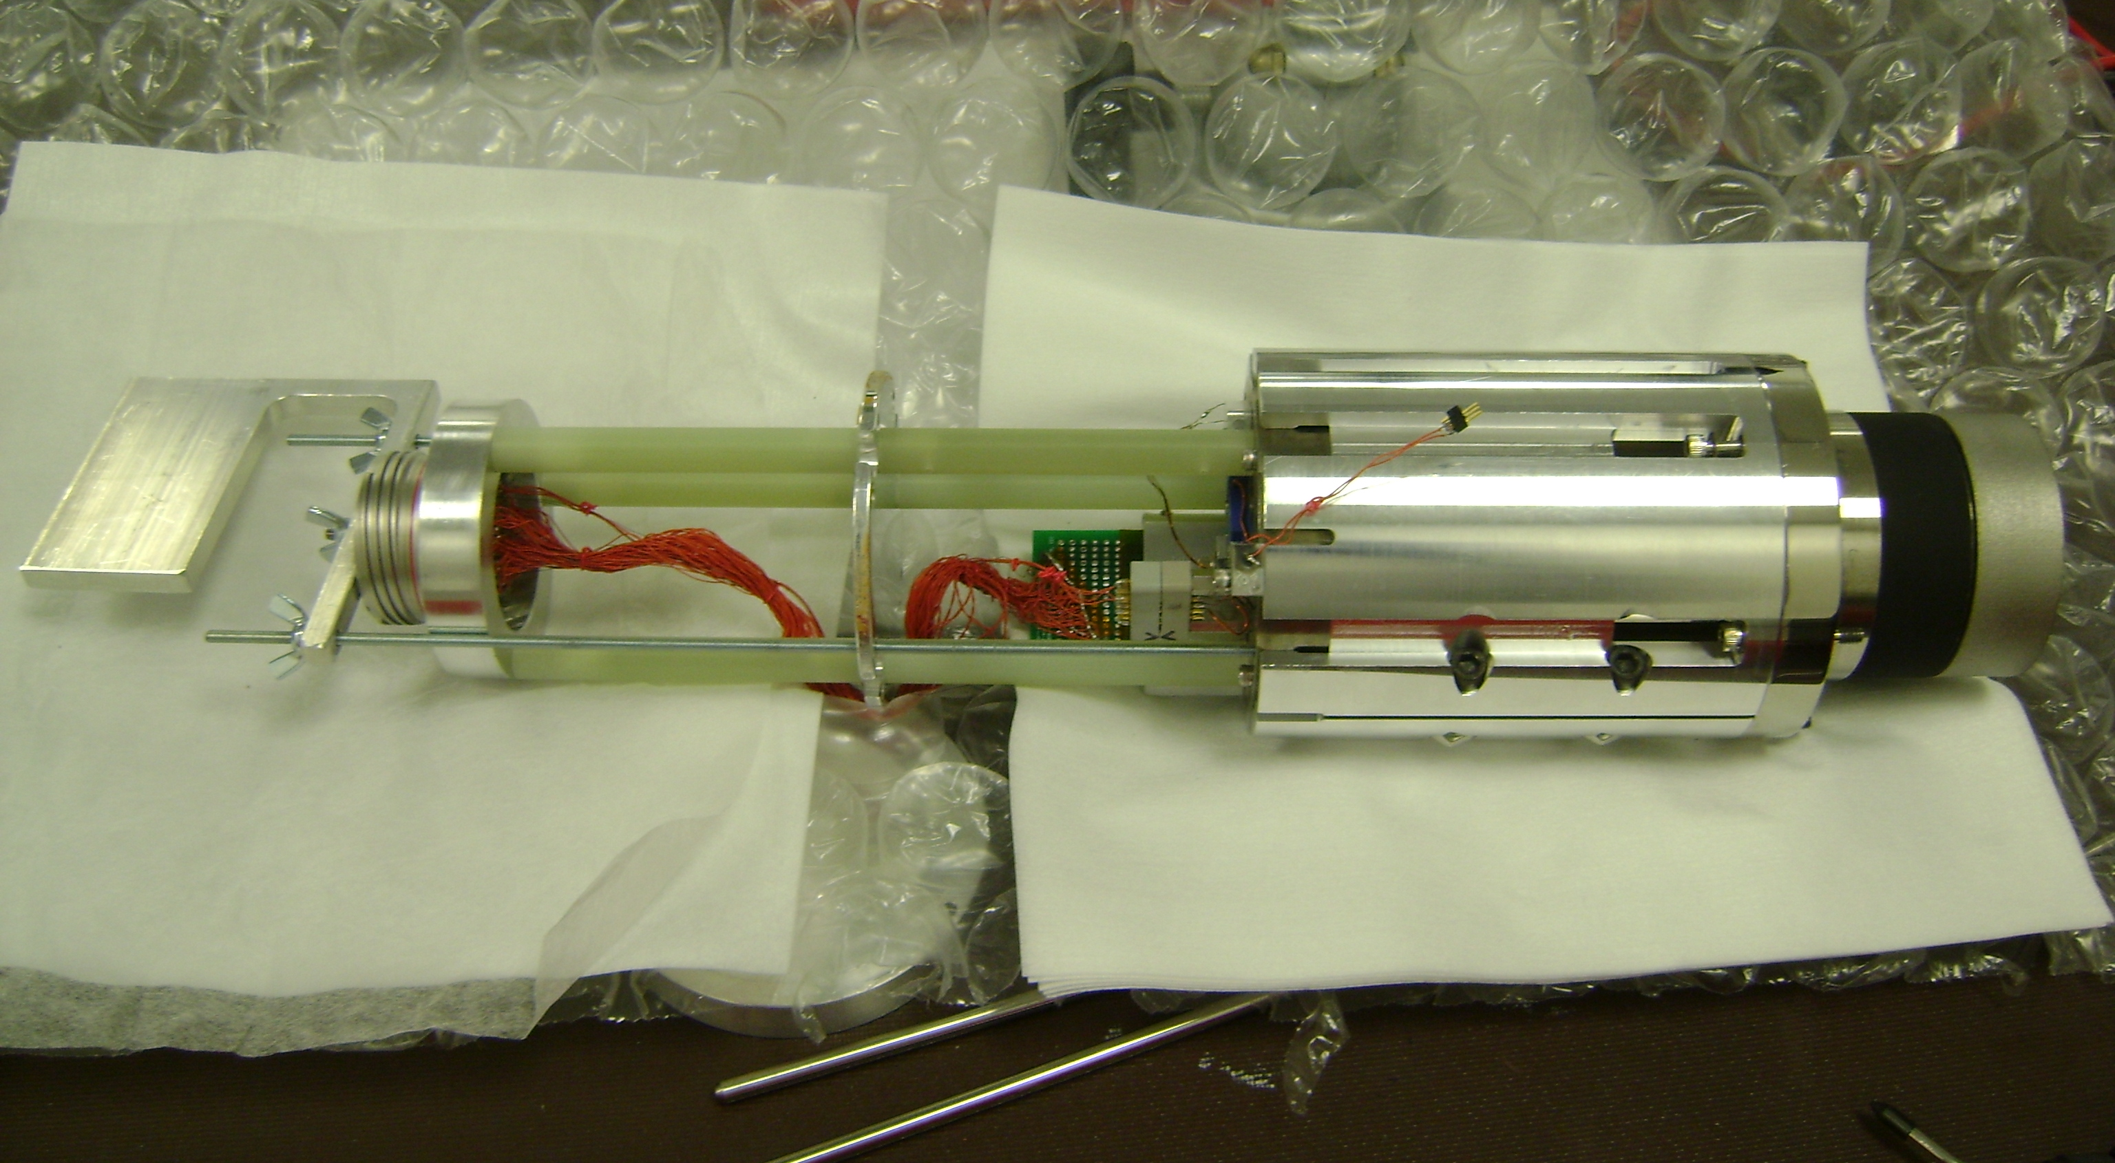
Temperature Sensor Layout
K09
CORSET

Slide 5
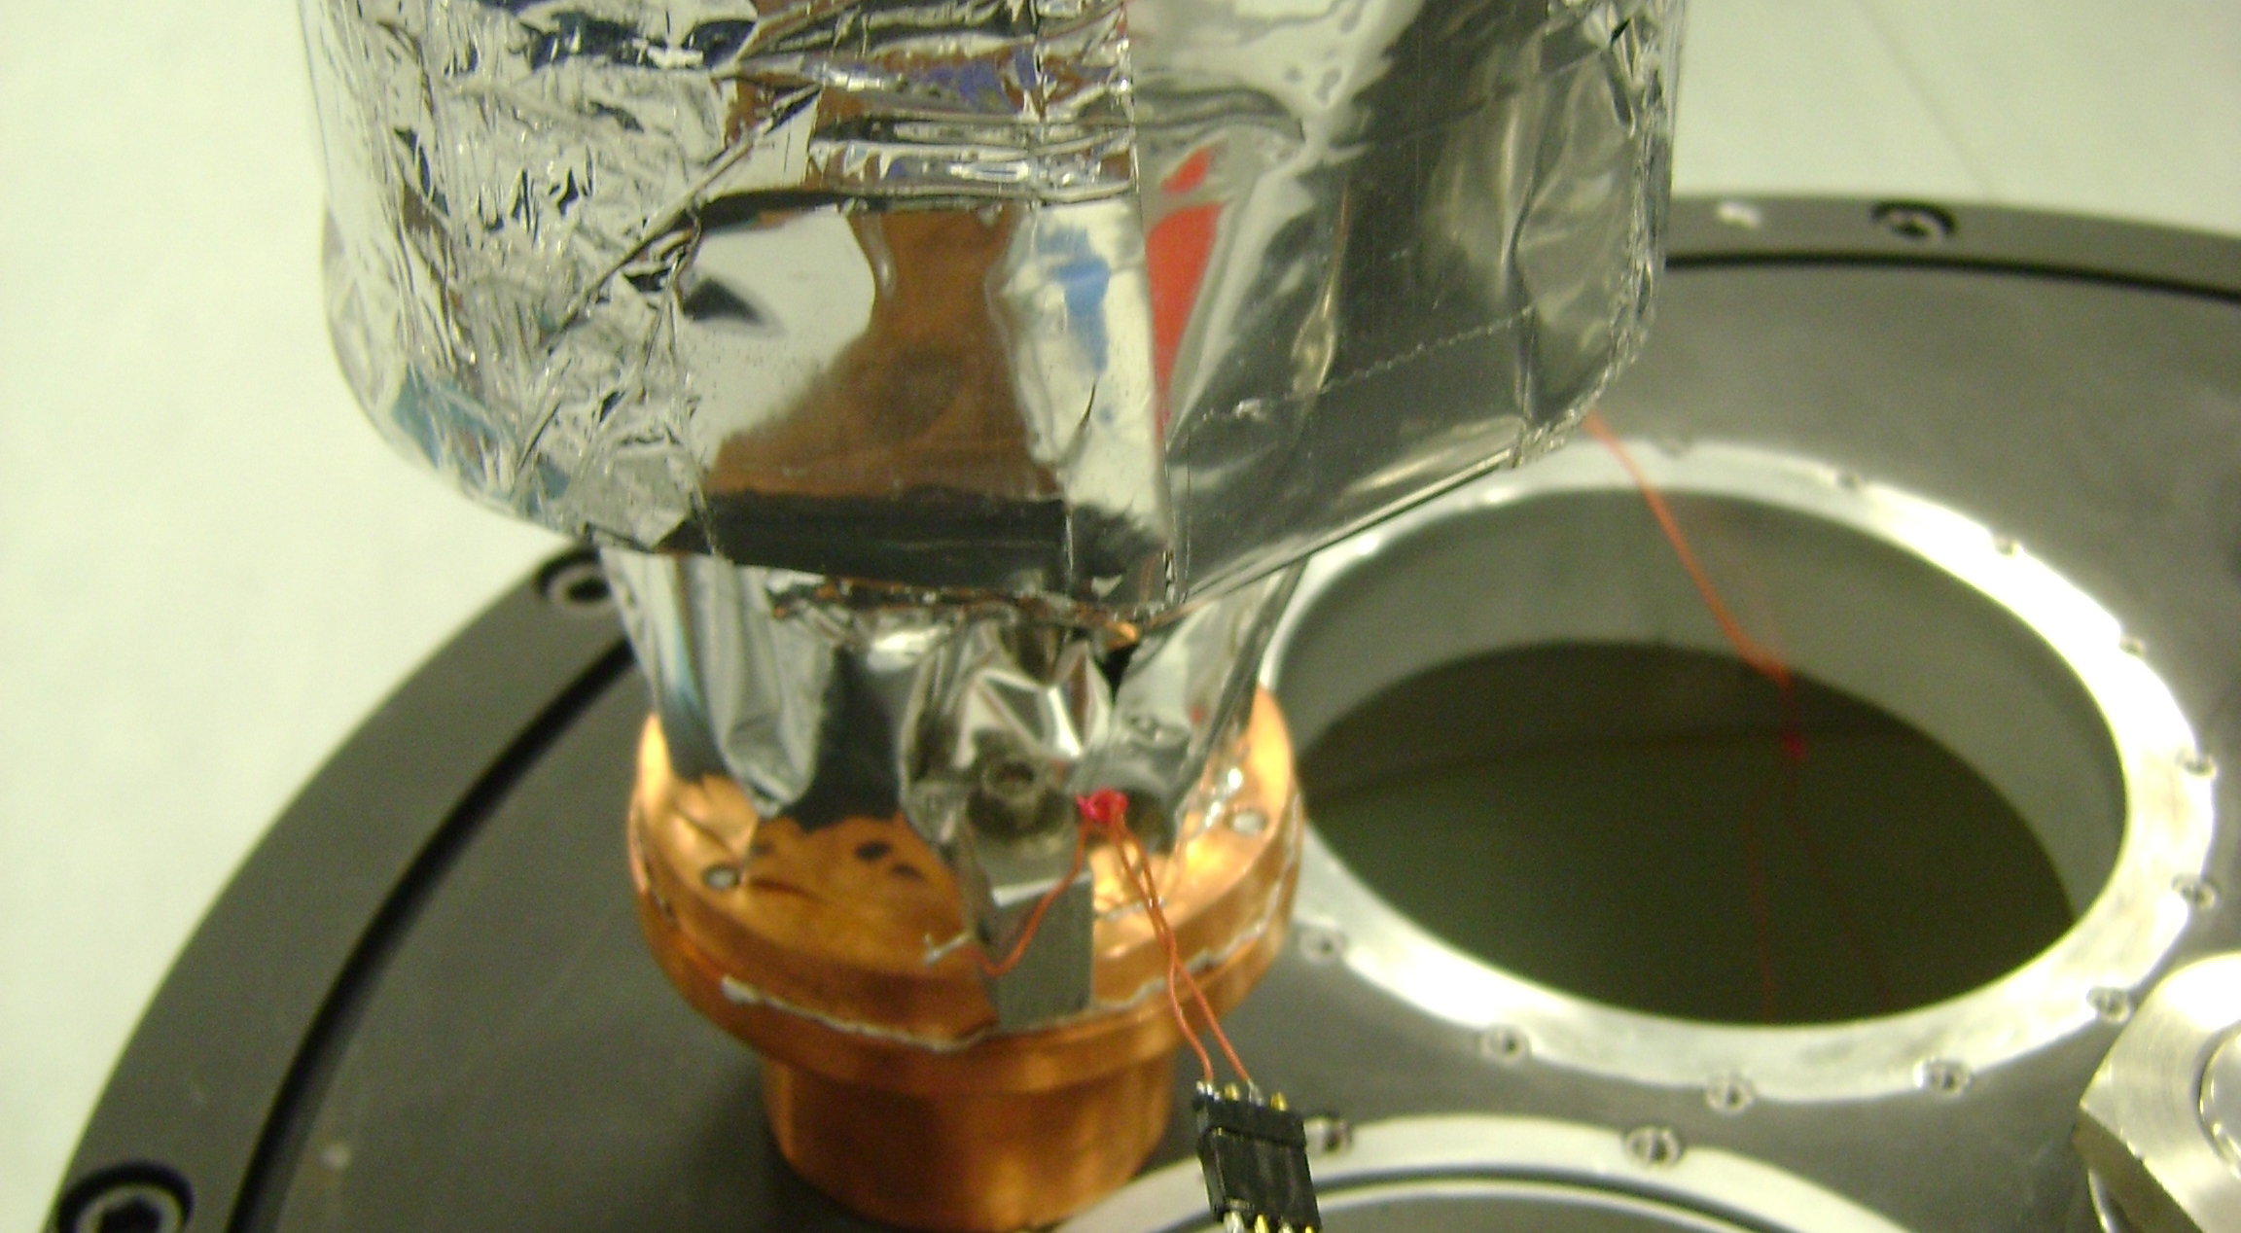
Temperature Sensor Layout
K14

Slide 6
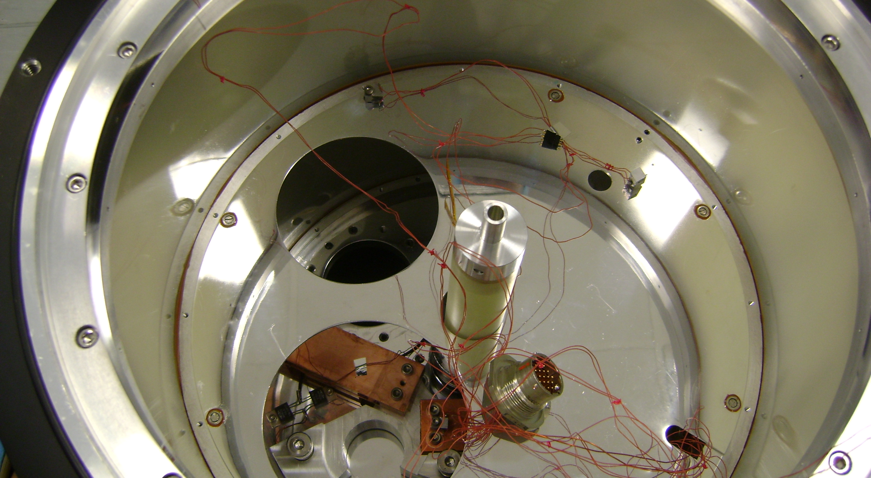
Temperature Sensor Layout
K07

