Slide 1
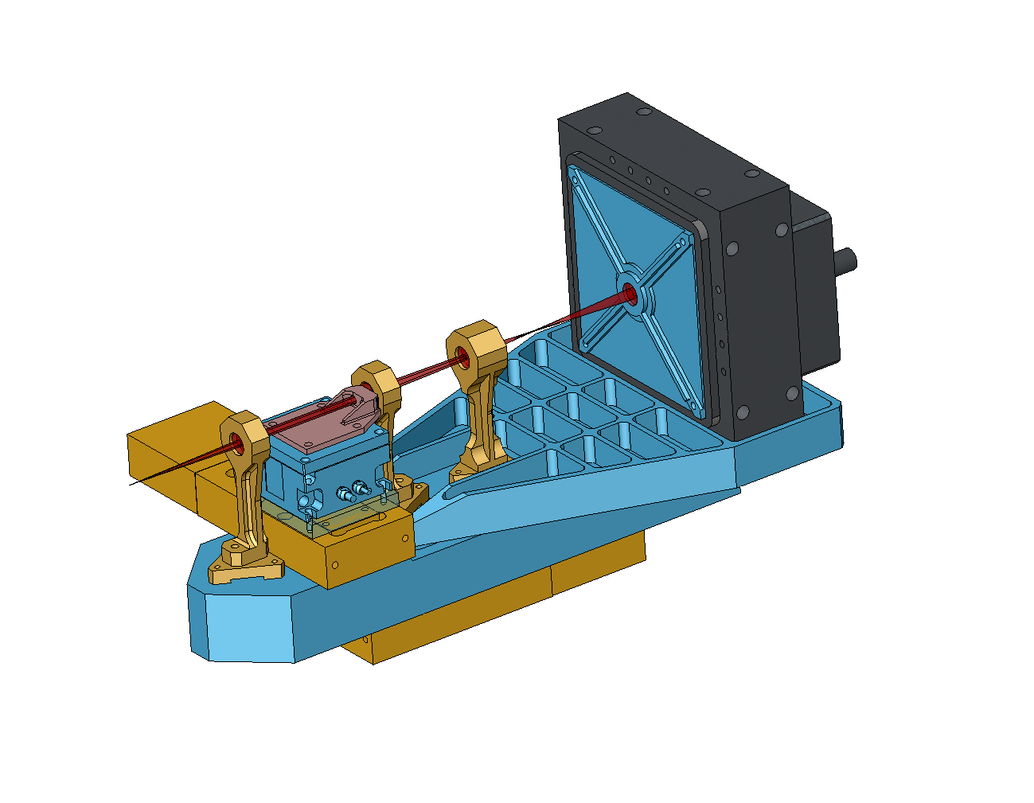
NGAO NGS WFS design review
Caltech Optical Observatories
1st April2010

Slide 2
Presentation outline
Requirements (including modes of operation and motion control)
Introduction
NGSWFS input feed (performance of the triplet and effect of atmospheric dispersion)
Modes of operation and pupil mapping
NGS WFS design (sensor design in all three modes, post-lenslet relay design and performance
Summary
Outstanding issues
Brief outline of CCID74 performance specs.

Slide 3
NGS WFS Requirements
Modes of operation (FR-130 and FR-3247)
  63 x 63 sub-apertures
  5 x 5 sub-apertures
  Pupil imaging mode
Transmission & Operating wavelengths (FR-203and FR-3444)
  500 to 900 nm with transmission of (500nm: 78%, 550nm: 80%, 633nm: 77%, 700nm: 74%, 880nm: 78%).
Patrol Field of Regard (FR-127)
  40 x 60 arcsec rectangle (limited by narrow field relay)
  NGS WFS Field Steering Mirror Ass’ly based pick-off design
WFS FoV
  4 arcseconds in 60 x 60 mode (FR-131)
Dynamic range (FR-141) = +/-1.77” @ 700 nm.
Static non-calibratable aberrations in the NGSWFS = 25 nm (FR-138)
NGS WFS operates with no ADC (B2C decision)

Slide 4
Motion control requirements
Field steering mirrors – need to be able to pick any star in a 60x40 arcsecond Field of Regard
Whole WFS motion – the WFS must work with and without the IF dichoric and with and without the IR ADC’s in the science path (the telescope is refocused when ADC is in or out as the science instruments don’t have a focus mechanism)
Lenslet XY motion & post-lenslet relay and camera focus – the WFS needs to operate in 63x63, 5x5 and pupil imaging modes.

Slide 5
NGAO optical relay – the packaging problem
Sci. Int. 1
NGS WFS
Sci. Int. 2
IF
LGS WFS

Slide 6
Context diagram of the NGS WFS
AO control
Config
Status
Optical
AO relay and Optical bench
NGS WFS
Mechanical
Data
The AO (supervisory) control can configure (FSM motion, lenslets, read-out mode etc.) and access status signals from the NGSWFS sub-system.
NGS WFS needs to interface mechanically and optically to the AO relay/ optical bench.
NGSWFS needs to send pixel data to the RTC.
Note that the RTC has no control path to the sensor (unlike the LGSWFS where there is a TT mirror control).
RTC

Slide 7
Input to the NGS sensor
Design characteristics:
NGS light is picked off in collimated space and focused using a (BASF2-N15-BASF2) triplet
F/# = 20.012
Plate scale = 1.063 mm/”

Slide 8
Input to the NGS sensor – spot diagram at the NGS sensor pick-off focal plane

Slide 9
OPD at the NGS sensor pick-off focal plane

Slide 10
Grid distortion at the NGS WFS input

Slide 11
Effect of atmospheric dispersion on high order NGS wavefront sensing
RMS dispersion (mas)
Zenith Angle (deg.)
Max. dispersion introduced by the atmosphere between 500-900 nm = 189 mas at 45 degree zenith angle – results spot blurring of 0.2” [as opposed to 10 mas (RMS) ‘nominal’ spot blurring with an ADC]. Atm. Dispersion goes up to 320mas at 60 deg. Zenith angle.

Slide 12
Static aberrations within the NGS WFS
Geometric spot size at the relay (RMS) = Error budget alloc. (asec, FWHM)/2.355 (FWHM/RMS) * 21 (um/pixel)/(1asec/pixel)
    We know from the relay design that the spot size is 3 um (RMS), hence error budget allocation must be 0.33 asec instead of 0.25 asec. This leads to a 6% change in apparent spot size at the detector.
    Since we will use the NGS WFS with bright stars (Mv>=8), atmospheric fitting error and not measurement error is the dominating error term in the error budget (Fitting error/Measurement error ~2)
We do have a alternate relay design with a extra (field flattening) optic that delivers performance within specs. - it is not clear if this is useful given the sensitivity analysis.
Seeing |  |  |  |  | Seeing
Natural seeing FWHM at GS wavelength | 0.43 | arcsec |  |  | Natural seeing FWHM at GS wavelength | 0.43 | arcsec
Subaperture Tip/Tilt corrected FWHM | 0.20 | arcsec |  |  | Subaperture Tip/Tilt corrected FWHM | 0.20 | arcsec
AO-compensated FWHM | 0.06 | arcsec |  |  | AO-compensated FWHM | 0.06 | arcsec
Contribution due to seeing | 0.20 | arcsec |  |  | Contribution due to seeing | 0.20 | arcsec
System Aberrations |  |  |  |  | System Aberrations
Aberrations in AO thru to WFS | 0.25 | arcsec |  |  | Aberrations in AO thru to WFS | 0.40 | arcsec
Atmospheric Dispersion |  |  |  |  | Atmospheric Dispersion
ADC in HOWFS? (NO) |  |  |  |  | ADC in HOWFS? (NO)
RMS blurring due to atmospheric dispersion | 0.109 | arcsec |  |  | RMS blurring due to atmospheric dispersion | 0.109 | arcsec
Total size of detected return beam: | 0.34 | arcsec |  |  | Total size of detected return beam: | 0.34 | arcsec
Charge Diffusion |  |  |  |  | Charge Diffusion
Charge Diffusion | 0.25 | pixels |  |  | Charge Diffusion | 0.25 | pixels
Contribution due to Charge Diffusion | 0.40 | arcsec |  |  | Contribution due to Charge Diffusion | 0.40 | arcsec
Subaperture Diffraction |  |  |  |  | Subaperture Diffraction
Lambda/d (for sensing) | 0.83 | arcsec |  |  | Lambda/d (for sensing) | 0.83 | arcsec
Spot size used for centroiding | 0.99 | arcsec |  |  | Spot size used for centroiding | 1.05 | arcsec

Slide 13
What’s the implication for the NGS WFS?
Wavefront error on input beam is 1.15 waves RMS (6 waves P-V) @ 600 nm at the extreme (and worst case) field points. This is mostly astigmatism.
KAON 692 Figures 9 and 10 along with corresponding analysis also indicate that for a large # of sub-apertures (60 in our case) the sub-ap spot size due to input aberration is going to be of the order of 2 um (RMS).

Slide 14
Analysis result
Impact of input aberrations
  Negligible impact on sub-aperture spot size.
  Acceptable centroid offsets (~0.1 pixel worst case)
  Small amount of distortion (0.13%) will be calibrated using stimulus and acquisition camera.
  Chromatic aberrations acceptable
The dynamic range of the sensor is +/- 2 asec (within spec.)
Atmospheric dispersion introduces 0.19 asec of spot blurring.
  The WFS relay is slightly out of spec., but sensitivity analysis reveal that this is not the bottleneck for performance with bright guide stars (request for change of specs).

Slide 15
NGS WFS parameters
Following Keck Drawing Drawing #1410-CM0010 Rev. 1, we have 59 (+1/2+1/2)*WFS sub-apertures across the a circle with the Keck pupil inscribed within it. We also support another calibration mode with 5x5 pupil samples across the Keck primary mirror.
The WFS FoV is 4” because the sensor needs to track extended objects that are 4” in diameter. One could also work out the spot size. This give us a p-value (ratio of pixel size to spot size) = 1
Seeing
Natural seeing FWHM at GS wavelength | 0.43 | arcsec
Subaperture Tip/Tilt corrected FWHM | 0.20 | arcsec
AO-compensated FWHM | 0.06 | arcsec
Contribution due to seeing | 0.20 | arcsec
System Aberrations
Aberrations in AO thru to WFS | 0.40 | arcsec
Atmospheric Dispersion
ADC in HOWFS? (NO)
RMS blurring due to atmospheric dispersion | 0.109 | arcsec
Total size of detected return beam: | 0.34 | arcsec
Charge Diffusion
Charge Diffusion | 0.25 | pixels
Contribution due to Charge Diffusion | 0.40 | arcsec
Subaperture Diffraction
Lambda/d (for sensing) | 0.83 | arcsec
Spot size used for centroiding | 1.05 | arcsec
For sanity check, we also calculate the apparent spot size at the detector.
  *The spacing indicates 60 sub-apertures, but Fried geometry supports only 59.

Slide 16
Modes of operation
63x63 sub-ap. mode of operation
  We use 4 physical pixels per sub-ap. Which can be binned on chip and read as 2x2 pixels/sub-aperture with almost zero read noise penalty. This gives us the flexibility of 2 modes, one with high linearity and another with lower read noise.
  Only 59x59 sub-apertures are lit by NGS star light at any time. The pupil imaged by the WFS nutates around the 63x63 sub-apertures.
5x5 mode of operation
  to simply the size of moving parts while facilitating the two pupil sampling modes, we use the same collimator and post-lenslet relay for both the 63 and 5 sub-ap mode of operation.
  We choose 48 pixels/sub-aperture (instead of 50 pixels/sub-ap) to enable 4x4 binned pixel/sub-aperture operation with standard centroiding algorithms.
  A small fraction of light will be lost from the outer-most sub-apertures due to pupil nutation.
Pupil imaging mode – The NGS WFS can image the pupil using the WFS camera.

Slide 17
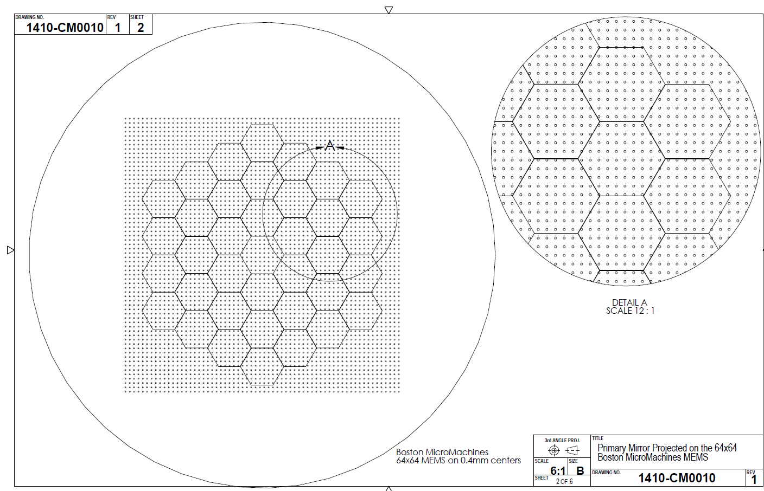
Keck primary projected on the 64x64 actuator BMM HODM
Envelope over which the pupil wobbles (nutates)

Slide 18
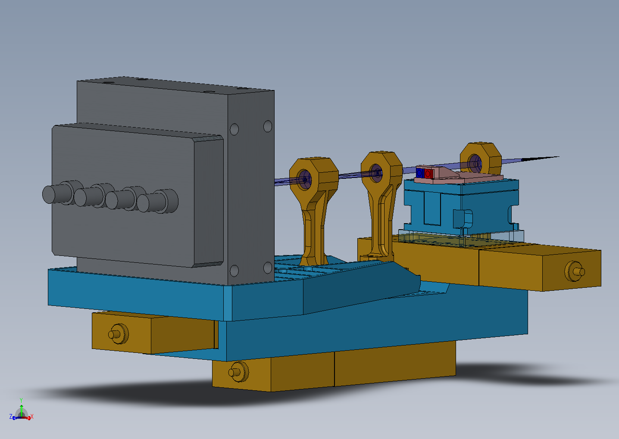
Motion control
Lenslet 1
Lenslet 2
Lenslet X & Y motion
Post-lenslet relay and camera focus
Whole WFS translation

Slide 19
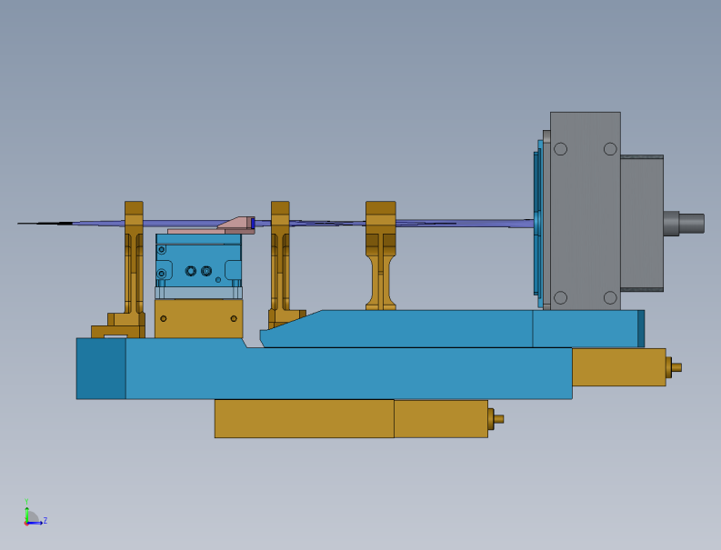
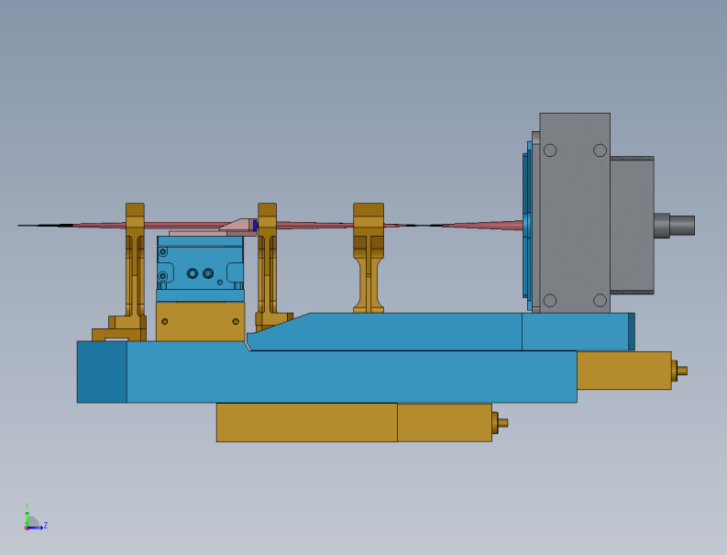

Modes of operation cont’d
Modes(Clockwise from top): 5x5, 63x63 and pupil imaging modes

Slide 20
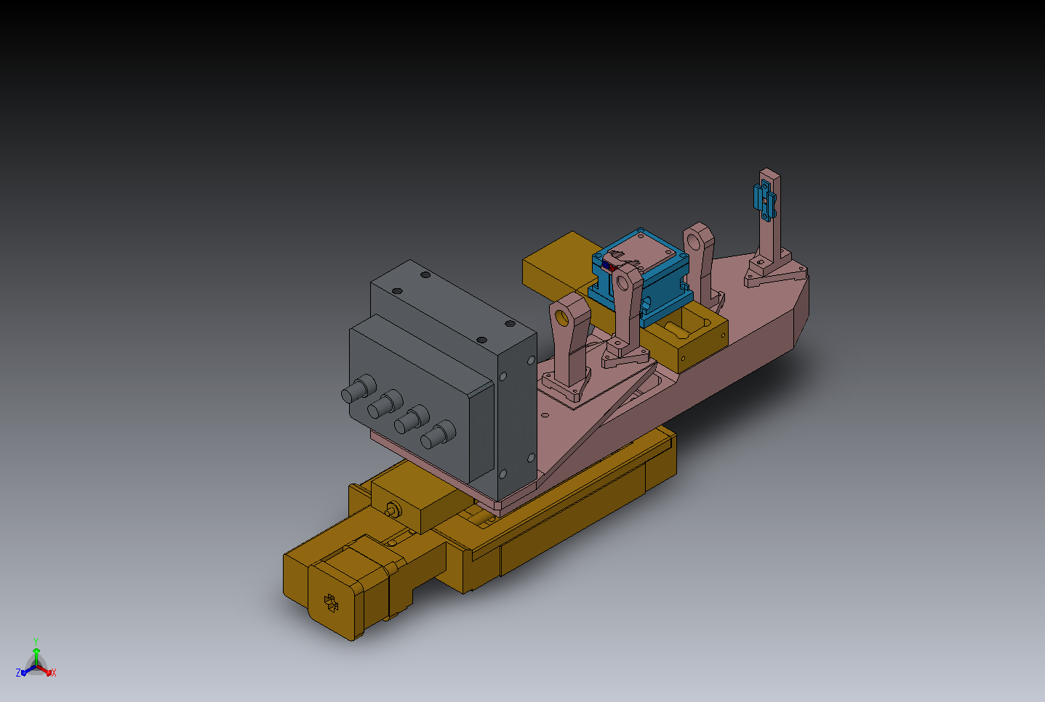


Modes of operation cont’d

Slide 21
Pupil mapping between NGSWFS-DM and primary mirror
As per Drawing #1410-CM0010 Rev. 1, :
The whole DM would be mapped by using a pupil that is 25.2 mm/24 mm * 10.949 = 11.49645 m and has the same focal length (149.583 m). This corresponds to an F/# = 13.01123.
Plate scale = 13.01123*11.49645/(180/pi*3600) = 725.1979 um/” at the telescope focal plane
The apparent plate scale at the NGS pick off focal plane is 19.06163 (instead of 20.012). The plate scale is 1.0623 mm/”.

Slide 22
WFS design parameters
Parameter | 60x60 mode | 5x5 mode | units
f_collimator | 60 | 60 | mm
Input plate scale | 1.0623 | 1.0623 | mm/"
Binned pixel size (# of pixels) | 1 | 12 | pixels
Detector plate scale (mm/") | 0.0210 | 0.2520 | mm/"
Plate scale ratio (IPS/DPS) | 50.58 | 4.22
input f/# | 19.06 | 19.06
pupil sampling | 63 | 5 | sub-aps across pupil
d_lenslet | 0.05 | 0.60 | mm
de-magnification (m) | 1.68 | 1.68
f_lenslet | 0.71 | 8.47 | mm
f# lenslet | 14.12 | 14.12
wavelength (for worst case FN calc.) | 0.90 | 0.90 | um
fresnel # | 0.98 | 11.80
radius of curvature of lenslet | 0.36 | 4.38 | mm

Slide 23
63x63 NGS WFS layout
Total relay length = 262 mm
Components from (left to right) –collimating doublet, lenslet array, field singlet, focusing doublet followed by the window and the detector.
Wavelength of operation – 500-900 nm (TBC)

Slide 24
63x63 sub-aperture NGS WFS spots
WFS spots on a 21um pixel detector with 4x4 pixels/sub-aperture as obtained from Zemax. There are 63 active spots while only 59 ‘lit’ spots will be actually seen by the WFS at any time.

Slide 25
63x63 NGS WFS layout

Slide 26
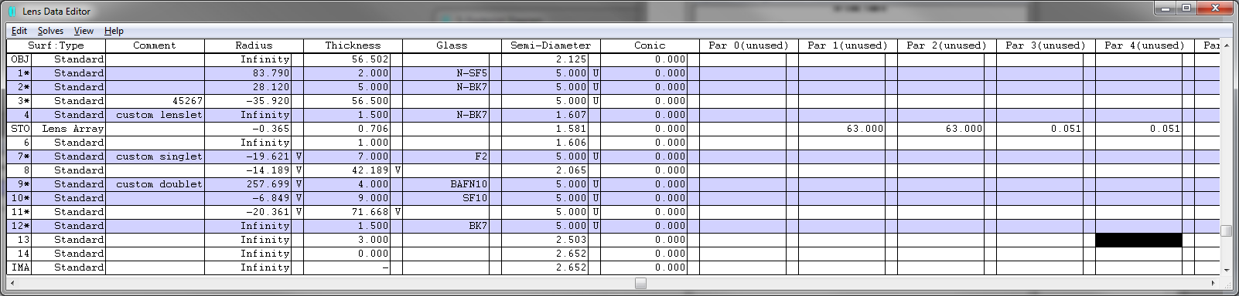
63x63 NGS WFS layout

Slide 27
63x63 NGS WFS post lenslet relay
Mag. = 1.681
Total relay length = 139 mm

Slide 28
Post lenslet relay – spots delivered by the relay
(Huygen’s) PSF Strehl = 97% at worst field point.
3 um RMS spot size corresponds to 0.33asec (FWHM) static error in the sensor @ 1asec/pixel plate scale

Slide 29
Post lenslet relay – grid distortion
The worst case sub-aperture spot motion due to distortion will be less than 0.1 of a pixel.

Slide 30
Pupil (HODM to Lenslet) mapping layout
Lenslet plane
HODM/ tweeter
Triplet
Field stop (STOP)
Collimator

Slide 31
Grid distortion in pupil mapping
Extreme actuator-lenslet mapping is off by 2%

Slide 32
Chromatic effects in pupil mapping
Lenslet pitch is 50 um (same as scale)

Slide 33
Results of pupil mapping analysis
Distortion in mapping of actuators to lenslets is >2% at the extreme sub-apertures.
Point actuators are mapped onto >4 um RMS dia. Blobs [compare to influence function of an actuator].
Chromatic effects make this blob as big as 12um (RMS) [compare to influence function of an actuator].
Need to model chromatic effects all the way from the field points on the primary mirror with entrance window, LGS dichroic, w/ and w/o IF dichroic in the optical relay to the WFS lenslet and compare with the actuator influence function.

Slide 34
5x5 NGS (calibration) WFS layout
Total relay length = 269 mm
Components from (left to right) –collimating doublet, lenslet array, field singlet, focusing doublet followed by the window and the detector.
Wavelength of operation – 500-900 nm

Slide 35
5x5 NGS WFS spot diagram
5040 um detector with 5 spots across the pupil with 4x4 (binned) pixels/sub-aperture [48x48 physical pixels/sub-aperture]

Slide 36
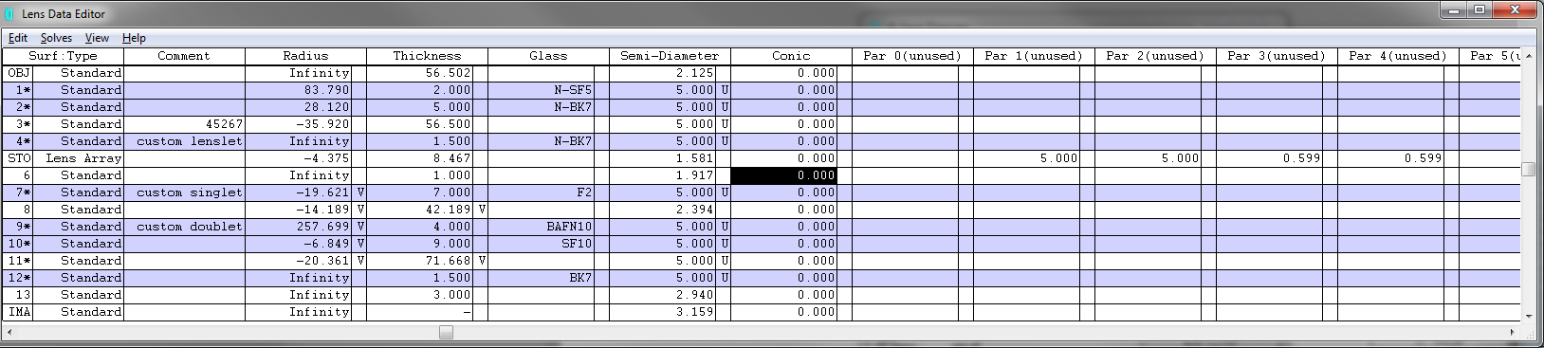
5x5 NGS WFS layout
Reminder: The 5x5 and the 63x63 modes use the same post-lenslet relay

Slide 37
NGS WFS behind the NGAO optical relay

Slide 38
NGS WFS spots showing 59 ‘lit’ sub-apertures
Wobble envelope

Slide 39
Post lenslet relay – magnified view
Magnified view of the WFS focal plane. 168 um correspond to 8 pixels.

Slide 40
NGS WFS operating in pupil imaging mode
Total relay length = 260 mm
Components from (left to right) –collimating doublet, field singlet, focusing doublet followed by the window and the detector.
Wavelength of operation – 500-900 nm
This mode is for alignment only and doesn’t have any special requirement.

Slide 41
NGS WFS operating in pupil imaging mode

Slide 42
NGS WFS operating in pupil imaging mode

Slide 43
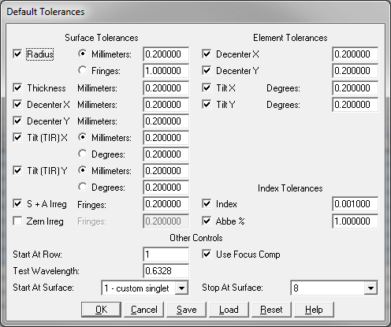
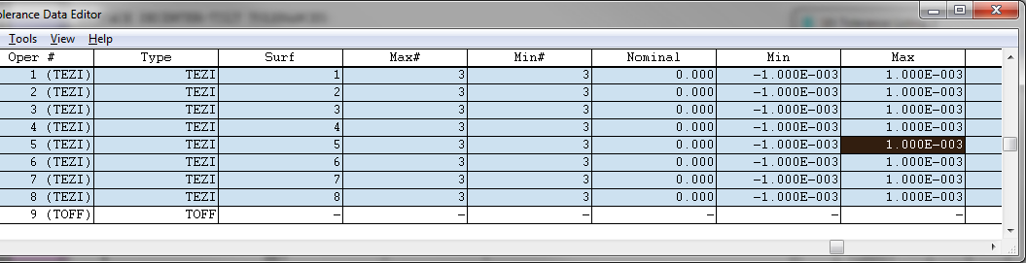
Preliminary tolerance analysis(using built in tolerancing in Zemax)
Since most of Zemax’s tools don’t work with a lenslet in the optical relay the simplest means to tolerance the WFS is to do it in 2 pieces, viz. post-lenslet relay and the collimator-to-lenslet part.

Slide 44
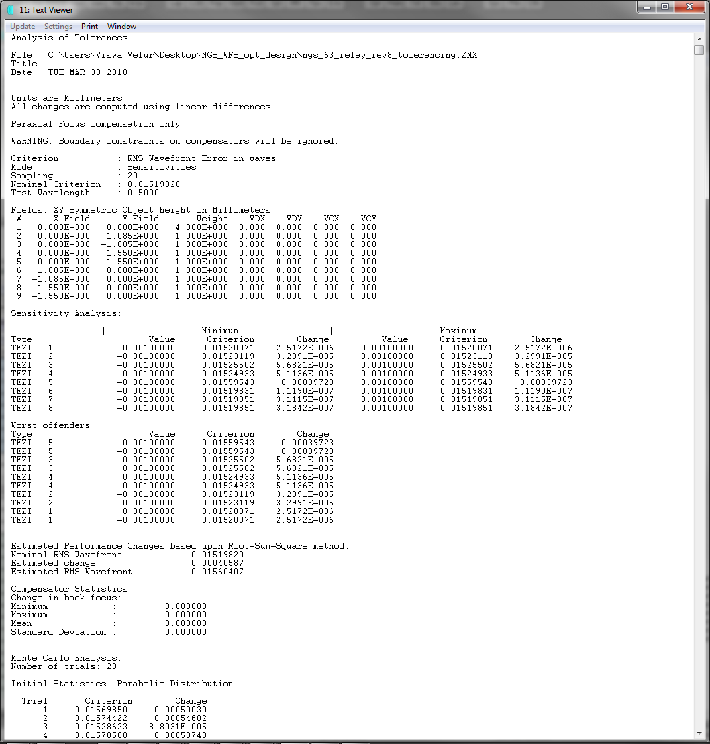
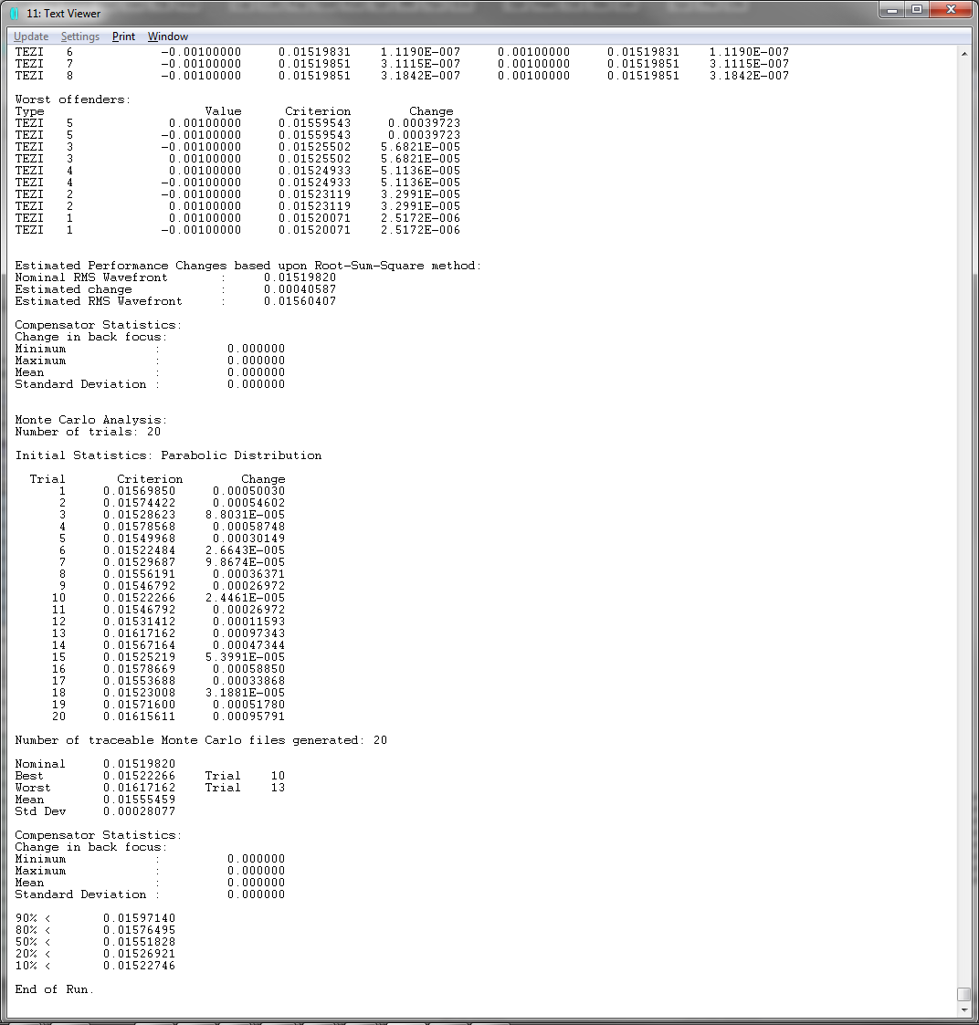
Preliminary tolerance analysis(using built in tolerancing in Zemax)
Nothing remarkable here!

Slide 45
Summary of work done by WFS team
Contributed to systems engineering and requirements ratification process
Designed a NGS feed using a refractive triplet to solve NGAO’s packaging problem while delivering a f/20 beam to the NGS sensor and analyzed its performance
Designed a compact WFS that works in 63x63, 5x5 and pupil imaging modes.
Quantified the effects of color and distortion in mapping the HODM pupil to the lenslet.
Did very preliminary tolerancing for the WFS.
Made a list of outstanding issues and analysis for the DD phase.
Built a compliance matrix and risk register.

Slide 46
Other issues
Thermal issues
  -15C operation (does this matter?)
Stray light
  Baffles / filters (unnecessary?)
  Ghosts (usually not an issue of NGS WFS, but for PDR mention for completeness)

Slide 47
Detector choice and performance
NGAO envisages the use of 256x256 pixel CCID74 detector with 21 um pixels that is under development at Lincoln Labs for wavefront sensing.

Slide 48
Predicted Quantum efficiency*
(based on 75 micron substrate, Bodacious Black AR coating^ on Pan-STARRS CCID-58)
^ - LL plans to use a different AR coating that will result in ~90% QE at 589 nm
*-Source - S. Adkins, Pvt. Comm.

Slide 49
Read noise [predicted and measured]

