Slide 1
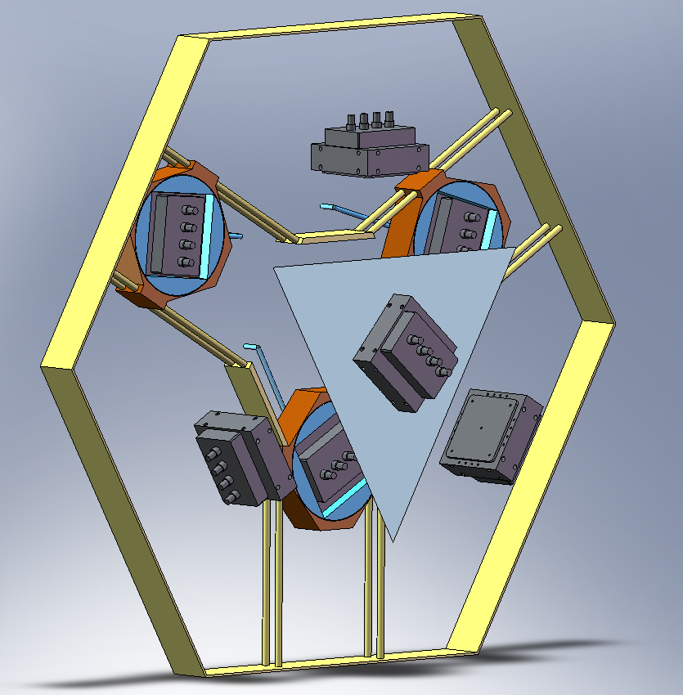
General concept: 6 DoF
3 Camera Rotation axis
Fixed frame
Mirror
3 Camera Translation
4 Fixed Cameras
NGAO OPTION 1

Slide 2
Search area
Pick off arms search area
Pick off arms effective 150” search area
Tetrahedron mirror 30” search area
NGAO OPTION 1

Slide 3
Optical Axis
NGAO OPTION 1

