Slide 1
Inductance in an Electro-Permanent Magnet as a proxy for Holding Force
“…magnets, how do they work?...”
J. Belicki
Contributions by R. Smith
2017-07-12

Slide 2
Zwicky Transient Facility’s (ZTF) Need
Instrument in beam path, so beam obstruction must be kept to a minimum
Limited space within/around instrument→ Limited number of power and signal wires
Required: Low profile mechanism to retain filters for ZTF, high reliability, ability to detect distance/engagement of filter
Solution?

Slide 3
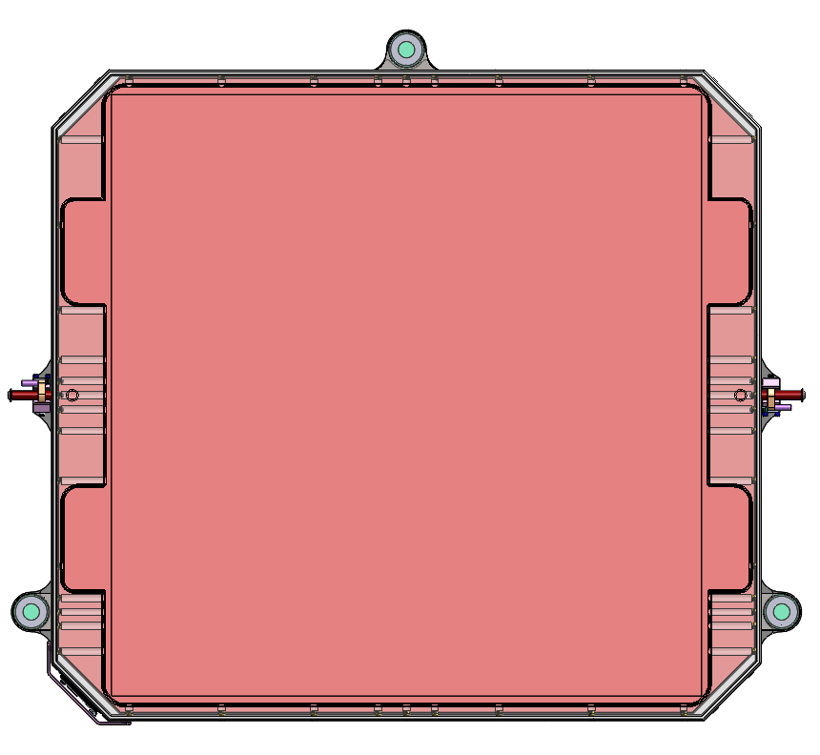
Electro-Permanent Magnets!
25mm
498mm
457mm
Three magnets obstruct < 0.2% of beam

Slide 4
What is an Electro-Permanent Magnet (EPM)?
An EPM is a permanently magnetized metal that has a coil of wire around its core
When power is supplied (24V for our magnets), a current flows through the coils and creates a magnetic field of equal (but opposite) magnitude, canceling out the magnetic field
Two wires used to supply power to EPM
Same two wires can be used to measure plate distance and engagement!

Slide 5
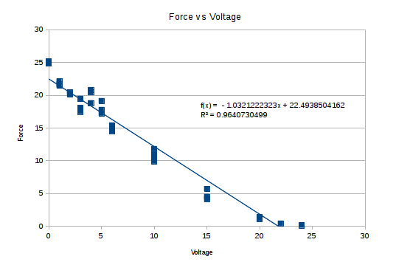
Force vs Current
V = I/R
Resistance is constant → Direct relationship between voltage and current at low frequencies
Data from J. Zimmer

Slide 6
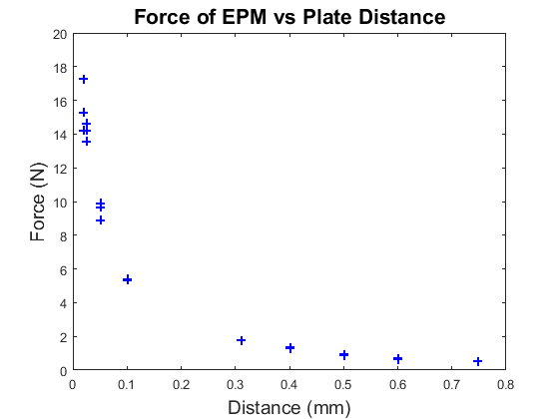
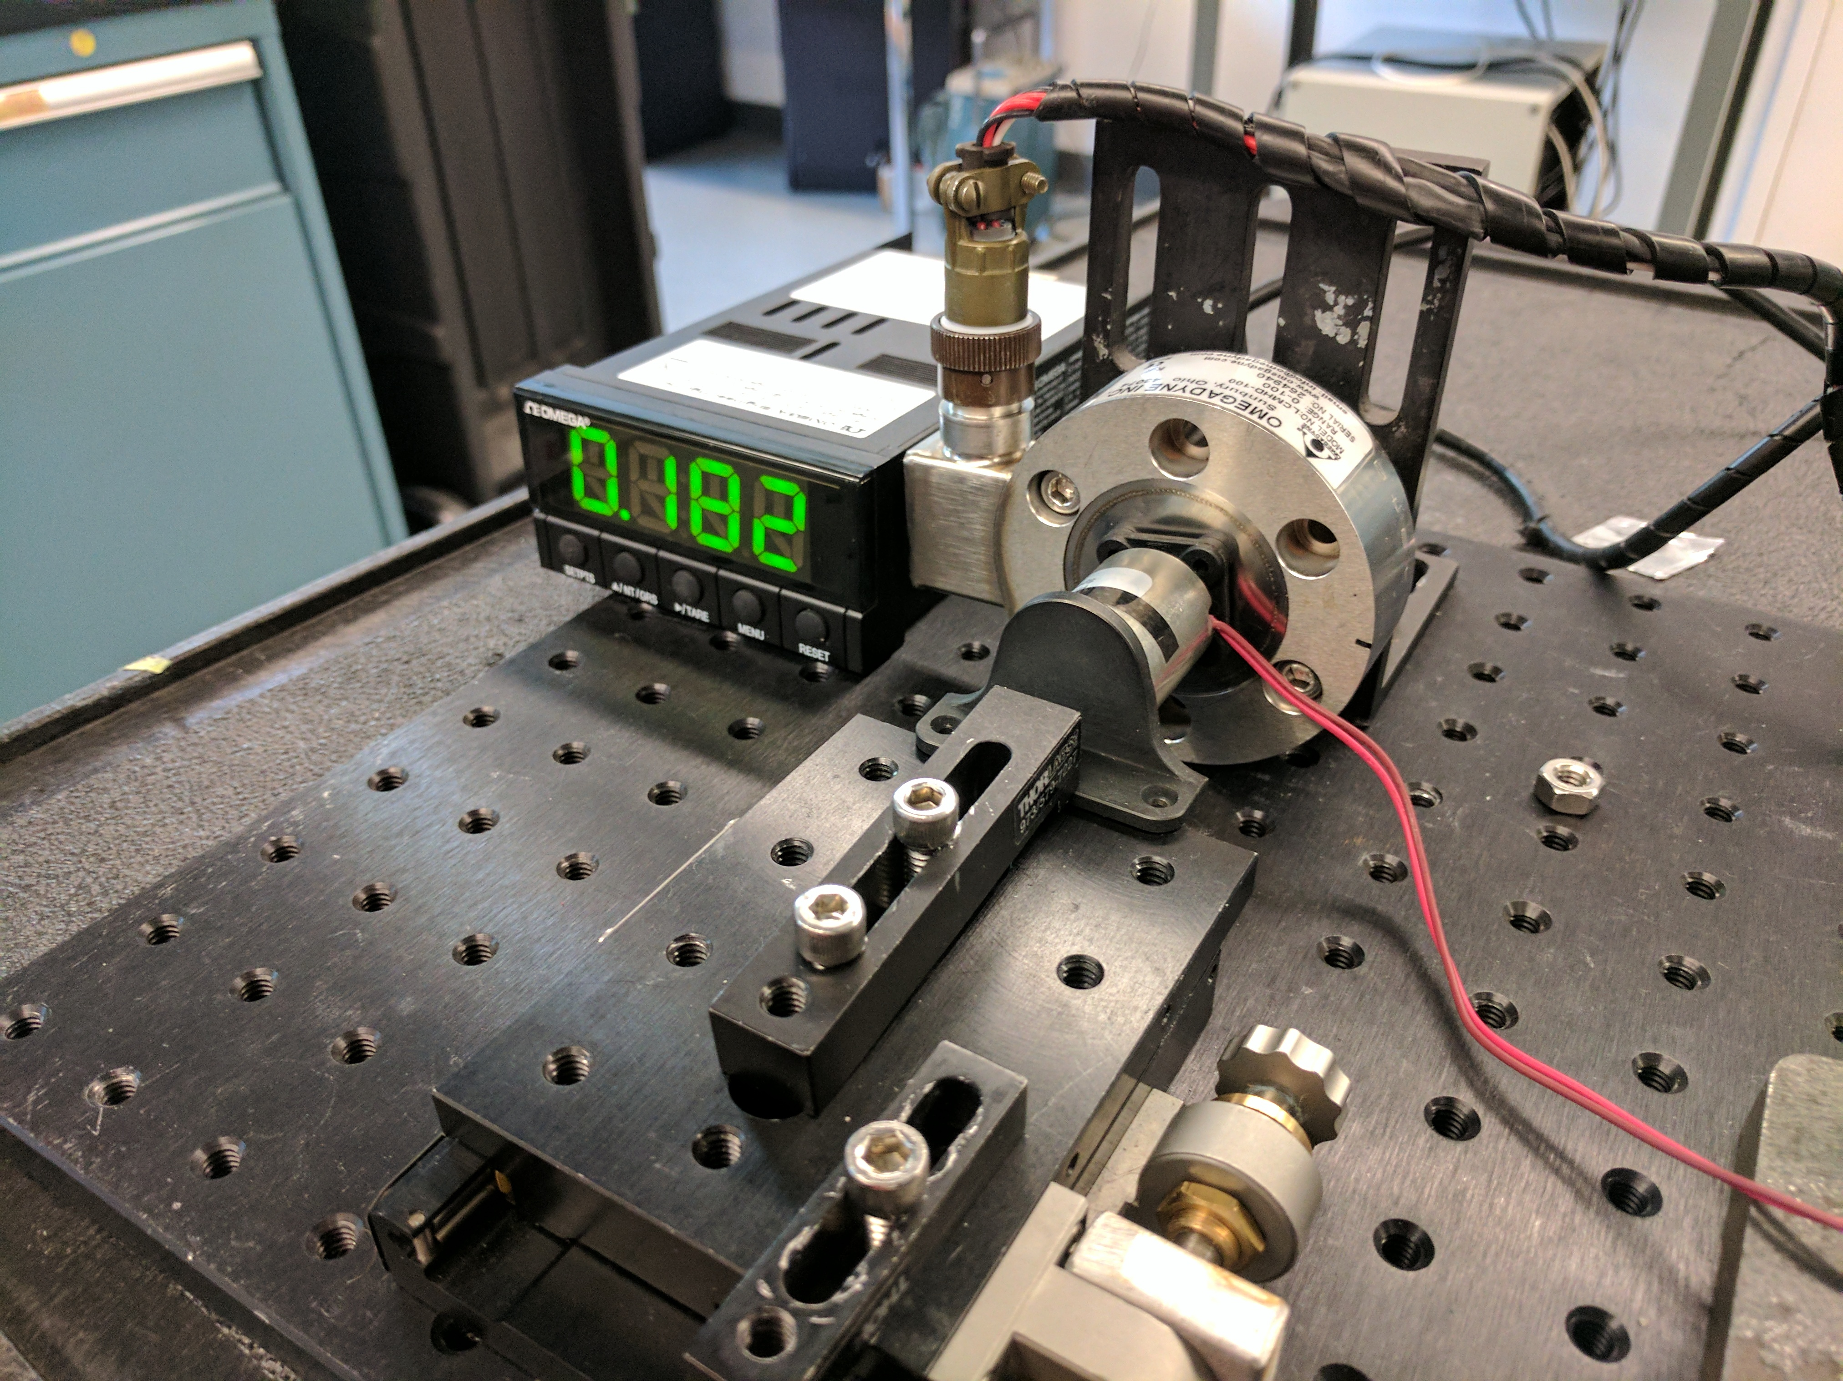
Force vs Distance
Force rolls off steeply with air-gap
→ pickup of metal particles could compromise holding force.
→ sensing of that air- gap is essential for reliability

Slide 7
B-H curves for electromagnet
Soft iron core with low hysteresis
B (tesla)
Mild steel target plate works approximately like this
Low residual magnetization with zero applied current
H (ampere turns)
Low L

Slide 8
Permanent magnets = high hysteresis
B (tesla)
2) Stays magnetized when current removed (dipoles stay aligned)
1) Magnetize by applying high current to coil to flip all dipoles to same orientation
H (ampere turns)
B field saturates at lower value than for soft iron → permanent magnet is not as strong at electromagnet

Slide 9
Inductance Sensing Circuit
24 V pulse
On to de-energize EPM,
Off when sensing.

Slide 10
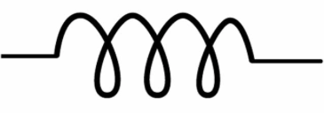
L-R Circuit rise time
V_{L}=L*di/dt
V_{i}
Initially i=0, V₀=0, so
V_{L} = A = L*di/dt
di/dt = A/L
dV₀/dt = A*R/L
A
V₀ =iR
V_{i} = V_{L} + V₀ = L*di/dt + iR
V₀ = A * [1 – exp(-R*t/L) ]

Slide 11
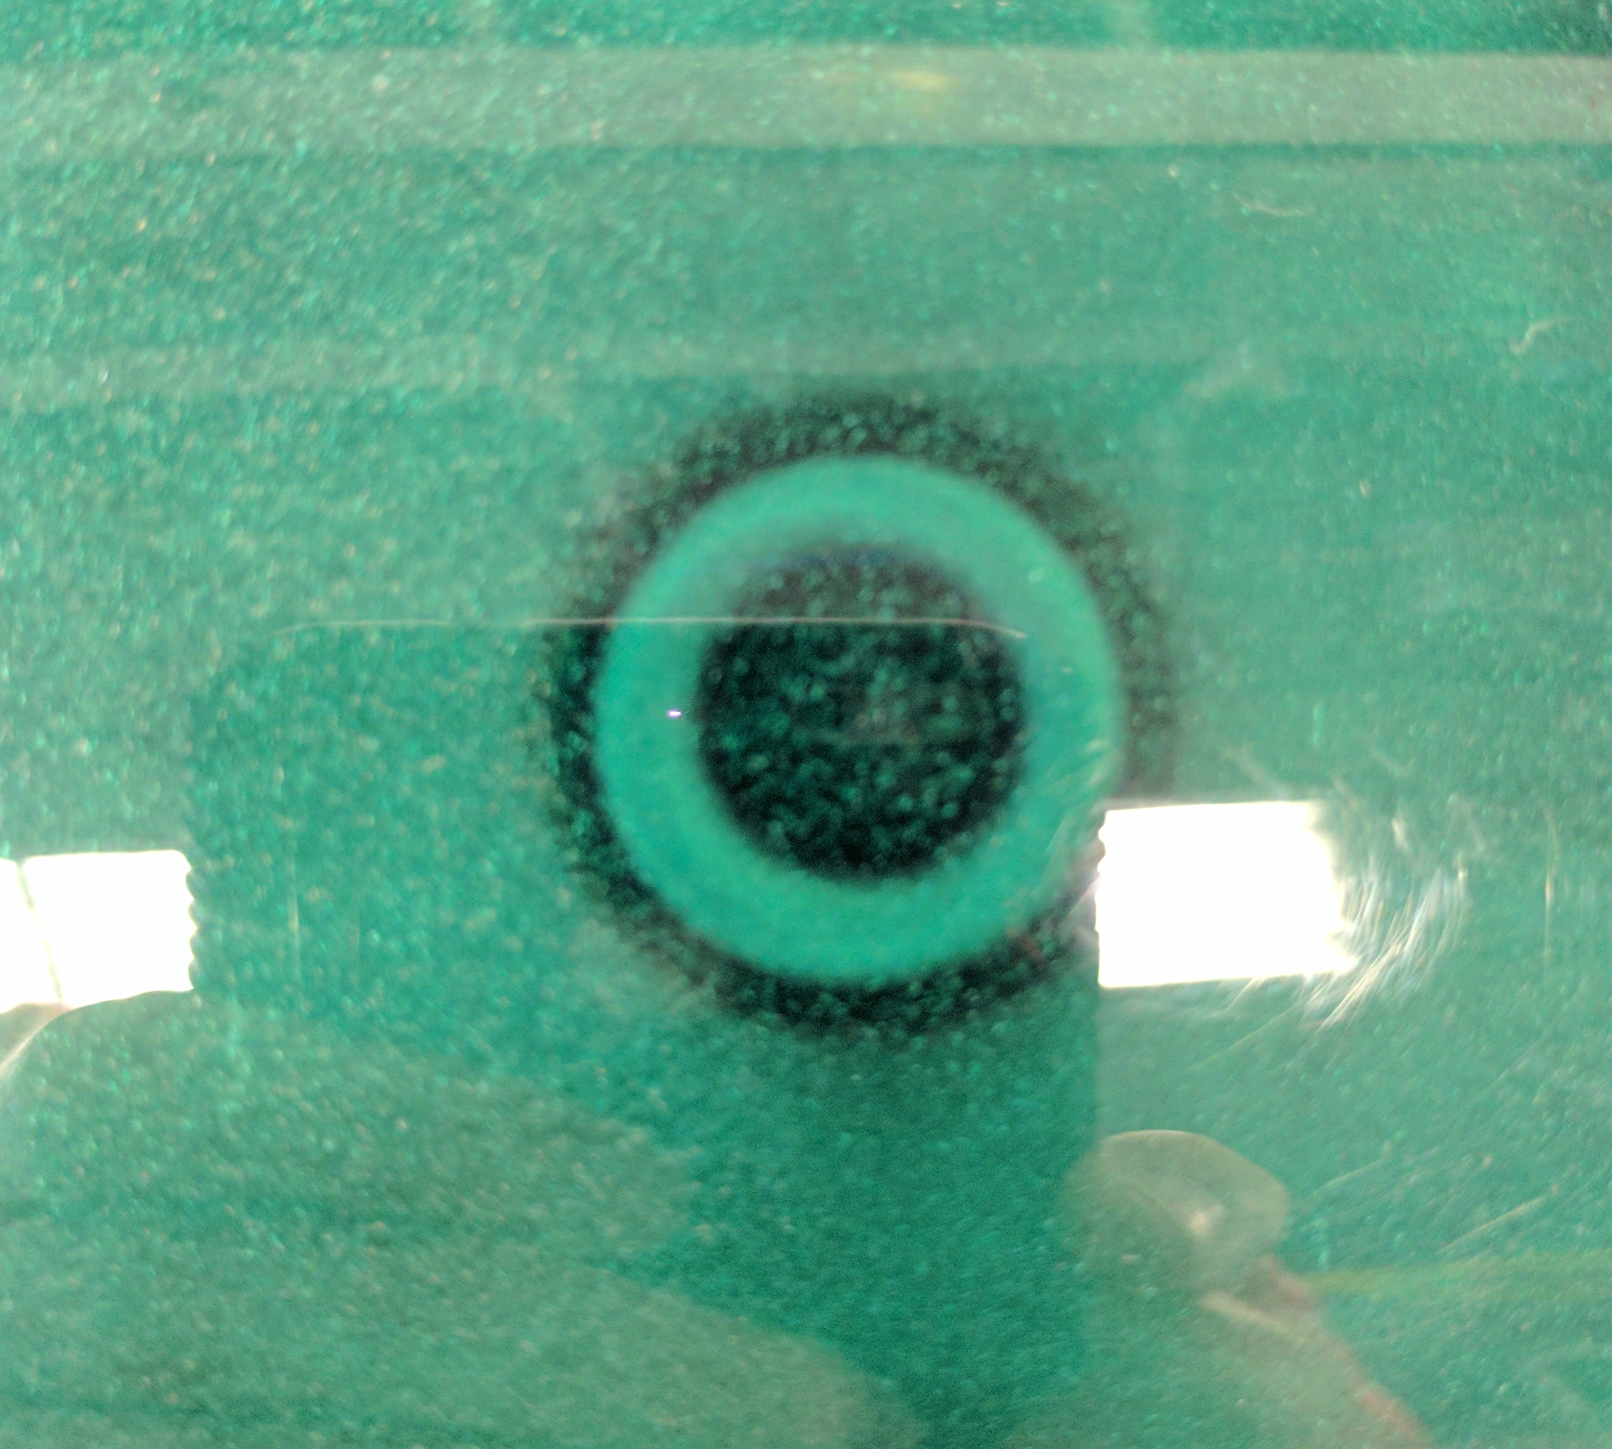
L-R Circuit rise time
V_{L}=L*di/dt
V_{i}
A
V₀ =iR
Inductance increases when target plate bridges air gap across permanent magnet.
V_{i} = V_{L} + V₀ = L*di/dt + iR
V₀ = A * [1 – exp(-R*t/L) ]
Magnetic field indication paper showing magnetic field lines from EPM

Slide 12
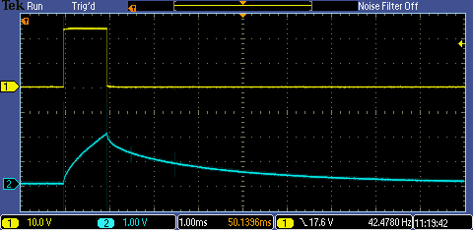
Measure initial rise with short pulse
V_{L}=L*di/dt
V_{i}
V₀ =iR
Pulse for only 1 ms, to allows signal to rise to about 10% of full value and thus only slightly offset holding force.
… but enough to pull core out of saturation (more on this later)
Input pulse, 24V
EPM Response

Slide 13
EPM is non-Linear Inductor!!
How does hysteresis curve affect inductance?
First we need to know how does one derive inductance from “first principals.”
In fact let’s go back to the beginning of creation.
“Let there be light”….

Slide 14
Let there be light!
Maxwell’s equations

Slide 15
Faraday’s Law
Voltage around loop = rate of change of flux through loop
V = - dΦ/dt
Inductance, L is defined by the relation:
v = L * d i/dt
Sign convention for V reversed!
L = dΦ/di
Thus
→ If flux is non linear function of current, so is inductance

Slide 16
B-H curves for electromagnet
Soft iron core with low hysteresis
B (tesla)
Low L
Slope, L=dΦ/di, is high at low current
Low residual magnetization with zero applied current
Air cored solenoid
Low L
H (ampere turns)
When core fully saturates, slope is same as for air core.
Low L

Slide 17
B-H curve for permanent magnet
high hysteresis
B (tesla)
High residual magnetization with zero applied current
Low L
Slope, dΦ/di=L, is low when applied current is low. Opposite of electromagnet with low hysteresis core.
High L
Avoid excess current since negative net field (B) will begin to demagnetize
H (ampere turns)
Apply this current to offset permanent field of core. Red curve is retraced when current is removed so magnetization remains.
B field saturates at lower value than for soft iron → permanent magnet is not as strong at electromagnet

Slide 18
When air gap is bridged
Hypothesis to explain data
B (tesla)
Plate in place
Narrow air gap
No plate present
Both core and plate saturated ... we never go here.
Very little slope change at low current
Inductance increases monotonically with air gap at large excitation current
H (ampere turns)

Slide 19
Ambiguity!

Slide 20
Non-monotonicity hypothesis
Linear segment approximation
Plate saturates
B (tesla)
Med.slope
Plate attached
Plate air gap
High slope
Core saturates
No Plate
Low slope
H (amp-turn)

Slide 21
More current helps, but still not monotonic
Plate saturates
B (tesla)
Med.slope
Plate attached
Plate air gap
High slope
Core saturates
No Plate
Low slope
H (amp-turn)

Slide 22
Subtract initial reading → monotonic
Plate saturates
B (tesla)
Plate attached
Plate air gap
High slope
Med. slope
No Plate
Core saturates
Low slope
H (amp-turn)

Slide 23
Multiple Pulse Times

Slide 24
Breaking Ambiguity!

Slide 25
Variations Between EPMs

Slide 26
Variations Between EPMs: signal @1ms – signal @ 0.5ms with scaling)

Slide 27
Variations Between EPMs: signal @1ms – signal @ 0.5ms w/o scaling)

Slide 28
Calibrations In Progress
Variation between EPMs
Temperature dependence
Better force versus distance → force versus measured rise time.

