Slide 1
ZTF: Electronics Cooling
Michael Feeney
07.24.2017

Slide 2
Introduction
Hardware Overview
What equipment? Where is it located?
Why do we need to cool it?
Heat Dissipation
Measured Power
Required Flow Calculations
Cooling Equipment Specifications
Chiller
Electronics Rack Heat Exchanger
Archon Controller Heat Exchanger
Plumbing Schemes
Serial
Parallel
Series-Parallel
Rough Circuit Analysis
Series-Parallel Plumbing Scheme
Circuit Analysis
Main Lines
Archon Lines
E-Rack HX
Archon HX
Thermal Performance
Electronics Rack
Archon Controllers
Surface Temperature
Plumbing Hardware

Slide 3
Hardware Overview
Archons
Telescope Layout
5X Archon Controllers (CCD controllers)
Located at the base of the Camera Support Structure to minimize analog signal path length.
Electronics Rack
Located at the base of the telescope (reduces torque moment arm and is convenient for access).
Why cool?
To assure that the electronics are operating at safe temperature ranges.
To avoid putting warm air near the beam (convection cells) and compromising dome seeing.
Electronics Rack

Slide 4
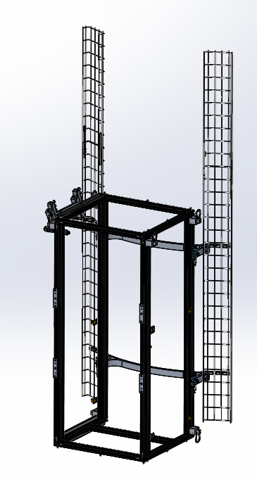
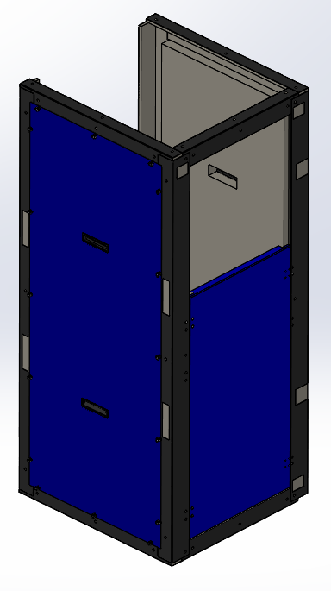
Hardware Overview: Electronics Rack
+
+
Electronics Rack Exoskeleton
Misumi frame.
Insulative Paneling
Bent aluminum sheet metal components lined with insulative foam.
Electronics Rack
Bud Industries 35RU Rack

Slide 5
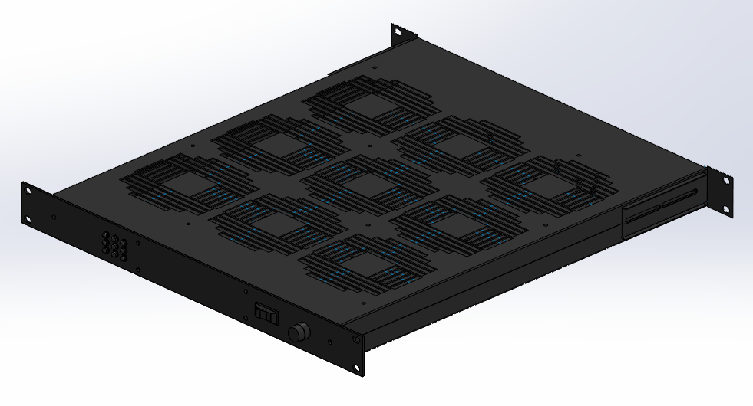
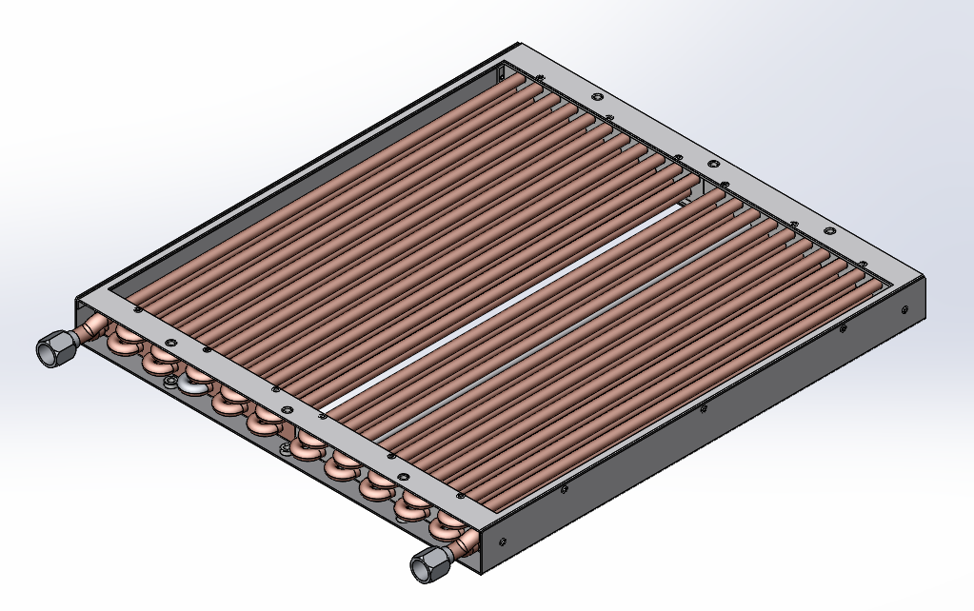
Hardware Overview: Electronics Rack
Fan Tray
Manufactured by Kooltronic, the fan tray is comprised of 9X 120mm fans capable of 945CFM. It sits atop the heat exchanger and draws air upwards.
Heat Exchanger
Manufactured by Thermatron, the heat exchanger is comprised of a network of 0.375” copper tubes with two parallel paths. The tubes zig zag a total of 20 times which creates a high surface area grid.
Subsystems
All of the support electronics for the various subsystems throughout the telescope sit in the rack mounted shelves or are rack mountable modules.

Slide 6
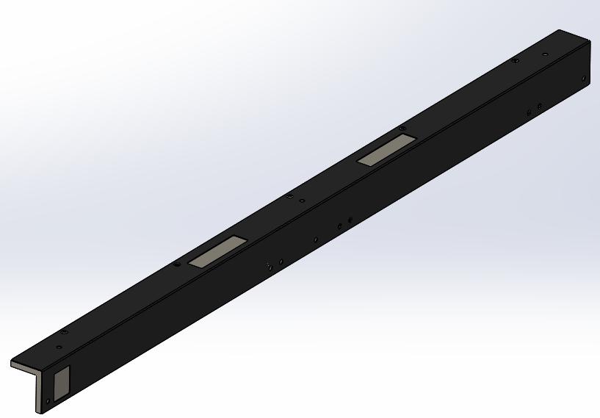
Hardware Overview: Electronics Rack
Main Panels
The main panels are made from 0.0625” thick aluminum sheet and are lined with 2”thick insulative adhesive-backed foam. There is one panel on the tube-side of the telescope and one on the outward facing side.
Misumi Rail Covers
Bent aluminum sheetmetal lined with 0.5” thick rigid insulation
Access Panels
The access panels are made from 0.0625” thick aluminum sheet and lined with 1” thick adhesive-backed foam. The access panels are on either side of the rack and hinge downward when the telescope is at South stow position. They provide convenient access to the various component trays in the rack
Cable Trays
The electronics rack is equipped with 2X cable trays on either side for managing the electrical cabling and plumbing.

Slide 7
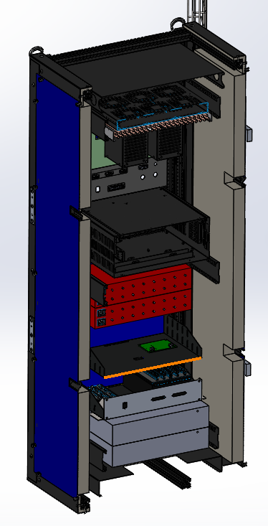
Hardware Overview: Electronics Rack
Fan Tray Circulates Air
The fan tray draws air from the inside of the rack upwards. The air hits the top of the rack and follows the path of least resistance (2 slots out the sides). From the increased pressure, the air is forced down the sides of the rack between the insulative foam on the panels and some panels that form a channel (not shown). The air exists into the main body of the rack through two slots in the bottom and repeats the cycle.
Natural Convection
The typical orientation of the rack is vertical (or nearly vertical). From natural convection and with the assistance of the fan tray, hot air rises to the top of the rack.
Foamcore Panels
Cool Air Buffer

Slide 8
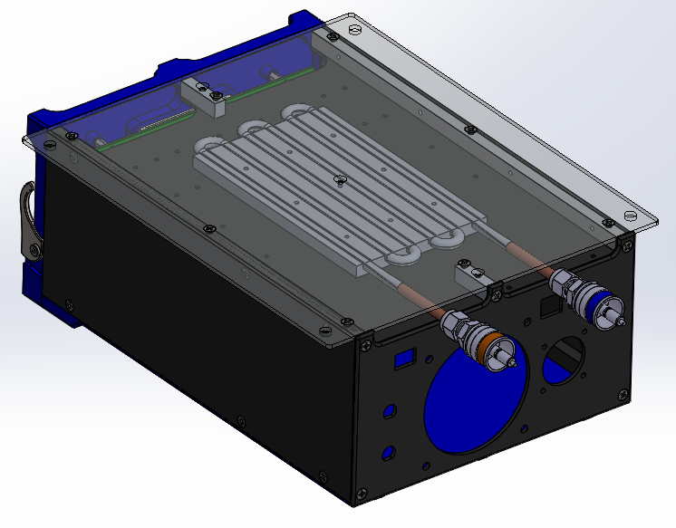
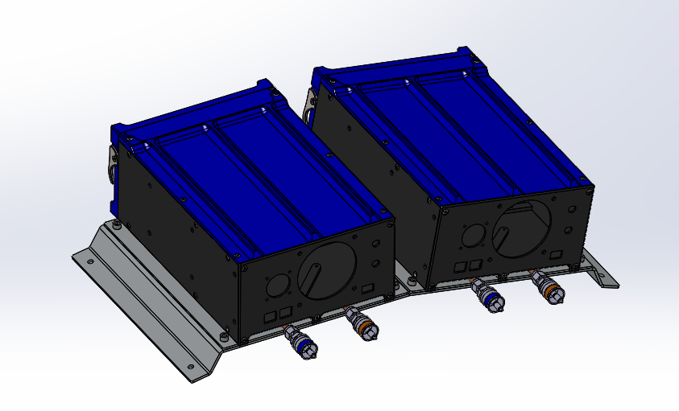
Hardware Overview: Archon Controllers
Archon Controllers
The Archon Controllers mount to the telescope with a bent aluminum sheet metal bracket. Each Archon can be conveniently removed from the bracket with 4 screws. The Archons mount outside the telescope tube at the base of the camera support structure legs (4 Archons for the science CCDs and 1 Archon for the guide-focus CCDs)
Coldplate
Each Archon is equipped with a Lytron CP15G01 cold plate which draws heat from the motherboard plane. The coldplate was modified with a threaded hole pattern such that it could be bolted securely to the motherboard plane and have solid thermal conduction.

Slide 9
Heat Dissipation
Hardware Overview
What equipment? Where is it located?
Why do we need to cool it?
Heat Dissipation
Measured Power
Required Flow Calculations
Cooling Equipment Specifications
Chiller
Electronics Rack Heat Exchanger
Archon Controller Heat Exchanger
Plumbing Schemes
Serial
Parallel
Combination
Rough Circuit Analysis
Combination Plumbing Scheme
Circuit Analysis
Main Lines
Archon Lines
E-Rack HX
Archon HX
Thermal Performance
Electronics Rack
Archon Controllers
Surface Temperature
Plumbing Hardware

Slide 10
Heat Dissipation: Required Flow
Electronics Rack:
Electronics Rack + KUKA Sunrise Cabinet + Guide-Focus Archon – 4(Science Archons)
513W + 150W +25W - 4(75W) = 388W
$T_{out}−T_{in}=\frac{P}{\left[ρ\right]\left[C_{p}\right]\left[Q\right]}$
$∆3°C=\frac{388W}{\left[1000\frac{kg}{m^{3}}\right]\left[4185\frac{J}{kg−°C}\right]\left[Q\frac{m^{3}}{s}\right]}$
$Q=0.489GPM$
Archon Controller: 75W Each
$T_{out}−T_{in}=\frac{P}{\left[ρ\right]\left[C_{p}\right]\left[Q\right]}$
$∆3°C=\frac{75W}{\left[1000\frac{kg}{m^{3}}\right]\left[4185\frac{J}{kg−°C}\right]\left[Q\frac{m^{3}}{s}\right]}$
$Q=.094GPM$/Archon
NO CONDENSATION FROM LINES OR HEAT EXCHANGERS!

Slide 11
Cooling Equipment Specifications
Hardware Overview
What equipment? Where is it located?
Why do we need to cool it?
Heat Dissipation
Measured Power
Required Flow Calculations
Cooling Equipment Specifications
Chiller
Electronics Rack Heat Exchanger
Archon Controller Heat Exchanger
Plumbing Schemes
Serial
Parallel
Combination
Rough Circuit Analysis
Combination Plumbing Scheme
Circuit Analysis
Main Lines
Archon Lines
E-Rack HX
Archon HX
Thermal Performance
Electronics Rack
Archon Controllers
Surface Temperature
Plumbing Hardware

Slide 12
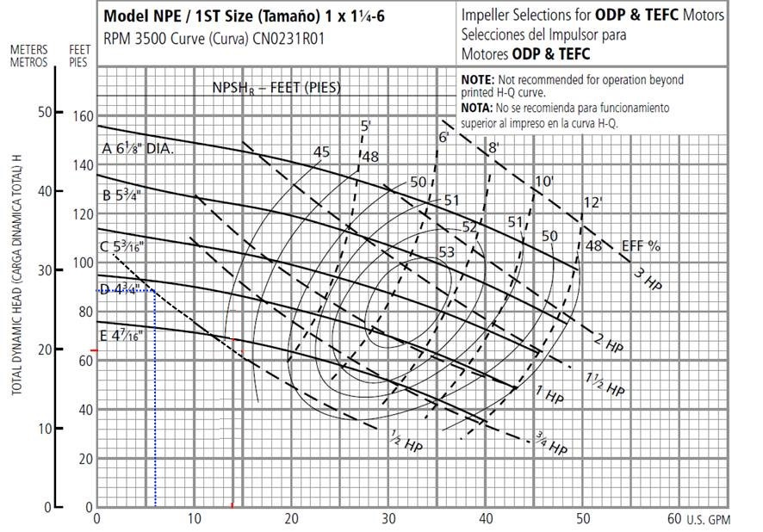
Cooling Equipment Specs: Chiller
Manufacturer: OptiTemp
Model Number: OTC-1.0 with 0.5Hp Pump
Maximum Working Pressure: 90ft (37psi) @6GPM

Slide 13
Cooling Equipment Specs: Electronics Rack Heat Exchanger
Manufacturer: Thermatron
Model Number: 726
Pressure Drop Plot is shown with water at 20C

Slide 14
Cooling Equipment Specs: Archon Controller Heat Exchanger
Manufacturer: Lytron
Model Number: CP15G01
Pressure Drop Plot is shown with water at 20C

Slide 15
Plumbing Schemes
Hardware Overview
What equipment? Where is it located?
Why do we need to cool it?
Heat Dissipation
Measured Power
Required Flow Calculations
Cooling Equipment Specifications
Chiller
Electronics Rack Heat Exchanger
Archon Controller Heat Exchanger
Plumbing Schemes
Serial
Parallel
Combination
Rough Circuit Analysis
Combination Plumbing Scheme
Circuit Analysis
Main Lines
Archon Lines
E-Rack HX
Archon HX
Thermal Performance
Electronics Rack
Archon Controllers
Surface Temperature
Plumbing Hardware

Slide 16
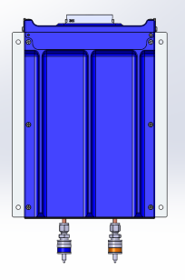
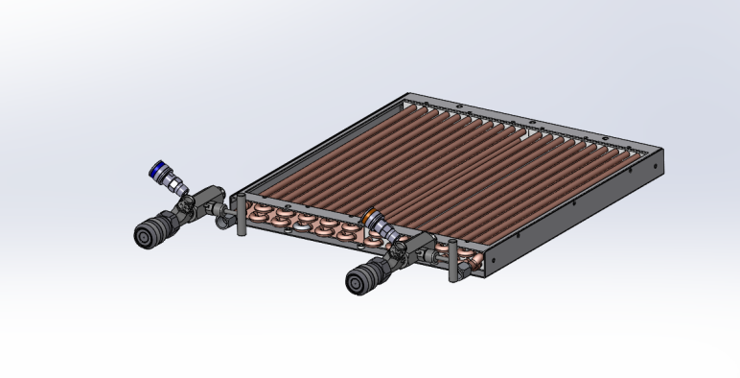
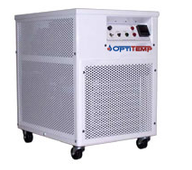
Plumbing Schemes: Serial
Advantages:
Simple plumbing
Disadvantages:
Big pressure drop
Considerable temperature difference between Archons
Archon Supply Branch
ID: 0.27
Length: 6ft
Archon Return Branch
ID: 0.27
Length: 6ft
Main Supply Line
ID: 0.75”
Length: 50ft
Chiller
OptiTemp OTC-1.0
Electronics Rack Heat Exchanger
Thermatron 726 Model
Main Return Line
ID: 0.75”
Length: 50ft

Slide 17
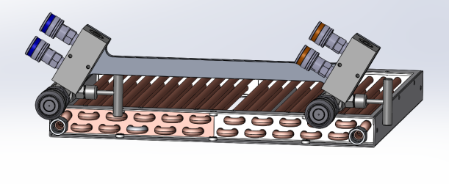
Plumbing Schemes: Parallel
Archon Return Branch (QTY 2)
ID: 0.270
Length: 6ft
Archon Supply Branch (QTY 2)
ID: 0.270
Length: 6ft
Main Supply Line
ID: 0.75”
Length: 50ft
Chiller
OptiTemp OTC-1.0
Electronics Rack Heat Exchanger
Thermatron 726 Model
Main Return Line
ID: 0.75”
Length: 50ft
Advantages:
Uniform temperature for all Archons
Disadvantages:
Complicated plumbing scheme

Slide 18
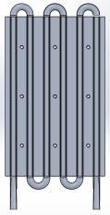
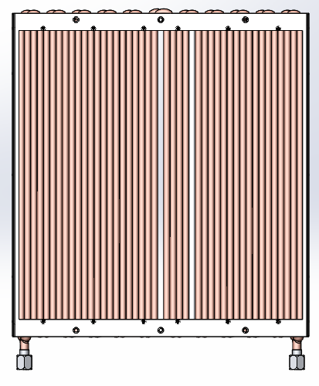
Plumbing Schemes: Series-Parallel (not too hot, not too cold)
Archon Return Branch 2
ID: 0.270
Length: 10ft
Archon Supply Branch 2
ID: 0.270
Length: 10ft
Archon Supply Branch 1
ID: 0.270
Length: 6ft
Archon Return Branch 1
ID: 0.270
Length: 6ft
Main Supply Line
ID: 0.75”
Length: 50ft
Main Return Line
ID: 0.75”
Length: 50ft
Chiller
OptiTemp OTC-1.0
Flow: 1-10GPM @34psi

Slide 19
Rough Circuit Analysis
Hardware Overview
What equipment? Where is it located?
Why do we need to cool it?
Heat Dissipation
Measured Power
Required Flow Calculations
Cooling Equipment Specifications
Chiller
Electronics Rack Heat Exchanger
Archon Controller Heat Exchanger
Plumbing Schemes
Serial
Parallel
Series-Parallel
Rough Circuit Analysis
Series-Parallel Plumbing Scheme
Circuit Analysis
Main Lines
Archon Lines
E-Rack HX
Archon HX
Thermal Performance
Electronics Rack
Archon Controllers
Surface Temperature
Plumbing Hardware

Slide 20
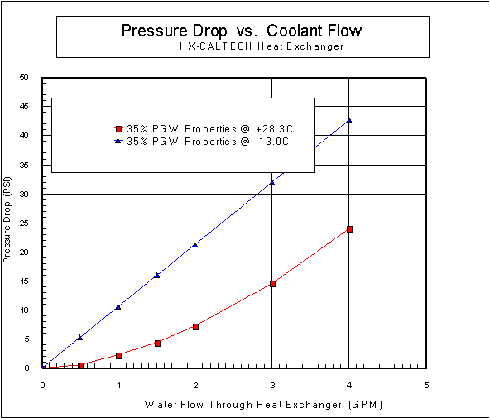
Rough Circuit Analysis: Series Parallel
Parallel:
Q = Q1 + Q2 + Q3
∆P1 = ∆P2 = ∆P3
Serial:
Q1 = Q2 = Q3
∆P = ∆P1 + ∆P2 + ∆P3
Assuming 6.5GPM ∆P = 36.5psi = ∆P₃+ ∆P₄+ ∆P₅
Neglecting the pressure drop in the lines, it is assumed all 36.5psi makes it to this branch of the Archon Heat Exchangers. Since each heat exchanger is identical, the pressure drop across each is equivalent (12.1psi). the max flow rate can be ~1.2gpm (see plot).
Assuming 6.5GPM ∆P = 36.5psi = ∆P₁+ ∆P₂
Neglecting the pressure drop in the lines, it is assumed all 36.5psi makes it to this branch of the Archon Heat Exchangers. Since each heat exchanger is identical, the pressure drop across each is equivalent (18.25psi). the max flow rate can be ~1.3gpm (see plot).
Assuming 6.5GPM ∆P = ∆P_{E} = 36.5psi
Neglecting the pressure drop in the lines, it is assumed all 36.5psi makes it to this branch of the Rack Heat Exchanger and the resultant flow is ~4.5gpm.
36.5psi
6.5GPM
Good initial estimates, but what about loss in lines?

Slide 21
Circuit Analysis
Hardware Overview
What equipment? Where is it located?
Why do we need to cool it?
Heat Dissipation
Measured Power
Required Flow Calculations
Cooling Equipment Specifications
Chiller
Electronics Rack Heat Exchanger
Archon Controller Heat Exchanger
Plumbing Schemes
Serial
Parallel
Combination
Rough Circuit Analysis
Combination Plumbing Scheme
Circuit Analysis
Main Lines
Archon Lines
E-Rack HX
Archon HX
Thermal Performance
Electronics Rack
Archon Controllers
Surface Temperature
Plumbing Hardware

Slide 22
Circuit Analysis: Main Lines
Darcy-Weisbach Equation for Turbulent Flow
$\text{∆}\text{P}\text{ = }\frac{1}{2}ƒ\frac{L}{D}ρv^{2}+ρgh_{supply}−ρgh_{return}; v= \frac{Q}{A}$
f: Friction Factor (Surface Roughness)
L: Length of Line
D: Diameter of Line
$ρ$: Density
v: Flow velocity
Q: Flow Rate
Main Line Diameter [in] | 0.75
Main Line Length [ft] | 170
Non-negligible pressure drop

Slide 23
Circuit Analysis: Archon Lines
Archon Line Diameter [in] | 0.25
Archon Branch 1 Line Length [ft] | 12
Archon Branch 2 Line Length [ft] | 20
Darcy-Weisbach Equation for Turbulent Flow
$\text{∆}\text{P}\text{ = }\frac{1}{2}ƒ\frac{L}{D}ρv^{2}+ρgh_{supply}−ρgh_{return}; v= \frac{Q}{A}$
f: Friction Factor (Surface Roughness)
L: Length of Line
D: Diameter of Line
$ρ$: Density
v: Flow velocity
Q: Flow Rate
Still Non-negligible pressure drop

Slide 24
Circuit Analysis: Main Lines + E-Rack HX
2.1GPM was assigned to the Archon paths.
Total Flow: 6.1GPM
4GPM through E-Rack HX
2.1GPM through Archons.
9psi loss in Main Line
Chiller Operating Pressure
9psi

Slide 25
Circuit Analysis: Main Lines + Archon Lines + Archon HX
Plus Main Line ΔP 9psi
Branch | Flow [GPM]
E-Rack Branch | 4
Archon Branch 1 | 1.15
Archon Branch 2 | 0.95
Total | 6.1

Slide 26
Circuit Analysis: Summary
∆P = 24.5psi, 0.95GPM
∆P = 25psi @ 1.15GPM
∆P = 4.5psi
∆P = 4psi
∆P = 29psi, @4GPM
∆P = 9psi

Slide 27
Thermal Performance
Hardware Overview
What equipment? Where is it located?
Why do we need to cool it?
Heat Dissipation
Measured Power
Required Flow Calculations
Cooling Equipment Specifications
Chiller
Electronics Rack Heat Exchanger
Archon Controller Heat Exchanger
Plumbing Schemes
Serial
Parallel
Combination
Rough Circuit Analysis
Combination Plumbing Scheme
Circuit Analysis
Main Lines
Archon Lines
E-Rack HX
Archon HX
Thermal Performance
Electronics Rack
Archon Controllers
Surface Temperature
Plumbing Hardware

Slide 28
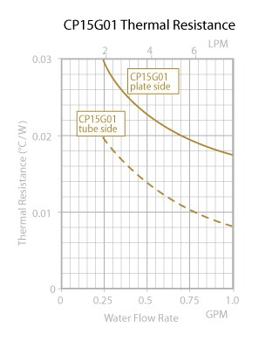
Thermal Performance: Archon Controllers
$0.0085\frac{℃}{W}$ (Branch 1) @ 1.15GPM
0.0095 $\frac{℃}{W}$ (Branch 2) @ 0.95GPM
Heat load is 75W
Branch 1 (2 Archons)
$∆T=\left[150W\right]\left[0.0085\frac{℃}{W}\right]=1.27℃$
Branch 2 (3 Archons)
$∆T=\left[225W\right]\left[0.0095\frac{℃}{W}\right]=2.13℃$
Where $∆T=T_{Archon}−T_{HX Coolant}$

Slide 29
Thermal Performance: E-Rack HX
$$∆T=\frac{388W}{275\frac{W}{℃}}=1.4℃$$
$$∆T=T_{Coolant In}−T_{Coolant Out}$$

Slide 30
Thermal Performance: Fluid Temp Rise
∆T = 2.1°C, 0.95GPM
∆T = 1.27°C @ 1.15GPM
∆T = 1.4°C, @4GPM

Slide 31
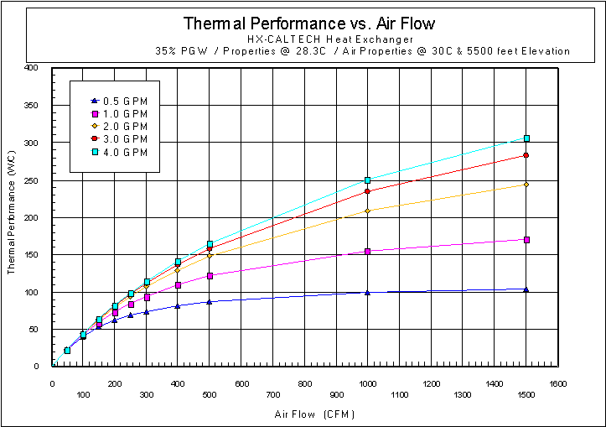
Thermal Performance: Electronics Rack Air Temperature
Air Flow:
The fan tray can output 950CFM maximum, so assuming ~40% efficiency, the flow is roughly 400CFM. (Component Obstruction)
PGW (Propylene Glycol Water) Flow:
4gpm
Thermal Performance:
$Thermal Performanc= \frac{388W}{T_{Air into HX}−T_{Coolant into HX}}$
For 20C Ambient:
Coolant is 20C-3C = 17C
Air is 20C + 5C = 25C
Heat load is 388W
$∆T=\frac{388W}{150\frac{W}{℃}}=2.58℃$
Where $∆T=T_{Rack Air into HX}−T_{HX Coolant}$
Notes:
Diminishing returns with increased coolant flow
Save space in the bottom of the rack for another fan set (air flow booster).

Slide 32
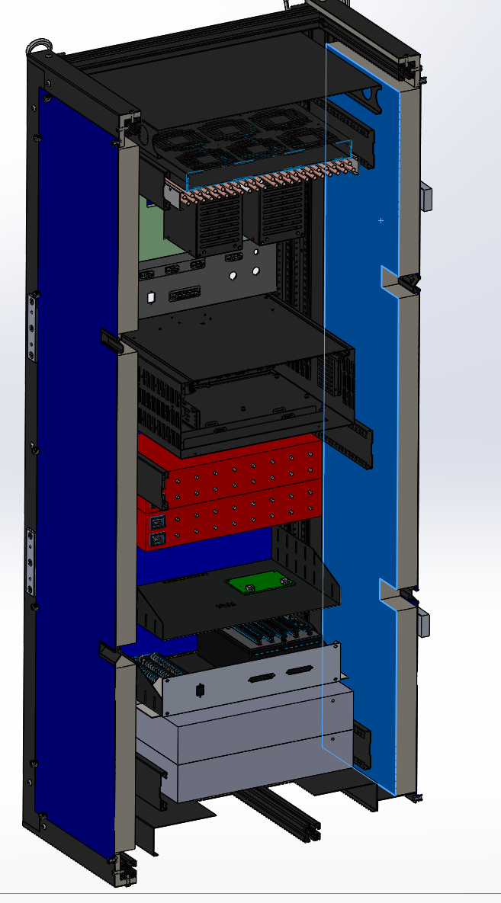
Thermal Performance: Electronics Rack Surface Temperature
T_{e}
T_{a}
$\left[\frac{\left[T_{i}−T_{e}\right]\left[k\right]\left[A\right]}{L}\right]=\left[σ\right]\left[A\right]\left[T_{e}^{4}−T_{a}^{4}\right]$
$\left[\frac{\left[T_{i}−T_{e}\right]\left[k\right]}{L}\right]=\left[σ\right]\left[T_{e}^{4}−T_{a}^{4}\right]$
$σ$: Stefan-Boltzmann Constant, $5.67E−8\frac{W}{m^{2}K}$
k: Thermal Conductivity
T_{i}: Internal Side Insulation Surface Temperature
T_{e}: Panel Surface Temperature
T_{a}: Ambient Temperature
Electronics Rack Surface Temperature:
Allowed Ti-Te = 12deg
T_{i}

Slide 33
Plumbing Hardware
Hardware Overview
What equipment? Where is it located?
Why do we need to cool it?
Heat Dissipation
Measured Power
Required Flow Calculations
Cooling Equipment Specifications
Chiller
Electronics Rack Heat Exchanger
Archon Controller Heat Exchanger
Plumbing Schemes
Serial
Parallel
Combination
Rough Circuit Analysis
Combination Plumbing Scheme
Circuit Analysis
Main Lines
Archon Lines
E-Rack HX
Archon HX
Thermal Performance
Electronics Rack
Archon Controllers
Surface Temperature
Plumbing Hardware

Slide 34
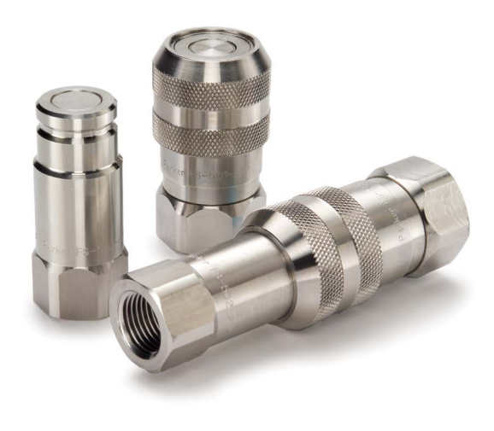
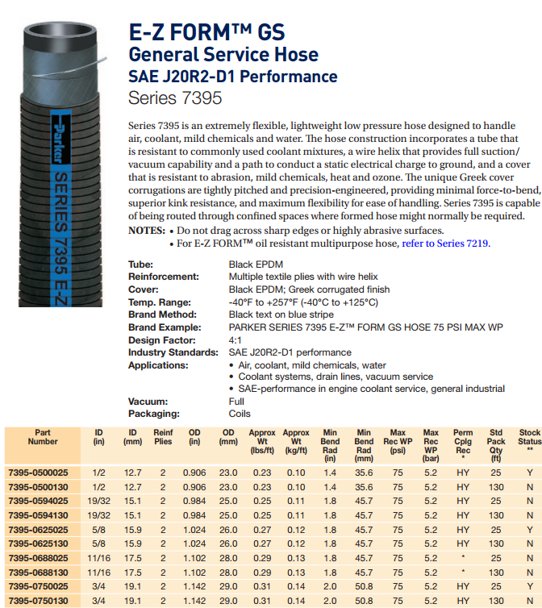
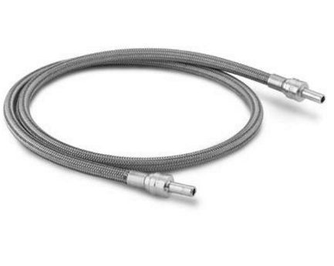
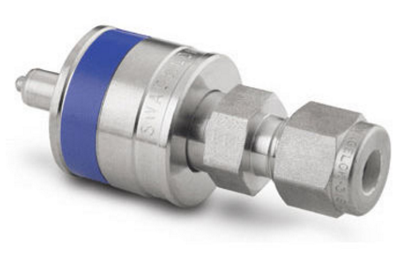
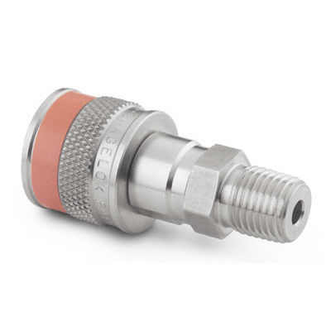
Plumbing Hardware
Main Line Plumbing
Parker QDCs
Parker flexible line
Archon Plumbing:
QDCs stem and body shutoffs
PTFE lined SS braided hoses

Slide 35
Conclusions
These are theoretical calculations
Will need to be confirmed through testing
All calculations made at 20C.
Pressure drops will increase with increased viscosity.
Fluid flow pressure drops are non-linear. Not as easy as electrical engineering
Electrical Engineering is easier than Plumbing

