Slide 1
ZTF Grounding or Yes, there are two paths you can go by
Stephen Kaye

Slide 2
ZTF Instrument - Topology
Back plate
o-ring
VIB
o-ring
Focal Plane

Slide 3
VIB Connections
J4
J2
J5
J3
J4
J2
J5
J3
Quadrant 1
Connections
NE
Quadrant 2
Connections
SE
J8
J7
J10
J9
J8
J7
J10
J9
J2
J4
J3
J5
J2
J4
J3
J5
J7
J8
J9
J10
J7
J8
J9
J10
Quadrant 3
Connections
NW
Quadrant 4
Connections
SW

Slide 4
ZTF Instrument - Preamplifier

Slide 5
Noise Problem for ZTF
Ideally, single sided mode should have an rms noise which is √2 lower than differential mode
Single sided configuration reveals rms noise much higher than differential mode
There must be noise pickup on the video signal
Differential mode takes care of the noise, so the pickup is common mode

Slide 6
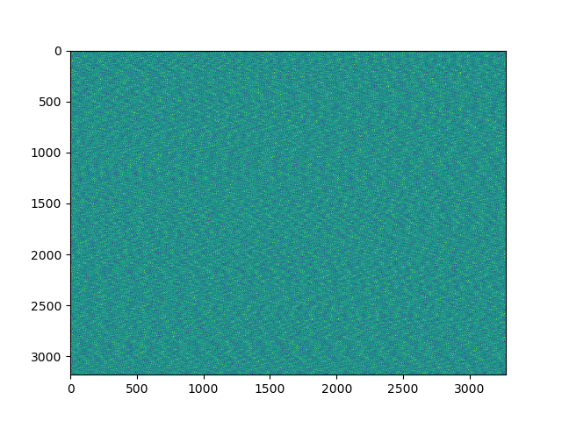
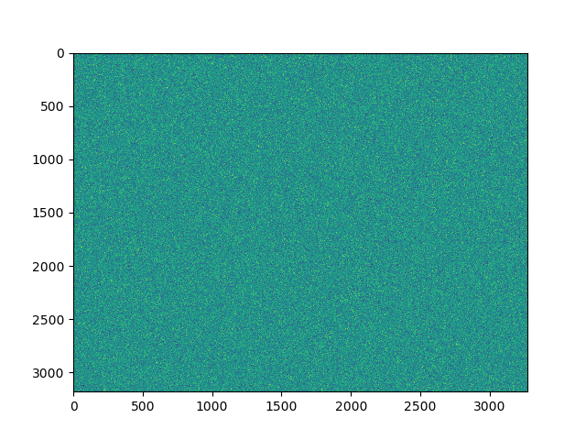
Zoomed in noise images
Single Sided
Differential

Slide 7
Nature of Single Sided Noise
Using FFTs of the raw data to see dominant frequencies
Can we understand what is causing the noise by dominant frequency
Dominant frequency is 53.88 kHz. Maybe a switching supply?
FFTs were interesting, but minimally useful to solve the noise problem

Slide 8
Build Up of Dewar
After returning from Palomar, the build up of the dewar proceeded slowly to discover where the noise was coming from.
Typical noise was seen when the video cable shield came into contact with the dewar without any cables connected on the dewar side
Grounding and shielding were suspected in the noise pick up

Slide 9
Eliminating the Noise
It was found that the single sided noise was greatly reduced when the compressor lines were detached from the dewar (orange plot)
Also, the backplate temperature cable was disconnected

Slide 10
Grounding
We completed, by ohmic measurement, the grounding diagram for the instrument
Due to multiple controllers and multiple paths back to earth ground, the entire dewar needed to be disconnected to understand the grounding.

Slide 11
Tray
Backplate shield, pins 13, 14, 16
Compressor
Dewar
x
x
x
x
Controller
#1
Controller
#2
Controller
#3
Controller
#4
Chassis
Original Video Cable Grounding Diagram

Slide 12
Tray
Backplate shield, pins 13, 14, 16
x
x
Compressor
Dewar
x
x
x
x
x
x
Controller
#1
Controller
#2
Controller
#3
Controller
#4
Chassis
Original Clock and Bias Cable Grounding Diagram

Slide 13
New Grounding Configuration
The video shields should be connected to the chassis ground on the controller side of the cable
A temporary grounding with alligator leads we implemented to complete the shield grounding
No effect was seen with the clock and bias cables, so these were left as is for the first test

Slide 14
Tray
Backplate shield, pins 13, 14, 16
Compressor
Dewar
Controller
#1
Controller
#2
Controller
#3
Controller
#4
Chassis
New Video Cable Grounding Diagram

Slide 15
Detail of grounds for one controller
Shield, analog and digital grounds connected only at “star point” close to ADCs
To electronic rack thence telescope
VIB
CCD
Video
Power
CCD
Loop
Refrigerant lines
Telescope
Loop
AC cable
Earth pin

Slide 16
Video Shield to Controller Chassis
Video shield connected to controller chassis
This completes the chassis shield from controller through shield to dewar
Rms noise for single sided case is reduced nearly to differential levels.
Interference is still degrading noise in single sided transmission but…
Common mode rejection provides ample noise margin in differential mode.

Slide 17
Conclusions and Take-Aways
Compressor lines add an extra ground path for the dewar
Cable tray also add an extra unanticipated ground path
Grounding of the instrument should be completed so that unanticipated paths don’t affect the instrument
Double check grounding on each component with an ohm meter as the instrument is going together
Measure and complete a grounding diagram as the instrument is going together
All this is especially important with a multiple controller configuration, where grounding everything is necessary yet loops are inevitable. The goal then is to shunt the resulting currents around the signal wiring.

