Slide 1
The LINC-NIRVANA GLAO Subsystem
ARC
15 sep 2014

Slide 2
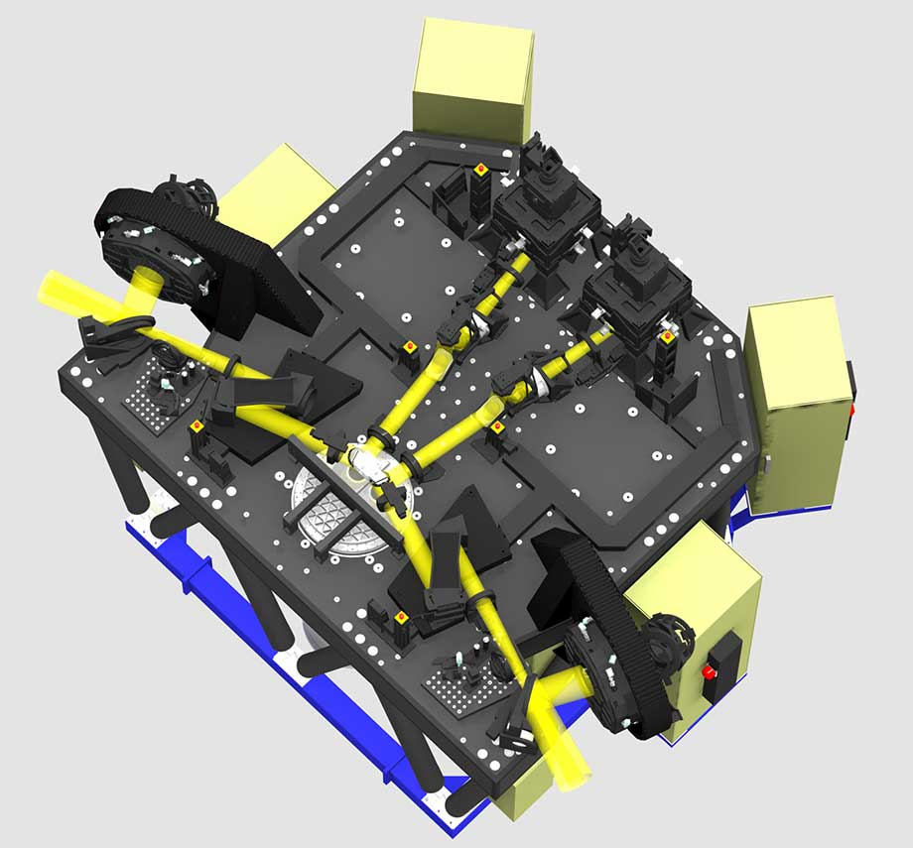
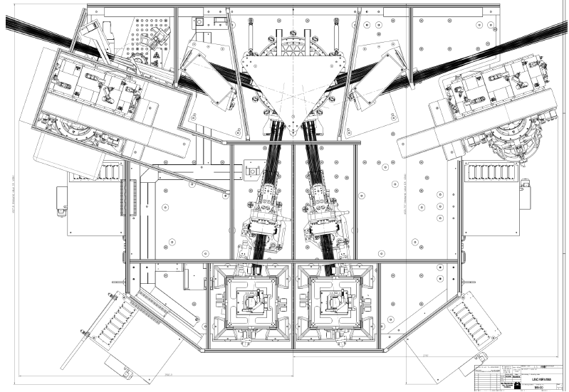
A subsystem of a bigger instrument …
~6m
~4m

Slide 3
The heart of LN GLAO is the GWS …

Slide 4
The heart of LN GLAO is the GWS …

Slide 5
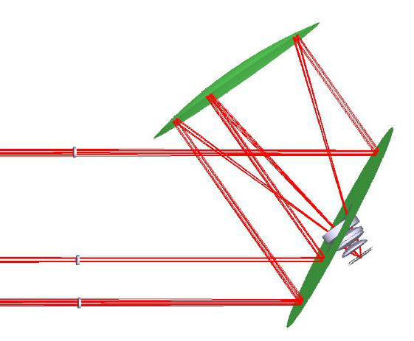
Pupils from each star are optically co-added (e.g., 10 17.5 R-mag stars => one 15.0 R-mag star)
The annulus patrolled by the 12 probes has a 6’ outer diameter and a 2.7’ inner diameter

Slide 6
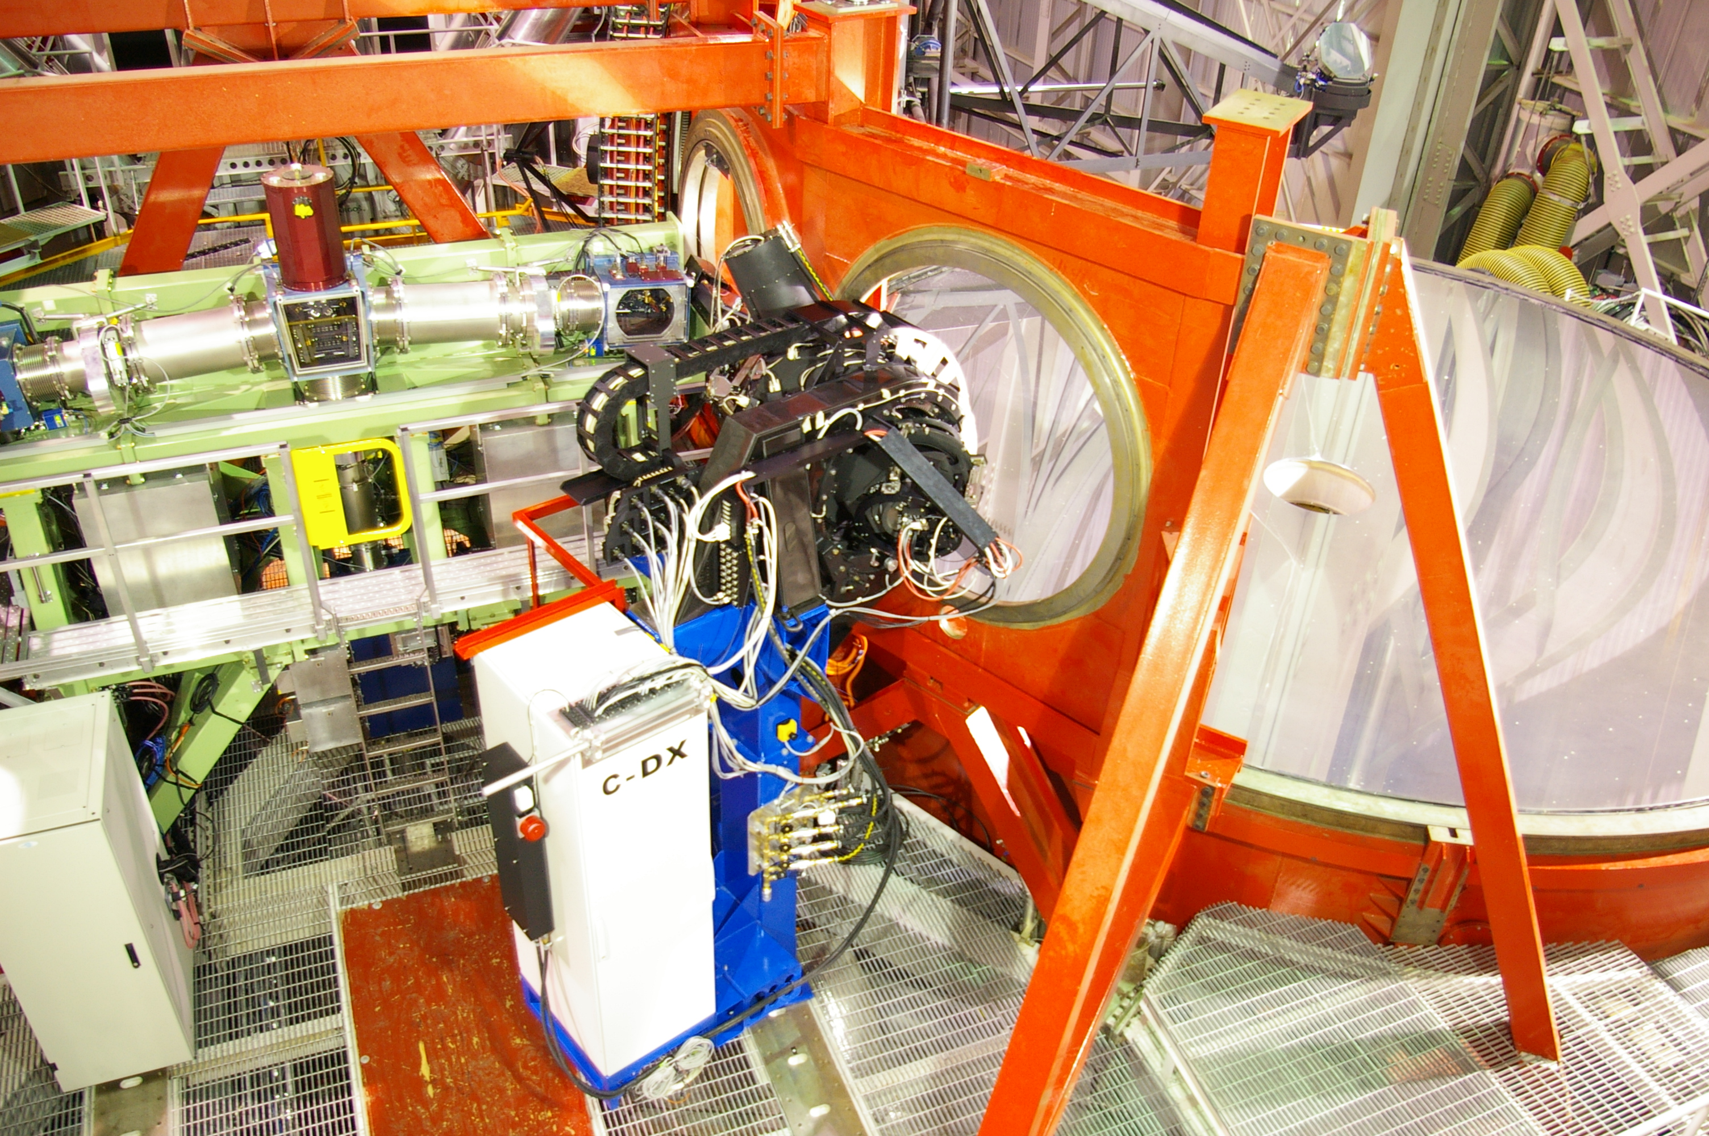
The right side L-N GWS was realized at LBT recently in the form of LN Pathfinder …

Slide 7
The right side L-N GWS was realized at LBT recently in the form of LN Pathfinder …

Slide 8
The right side L-N GWS was realized at LBT recently in the form of LN Pathfinder …

Slide 9
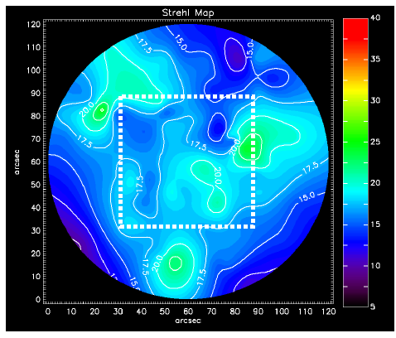
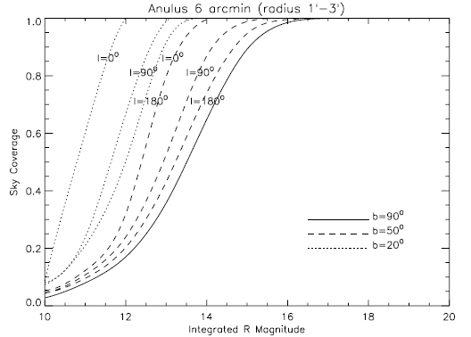
Future = multiple stars …
MAD demonstrated that Strehl can be kept within an approx. 10% range (figure from Marchetti et al).
The probability of finding an asterism with integrated brightness < R=15, and within the PF FoV, is high (figure from Ragazzoni et al).
Combining the light from multiple stars can provide homogenous field correction and extend the sky coverage of an AO system.

Slide 10
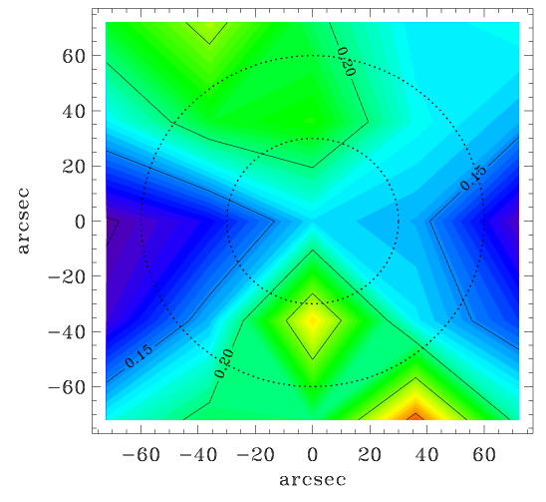
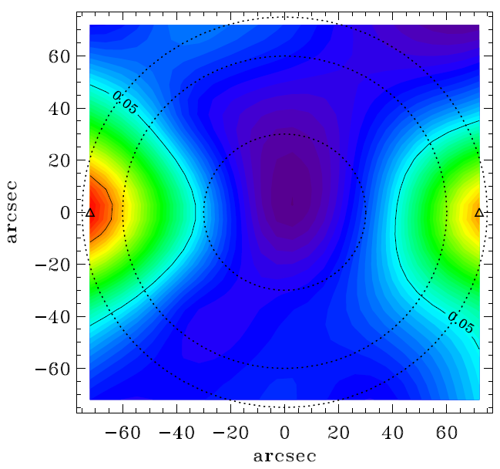
And we did simulations …
FWHM
Strehl
Simulated PF performance as it varies spatially across the field of view

Slide 11
And finally … a fun movie:

Slide 12
The downsides of NGS GLAO (versus LGS)
As mentioned at this workshop and elsewhere:
Lower PSF uniformity.
Lower sky coverage.
?
?
More complicated to build and operate.
LBT will have one of each, and will therefore be a good test of the above predictions.

Slide 13
Extra Slides

