Slide 1
Ground Layer AO at ESO’s VLT
Claire Max
Interim Director
UC Observatories
September 14, 2014

Slide 2
Overview
One VLT telescope devoted to wide fields and GLAO
  Four sodium-layer laser guide stars
  One adaptive secondary mirror feeds all AO systems
Two science instruments:
  MUSE (24 visible-light IFUs)
  HAWK-I (wide field near-IR imager)
Each one has its own GLAO system
  GALACSI AO system feeds MUSE (visible)
  GRAAL AO system feeds HAWK-I (near-IR)
Things to think about

Slide 4
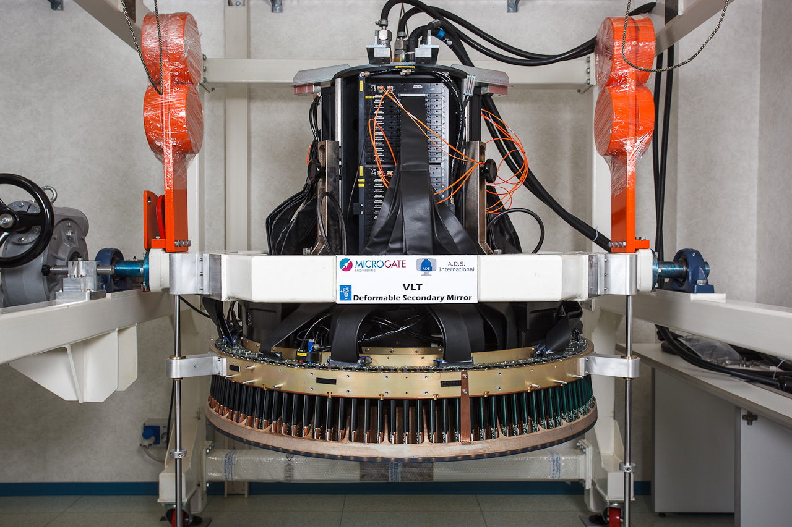
VLT adaptive secondary: built by MicroGate, cost approx. $14M

Slide 5
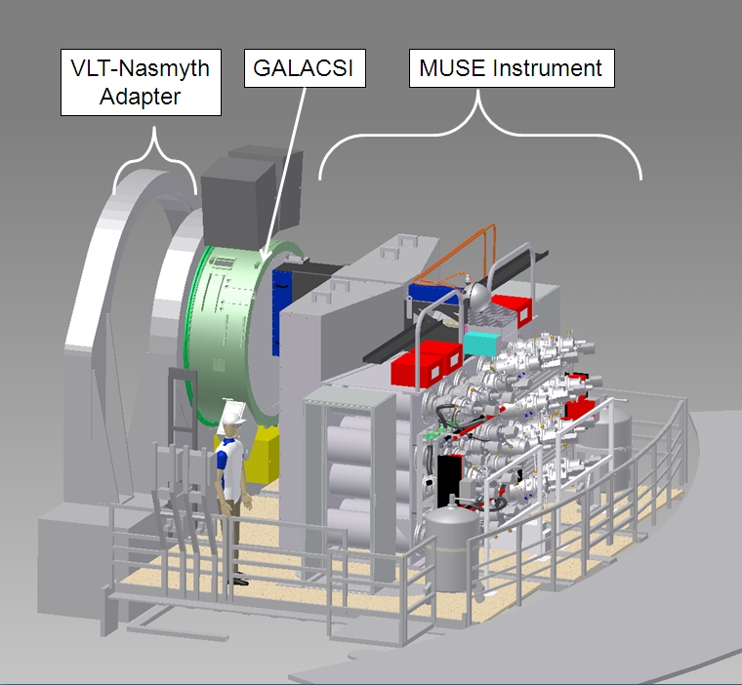
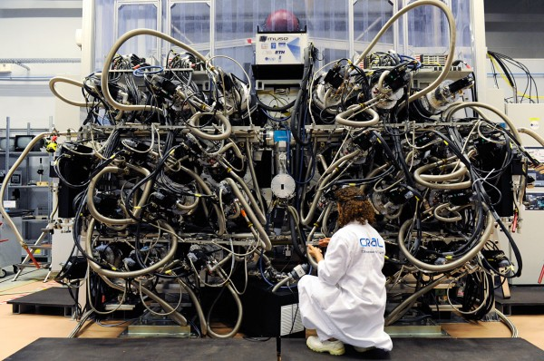
MUSE: 24 visible light IFUs (!)

Slide 6
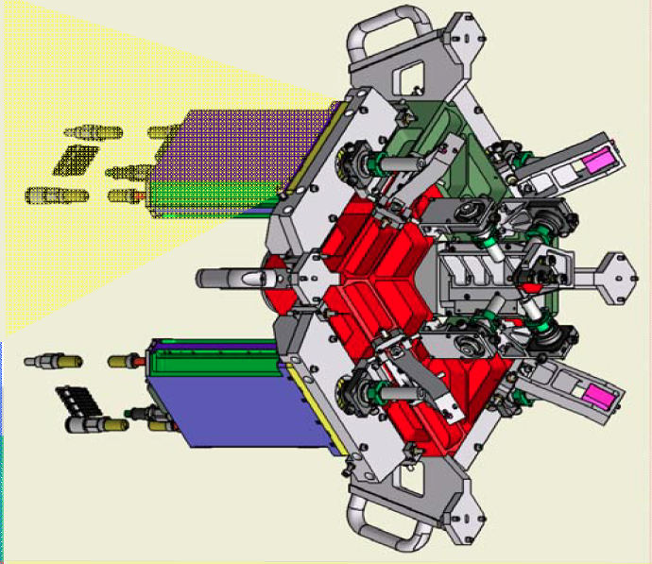
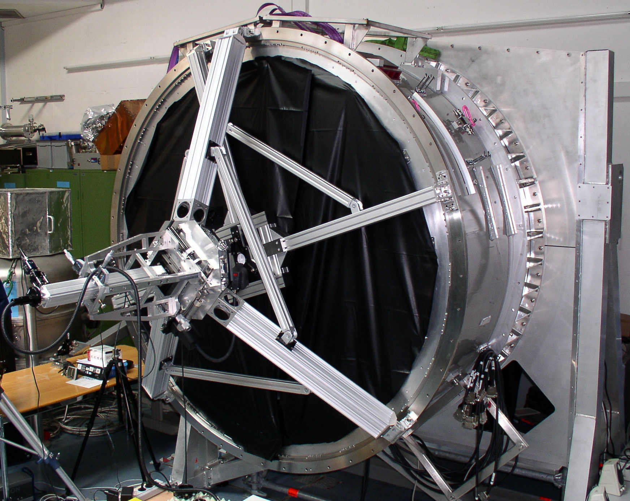
AO modules for these GLAO systems: large, sophisticated, complex
GALACSI design
GALACSI on elevation bearing

Slide 7
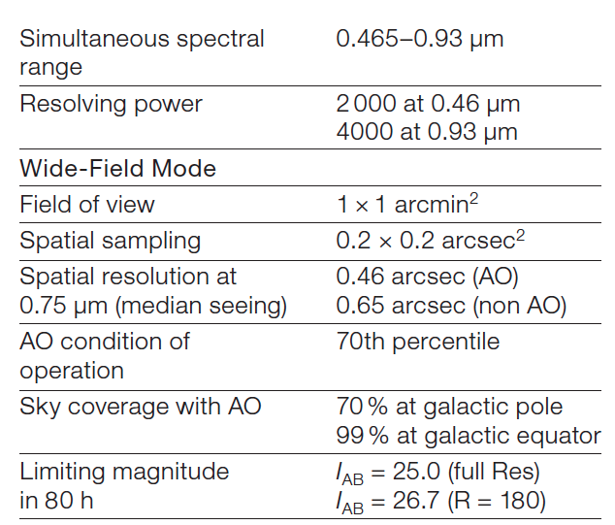
MUSE +GALACSI AO: performance predictions

Slide 8
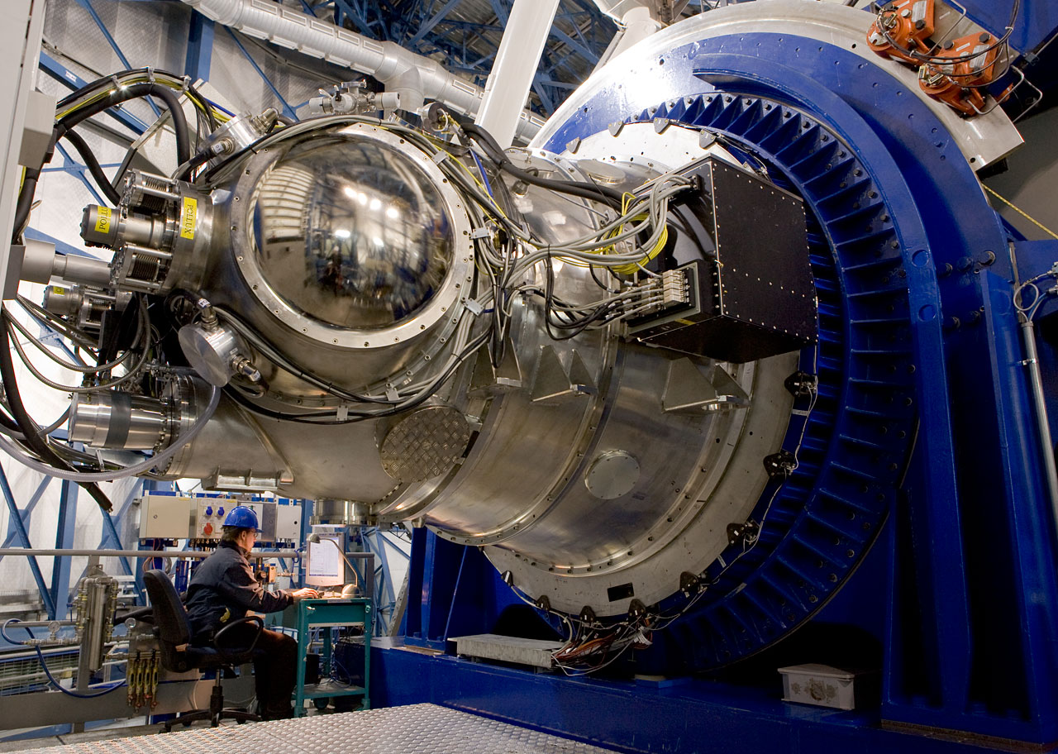
HAWK-I plus GRAAL AO:
GLAO for near-IR wide field imaging
HAWK-I imager
GRAAL GLAO system

Slide 9
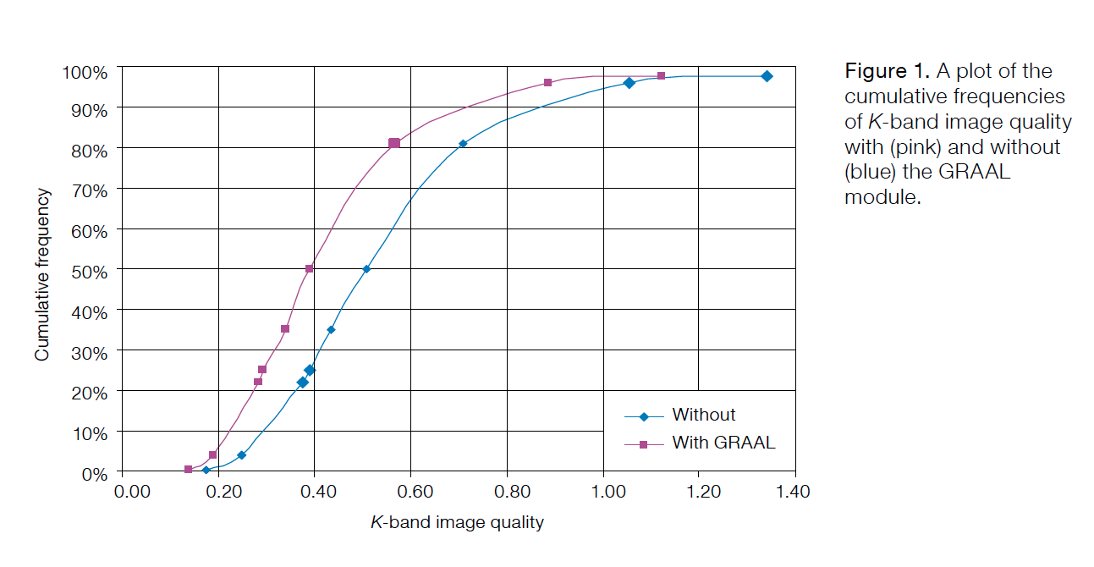
GRAAL + HAWK-I:
Performance predictions, K band
Image quality:
No AO ~0.5”
With AO ~0.4”

Slide 10
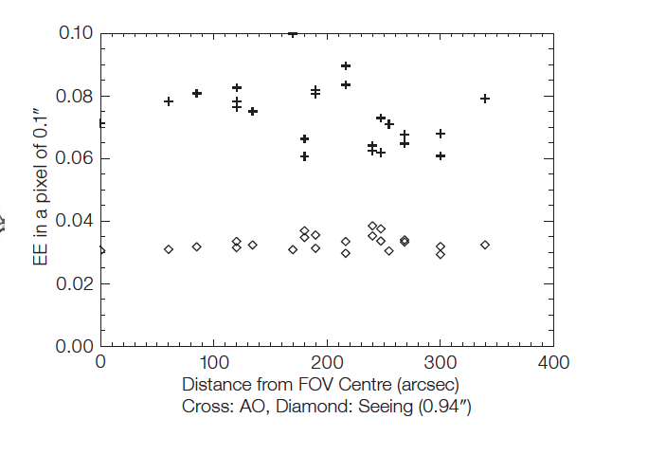
GRAAL + HAWK-I:
Performance predictions, K band
About 6 arc min field

Slide 11
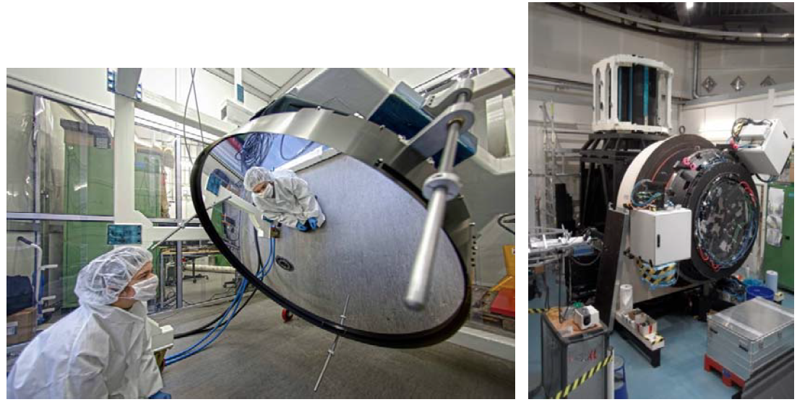
ESO built the ASSIST Test Stand to test AO systems with DM in the lab

Slide 12
Main Points
Extremely ambitious ESO VLT wide field program
  Both with and without GLAO
Re-engineered adaptive secondary mirror (~$14M)
Four sodium-layer LGS
Large and expensive instruments (MUSE, HAWK-I) designed to take advantage of GLAO
  MUSE (visible): 0.2 arc sec/px, HAWK-I (near-IR): 0.1 arc sec/px
  Low internal errors (?)
Each instrument has its own AO module
Predictions:
  MUSE with GLAO: Image quality 0.65” -> 0.46” (30% improved)
  HAWK-I with GLAO: Image quality 0.50” -> 0.40” (20% improved)

Slide 13
Issues for extragalactic science with VLT GLAO
What are/were the science trade-offs?
Example: can trade field of view against image quality
  Wider field -> larger FWHM
Wider field -> may be able to undertake larger surveys and/or use less telescope time for a given survey
Larger FWHM -> lower SNR for given exposure time (so larger field may or may not speed up survey); less spatial resolution
Trade depends on the science that you want to do
I wasn’t able to find this kind of trade study in preparation for the two VLT GLAO systems + instruments

Slide 15
GRAAL- GALACSI Comparison
parameter | GRAAL |  | GALACSI
Instrument | Hawk-I (IR imager) ESO |  | Muse (VIS 3D-spectrograph) Lyon
Mode | Maintenance mode | GLAO | Wide Field Mode | Narrow Field Mode
Field of view | 10” | 7.5’ | 1’ | 7.5”
AO mode | SCAO | GLAO | GLAO | LTAO
Performance | (S.R. ~ 80% in K-band) | x1.7 EE gain | x2 EE gain | S.R. >5% (10% goal) @650nm
Natural Guide Stars | On axis, ~ 8 mag | R-mag 14.5 within 6.7’ to 7.7’ radius | R-mag <17.5 within 52” to 105” radius | On Axis, NIR, Jmag 15 Low Order sensing
Sky coverage | Close to “bright” stars | 95% | >90% | Science target = TT reference
4LGSF config. | NGS only | Ø12’ | Ø2’ | Ø20”
WFS | 1 NGS L3-CCD (40*40 sub app.) | 4 LGS L3-CCD (40*40 sub app.) 1 TT L3-CCD | 4 LGS L3-CCD (40*40 sub app.) 1 TT L3-CCD | 4 LGS L3-CCD (40*40 sub app.) 1 IR Low Order
Loop frequency | HO loop: ≥ 700 Hz | HO loop: ≥ 700 Hz TT loop: 250Hz | HO loop: 1 kHz TT loop: 200Hz | HO loop: 1 kHz LO loop: 200-500Hz

