Slide 1
Some Thoughts on
Ground Layer Adaptive Optics & Adaptive Secondary Mirrors for Keck
P. Wizinowich
9/15/14

Slide 2
Keck Image Quality
Median image FWHM = 0.55” at 650 nm
  0.58” at 500 nm

Slide 3
Median Seeing & Image Quality from Racine (Aug. 2014)
Median seeing from DIMM (doesn’t include outer scale)
Notes:
Racine assumed Keck has same seeing as CFHT site (no separate DIMM measurement at Keck)
All numbers at 0.5 um wavelength
- Site IQ = DIMM seeing * [1 – 2.183(r0/L0)^0.356]^0.5 = 0.81 for r0=16 cm & L0=30m from Tokovinin (2002)

Slide 4
Site Seeing Contributions
Median seeing of 0.63” consists of
  ~0.45” in 1st 80 m (Chun)
  ~0.15” between 80 m and 500 m (Chun)
  → ~0.33” in free atmosphere above 500 m
  Summed with the 5/3 power since more power in wings than a Gaussian
If completely removed the GL seeing
  Median seeing would reduce to 0.38”
  Median IQ would reduce from 0.58” to 0.40” at 0.5 µm
Critical to measure ground layer at Keck before proceeding with GLAO!

Slide 5
Keck Instrument Considerations
Existing instruments weren’t designed with GLAO in mind.
  Does GLAO need its own instrument(s)? VLT has built two.
  Existing instruments don’t have the wide GLAO field but could improve their image quality (perhaps also compensating for free atmosphere for narrow field)
DEIMOS: 0.12”/pix. 16.7x5.0 arcmin imaging field. 0.4 to 1.05 µm.
HIRES: 0.36 to 1.0 µm.
LRIS: 0.135”/pixel. 6x7.8 armin field. 0.32 to 1.0 µm. Need to consider ADC.
MOSFIRE: 0.18”/pixel. 6.1x6.1 arcmin field. 2.8 pixel grating resolution. 0.97 to 2.5 µm.
Focal plane typically well inside instrument
  e.g. ~1.2 m for DEIMOS, ~0.95 m for MOSFIRE
Slit size typically 0.5” to 0.7”.
  Easy to make smaller for MOSFIRE. Smaller might be possible with DEIMOS/LRIS mask cutting tool or might require a laser cutter
Instrument IQ often worse than telescope IQ
  e.g. 2002/3 LRIS average segment FWHM = 0.91”
  Would be good to understood. Could ASM help with this?

Slide 6
Keck Secondary Mirror Considerations
Existing secondary mirror
  1.4 m diameter
    1.31 m for 0˚ FOV & 1.4 m for 10 arcmin FOV.
  -4.74 m radius of curvature
  -1.64 m conic constant
Secondary module currently also houses
  Laser launch telescope & beam transport optics
  TBAD (transponder based aircraft detection) system

Slide 7
Adaptive Secondary Mirror Considerations
Demonstrated with ASMs at MMT, LBT & Magellan for high performance NGS AO with pyramid WFS (Gregorian at LBT & Magellan)
  MMT: 642 mm, 336 actuators
  LBT: 911 mm, 672 actuators
  AO systems not yet scientifically productive: total of 7 refereed science papers in 2013
Implementing as part of VLT 4LGS GLAO facility
  1.12 m, 1170 actuators, hexapod mount
  Multi-ifu (MUSE) behind GALACSI: 1’x1’ fov with 0.2”/pixel. 2x EE in 1 pixel at 0.75 µm
  Imaging (HAWK-I) behind GRAAL: 7.5’x7.5’ fov. 1.5 to 2x gain in integration time (0.85 – 2.5 µm)
25 to 40 mm actuator spacing → 1000 to 2000 actuators for 1.4 m Keck secondary
  349 actuators in current Keck AO
Testing/calibrating a convex secondary more challenging
  Is there a way to daytime calibrate or does image sharpening need to be done on sky?
Need ~2 kW of power & cooling at top end & to address related safety issues
Need to re-work secondary mirror module & mounting of launch telescope, laser beam transport optics & TBAD
  Could re-mount launch telescope on elevation ring if needed but would need new beam transport system. Might need a new launch telescope if 2’ field not adequate
Maintenance/safety issues need to be carefully considered (Christou, SPIE 2014)
  Multiple failure modes: dust/cinder in gap, freezing, etc.

Slide 8
Non-GLAO ASM Benefits
Would have a spare secondary
  Single point failure mode for both telescopes
Use to correct static aberrations or slowly varying aberrations vs elevation or time
  E.g. segment warping residuals
  Would need a WFS, perhaps as part of a guider
Existing secondary mirrors have several issues that could be addressed by an ASM
  K2 f/15 has a rolled edge
  Smoothness of focus corrections
  Reliability of vacuum system & Hg girdle

Slide 9
Wavefront Sensor Consideration
Multiple wavefront sensors (WFS) are required
  4 LGS & 1 NGS?
WFS’s orientation preferably fixed with respect to ASM
  NGS WFS pickoff would need to compensate for field rotation (easy if mounted to instrument rotator) but then need to derotate pupil on WFS
  LGS WFS should be fixed with respect to ASM & LGS asterism (e.g. fixed if in tertiary tower, but a different rotation needed if mounted to instrument rotator at Cass or Nas)
WFS package needs to be in front of science instrument
  → 1 WFS package per instrument location
  At Nasmyth likely need to mount to front of science instrument. El ring constrains diameter & primary mirror constrains depth.
  At Cassegrain could mount to front of science instrument or mount to tower. Tower constrains diameter.
LGS separation needs to be wide enough to distinguish ground layer → arcminutes
Beamsplitter likely needed to send light to WFS
  Telescope focal plane is inside existing science instruments & (likely) inaccessible
    E.g. the telescope focal plane is ~1.2 m inside DEIMOS
  The LGS focus further inside instrument (0.25 m at zenith)
  1.4 m to focal plane + 5 arcmin field → 320 mm diameter b/s
Pyramid WFS have primarily been used with ASM but Shack-Hartman WFS may be needed for LGS (pyramid not demonstrated yet with LGS)

Slide 10
Other AO Hardware/Software Considerations
Wavefront sensor assembly motion control HW/SW likely PMAC/EPICS
Real-time controller likely to be provided by Microgate as part of the ASM
  Challenges mostly in Keck specific interfaces (WFS, DCS, operations software)
Operations and supervisory software would need to be developed
  Interfaces with science instruments, differential atmospheric refraction & tracking, telescope offloading, acquisition & dithering sequences, image sharpening, etc.

Slide 11
Laser Considerations
Keck I:
  20W LMCT solid-state sum-frequency laser
  Typically ~ 9th mag LGS
Keck II:
  20W TOPTICA/MPBC Raman fiber amplifier laser
  Predicted <~ 6.5 mag LGS
  Sufficient return to split into multiple beacons
Launch telescopes behind secondary mirror
  Field of regard ~ 2 arcmin diameter

Slide 12
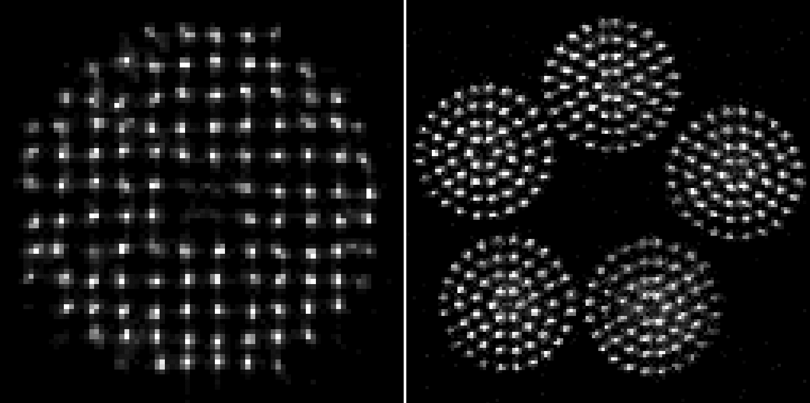
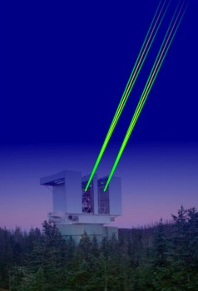
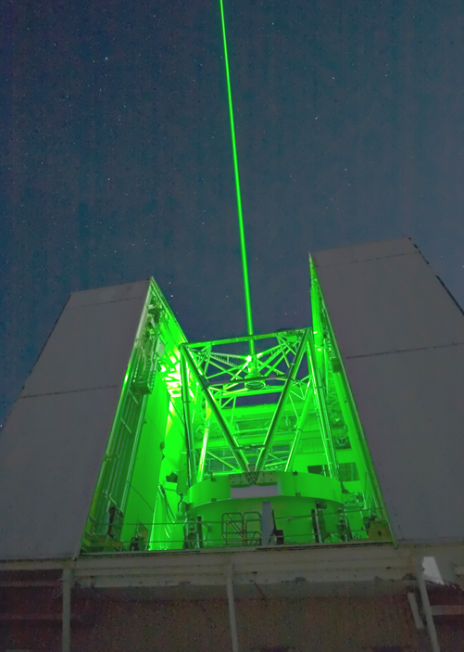
Competition Considerations:
GLAO at MMT, LBT, SOAR
Nominally in science operation at MMT & SOAR for several years
Commissioning at LBT
No (?) science results to date
SOAR
Notes:
The scientific demand for GLAO & its scientific productivity will be v. interesting to see
It makes so much sense to effectively produce better seeing conditions.
Time will tell if the user community will agree.
Science has started at the MMT but my underst is that the demand isn’t high yet
LBT system is very complex & commissioning will require some time

Slide 13
VLT Adaptive Optics Facility (Arsenault)
Notes:
GALACSI x2 EE in central pixel in GLAO (1’ FOV) → 24 vis IFUs; SR>5% at 0.65um in LTAO (7.5” FOV)
GRAAL x1.7 EE in central pixel (2x improvement in < 0.4” 50% EE at K) in GLAO (7.5’); SR=80% in K with SCAO
PAC scheduled for 4Q14

