Slide 1
Flat Field Forensics
Timothee Greffe – COO – 2017/07/06

Slide 2
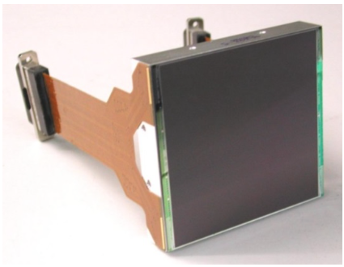
Intro | Downing Dip | Bilgi Bump | Next
CCD 231-C6 from e2v
6k by 6k sensor
15um pitch
350 ke- Full Well Capacity
Used in ZTF and WaSP cameras
All tests were performed using the WaSP camera

Slide 3
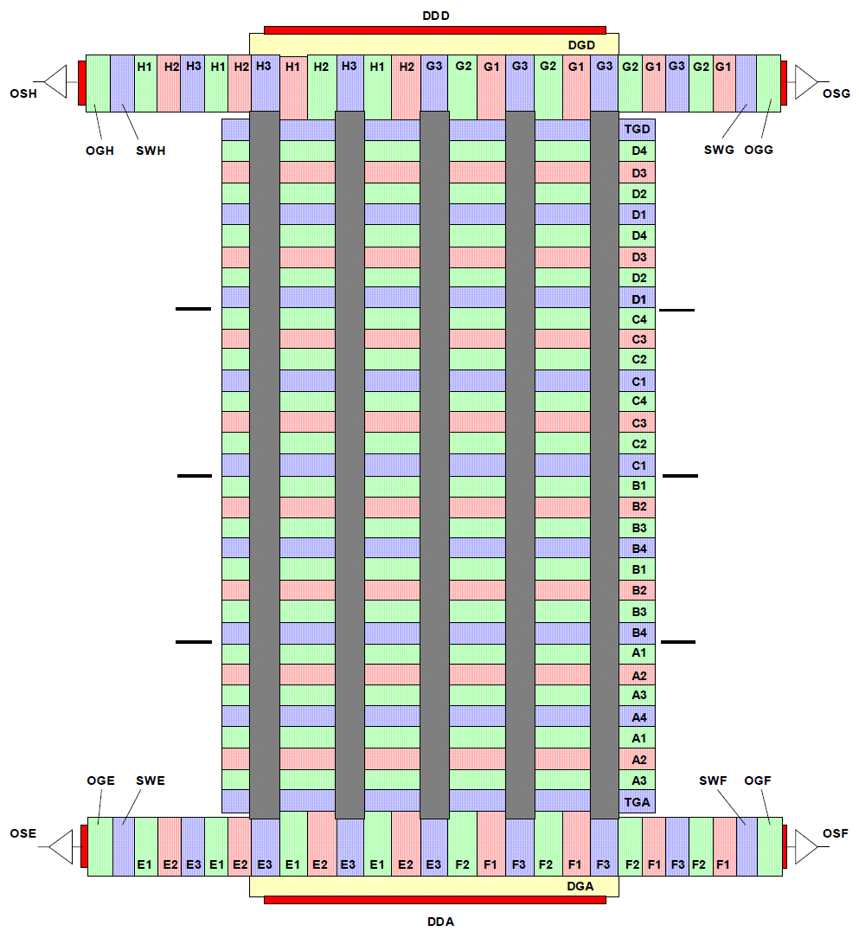
Intro | Downing Dip | Bilgi Bump | Next
“Up” Amplifiers
CCD231 Topology:
Image Area
“Down” Amplifiers

Slide 4
Intro | Downing Dip | Bilgi Bump | Next
Reminder : Charge Transfer
0
10
Potential
Serial
Register
Rφ
Transfer
Gate
Iφ4
Iφ3
Iφ2
Iφ1

Slide 5
Intro | Downing Dip | Bilgi Bump | Next
Initial goal and field of study : Steep the PTC by fine tuning

Slide 6
Intro | Downing Dip | Bilgi Bump | Next
One parameter available : Voltage of the Image phase clocks
-4
2
10
Potential
Rφ
TG
Iφ4
Iφ3
Iφ2
Iφ1

Slide 7
Intro | Downing Dip | Bilgi Bump | Next
Strange Dip appears for low common-mode voltage

Slide 8
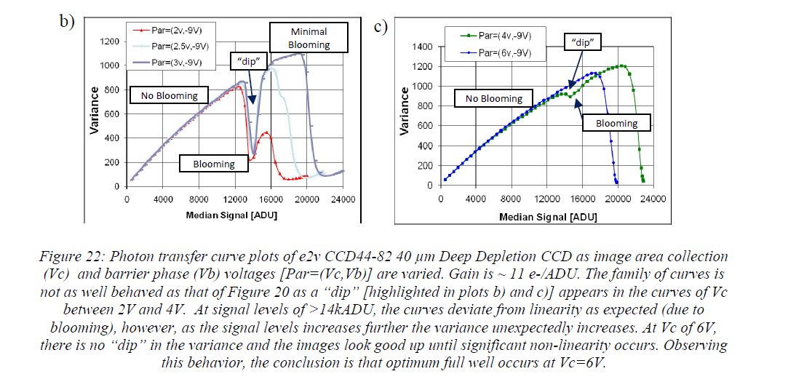
Intro | Downing Dip | Bilgi Bump | Next
Extract from “Bulk Silicon CCDs, Point Spread Function and Photon Transfer Curves: CCD testing activities at ESO”
Mark Downing et al.

Slide 9
Intro | Downing Dip | Bilgi Bump | Next
One might think : “ Who cares since we are not seeing anything wrong when driven with recommended voltage?”
All is not for the best, we must cultivate our garden.

Slide 10
Intro | Downing Dip | Bilgi Bump | Next
Focus on -4V to 2V voltage swing.
Blooming/FWC
Downing Dip
How can the noise decreases for a given luminosity level and recover good statistic later?

Slide 11
Intro | Downing Dip | Bilgi Bump | Next
Hypothesis: Drift of the whole image area after a given threshold

Slide 12




Intro | Downing Dip | Bilgi Bump | Next
What if during a pixel shift, we mix charges from a pixel to the next one?
A,σA
B,σB
$$C=\left(1−η\right)A+ηB$$
$$η∈ \left[0;1\right]$$
σC ?
C,σC
If uncorrelated noise
If correlated noise between A and B…
Additive term null in 0 and 1
1
1
0.5
0.5
0.5
$$η$$
0.5
$$η$$
1
1
=> But the dip in the PTC is not ½ depth…

Slide 13
Intro | Downing Dip | Bilgi Bump | Next
A drift mechanism can explain the “Downing Dip”
=> We have to figure out if it occurs, where, when and how….

Slide 14
Intro | Downing Dip | Bilgi Bump | Next
Hypothesis: Drift of the whole image area after a given threshold
Reference level for Cross-Correlation

Slide 15
Intro | Downing Dip | Bilgi Bump | Next
There is indeed a drift of the whole image area during the Downing Dip!

Slide 16
Intro | Downing Dip | Bilgi Bump | Next
Charge Transfer : How it should work
TGD | IPHI4 | IPHI3 | IPHI2 | IPHI1 | IPHI4 | IPHI3 | IPHI2 | IPHI1
Serial Register
Time

Slide 17
Intro | Downing Dip | Bilgi Bump | Next
Main Idea: What if the last IPHI4 node is missing?
TGD | IPHI4 | IPHI3 | IPHI2 | IPHI1 | IPHI4 | IPHI3 | IPHI2 | IPHI1
Serial Register
Time

Slide 18
Intro | Downing Dip | Bilgi Bump | Next
Recommended clocking with IPHI4 missing.
TGD | IPHI3 | IPHI2 | IPHI1 | IPHI4 | IPHI3 | IPHI2 | IPHI1
?
?
?
Serial Register
?
?
Time

Slide 19
Intro | Downing Dip | Bilgi Bump | Next
STATE I
Because of structural traps, charges can’t flow immediately to the serial register:
Everything seems to be ok.
TGD | IPHI3 | IPHI2 | IPHI1 | IPHI4 | IPHI3 | IPHI2 | IPHI1
Serial Register
X
Time

Slide 20
Intro | Downing Dip | Bilgi Bump | Next
STATE II
All the charges are flowing immediately to the serial register:
=> The whole image is shifted
TGD | IPHI3 | IPHI2 | IPHI1 | IPHI4 | IPHI3 | IPHI2 | IPHI1
Serial Register
Time

Slide 21
Intro | Downing Dip | Bilgi Bump | Next
New timing to get rid of this effect:
TGD | IPHI3 | IPHI2 | IPHI1 | IPHI4 | IPHI3 | IPHI2 | IPHI1
Serial Register
Time

Slide 22
Intro | Downing Dip | Bilgi Bump | Next
No Dip, No shift anymore!
“Downing Dip” defeated

Slide 23
Intro | Downing Dip | Bilgi Bump | Next
Back to the recommended voltage: 0V to 10V

Slide 24
Intro | Downing Dip | Bilgi Bump | Next
When looking closely :

Slide 25
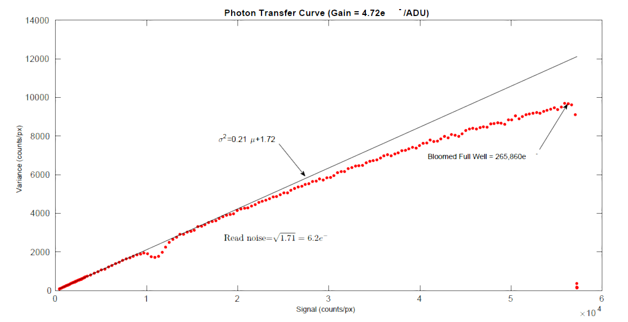
Intro | Downing Dip | Bilgi Bump | Next
Named after Pavan Bilgi, famous student at COO.

Slide 26
Intro | Downing Dip | Bilgi Bump | Next
Again, an effect with threshold implied!
No Pixel Shifting
=> Different mechanism leads to this behavior
Phenomenon already visible when using a different voltage on the image phases.
=> Not introduced during charge transfer over the image area.

Slide 27
Intro | Downing Dip | Bilgi Bump | Next
Voltage of the serial register is increased to “help” the charges flowing through it.
TGD | IPHI3 | IPHI2 | IPHI1 | IPHI4 | IPHI3 | IPHI2 | IPHI1
Serial Register
Time

Slide 28
Intro | Downing Dip | Bilgi Bump | Next
The “Bilgi Dump” disappeared!
“Bilgi Bump” defeated

Slide 29
Future investigations
Intro | Downing Dip | Bilgi Bump | Next
We’d like to see the last phase node missing or tied together with the previous one.
  => But yet no certitude : Our model rely on badly understood structural trap phenomenon
Call for ideas and comments.
A SWIR Camera might be used to inspect the sensor itself.

Slide 30
Thank you for your attention
Intro | Downing Dip | Bilgi Bump | Next

