Slide 1
Vacuum, Extreme Radial Velocity Experiment:
VERVE
An instrument for ultra-precise radial velocity measurements
J. Kent Wallace (JPL)
28 July 2015

Slide 2
Fellow Contributors
Michael Randolph, LCHS
Rebecca Jensen-Clem, CIT
Gautam Vasisht, JPL
Phil Muirhead, BU
Lynne Hillenbrand, CIT
Erik Hovland, JPL
Richard Dekany, CIT

Slide 3
Outline
Radial Velocity Measurement Overview
Instrument Description
Preliminary Data
Performance Predictions
Conclusion

Slide 4
Outline
Radial Velocity Measurement Overview
Instrument Description
Preliminary Data
Performance Predictions
Conclusion

Slide 5
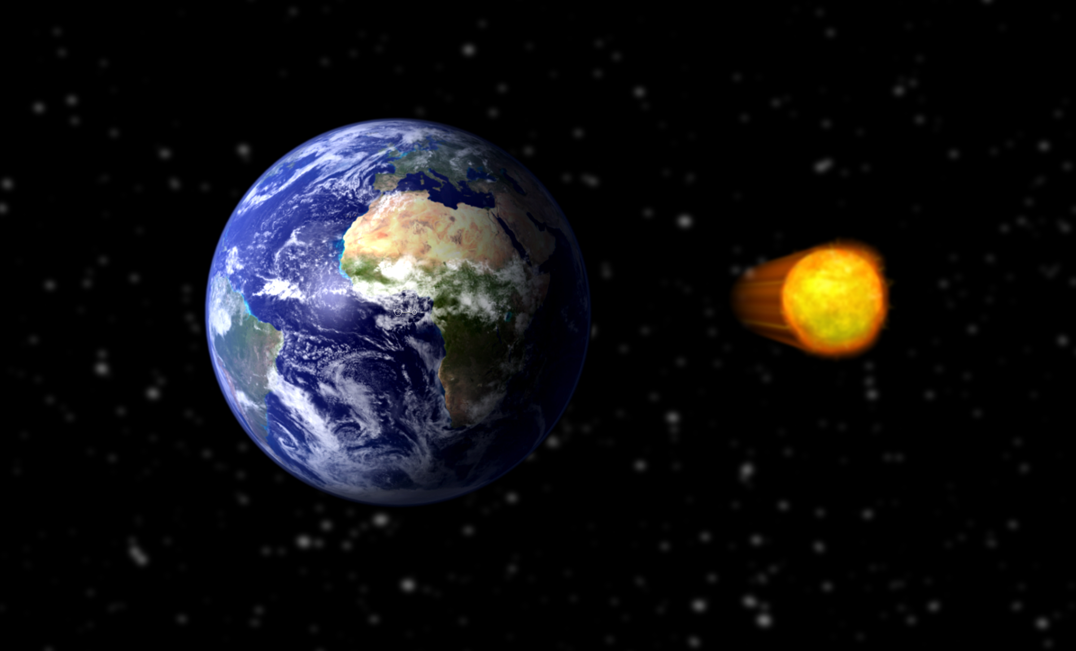
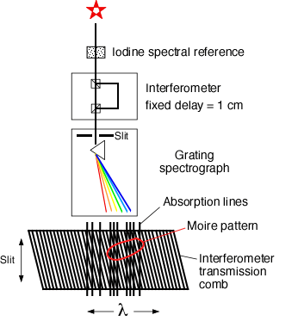
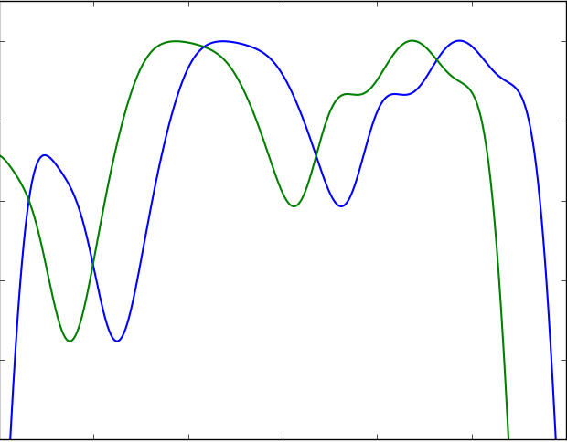
Radial Velocity Measurement Overview
1
Traditional
Spectroscopy
The Goal
Iodine spectral reference
Grating
spectrograph
ΔRV=10cm/s
The State of the Art: 70cm/s
Δλ = 1x10⁻⁵Å
Intensity
The Requirement:
Δλ = 2x10⁻⁶Å
Wavelength

Slide 6
Radial Velocity Measurement Overview
1
2
Traditional
Spectroscopy
Externally Dispersed Interferometry (EDI)
Iodine spectral reference
Scanning
Interferometer
Grating
spectrograph
Grating
spectrograph
Absorption lines
Moire pattern
Time
Interferometer
transmission
comb
Intensity
λ
spectralfringe.org
Wavelength

Slide 7
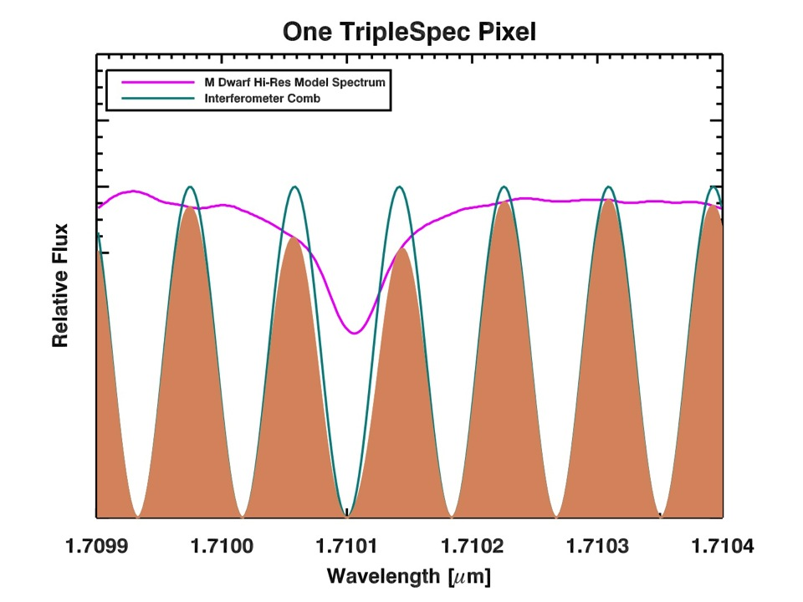
One Pixel
Relative Flux
5499.91
5499.95
5500
5500.05
5500.09
Wavelength [Å]
Image Credit: Phil Muirhead
Notes:
TSPEC sees the integrated light after multiplication by the comb: the tan area.

Slide 8
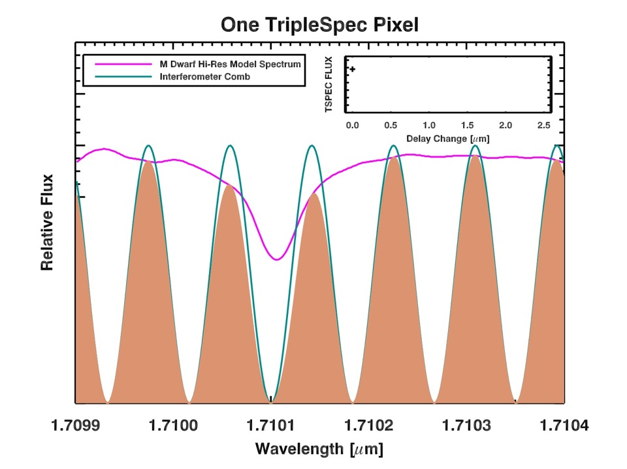
One Pixel
Flux
0.0
0.5
1.0
1.5
2.0
2.5
Delay Change [μm]
Relative Flux
5499.91
5499.95
5500
5500.05
5500.09
Wavelength [Å]
Image Credit: Phil Muirhead
Notes:
Now, I’m going to slightly piston the interferometer mirror to change the phase of the comb.
Watch the total flux in the pixel.

Slide 9
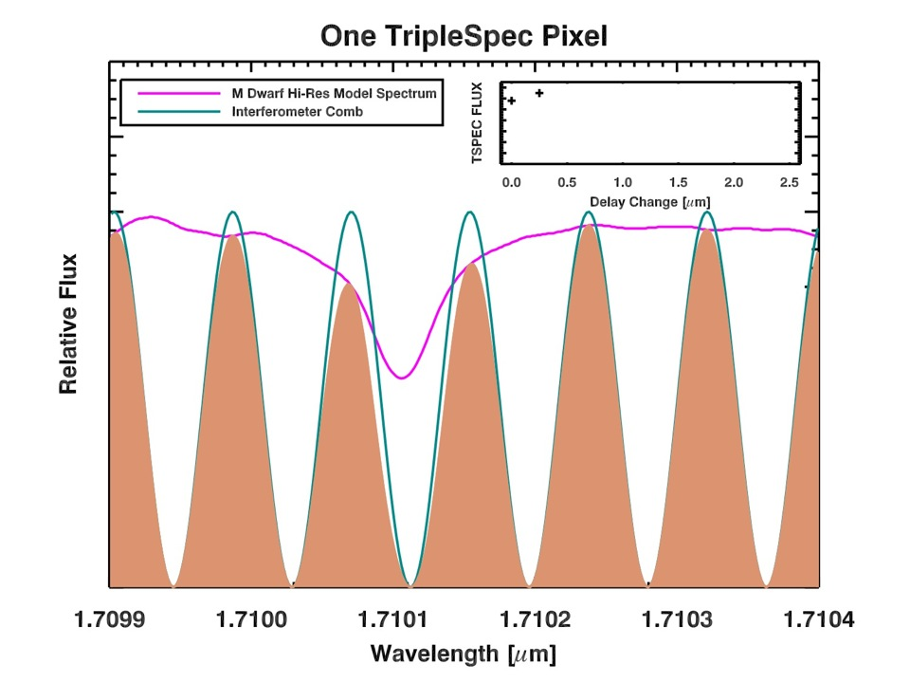
One Pixel
Flux
Flux
0.0
0.5
1.0
1.5
2.0
2.5
Delay Change [μm]
Relative Flux
5499.91
5499.95
5500
5500.05
5500.09
Wavelength [Å]
Image Credit: Phil Muirhead

Slide 10
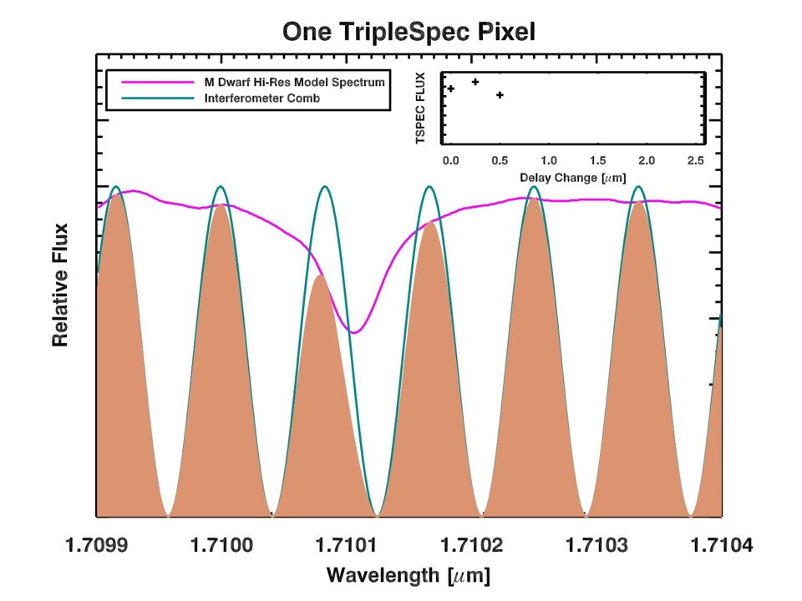
One Pixel
Flux
Flux
0.0
0.5
1.0
1.5
2.0
2.5
Delay Change [μm]
Relative Flux
5499.91
5499.95
5500
5500.05
5500.09
Wavelength [Å]
Image Credit: Phil Muirhead

Slide 11
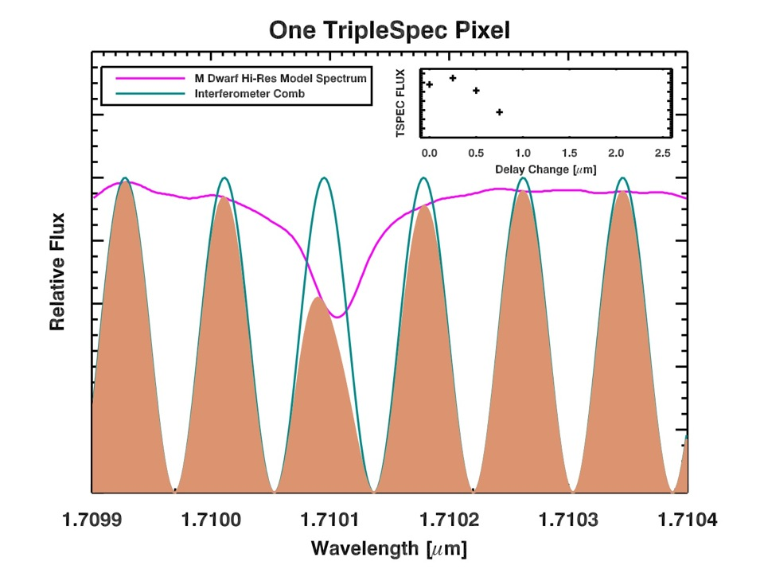
One Pixel
Flux
Flux
0.0
0.5
1.0
1.5
2.0
2.5
Delay Change [μm]
Relative Flux
5499.91
5499.95
5500
5500.05
5500.09
Wavelength [Å]
Image Credit: Phil Muirhead

Slide 12
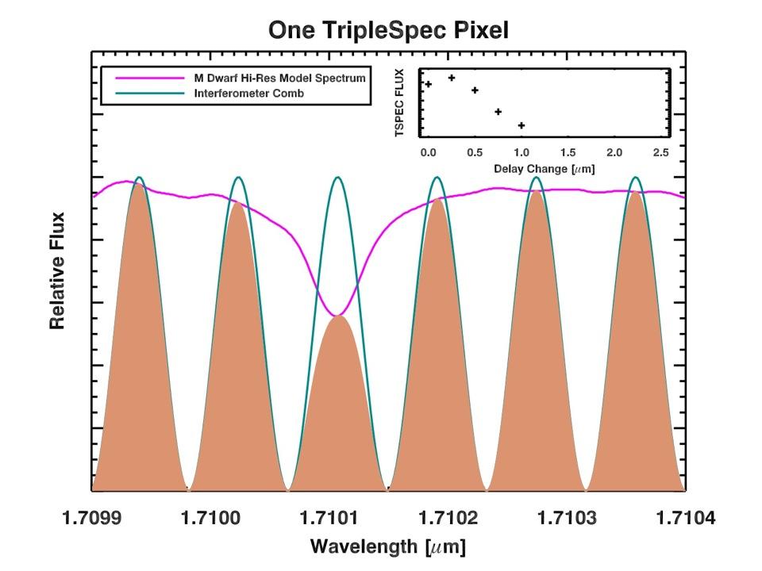
One Pixel
Flux
Flux
0.0
0.5
1.0
1.5
2.0
2.5
Delay Change [μm]
Relative Flux
5499.91
5499.95
5500
5500.05
5500.09
Wavelength [Å]
Image Credit: Phil Muirhead
Notes:
Absorption line bites into comb.

Slide 13
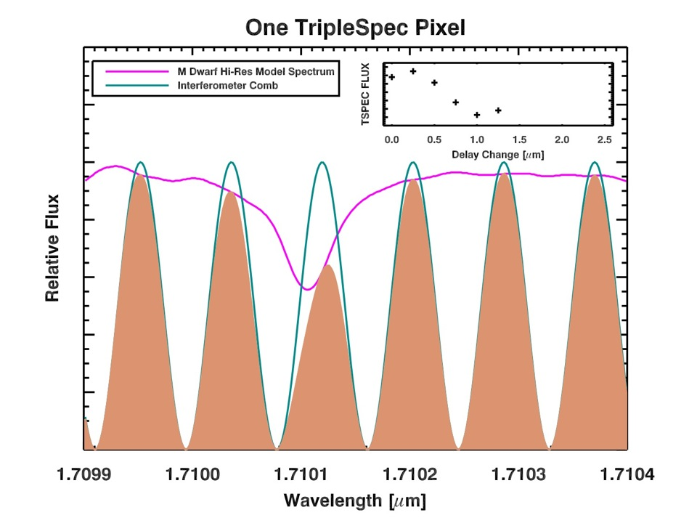
One Pixel
Flux
Flux
0.0
0.5
1.0
1.5
2.0
2.5
Delay Change [μm]
Relative Flux
5499.91
5499.95
5500
5500.05
5500.09
Wavelength [Å]
Image Credit: Phil Muirhead

Slide 14
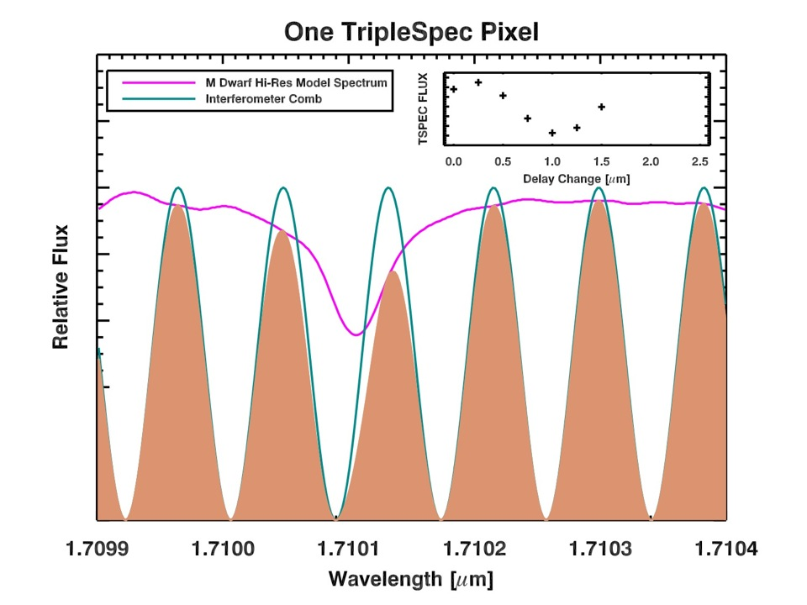
One Pixel
Flux
Flux
0.0
0.5
1.0
1.5
2.0
2.5
Delay Change [μm]
Relative Flux
5499.91
5499.95
5500
5500.05
5500.09
Wavelength [Å]
Image Credit: Phil Muirhead

Slide 15
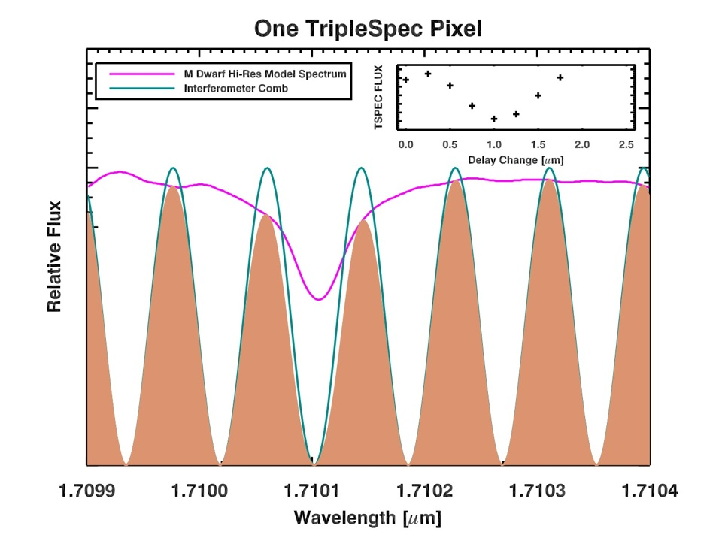
One Pixel
Flux
Flux
0.0
0.5
1.0
1.5
2.0
2.5
Delay Change [μm]
Relative Flux
5499.91
5499.95
5500
5500.05
5500.09
Wavelength [Å]
Image Credit: Phil Muirhead

Slide 16
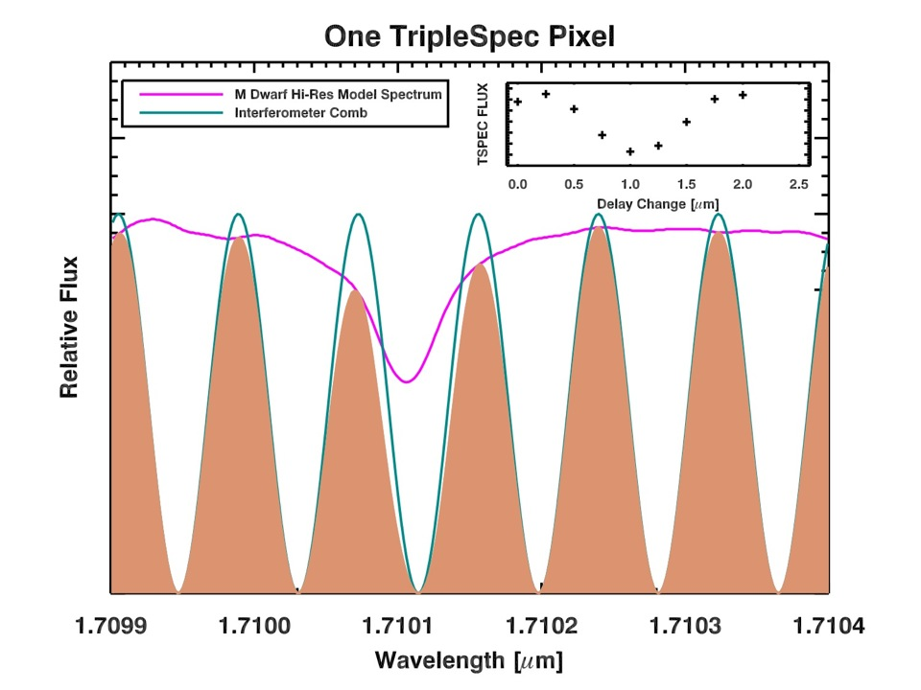
One Pixel
Flux
Flux
0.0
0.5
1.0
1.5
2.0
2.5
Delay Change [μm]
Relative Flux
5499.91
5499.95
5500
5500.05
5500.09
Wavelength [Å]
Image Credit: Phil Muirhead

Slide 17
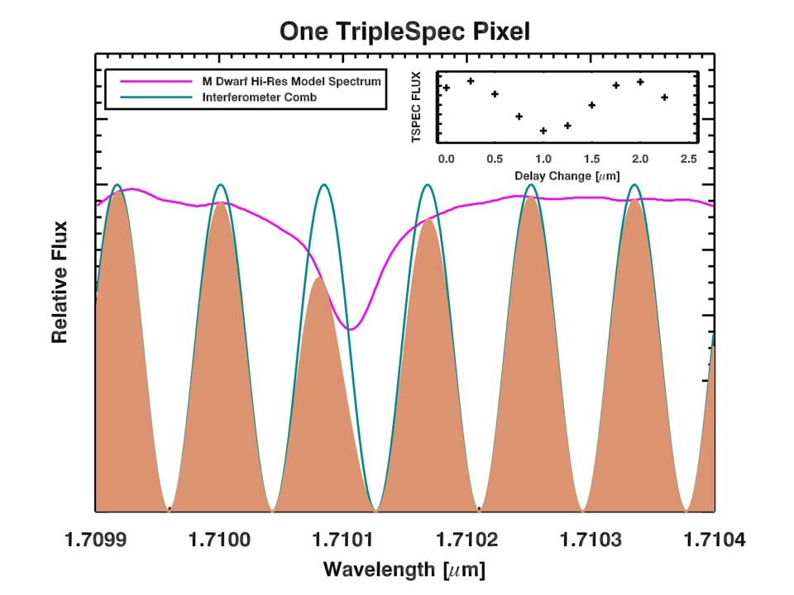
One Pixel
Flux
Flux
0.0
0.5
1.0
1.5
2.0
2.5
Delay Change [μm]
Relative Flux
5499.91
5499.95
5500
5500.05
5500.09
Wavelength [Å]
Image Credit: Phil Muirhead

Slide 18
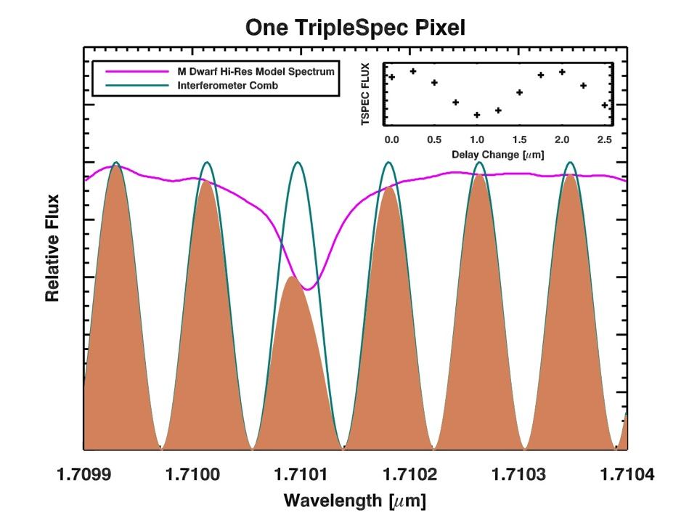
One Pixel
Flux
Flux
0.0
0.5
1.0
1.5
2.0
2.5
Delay Change [μm]
Relative Flux
5499.91
5499.95
5500
5500.05
5500.09
Wavelength [Å]
Image Credit: Phil Muirhead

Slide 19
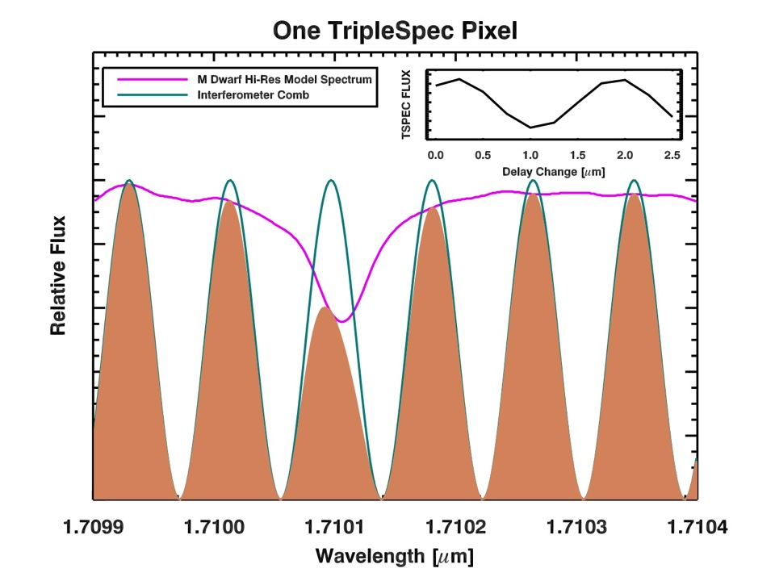
One Pixel
Flux
Flux
0.0
0.5
1.0
1.5
2.0
2.5
Delay Change [μm]
Relative Flux
5499.91
5499.95
5500
5500.05
5500.09
Wavelength [Å]
Image Credit: Phil Muirhead

Slide 20
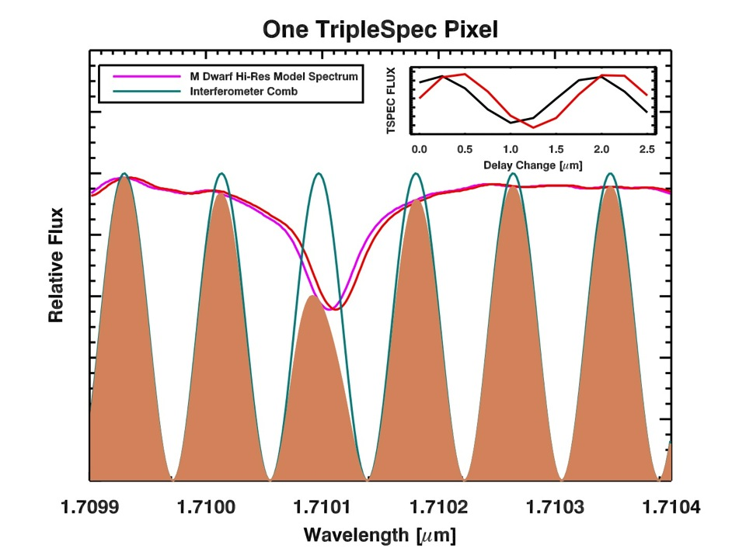
One Pixel
Flux
Flux
1 km/s Doppler Shift
0.0
0.5
1.0
1.5
2.0
2.5
Delay Change [μm]
Relative Flux
5499.91
5499.95
5500
5500.05
5500.09
Wavelength [Å]
Image Credit: Phil Muirhead
Notes:
A small change in RV causes a dramatic change in phase.
Imprinted an AC signal on each pixel.
One of thousands of pixels.
But, delay change calibration is critical.

Slide 21
Outline
Radial Velocity Measurement Overview
Instrument Description
Preliminary Data
Performance Predictions
Conclusion

Slide 22
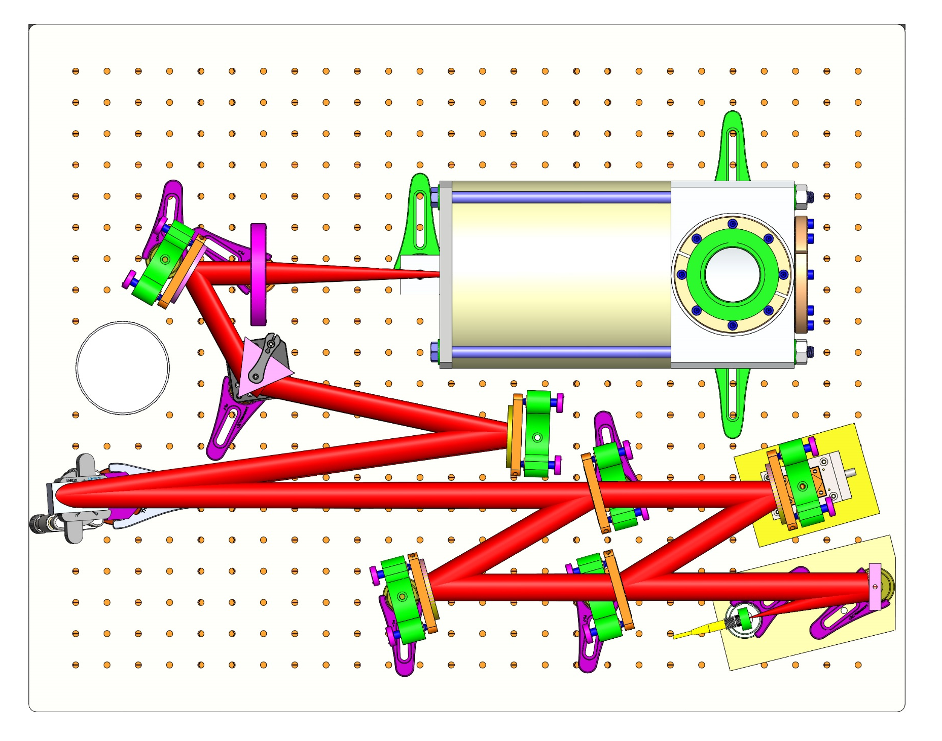
Instrument Description
Fold Mirror
Lens
Imaging Array
Prism
Grating
PZT
Flexure Stage
BS2
Fold Mirror
BS1
Fiber-Fed OAP

Slide 23
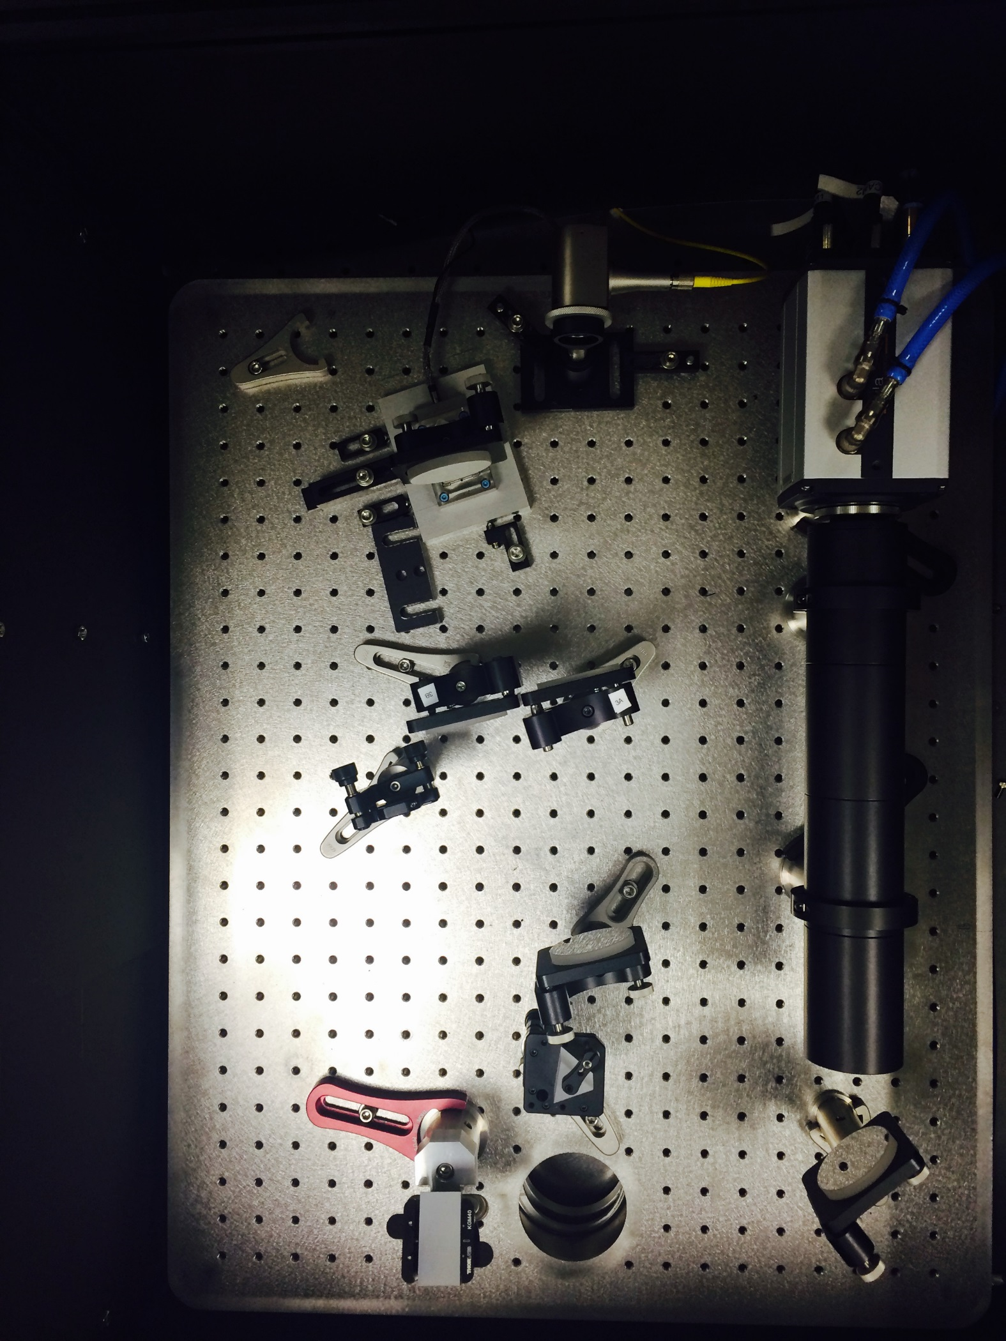
Instrument Description
Fold Mirror
Imaging Array
Lens
BS1
Fiber-Fed OAP
Prism
Grating
BS2
PZT
Flexure Stage
Fold Mirror

Slide 24
Outline
Radial Velocity Measurement Overview
Instrument Description
Preliminary Data
Performance Predictions
Conclusion

Slide 25
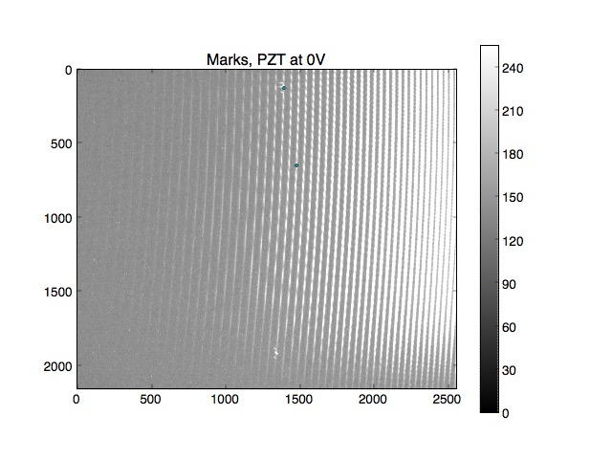
Preliminary Data

Slide 26
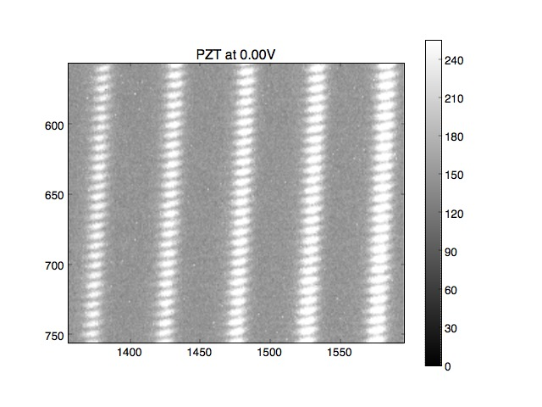
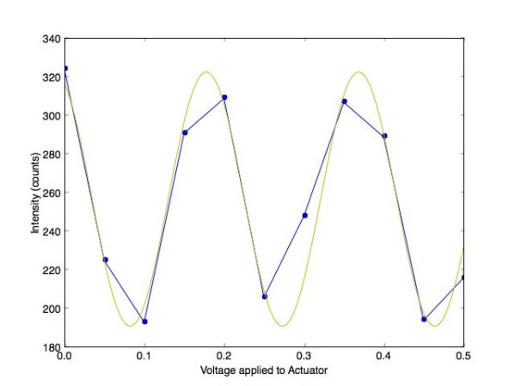
Preliminary Data

Slide 27

Preliminary Data

Slide 28
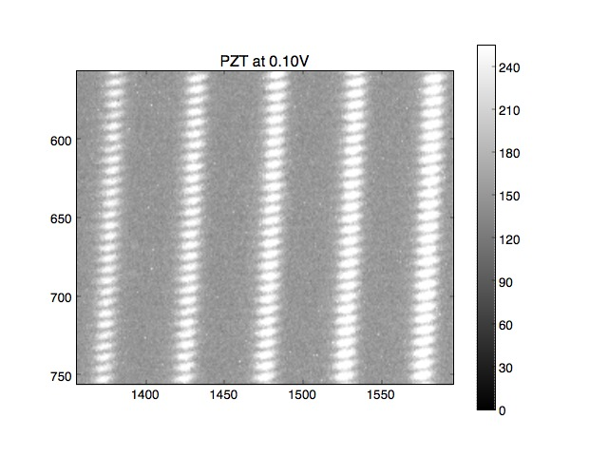
Preliminary Data

Slide 29

Preliminary Data

Slide 30

Preliminary Data

Slide 31

Preliminary Data

Slide 32

Preliminary Data

Slide 33

Preliminary Data

Slide 34

Preliminary Data

Slide 35

Preliminary Data

Slide 36

Preliminary Data

Slide 37
Outline
Radial Velocity Measurement Overview
Instrument Description
Preliminary Data
Performance Predictions
Conclusion

Slide 38
Performance Predictions
The Palomar 200” telescope would take about 0.075 seconds to reach an SNR=8 resolution element, given the assumptions in the above tables. For 425 scans, each with 200 0.075 sec phase steps, the 200” telescope would require about 1.8 hours to reach a radial velocity precision of 10 cm/sec.

Slide 39
Outline
Radial Velocity Measurement Overview
Instrument Description
Preliminary Data
Performance Predictions
Conclusion

Slide 40
Conclusion
Radial velocity precision of 10 cm/sec appears achievable with externally dispersed interferometry.
We are developing instrumentation to demonstrate this.
Low-noise detectors are critical to demonstrating this new instrument.

