Slide 1
Photon counting with Electron Multiplication CCDs
An introduction to
Roger Smith
Caltech
2015-07-28
With thanks to those who have posted slides on the internet, such as Peter Sinclair (ESO) and Jim Janesick.

Slide 2
A tutorial
What’s photon counting and when is it useful.
How it was done prior to CCDs?
Standard trade-offs.
Early problems
How does an EM CCD work?
Why we like CCDs for photon counting.
Remaining problems and what can be done.
Pushing the limits.

Slide 3
What’s photon counting
and when is it useful

Slide 4
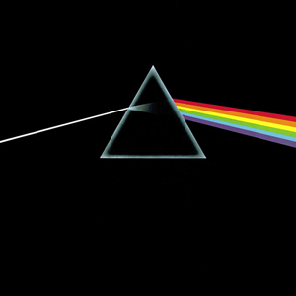
The Problem
Faint target or
time resolved
High spectral or spatial resolution
Dark side of the Moon
Pink Floyd, 1973
For high dispersion spectroscopy or time resolved observations, few photons per pixel per frame.
For some applications we would like to identify when each photon arrives.

Slide 5
Current performance
>80% QE from UV to ~900 nm
Per second … only 3 spurious counts
per million pixels !
All the features of standard CCDs, especially the ability to calibrate accurately since performance,

Slide 6
The big idea
In the optical we get one electron (or none) per photon.
We can never totally eliminate the noise floor in the measurement of this charge.
Best median ~ 1 e-, but broad distrbution.
So….
(Somehow) endow each electron with energy and use this to dislodge many electrons.
→ raise signal above noise floor

Slide 7
Signal Histograms
#
Read noise
Read noise +1 e-
1 e-
Output signal (volts)

Slide 8
Amplify the signal → exceeds noise
Ideal case
#
Gain variation plus noise
1 e- amplified
Output signal (volts)
BUT, gain variation from photon to photon is another kind of noise.
In fact it’s a worse kind of noise since it applies to bright signals not just faint ones.
THIS IS VERY BAD.
WHAT TO DO ????

Slide 9
Apply threshold → count photons
Ideal case
#
Gain variation plus noise
1 e- amplified
Output signal (volts)
Signal Threshold
Single photon events unambiguously identified.
No read noise.
Signal-to-noise ratio is given by Poisson statistics (variance=mean).
High frame rate with no penalty (at least in theory)
Photon arrivals can be time tagged.
Read-modify-write to memory in sync with sensor readout to count photons. → Image available for inspection during exposure.

Slide 10
Multiple events per pixel
Ideal case
#
Gain variation plus noise
1 e- amplified
2 e- amplified
Signal Threshold
2nd Signal Threshold
Maybe multiple events can be distinguished … ?
Cosmic rays are off scale and might be filtered out …?

Slide 11
Multiple events per pixel
Real world
#
Gain may saturate
Gain dispersion causes overlap
1 e- amplified
2 e- amplified
In practice multiple events are not reliably distinguished
→ counted as one event
Need high frame rate or to limit flux to avoid “coincidence losses”

Slide 12
Higher noise at high frame rate
Real world
#
Events not detected
1 e- amplified
Output signal (volts)
Signal Threshold
The higher frame needed to avoid coincidence losses requires higher bandwidth output amplifier (faster settling) → for white noise, total noise increases as √(pixel_rate).

Slide 13
Histograms overlap
Real world
#
Events not detected
1 e- amplified
Output signal (volts)
Signal Threshold
Attempting to recover these real events by lowering threshold will result in elevated dark counts due to electronic noise.

Slide 14
Increase gain to compensate
Real world
#
Events not detected, now reduced
1 e- amplified
Output signal (volts)
Signal Threshold

Slide 15
EMCCD gain histogram
Real world
#
Exponential gain distribution
P(n) = n/g*exp(-n/g)
Output signal (volts)
Signal Threshold
For EMCCD lowest gain has high probability.
Must operate at high gain to get most events out of noise band.
Minimizing pixel rate to reduce output noise will improve counting efficiency.
(lower frame rate, region of interest, mosaic of smaller CCDs)

Slide 16
EMCCD at lower frame rate
Real world
#
Events not detected, now reduced
P(n) = n/g*exp(-n/g)
Output signal (volts)
Signal Threshold
Lower pixel rate → reduce output noise to improve counting efficiency.
lower frame rate
region of interest
more output amplifiers
Mosaic of smaller CCDs)

Slide 17
Early photon counting imagers
To see why we like EMCCDs consider

Slide 18
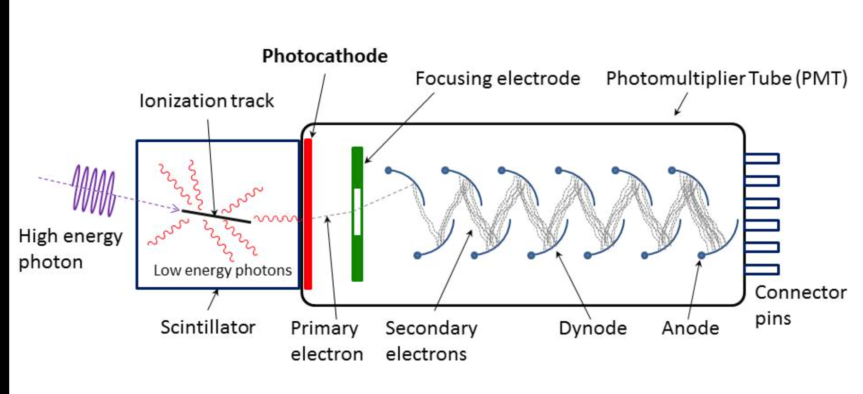
Photo-multiplier tubes 1934-today
Photo-electric effect works best for higher energy photons (blue/UV)
Photoelectric effect (Heinrich Hertz, Albert Einstein): photon liberates electron from metal alloy.
Accelerate with electric field
Impact liberates secondary electrons to provide gain (Westinghouse, 1919)
Very fast photon counting possible. No imaging capability

Slide 19
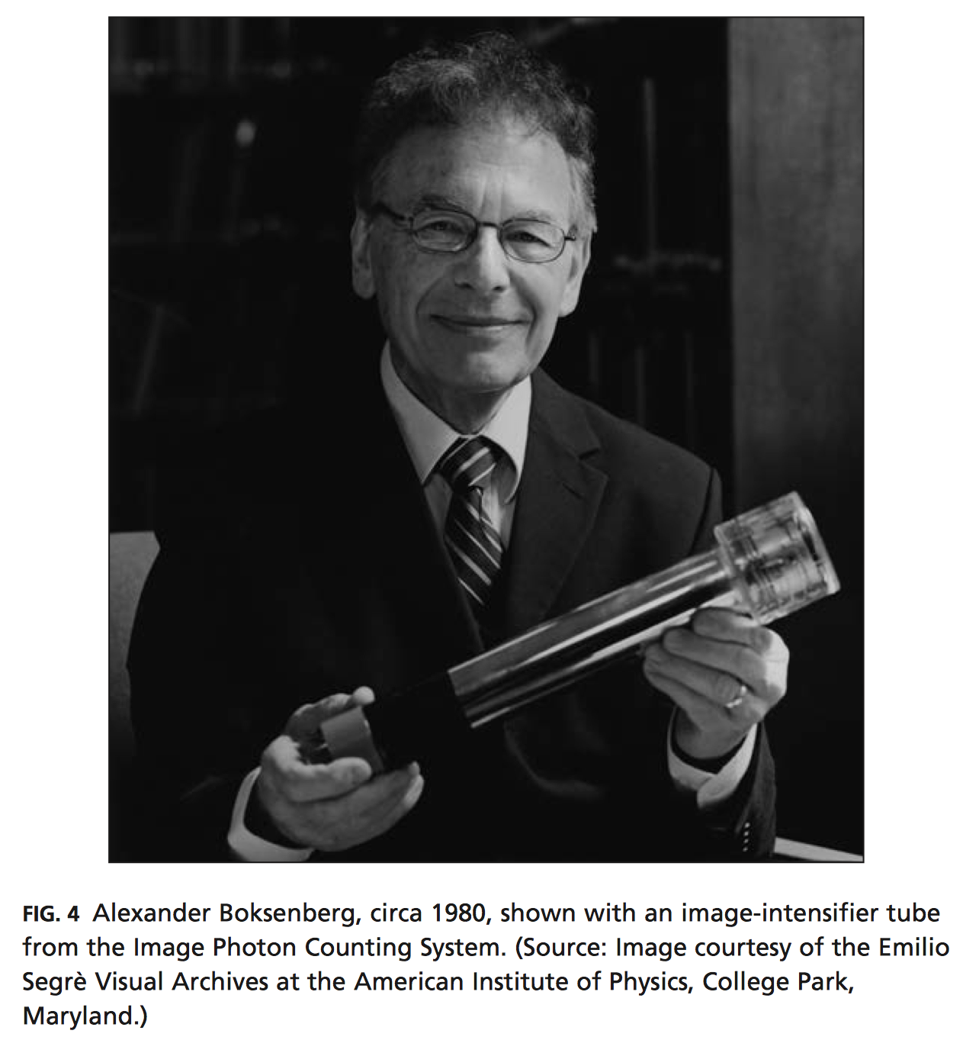
Magnetically focused image intensifier
Charge spirals around axial magnetic field lines
Tune ratio of electric and magnetic fields to charge makes integer number of circles about magnetic field lines → charge location at output phosphor matches input, independent of velocity when leaving photocathode.
Notes:
http://www.history.ucsb.edu/projects/histpublications/files/08269-2014_mccray_how_astronomers_digitized_sky.pdf

Slide 20
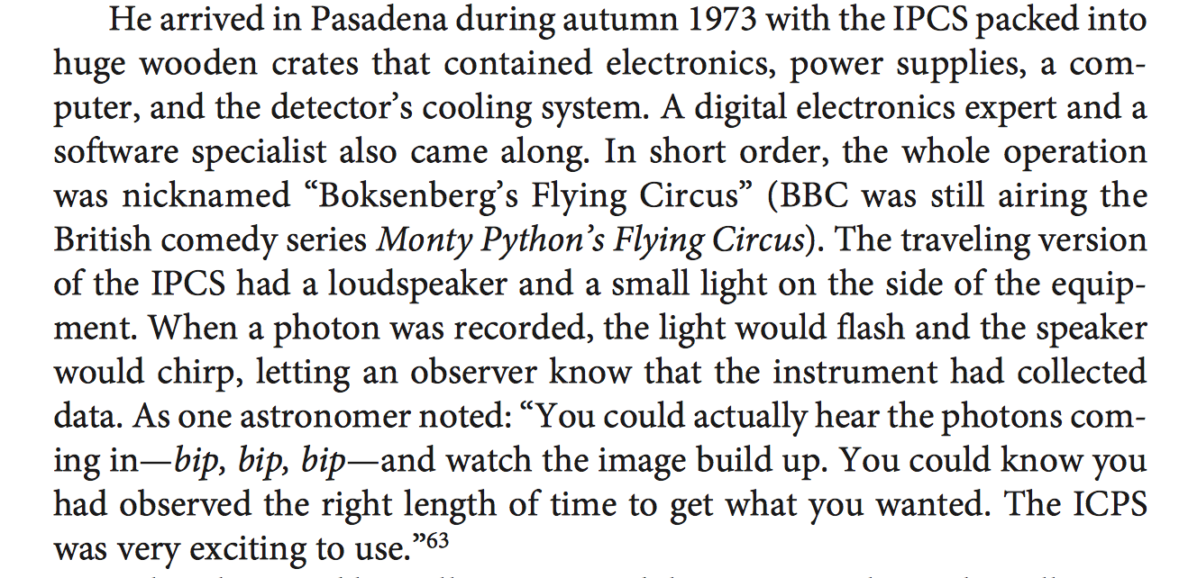
IPCS comes to Palomar in 1973

Slide 21
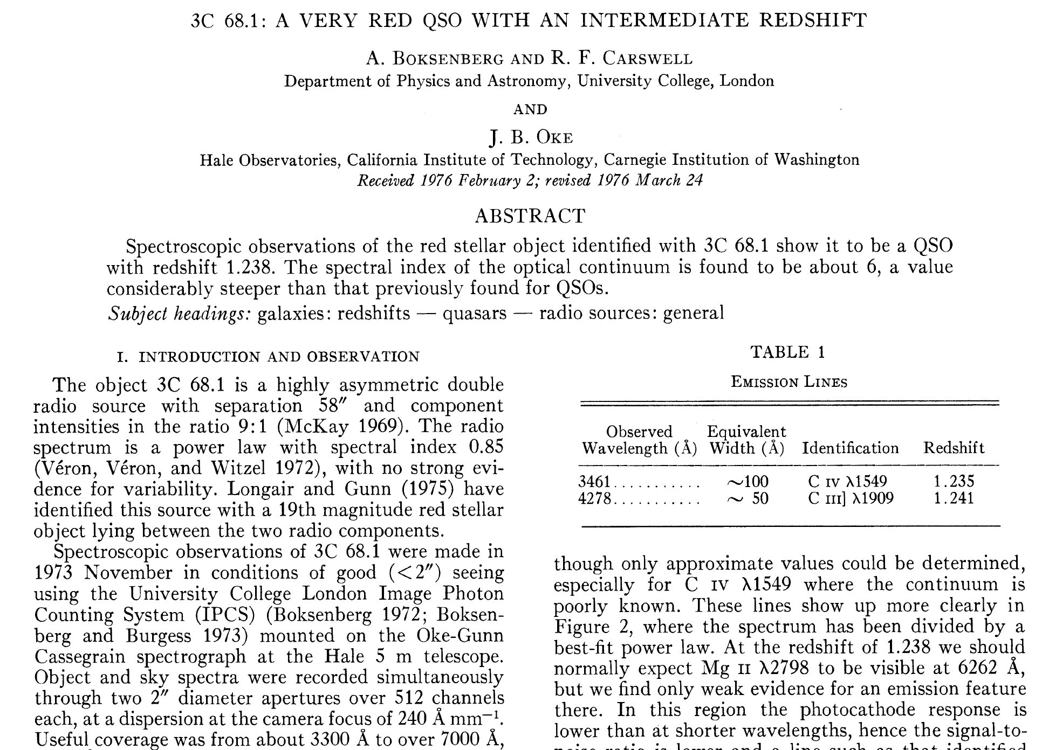

Slide 22
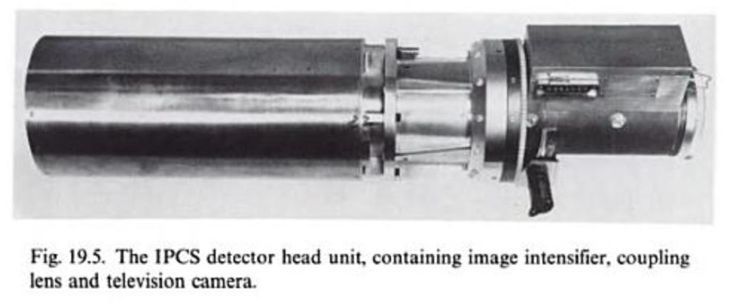
Image Photon Counting System

Slide 23
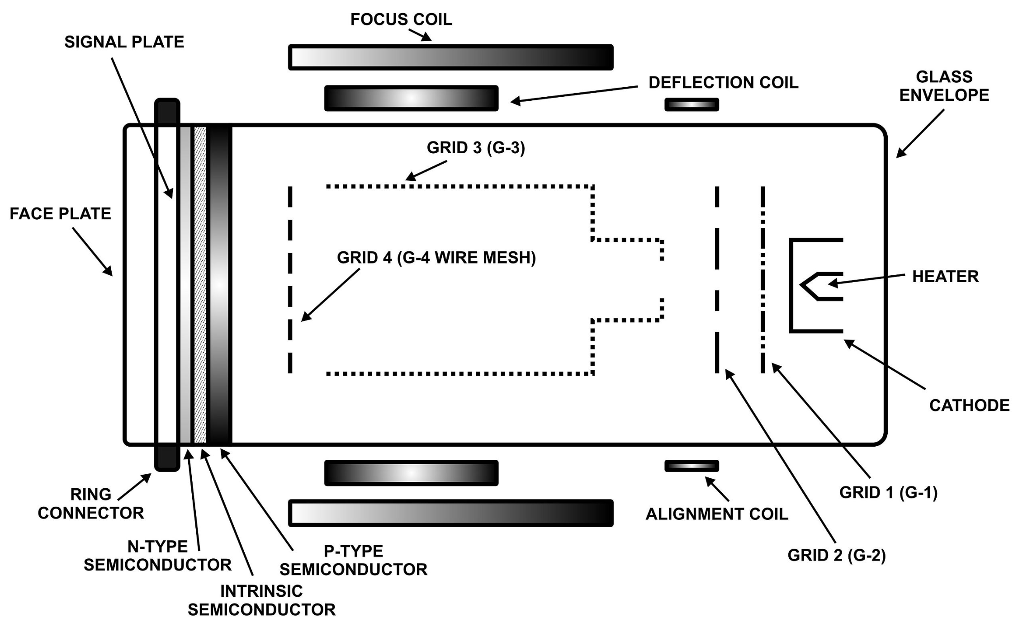
Schematic
Relay lenses
Plumbicon TV Tube with magnetic deflection
RCA 4 stage image intensifier
10 KV per stage
7 amps in solenoid at ~30V
Water cooled to ~0 C to keep dark current low
Notes:
https://en.wikipedia.org/wiki/Video_camera_tube#Plumbicon

Slide 24
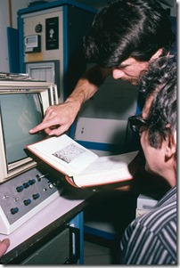
Pros Cons
No read noise
Time of photon arrival recorded
Programmable pixel size and location
QE ~20%; cannot exceed 50%
Pixel can move in response to
Drift in electronics
External magnetic fields
Count rate limit ~ 1ph/s/pix
Calibrations are very slow.
3 hours to get 1% SNR.
Complex and dangerous…
Image visible as it accumulates

Slide 25
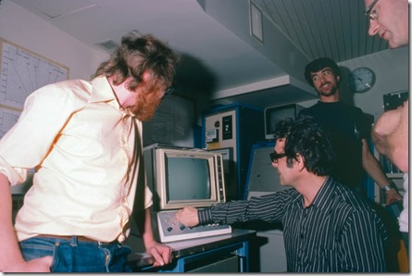
AAO control room, 1980
Roger Smith
IPCS support at AAO
John Fordham (IPCS electronics devloper)
Alec Boksenberg

Slide 26
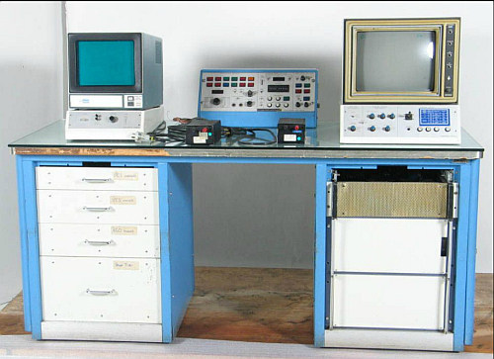
Now in science museum

Slide 27
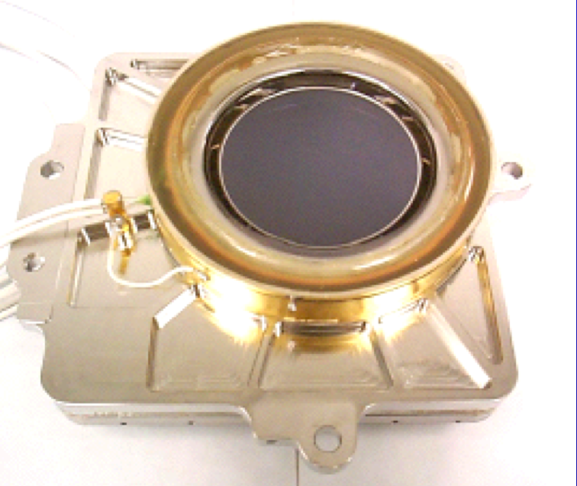
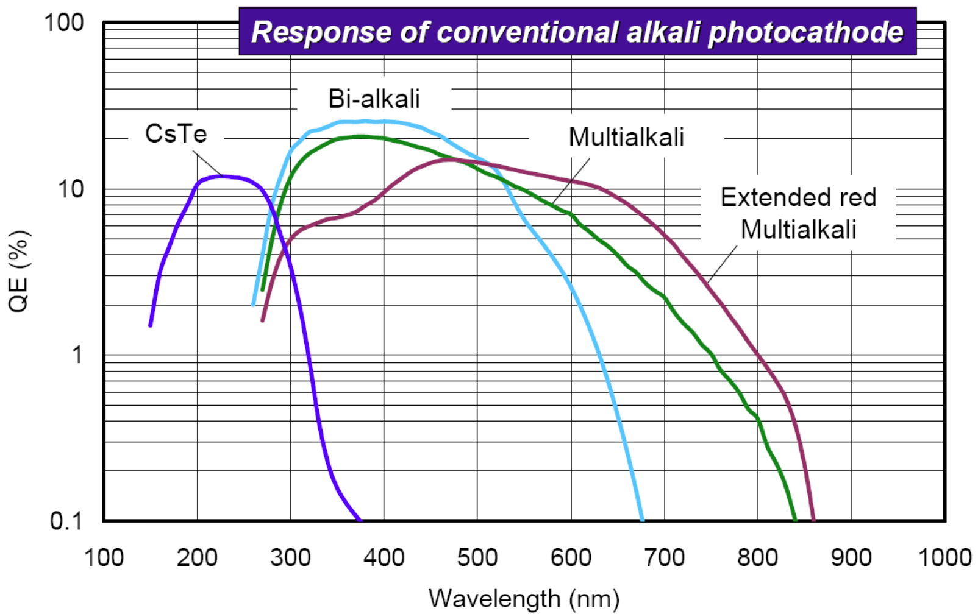
Intensifier + CCD, or strip line
Galex UV camera
Microchannel plate image intensifiers more stable
Plumbicon TV replaced by CCDs with lower noise so better counting efficiency
Image intensifiers still useful where solar blind UV sensor or fast gating is required, but….
Photocathode’s can’t match CCD QE.
Low noise of CCD has eroded parameter space in which photon counting is needed.

Slide 28
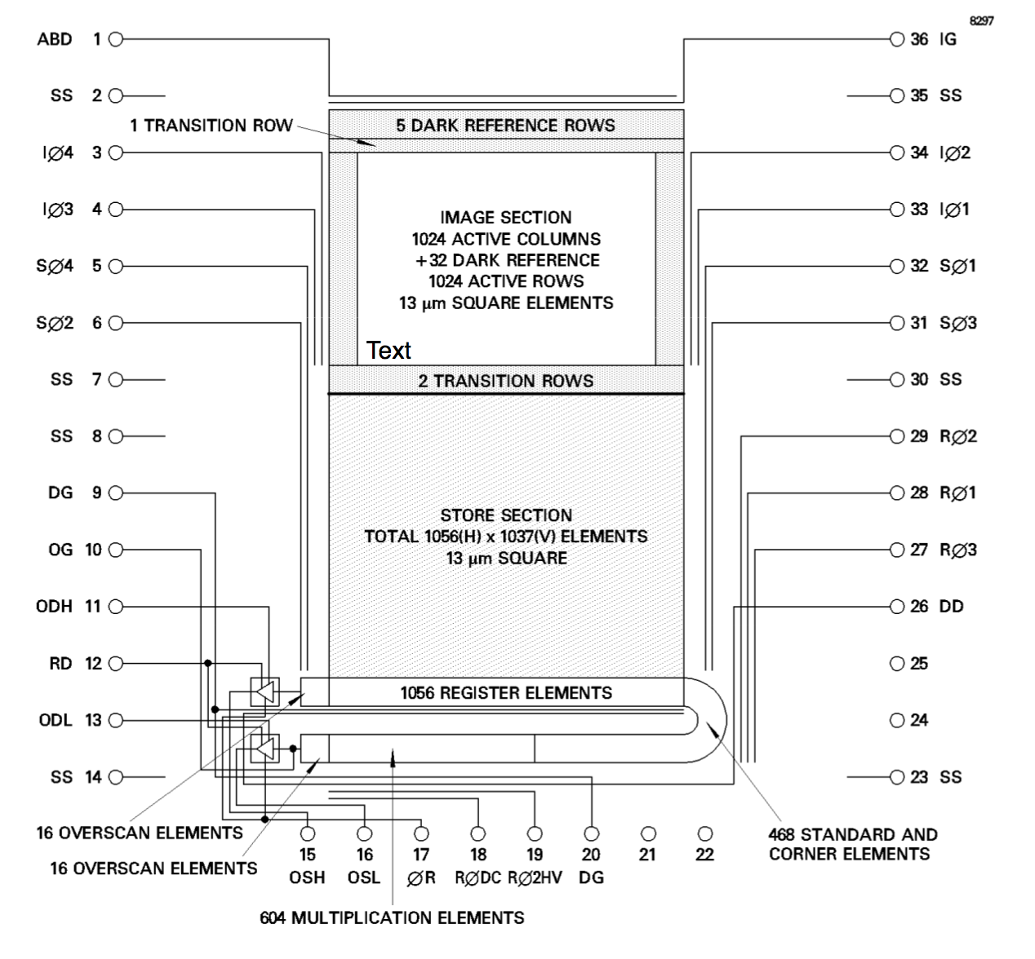
EMCCDs deliver high QE
Intensified CCD = Photocathode → intensifier → CCD
EMCCD = Conventional CCD → gain register
Normal output
Photon counting output

Slide 29
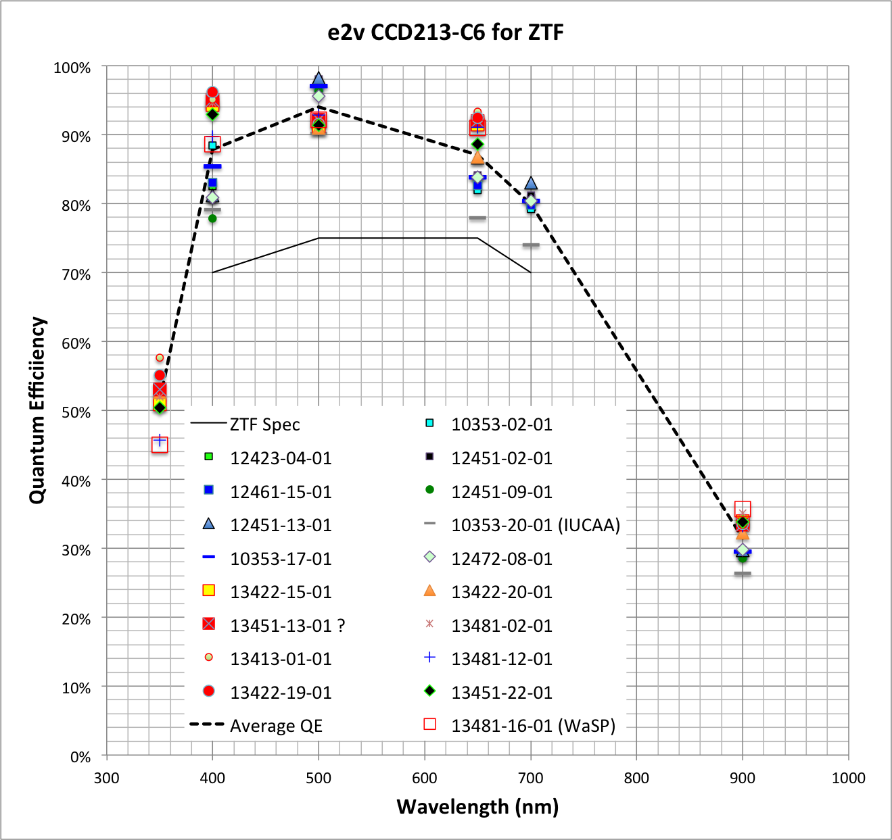
Typical QE for scientific CCD
6Kx6K CCDs recently procured for ZTF
We want this for photon counters too!

Slide 30
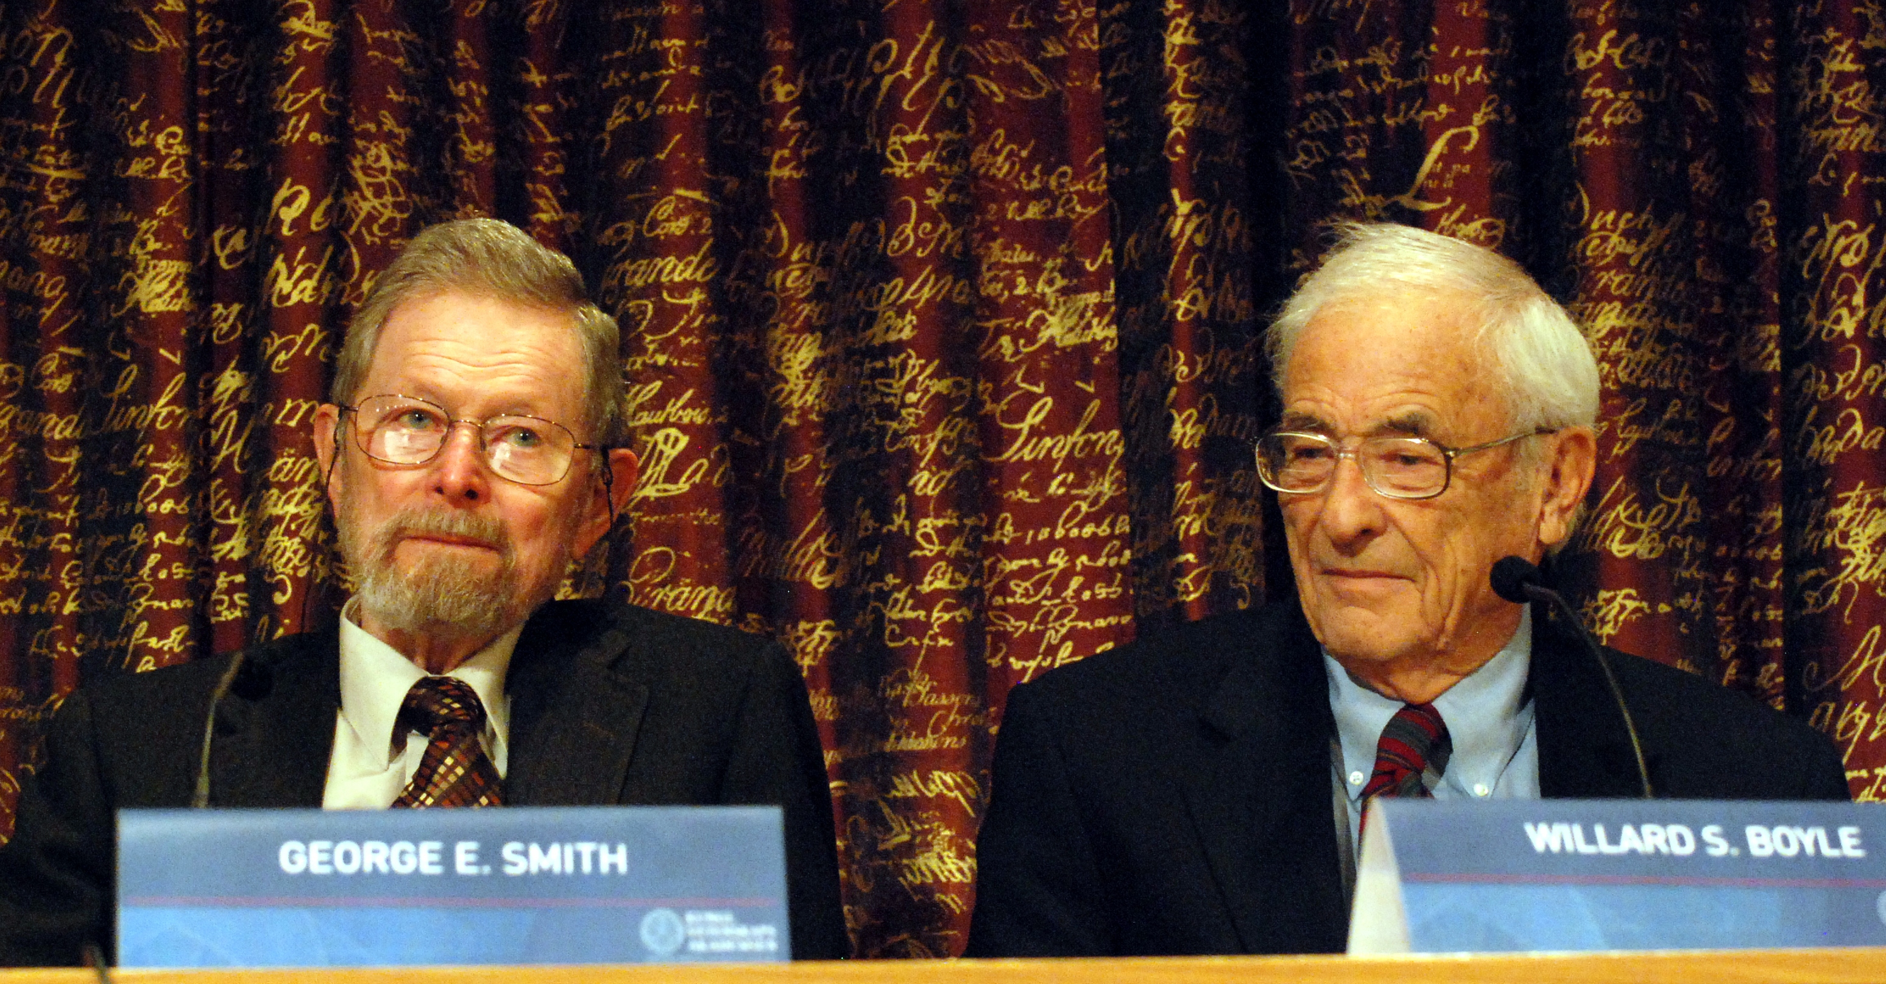
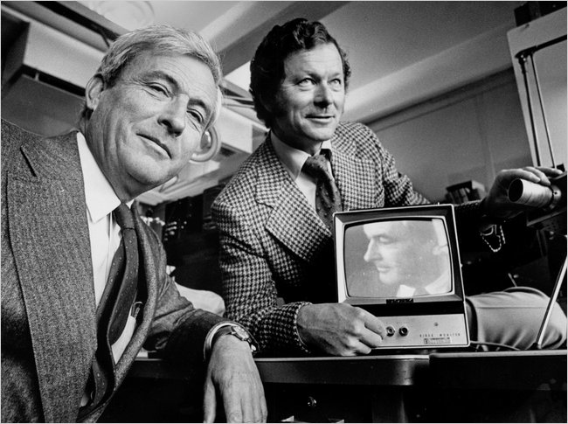
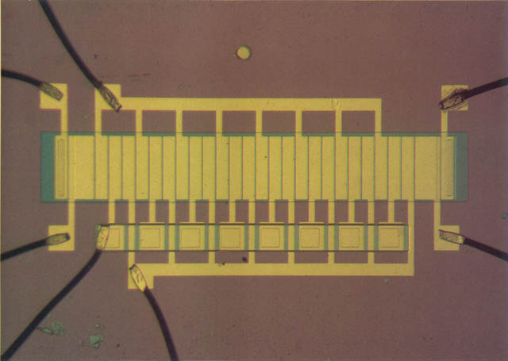
CCD was invented in 1969
Nobel Prize in 2006
Willard Boyle and George Smith

Slide 31
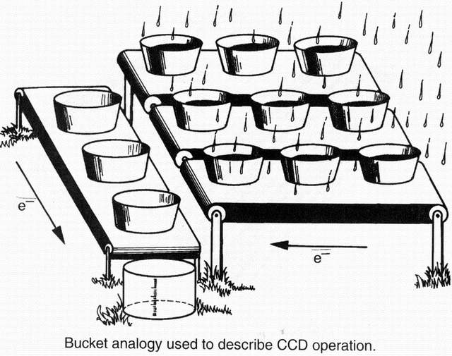
How CCDs work….

Slide 32
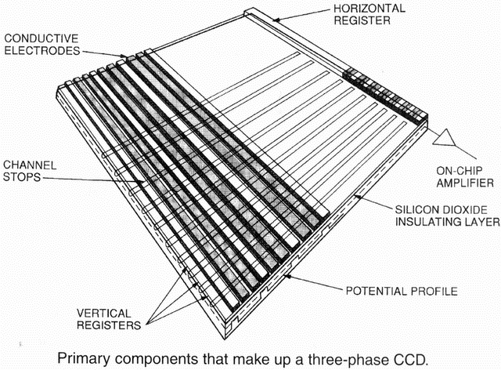

Slide 33
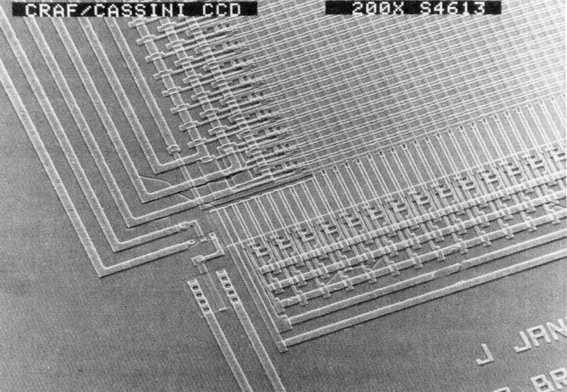

Slide 34
CCD basics
Every photon (λ<1 µm) not reflected, is absorbed making electron-hole pair.
Electrons are confined by electric field under capacitor plate.
p-n junction doped into silicon keeps charge away from traps at surface.
Manipulate voltages on capacitor plates to shift entire charge map towards output …without mixing pixels !!
Move charge onto ~32 fF output capacitance to produce ~ 5 µV per electron signal.
Low noise MOSFET relays output voltage to external electronics.

Slide 35
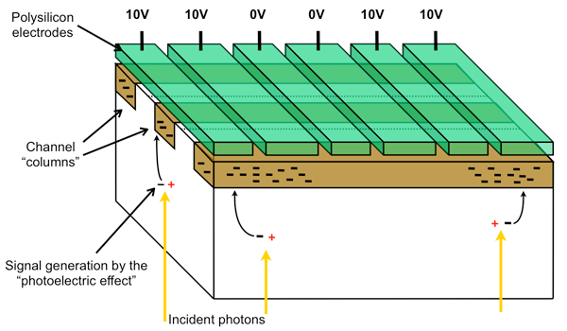
CCD storage in silicon under oxide-isolated electrodes

Slide 36
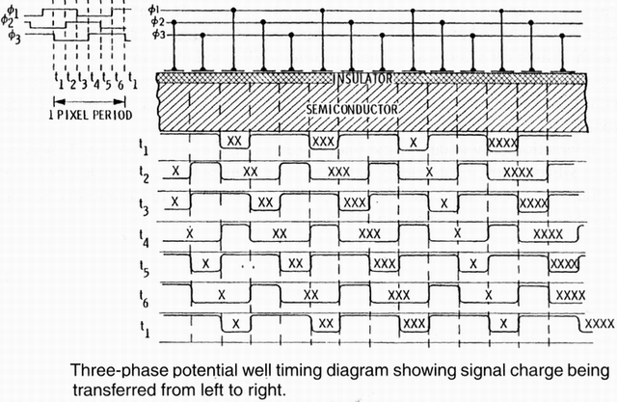
Charge transport

Slide 37
Charge transport

Slide 38
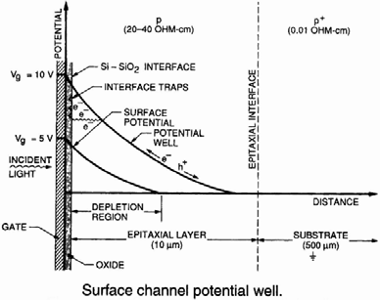
Problem: surface traps capture charge

Slide 39
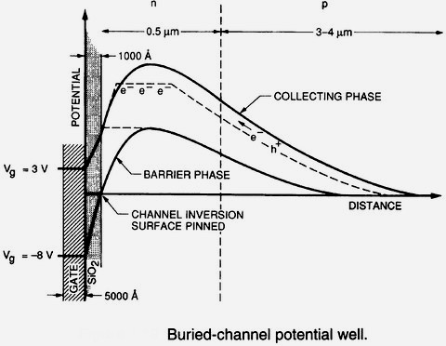
Solution: “buried channel”
Created by n-type implant into p-type substrate
Charge stored below surface

Slide 40
Solution: “buried channel”
Created by n-type implant into p-type substrate
When pixel fills…
charge spills over barrier just before reaching surface

Slide 41
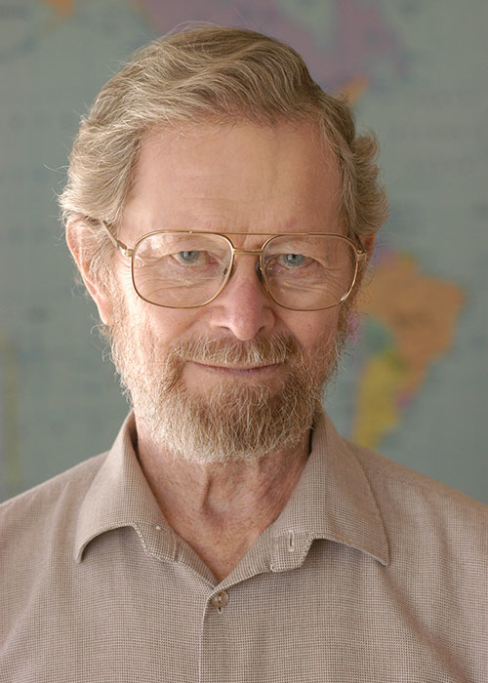
Gain register patented in 1973
George Smith had memory devices in mind, not photon counting.

Slide 42
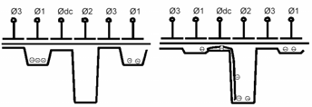
Avalanche mechanism
50V
With 40-50V on ϕ2 electrode, conduction band electrons falling into potential well gain enough kinetic energy to sometimes dislodge a valence band electron.
Probability of impact ionization is only a few percent but after ~600 transfers gain can be substantial.

Slide 43
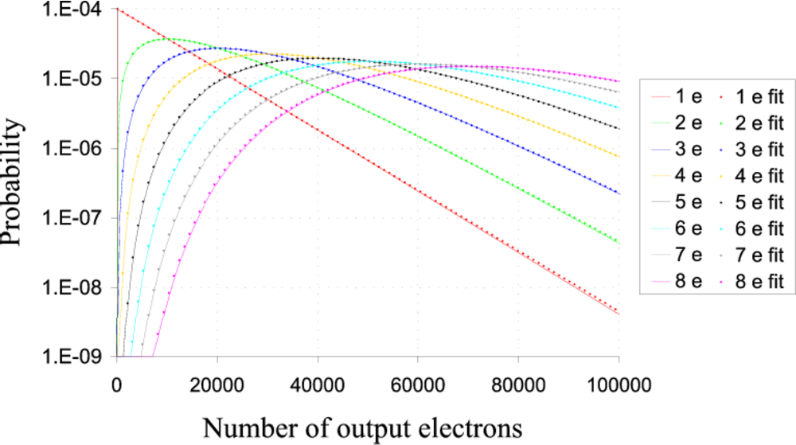
Gain distribution

Slide 44
Exponential output distribution for 1e- input
For one input electron (m=1), probability of n output electronics is exponential
P(n) = n/g * exp(-n/g)
Must operate at high enough gain to push most events above noise floor.
……What could go wrong with that?

Slide 45
Intensified CCD mode
When coincidence losses begin to become significant, one can switch to coadding frames without threshold detection.
The exponential distribution of gains results in noise that is proportional to signal with net effect of degrading S/N by √2 and is equivalent to halving the QE.
There is a narrow range of signals where this is preferable to conventional direct integration with unamplified readout.
EMCCDs can be operated in any of the modes:
Photon counting
Intensified
Integrating

Slide 46
Revisit potential diagram
Higher voltage
Peak moves towards surface → charge reaches surface sooner.
-
--
--
-
Higher gain so more charge to store
Charge trapped at by surface defects
Reducing temperature in search of lower dark current causes slower release of trapped charge → longer trails after cosmic rays or events experiencing high gain.
Storage
phase
Image processing required to avoid counting smear as separate event.
Barrier
phase

Slide 47
Calibrations – major advantage of EMCCD
Normal output can be used (or gain reduced) for calibrations at the higher count levels needed for good S/N.
Normal output
Photon counting output

Slide 48
Clock Induced Charge (CIC)
Typically less than 0.1 e-/pixel/frame liberated by normal clocking. Normally negligible but photon counting requires frequent enough readout to minimize coincidence losses so CIC can easily exceed dark current.
Mitigations:
Avoid surface inversion (holes moving in and out of channel stops)
Reduce parallel clock swing (image area needs negligible pixel capacity)
Slower edges (on parallel clocks)
Use minimum frame rate allowed by coincidence losses. Accept (and correct for) some coincidence losses.
Faster serial clocks (10MHz) are required to reduce serial CIC (i.e. this always true … some dissenting opinion). This makes clock driver, and waveform design more challenging, and raises noise floor.
Temperature dependence ??

Slide 49
Charge trapping in image area
Since pixels are mostly empty, even shallow charge traps will defer charge.
Need particularly good quality silicon to minimize trap density.
If light levels are low enough, use slow tri-level parallel clocking to allow trapped charge time to be released and returned to pixel.
If running very cold charge can be injected (single bright line) between frames to fill traps. Eventually these will release resulting in higher dark current at trap site but preferable to blocked column.

Slide 50
Summary of Advantages
Noiseless, like original photon counters
Excellent QE (same as conventional CCDs).
Stable performance → accurate calibrations.
For more dynamic range, easily switched to “intensified” or “integrating” modes → high S/N for calibrations in relatively short exposures.
All features and modes of standard CCD available.
Extremely low dark current achieved: 0.01 e-/hr = one count per 360,000 pixels in one second

Slide 51
Challenges
Clock Induced Charge, especially serial.
Traps in image area.
Need high gain for good counting efficiency → some complications when running very cold for low dark current.
Mysterious dark current floor at low temperature.
For UV:
Lower bandgap of silicon compared to UV photocathode requires lower temperature to achieve similarly low dark current.
Wide wavelength response problematic in applications which need to be “solar blind”

