Slide 1
Concurrent Vertical and Horizontal CCD Clocking

Slide 2
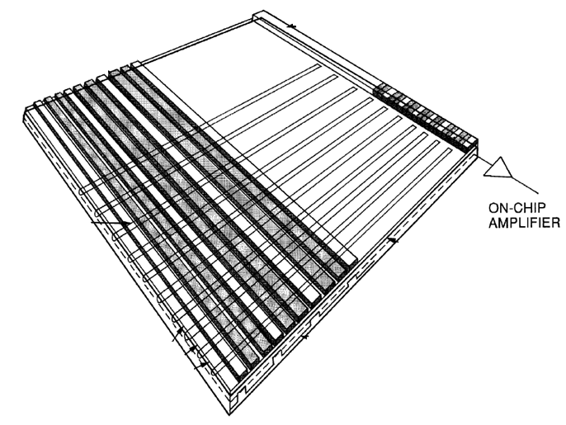
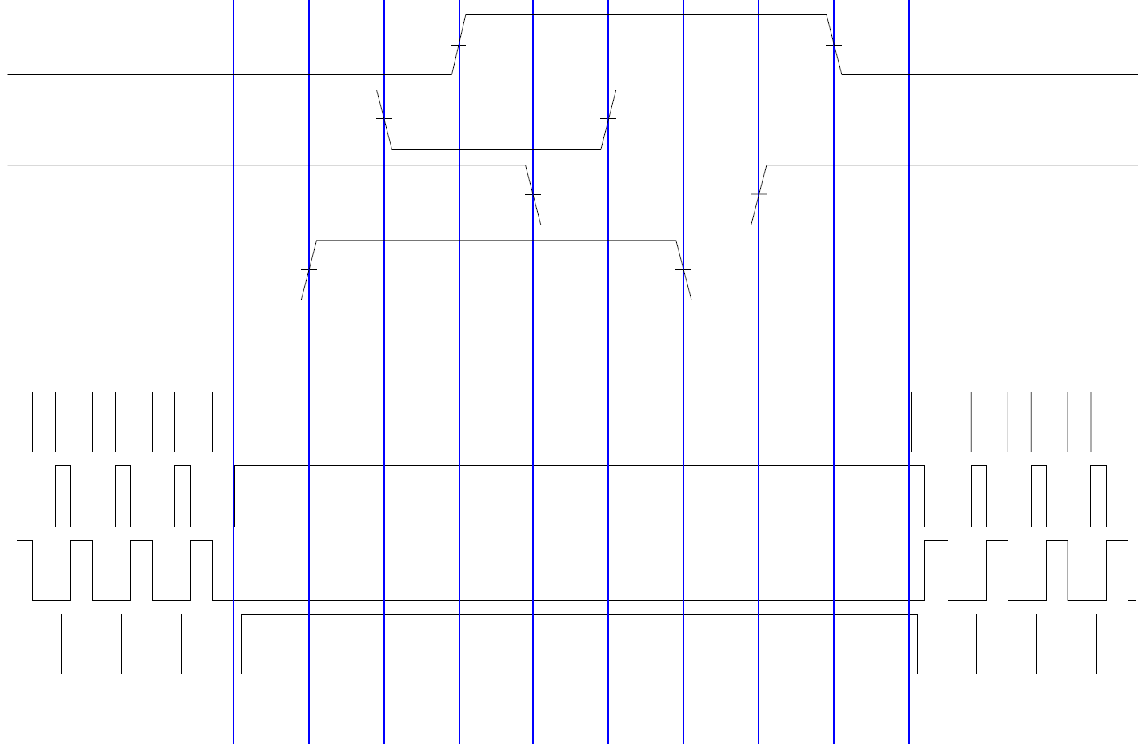
Technique Motivation Method part 1 Method part 1 Method part 3 Further steps
Typical CCD
Pixels
Line transfer (~ 0.2 ms)
Pixels (~ 1ms)
Line transfer
Serial register
Voltage
Electrodes
CCD [ Janesick, 2001]*
Time

Slide 3
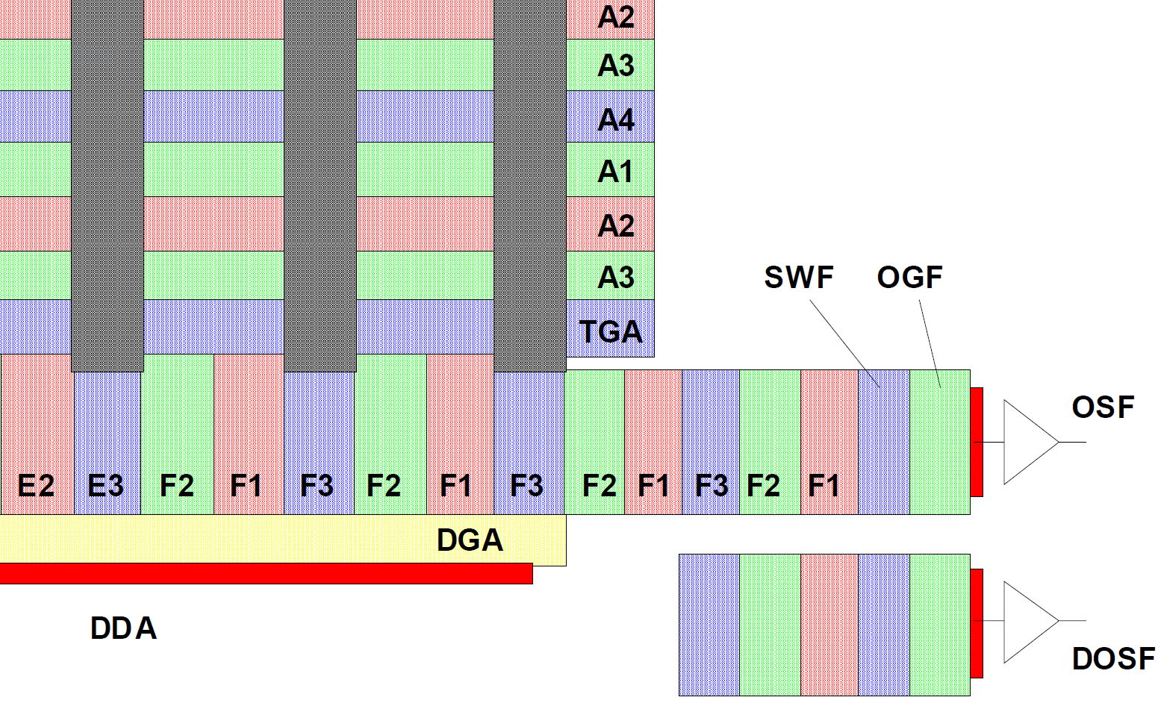
Technique Motivation Method part 1 Method part 1 Method part 3 Further steps
Standard Parallel shift
A2
A3
A4
A1
A2
LAST LINE
A3
TGA
Voltage
Time

Slide 4
Technique Motivation Method part 1 Method part 1 Method part 3 Further steps
Standard Parallel shift
LINE
DUMP (~ 25 us)
A4
A4
TG
A1
A2
A3
A1
A2
A3
SERIAL

Slide 5
Technique Motivation Method part 1 Method part 1 Method part 3 Further steps
Concurrent clocking
A2
A3
A4
A1
A2
LAST LINE
A3
TGA
Voltage
Time

Slide 6
Technique Motivation Method part 1 Method part 1 Method part 3 Further steps
Concurrent clocking
Use a short pulse for Transfer Gate
Use a staircase potential slide for line dump into serial register
A4
A4
TG
LINE
DUMP (~ 3 us)
A1
A2
A1
A2
A3
A3
SERIAL

Slide 7
Technique Motivation Method part 1 Method part 1 Method part 3 Further steps
Immediate benefits
6% reduction in ZTF CCD readout time.
Average 10 hours/night with 25s exposure time:
10s readout ➔ 10*3600/(25+10) = 1029 exposures/night
9.4s readout ➔ 10*3600/(25+9.4) = 1047 exposures/night
= 18 more frames per night

Slide 8
Technique Motivation Method part 1 Method part 1 Method part 3 Further steps
How fast to pulse TG?
$x$, length along Transfer Gate
Time
$$\frac{dV}{dt}=\frac{1}{rc}⋅\frac{d^{2}V}{dx^{2}}$$
$r$, resistivity and $c$, the capacitance per unit volume of electrode
How steep for last line potential staircase?

Slide 9
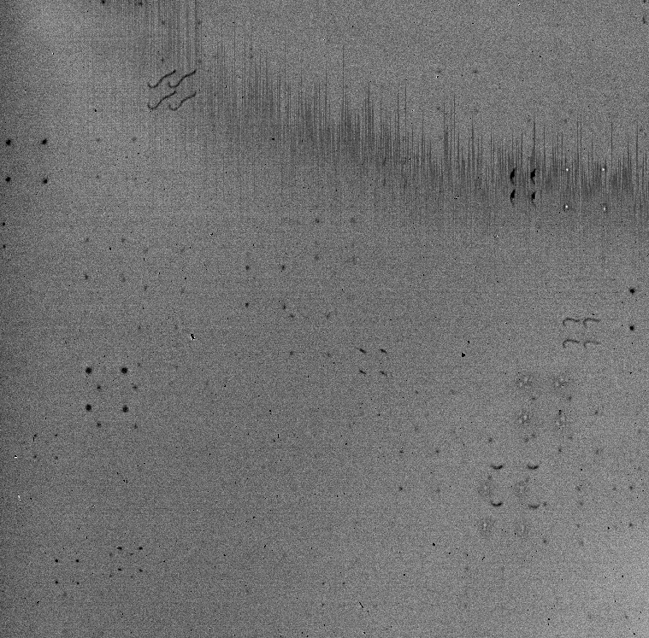
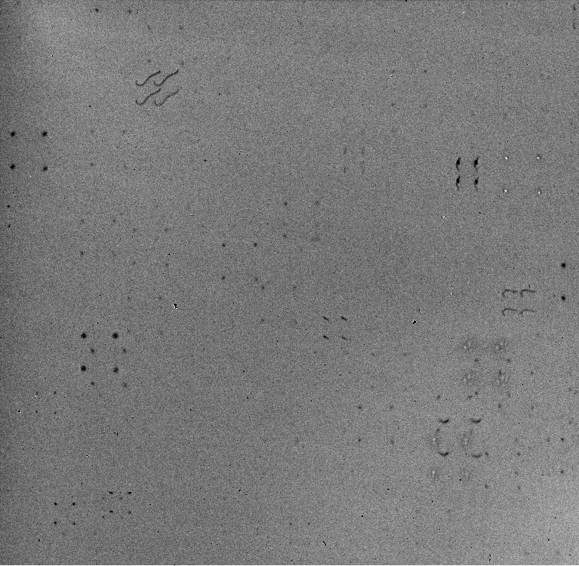
Technique Motivation Method part 1 Method part 1 Method part 3 Further steps
TG pulse 1us, Step of 0.5V
TG pulse 5us, Step of 2V

Slide 10
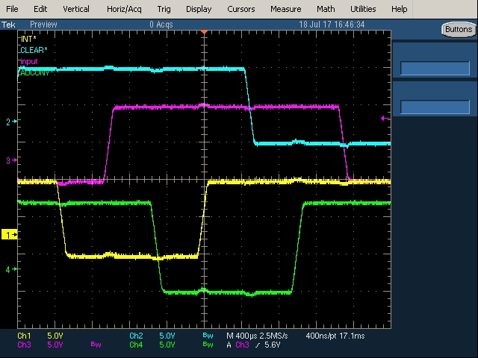
Technique Motivation Method part 1 Method part 2 Method part 3 Further steps
Step 2
Now add serial clocking and slow the parallel clock edges

Slide 11
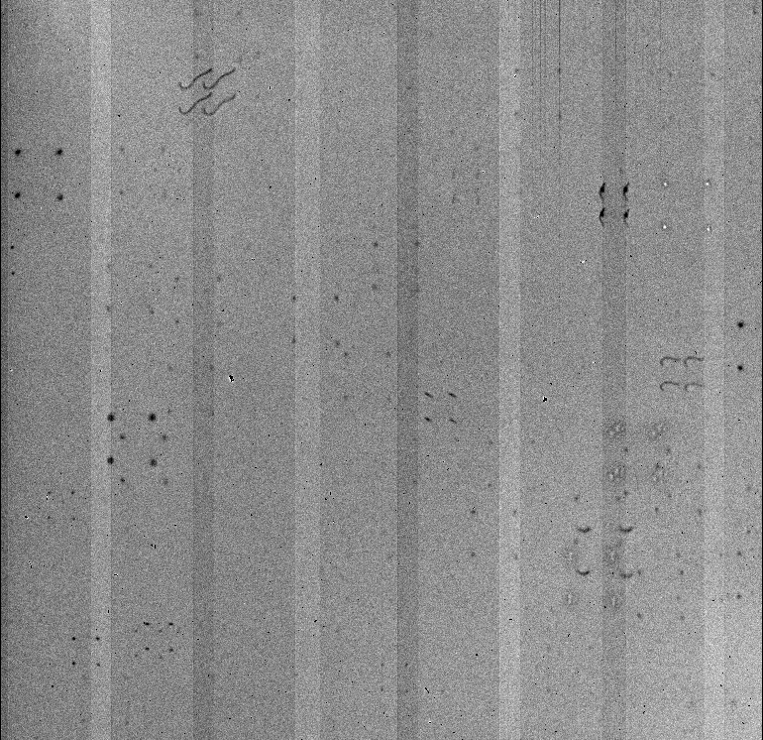
Technique Motivation Method part 1 Method part 2 Method part 3 Further steps
Image subtraction shows that only parallel cross talk is added.
-
=

Slide 12
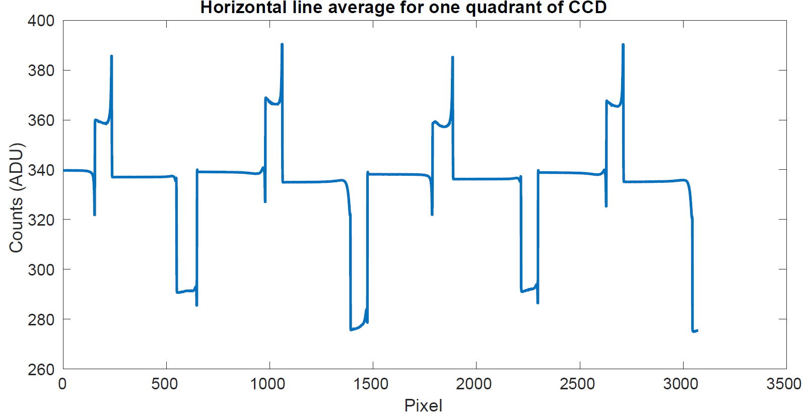
Technique Motivation Method part 1 Method part 2 Method part 3 Further steps

Slide 13
Technique Motivation Method part 1 Method part 2 Method part 3 Further steps
Bands in the image are caused by ‘ground bounce’ (variations in the reference level of the sense node)

Slide 14
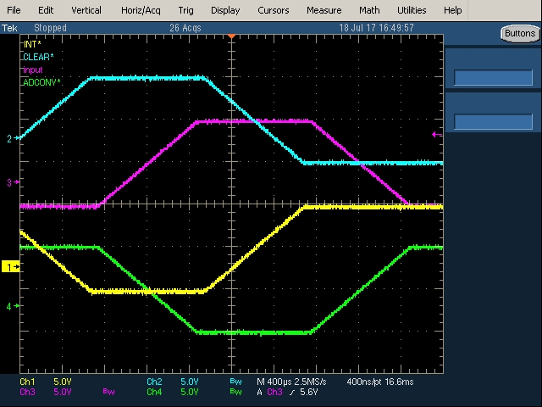
Technique Motivation Method part 1 Method part 1 Method part 3 Further steps
Step 3
Make parallel clock edges concurrent to create equal and opposing currents

Slide 15
Technique Motivation Method part 1 Method part 1 Method part 3 Further steps
However, the clock swings must all be the same to correctly set up equal and opposing currents:
A4
A4
TG
Fixed clock swing
LINE
DUMP (~ 3 us)
A1
A2
A3
A1
A2
A3
SERIAL

Slide 16
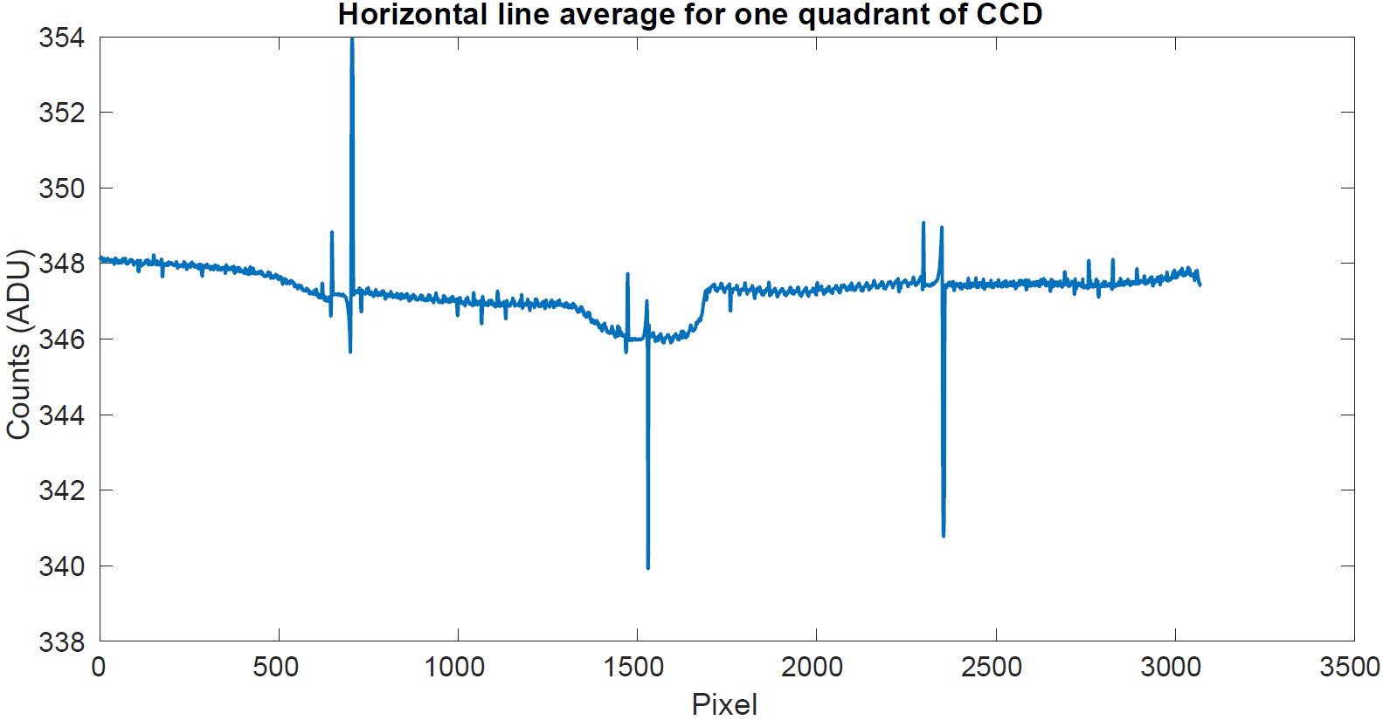
Technique Motivation Method part 1 Method part 1 Method part 3 Further steps
However this isn’t perfected yet:
Further tweaking required to correctly cancel currents or ensure that it’s a removable fixed pattern

Slide 17
Technique Motivation Method part 1 Method part 1 Method part 3 Further steps
Longer term benefits
Can expand line transfer to occupy the whole line read time:
Reduction in CIC due to slow clock edges
Can achieve higher CTE by allowing more time for charge de-trapping and boosting the effectiveness of tri-level clocking

Slide 18
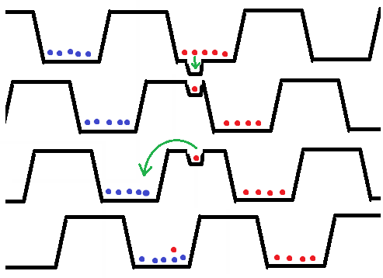
Technique Motivation Method part 1 Method part 2 Method part 3 Further steps
Recovery of trapped charge requires clocking to be slower than emission time constant.
Concurrent clocking makes this possible, especially for slow pixel rates, typical of low background applications where charge trapping is most troubling.
Bi-level clocks:
trapped charge is released into trailing pixels
Tri-level clocking*:
Trapped charge returned to original pixel
line
line
line
Time
*Murray, Neil J (2014). UV/Optical/IR Space Telescopes and Instruments: Innovative Technologies and Concepts VI, SPIE, article no. 8860-20
Notes:
However, Neil Murray from the Open university in the UK proposed that if we just add a third clocking level in the readout and also add a delay in the shift of a pixel you can encourage the charge to be released into its original charge packet.
As you can see on the right, because of the potential gradient created by the third level it’s unlikely that trapped charge gets separated from its packet.
And that’s how it works in a nutshell.

