Slide 1
Gattini Detector Installation
PROCEDURE GATPAL-ABA-P00
Alex Delacroix
Roger Smith

Slide 2
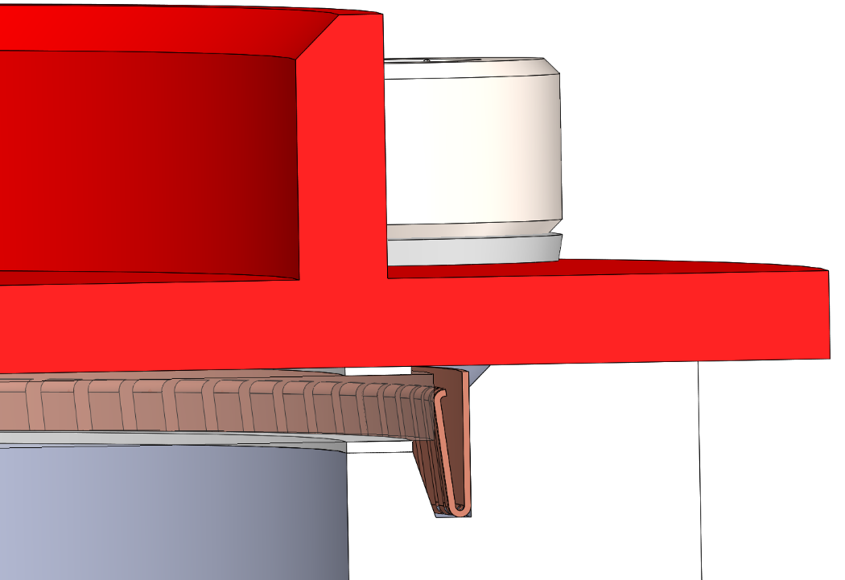
Gattini Detector Installation PROCEDURE GATPAL-ABA-P00 (See Assembly Drawing GATPAL-ABA-AA0 for detailed parts list)
Step 1a:
Step 1b:
Press Fit the 2X Dowel Pins Item 2 into the Housing Item 1
Insert the Springed filter holder Item 3 into the Housing 1

Slide 3
Gattini Detector Installation PROCEDURE GATPAL-ABA-P00 (See Assembly Drawing GATPAL-ABA-AA0 for detailed parts list)
Step 1d: Install the Filter Holder Baffle Item 6 onto the Housing Item 1, using 6X Screws and washers Item 7 & 8.
Step 1e: Install the Second Filter Cushioning Ring Item 4 into the Housing Item 1
Step 1d: Install the Filter Item 5 into the Springed Fingers Item 2
Step 1c: Install the First Filter Cushioning Ring Item 4 into the Housing Item 1

Slide 4
Gattini Detector Installation PROCEDURE GATPAL-ABA-P00 (See Assembly Drawing GATPAL-ABA-AA0 for detailed parts list)
Step 2:
Install the Fuse Item TBD onto the Detector Mounting Plate Item 9, using 1X Screw and washer Item 7 & 12. Torque to 0.5 Nm.
Install the Heater Item 11 onto the Detector Mounting Plate Item 9, using 1X Screw and washer Item 7 & 12. Torque to 0.5 Nm.
Install the Temperature Sensor Item 10 onto the Detector Mounting Plate Item 9, using 2X Screws and washers Item 7 & 12. Torque to 0.5 Nm.

Slide 5
Gattini Detector Installation PROCEDURE GATPAL-ABA-P00 (See Assembly Drawing GATPAL-ABA-AA0 for detailed parts list)
Step 3a:
Insert the Detector Connector – PCB Assembly Item 22 into the Detector Cold Plate Item 13,
leaving the Connector side protruding 14mm.
Fill with Armstrong A12 Epoxy per TBD procedure.

Slide 6
Gattini Detector Installation PROCEDURE GATPAL-ABA-P00 (See Assembly Drawing GATPAL-ABA-AA0 for detailed parts list)
Step 3b:
Install the 3X Detector Mount Flexure Item 15 on the Cold Plate Item 13, using 2X Lock Washer Item 7 and 2X Shoulder Screw Item 16.

Slide 7
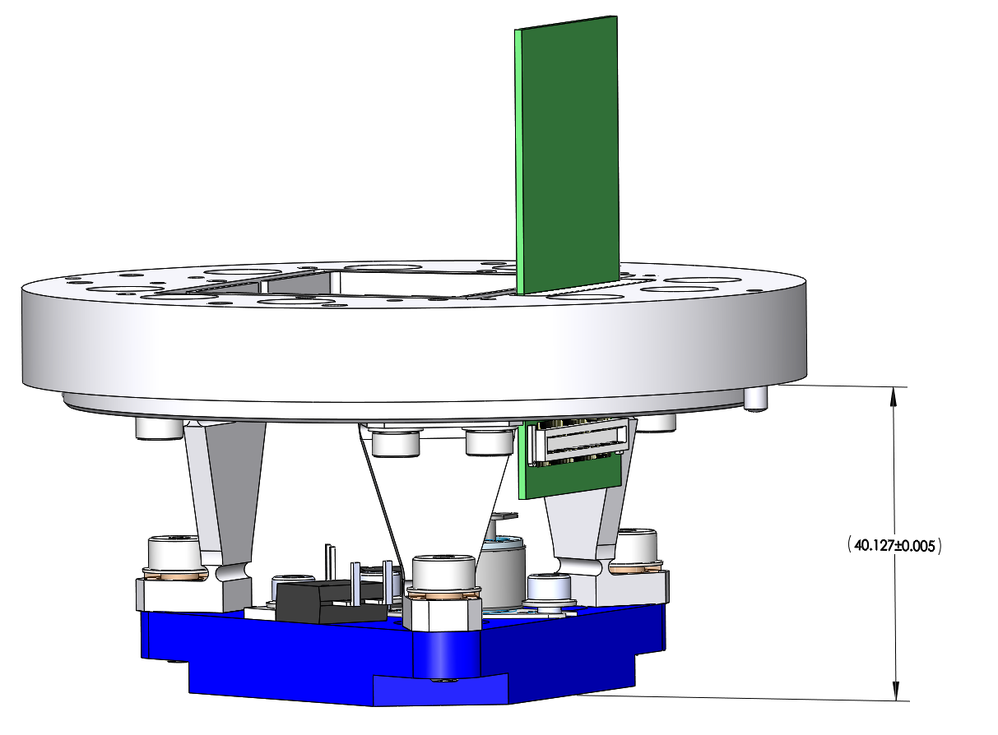
Gattini Detector Installation PROCEDURE GATPAL-ABA-P00 (See Assembly Drawing GATPAL-ABA-AA0 for detailed parts list)
Step 3c:
Install the Detector Mount previously assembled on the 3X Detector Mount Flexure Item 15, using:
Step 3d:
Verify the Assembled dimension:
3X Shoulder Screws Item 21
3X Belleville washer Item 20
3X Phenolic washer Item 19
3X Insulating Sleeve Item 18
3X Insulating Spacer Item 17

Slide 8
Gattini Detector Installation PROCEDURE GATPAL-ABA-P00 (See Assembly Drawing GATPAL-ABA-AA0 for detailed parts list)
Step 4a:
Secure the rotation stage in the vertical position and install the Detector housing as completed in the assembly Step 3, using 3X M4—0.7 x 14MM Lg screws

Slide 9
Gattini Detector Installation PROCEDURE GATPAL-ABA-P00 (See Assembly Drawing GATPAL-ABA-AA0 for detailed parts list)
Step 4b:
Install the 2X Guide rods on the detector and feed them thru the Cold plate.

Slide 10
Gattini Detector Installation PROCEDURE GATPAL-ABA-P00
Step 4c:
Install the central nut, finger tight.
Remove the lower Guide rod.

Slide 11
Gattini Detector Installation PROCEDURE GATPAL-ABA-P00
Step 4d:
Install the lower nut.
Remove the last Guide Rod
Install the last nut, finger tight.

Slide 12
Gattini Detector Installation PROCEDURE GATPAL-ABA-P00
Step 4e:
Torque all 3 nuts to TBD N.m

Slide 13
Gattini Detector Installation PROCEDURE GATPAL-ABA-P00
Step 5a:
Step 5b:
Install the Detector Housing Assembled in Step 1 on the Horizontal Stage
- Rotate and lock the rotation Stage to horizontal position

Slide 14
Gattini Detector Installation PROCEDURE GATPAL-ABA-P00
Step 5c:
Slide the Horizontal Stage under the Detector Assembly

Slide 15
Gattini Detector Installation PROCEDURE GATPAL-ABA-P00
Step 5d:
Lower the Detector Assembly into the Housing Assembly:

Slide 16
Gattini Detector Installation PROCEDURE GATPAL-ABA-P00
Step 5e:
Install and torque the 9X Belleville washers Item 27 and the 9X Vented SHCS, M4-0.7 X 10mm Lg, Item 28:

Slide 17
Gattini Detector Installation PROCEDURE GATPAL-ABA-P00
Step 5f:
Install the Cold Plate Cover Item 29, the 7X Belleville washers Item 7 and the 7X Vented SHCS, M4-0.7 X 10mm Lg, Item 30:

Slide 18
Gattini Detector Installation PROCEDURE GATPAL-ABA-P00 (See Assembly Drawing GATPAL-ABA-AA0 for detailed parts list)
Step 6:
Remove the 3X M4—0.7 x 14MM Lg screws
Lift Clear the Rotation Stage
While holding the Detector Housing Assembly, open the jaws.
Remove the Detector Assembly from the Jaws.

