Slide 1
Classifier t15_f5_c3
Umaa Rebbapragada
January 09, 2019

Slide 2
Changes
No major changes
We aborted the ingest of the Zooniverse MSIP feed
GP examples were stale; preceded major update of pipeline on Nov 15 that improved image differencing
Created a new train/test split that samples test set across all of ZTF rather than recent months
Improved/streamlined performance plots
Results are still only shown on the first test set sampled from recent notes (September 2018 and on)
Plots from the second test set will come with t16

Slide 3
Cross Validation Performance
Remember, each classifier version was trained on different folds. Results not directly comparable, but convey a sense of progress.
When train/test split is distributed across survey’s lifespan, results are
Vers | Date | #Train | # Real | # Bogus | # Feat | FPR | FNR | ACC | FNR at 1% FPR
t1_f1_c1 | 10 Jan | 1620 | 1316 | 304 | 67 | 30.7 | 3.8 | 91.2 | 36.4
t6_f4_c3 | 17 Mar | 5498 | 2749 | 2749 | 61 | 11.3 | 3.8 | 93.6 | 27.0
t7_f4_c3 | 11 April | 7767 | 3361 | 4406 | 61 | 4.8 | 7.6 | 94.0 | 17.1
t8_f5_c3 | 7 May | 14762 | 5076 | 9686 | 59 | 10.1 | 2.7 | 93.6 | 20.1
t12_f5_c3 | 8 Aug | 20923 | 7936 | 12987 | 59 | 14.9 | 7.2 | 89.0 | 33.6
t15_f5_c3 | 31 Dec | 15789 | 2530 | 13259 | 59 | 7.8 | 3.9 | 96.1 | 3.9
Vers | Date | #Train | # Real | # Bogus | # Feat | FPR | FNR | ACC | FNR at 1% FPR
t15_f5_c3 | 31 Dec | 13457 | 2853 | 10604 | 59 | 11.4 | 0.1 | 94.2 | 6.9

Slide 4
Test Set
All labeled observations starting from September 4, 2018
566 reals
537 bogus
New classifier
t15_f5_c3
Trained through September 3, 2018
Current (last deployed) classifier:
t12_f5_c3
Trained through July 5, 2018

Slide 5
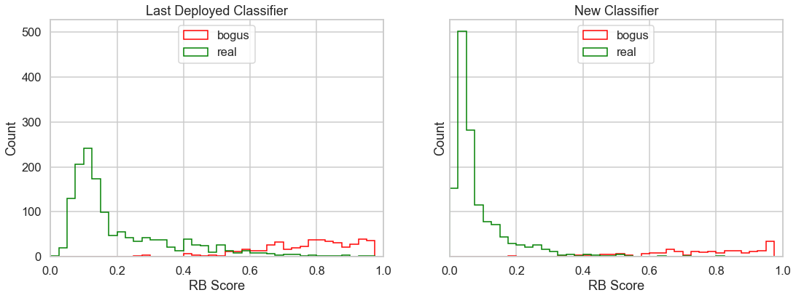
Reals v. Bogus Score Distribution

Slide 6
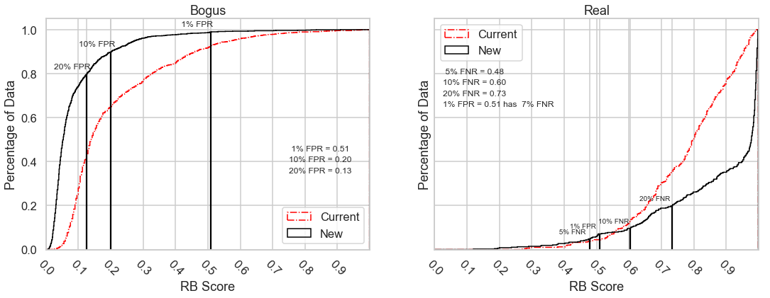
Cumulative Score Distributions

Slide 7
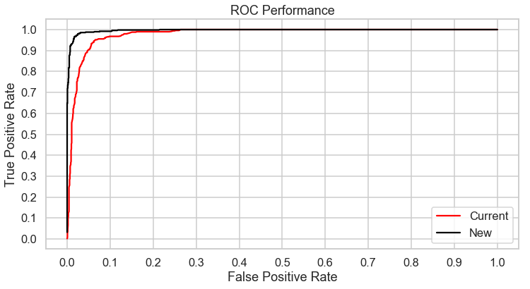
ROC Performance

Slide 8
Comparison of t15 and t12 (deployed), on Galatic Plane (|b| < 10)
t12
t15

Slide 9
Training Set Information
t15_f5_c3

Slide 10
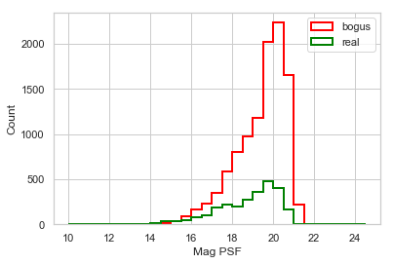
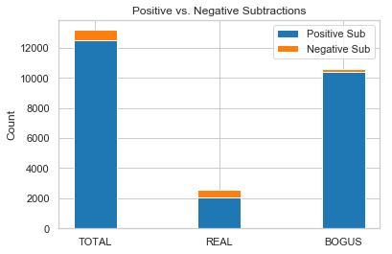
Training Set Information
Magnitude Breakdown
Pos/Neg Sub Breakdown

Slide 11
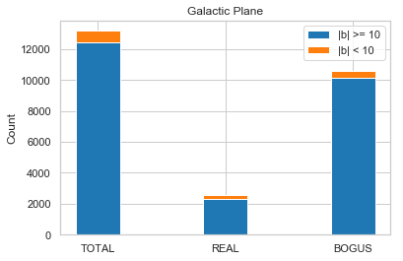
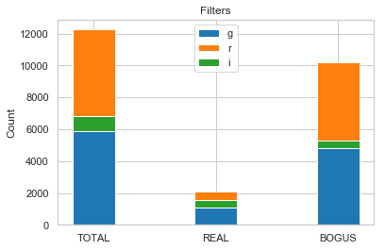
Training Set Information
Galactic Plane
Filters

Slide 12
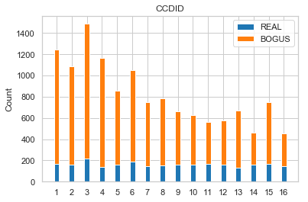
Training Set Information
CCDID Breakdown

