Slide 1
IRMS Optical Subsystem Review

Slide 2
The Charter
Confirm that the MOSFIRE design is a feasible baseline for IRMS (yes)
Verify that the MOSFIRE design can achieve or approach the requirements of IRMS (achieves)
This optical mini-study is a gateway to the next phase of the design study

Slide 3
Outline
Present MOSFIRE and its components.
Describe the IRMS requirements and study scope.
Show that the MOSFIRE design is an excellent starting point, and that with tweaks can achieve IRMS requirements
  I’ll show the work performed along the way

Slide 4
What is MOSFIRE?
Multi-Object Spectrometer for Infrared Exploration (0.97 – 2.45 µ)
A large vacuum-cryogenic instrument
At the Cass focus of Keck I:
  Spectroscopy:
    6.1’ slit
    Rθ ~ 2200
    Configurable slit
  Imaging over ~ 6’ x 6’ FOV
~Works in the lab

Slide 6
History of MOSFIRE
MOSFIRE began in July 2005, passed PDR in April 2006 and DDR one year later.
Designed to simplify as much as possible.
First light in lab July 1, 2010
First light on Keck March 2012?

Slide 7
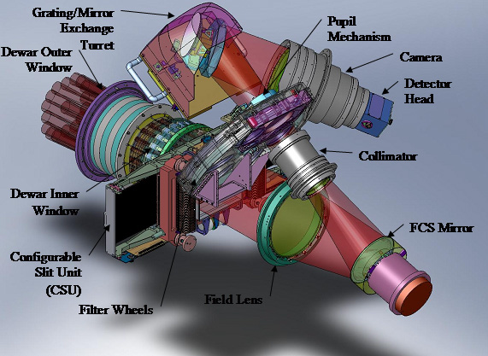

Slide 8
Paraxial Description of Optics
Detector is 36.9 mm
So the demagnification is 7.25 (f/2.00 camera)

Slide 9
Beam Diameter & f/#
Pixel Scale [as/pix]
Beam Diameter [mm]
Camera f/#
Camera Field Angle [degree]

Slide 10
MOSFIRE Rx
f/15 collimator that delivers 125.0-mm diameter pupil (f=1875 mm)
f/2 camera that delivers 0.18 arcsec/pixel (f=250 mm)
Camera has a a large pupil relief of about one focal length and operates at an amazing f/0.93
13 lenses + 1200 l/mm grating → grating magnification of ~ 1.3

Slide 11
Charter
Scope as defined by TMT Statement of Work
The TMT statement of work “TMT.INS.CON.11.XXX.DRF02” (Section 2.1) is quoted below:
Verify that the results of RD2 are still valid for the as-built prescription for MOSFIRE. Confirm that, apart from modifications to the field lens and “front-end”, the remainder of the MOSFIRE design can be copied to meet the requirements of TMT/IRMS. In the event more spectrograph optics changes are needed than a small change of the field lens, the team should work with the IRMS Project Scientist to propose a design, along with ROM estimate of cost and impact, that approaches the science requirements with least perturbation of the MOSFIRE instrument.
Document and present the results of the above study to TMT Project Office, to reach agreement on any changes to the scope of the subsequent work prior to beginning that work.

Slide 12
Requirements (from Appendix of SoW)
Wavelength Range 0.95 – 2.49 µ
Covers a single band at a time
80% EqE in two pixels in spectroscopy mode
0.07” diameter images in imaging mode (allow refocus)
FOV of 2’
Spectral and imaging sampling of 0.06” per pixel
R = 3270 with 3” slit (Rθ ~ 700 as)
YJHK produced in 6-3 order

Slide 13
Additional Requirements / Changes in Scope
Preconstruction design rather than as-built design
More than just changes to field lens curvature (but no major changes)
Assume that the CSU’s bars can be curved to follow the TMT focal plane
Add a pupil quality + walk requirement

Slide 14
Collimator
Keck delivers a 2.1-m ROC focal plane with an exit pupil 20-m away from MOSFIRE’s focal plane.
TMT/NFIRAOS Delivers a -1.3-m ROC focal plane (curved in opposite direction) and the pupil sits roughly 188-m away from IRMS’s focal plane.
Collimator focused on a 2.1-m ROC focal plane oriented in the negative direction.

Slide 15
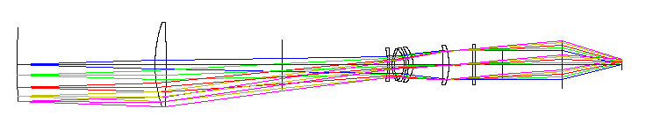
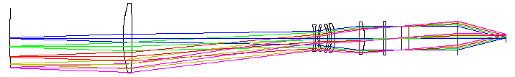
The Collimator
TMT Focal Surface
After Reoptimization

Slide 16
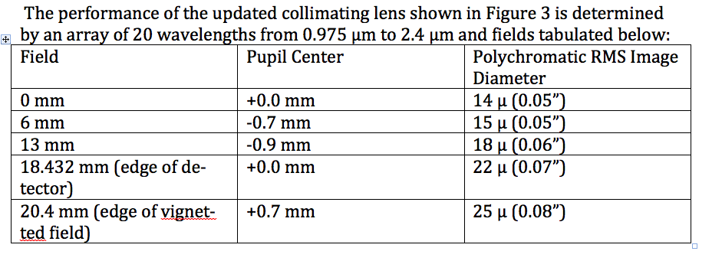
Collimator Performance
Spec is 0.07”

Slide 17
The Camera
Raytrace analysis in all bands with several wavelengths across a variety of spectroscopic positions. (No tracing outside of the spectroscopic field).
Using the unmodified MOSFIRE camera performance is such that the worst 1% of field/wavelength combos fall below 80% EqE. Almost all ensquared energies are above 85%
Reoptimizing the camera slightly yields 85% EqE in all fields and bands with almost all above 90%.

Slide 18
IRMS as an Imager

Slide 19
IRMS as an imager (2)

Slide 20
Additional Work
Ghost Analysis
  Based on a Zemax single pass analysis
    Bright detector → back to instrument → reflects back to detector
  Only very weak ghosts, several hundred microns in diameter.
Sensitivity Analysis
  Assuming MOSFIRE level misalignments the

Slide 21
Future Work
Talk with CSEM
Quotation on glass, polishing, and coating

