Slide 1
Zwicky Transient Facility:
Selected Science Highlights
Mansi M. Kasliwal

Slide 2
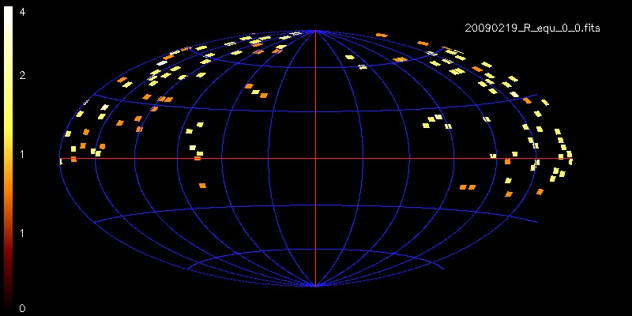
PTF & iPTF Sky Coverage
Imagine: ZTF will be 12x Faster!

Slide 3
Northern Sky Survey
Systematic Sample of AGN
Complete Inventory of Supernovae
Super Luminous Supernovae
Tidal Disruption Flares
Stellar Flare Rates
Cataclysmic Variables
Galactic Halo Mapping using RR Lyrae

Slide 4
Galactic Plane Survey
300 visits/year, δ > −30°, |b| < 7°
Young Star Outbursts
Large-scale Gyro-chronology
Star-formation History of Milky Way
Born-Again Stars with Late Thermal Pulse
Supernovae in Molecular Clouds
Black Hole Novae
Stellar Mergers
R Cor Bor Stars

Slide 5
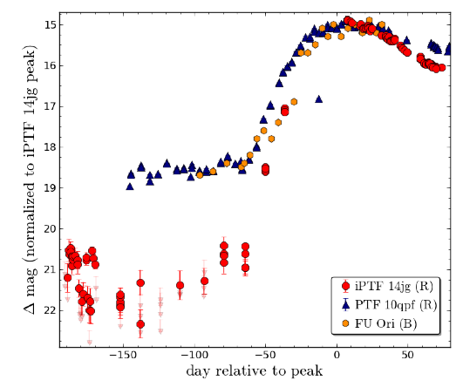
I. Young Star Outbursts
Hillenbrand et al. 2014
Outbursts play a central role in:
Determining the final mass and angular momentum of the star
Disruption of the circumstellar envelope from which the star forms
Formation of planets

Slide 6
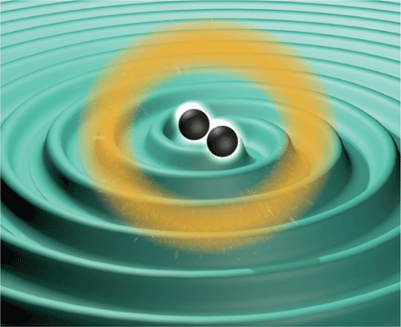
The Gap
Updated from Kasliwal 2011 (PhDT)

Slide 7
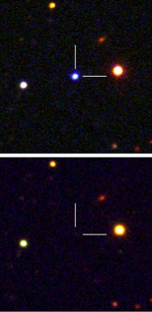
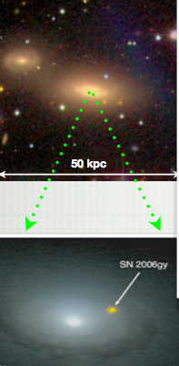
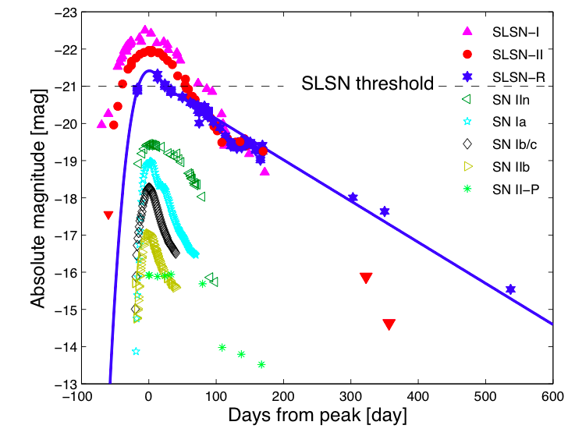
II. Super Luminous Supernovae
SLSN-I
Magnetars? PPI?
e.g. Quimby et al. 2011
SLSN-II
CSM Interaction
e.g. Ofek et al. 2008
SLSN-R
Pair Instability
e.g. Gal-Yam et al. 2009

Slide 8
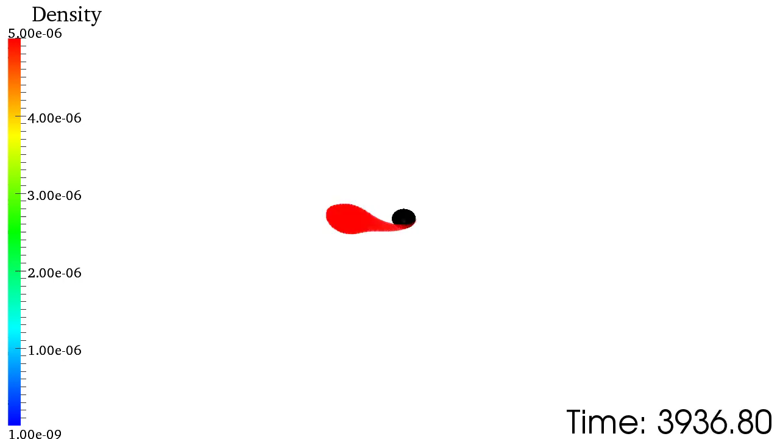
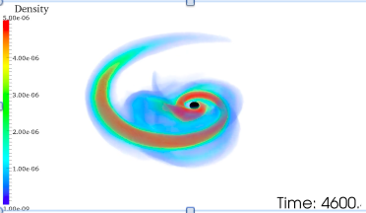
III. Seeing the Sound:
Bridging Gravitational Wave Physics &
Electromagnetic Astronomy
Strong Field Gravity: Masses, Spins, Inclination
Simulation: M. Duez

Slide 9
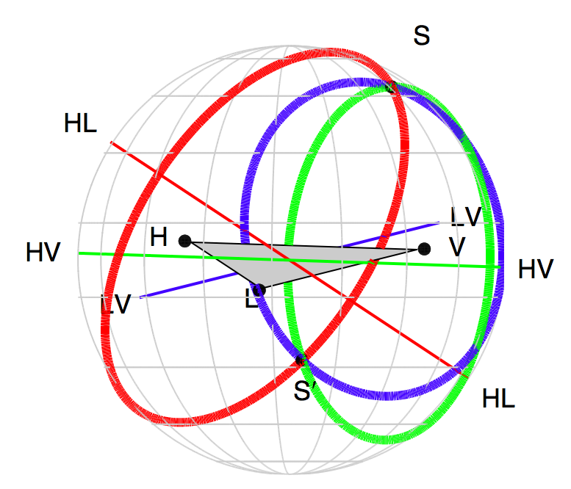
The Challenge:
Coarse LIGO Localizations
Kasliwal & Nissanke 2014
(See also Singer et al. submitted)

Slide 10
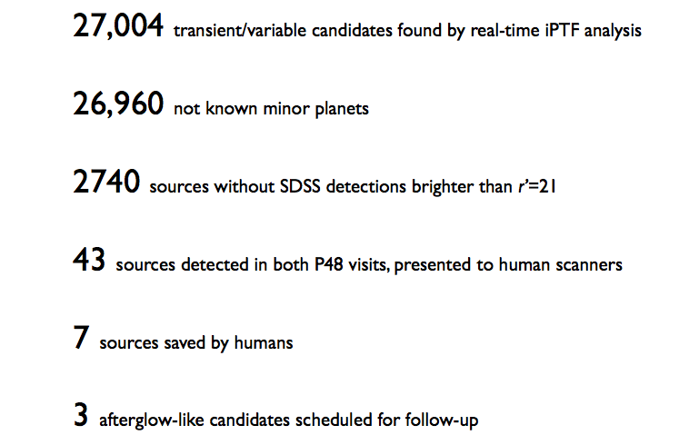
Needle in the 71 deg² haystack

Slide 11
Proof-of-concept:
First optical afterglow in 71 deg²
Singer et al. 2013

Slide 12
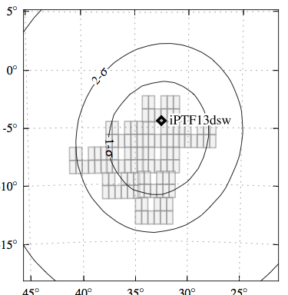
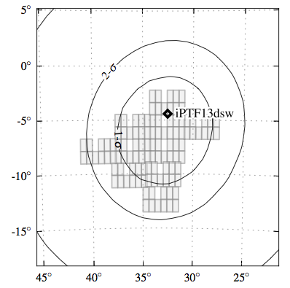
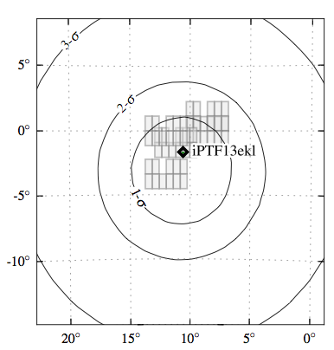
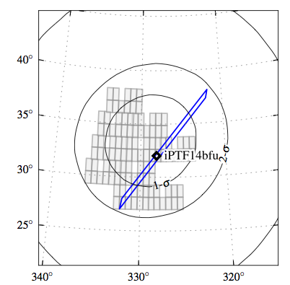
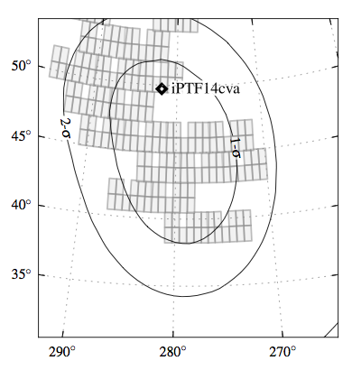
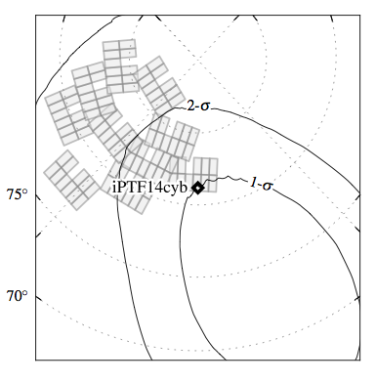
Six more times…
L. Singer, PhdT 2014

Slide 13
EM-GW Surveys:
Relative Sensitivity
Kasliwal & Nissanke 2013

Slide 14
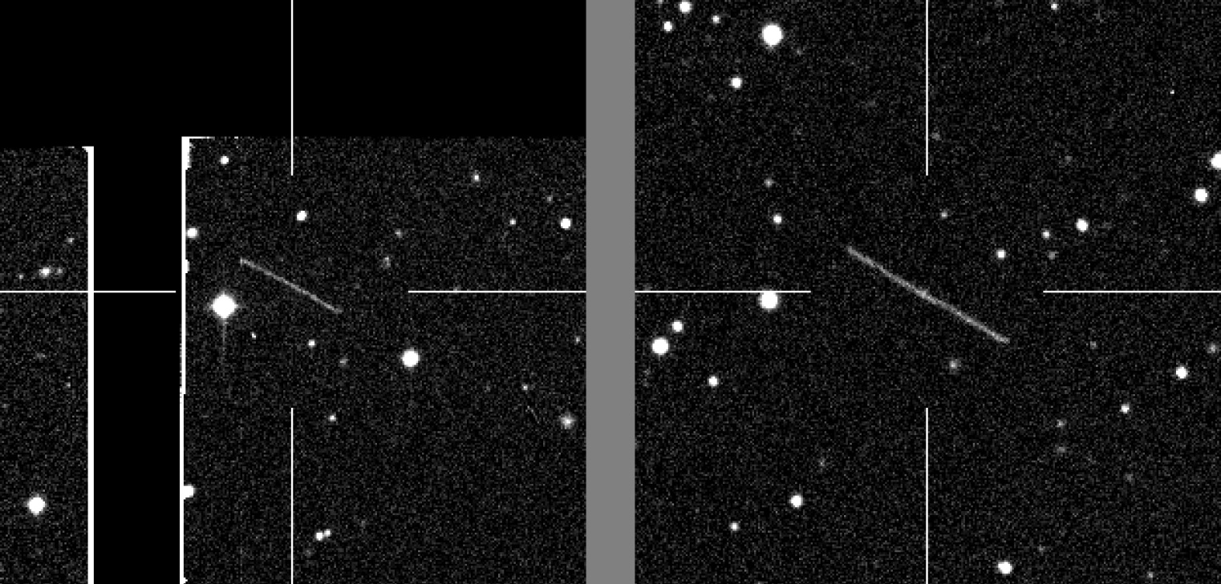
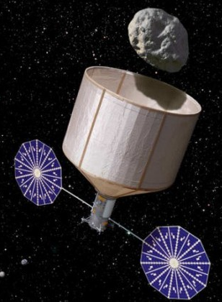
IV. Asteroids: iPTF discovery of NEA 2014 JG55
2 hours later
PhDT: A. Waszczak
NASA
Asteroid Redirect Mission
This 10m asteroid came within ¼ of the earth-moon distance!
The streak became brighter by 1 mag and faster by 50% in 2 hours.
ZTF will be 20x better at finding NEAs than iPTF

Slide 15

Thank You

