Slide 1
WASP-P00-1000
Science & Guider CCD
Installation Procedure
(Using Assembly Fixture WASP-F00-1000)
Alex Delacroix
Roger Smith

Slide 2
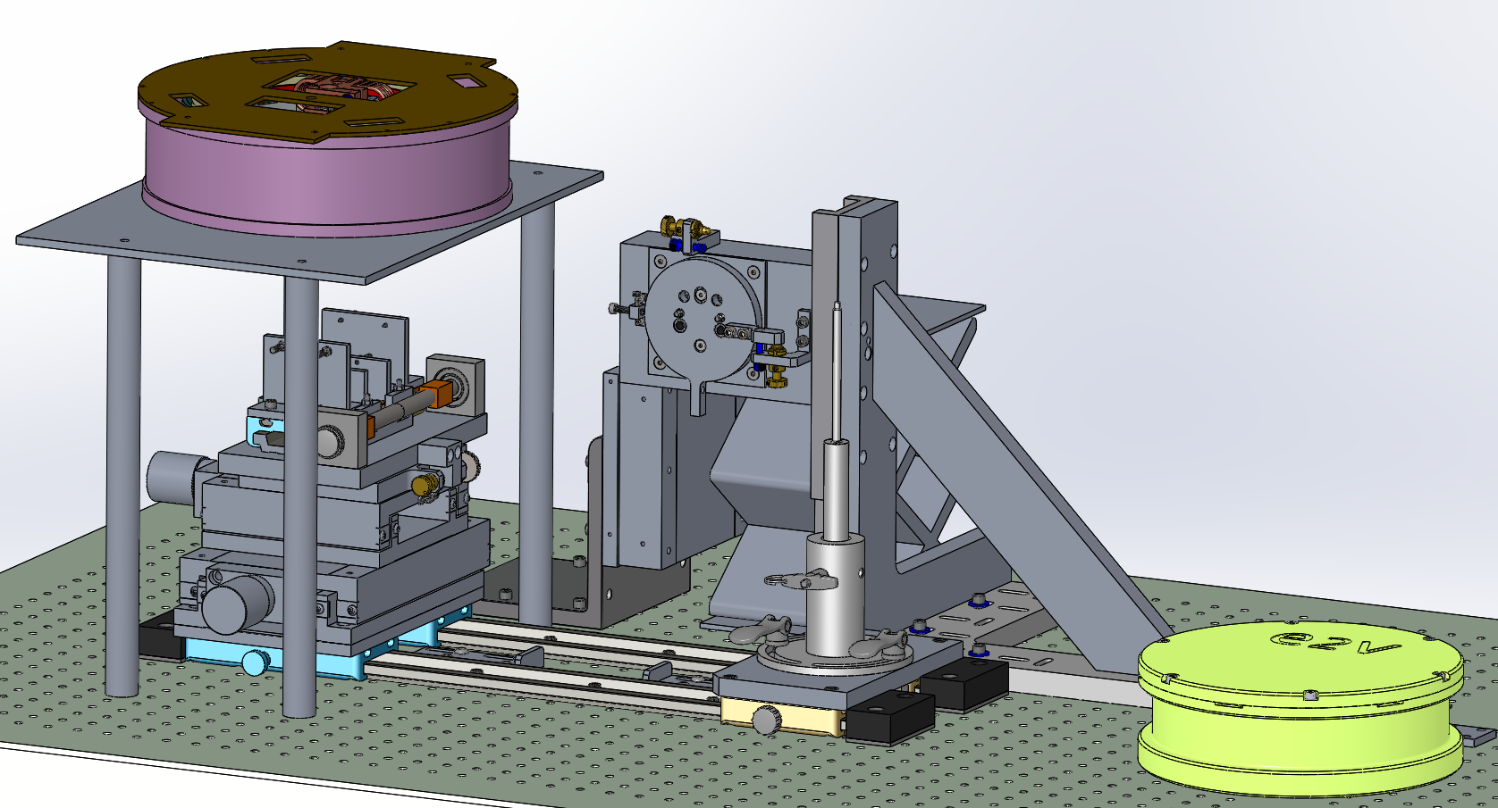
WASP CCD Assembly Fixture
WASP Dewar
Rotation Stage
CCD Handler
Horizontal Stage
Optical Bench

Slide 3
WASP CCD Assembly Fixture
Tools and parts needed:
Tools:
Flat head Screwdriver
Size 6 Socket Wrench
Clip opening plier
Allen Wrench Size 2
Allen Wrench Size 2.5
Allen wrench Size 3
Socket wrench Size 8
Allen wrench Size 4
Torque Wrench with Socket Size 4
Parts:
4X Science CCD Connector Fasteners
2X Science CCD Shorting Plugs
3X Barrel Nuts WASP-F00-0002
2X Science CCD Guide Rods WASP-F00-0004
Guide Rod and Cable Installation WASP-F00-1100
2X Guider guide rods WASP-F00-1020
Notes:
Need shorting connector on VIB.

Slide 4
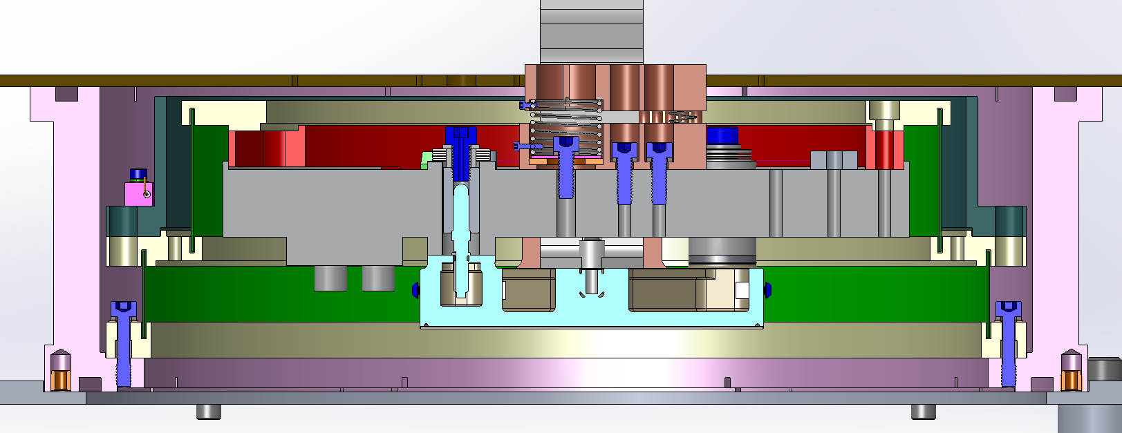
WASP CCD Assembly Fixture
PART I
SCIENCE CCD INSTALLATION

Slide 5
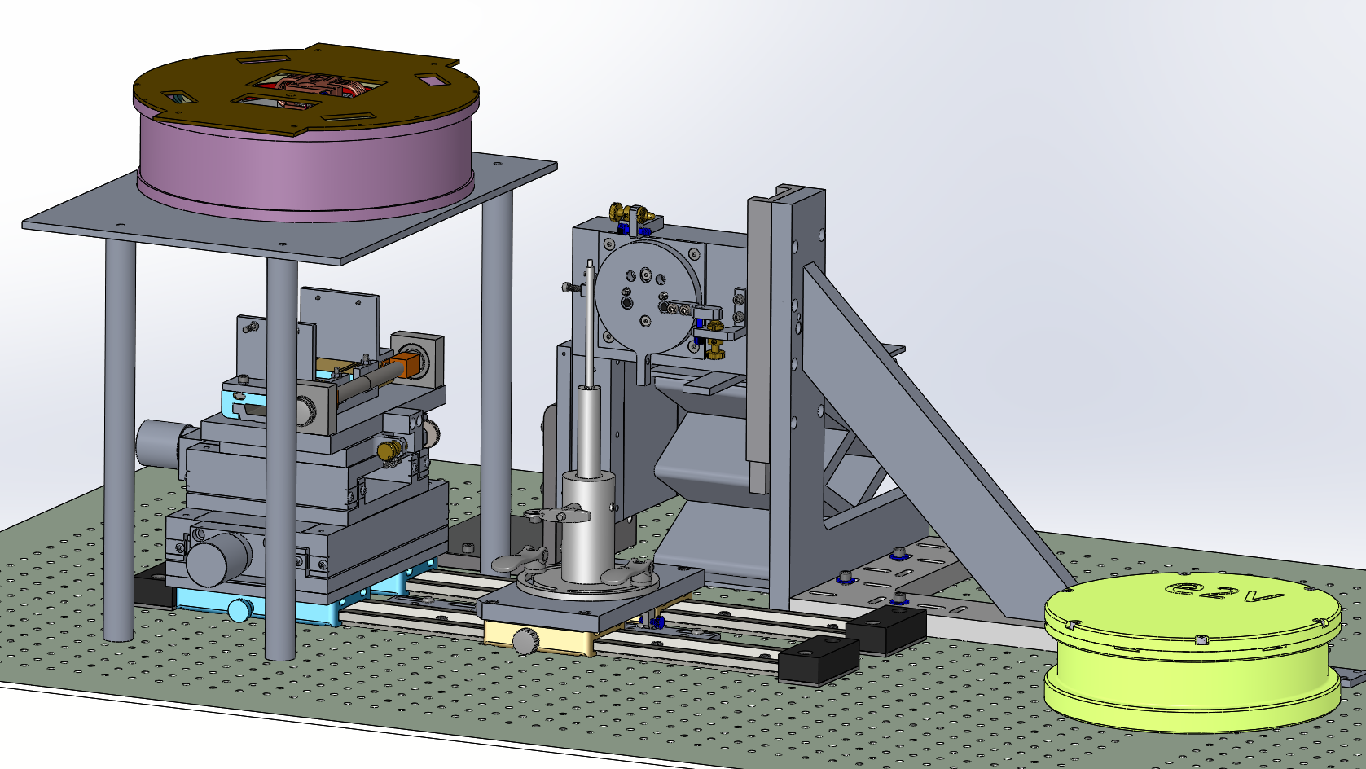
WASP CCD Assembly Fixture
Step 1: Rotate dewar base to correct azimuth. Install (WaSP!) captive science CCD fastener then VIB, attaching temperature sensors.
Remove the Guider Jaws, verify that the Lab Jack is in the low position, slide the CCD Handler into position
Use antistatic (pink) gloves .
Set diving board rotation to fully clockwise and lock.

Slide 6
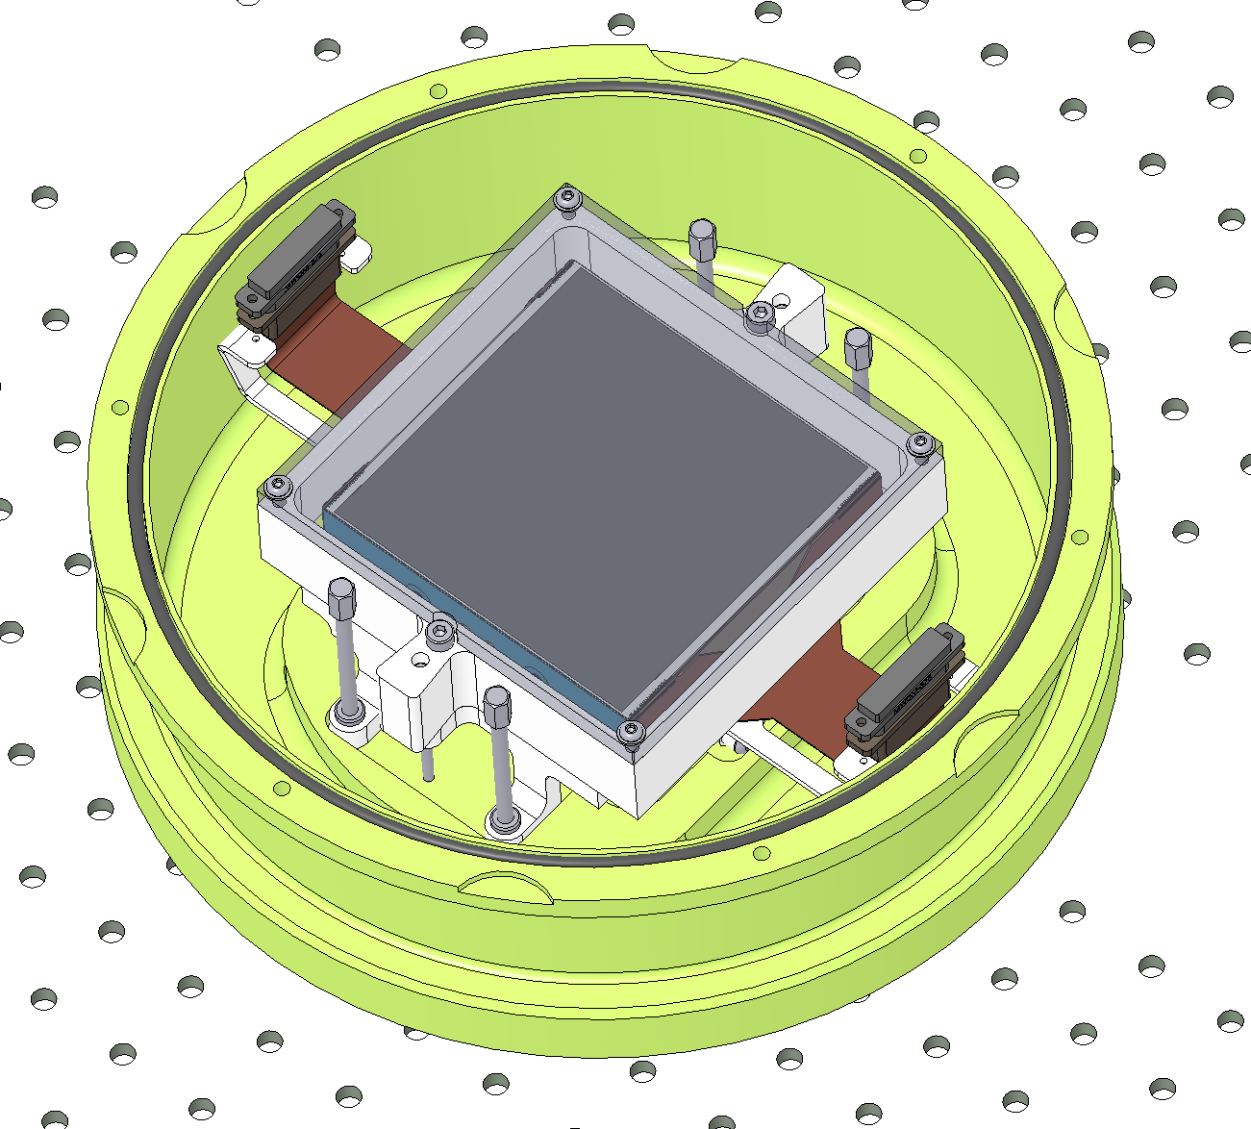
WASP CCD Assembly Fixture
Step 1: Open the e2v Container and remove the 4X fasteners
Tools:
-4mm allen
- Flat Screwdrive
- Size 6 Socket Wrench

Slide 7
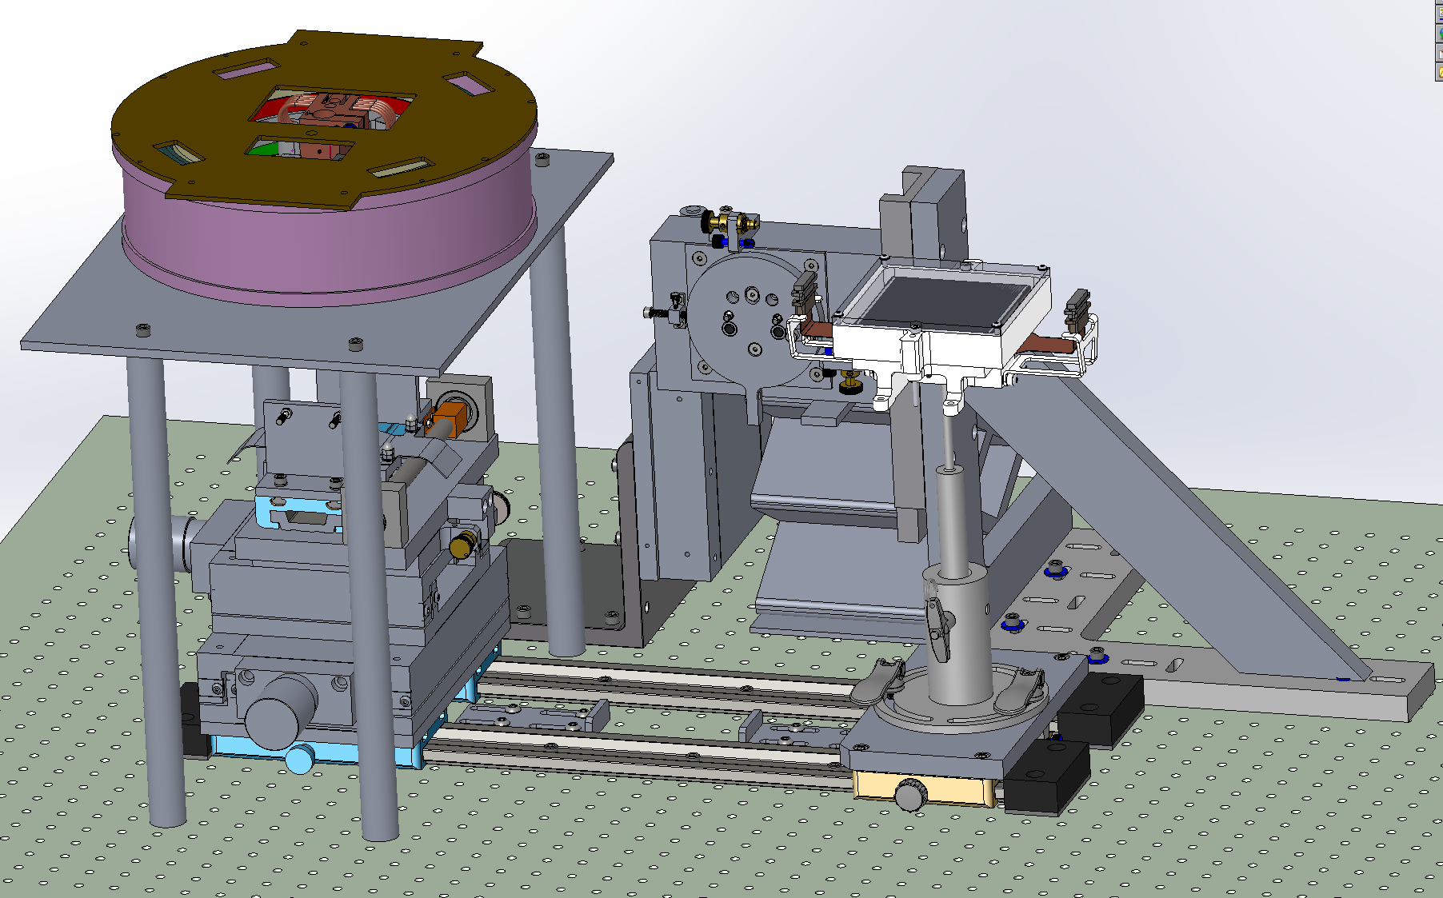
WASP CCD Assembly Fixture
Step 3: Install the CCD Handler to the Base.
Make sure middle CCD fastener is towards operator.

Slide 8
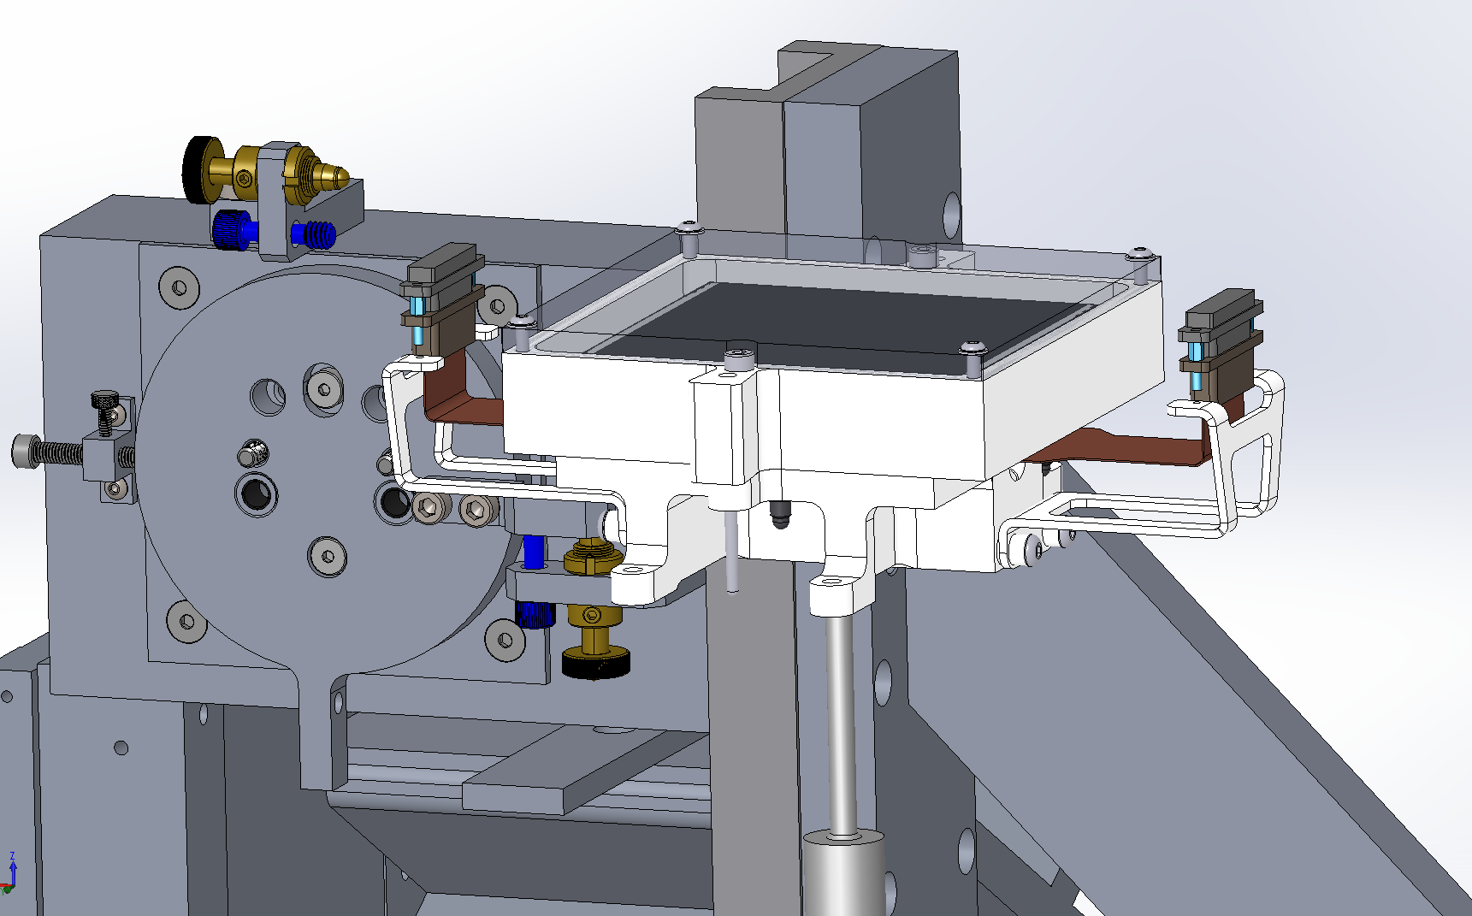
WASP CCD Assembly Fixture
Step 4: Remove the shorting plugs.
Tools:
- Clip opening pliers or flat head screwdrivers.
Notes:
No shorting plugs on Mechanical sample ! We should install these.

Slide 9
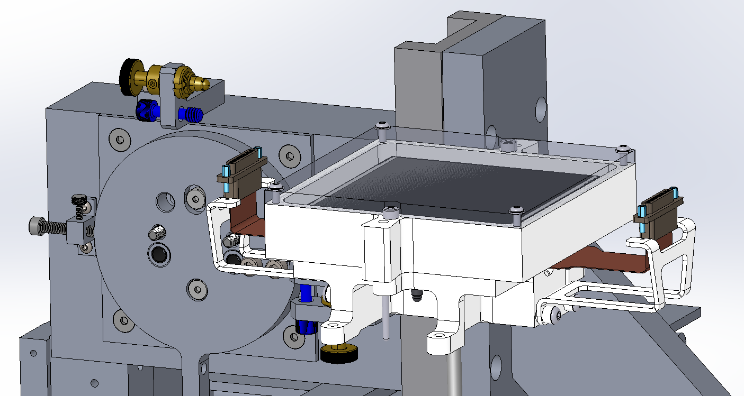
WASP CCD Assembly Fixture
Step 5: Remove the 4X Jack Posts
Tools:
- Socket size 4

Slide 10
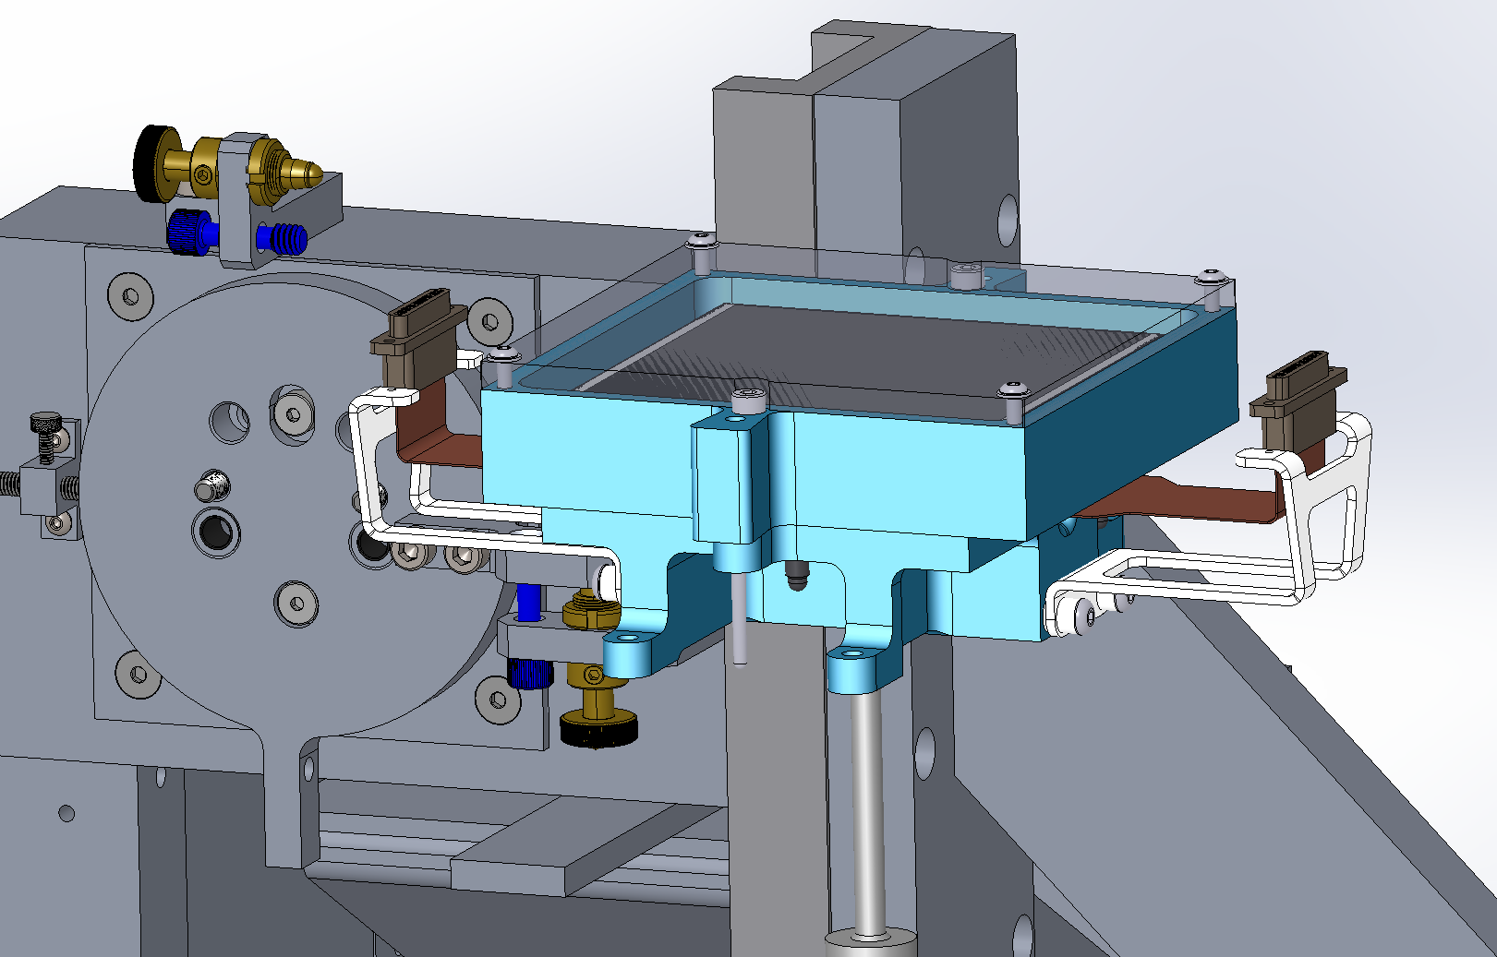
WASP CCD Assembly Fixture
Step 6: Remove the Connector brackets (2X 2XM3 Screws)
Tools:
- Allen Wrench Size 2.5

Slide 11
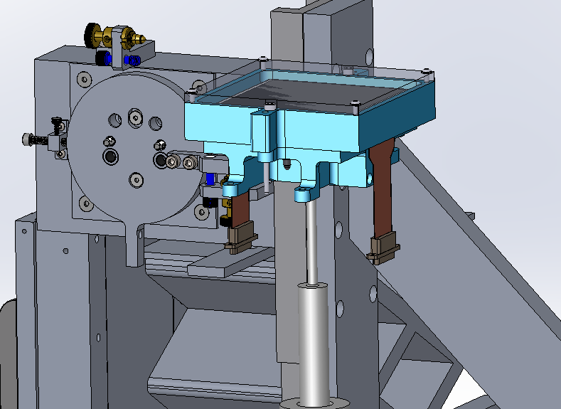
WASP CCD Assembly Fixture
Step 7: Release the ribbons; remove arms supporting cables, taking care not to drop arms or tension flex cables

Slide 12
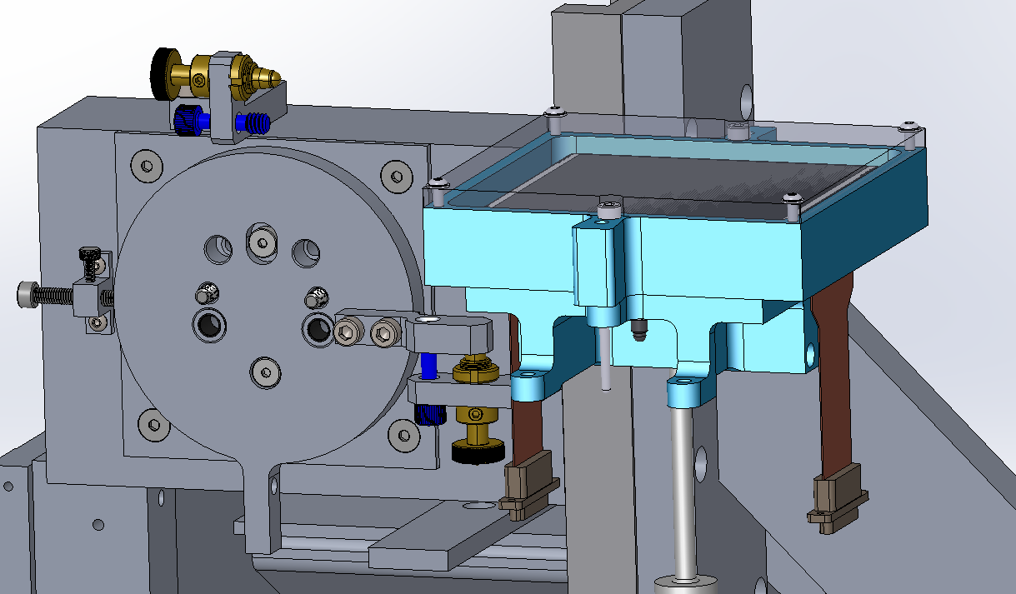
WASP CCD Assembly Fixture
Step 8: Remove the 2X M3.5 and slide the e2v Cover up
Tools:
- Allen wrench Size 3
DO NOT UNDO CCD STUDS NUTS UNTIL LID REMOVED !!!

Slide 13
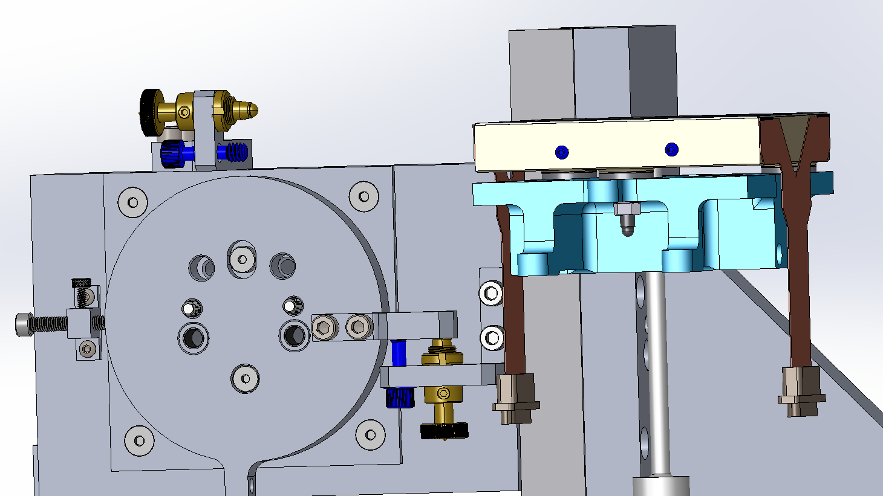
WASP CCD Assembly Fixture
Step 9: Remove the 3X M5 Nuts by rotating the stand to expose each nuts, rotate back to initial position to undo the last nut while holding the stand, then slide the stand down.
Tools:
- Socket wrench Size 8

Slide 14
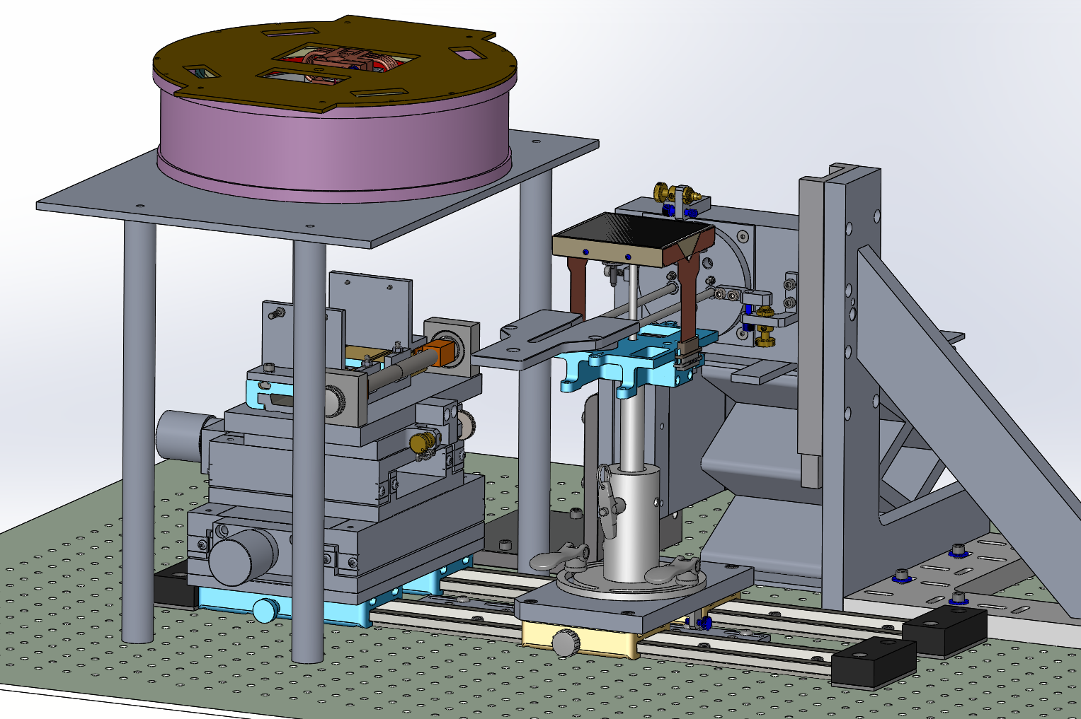
WASP CCD Assembly Fixture
Step 10: Slide the Handler into place and Insert the Coupler

Slide 15
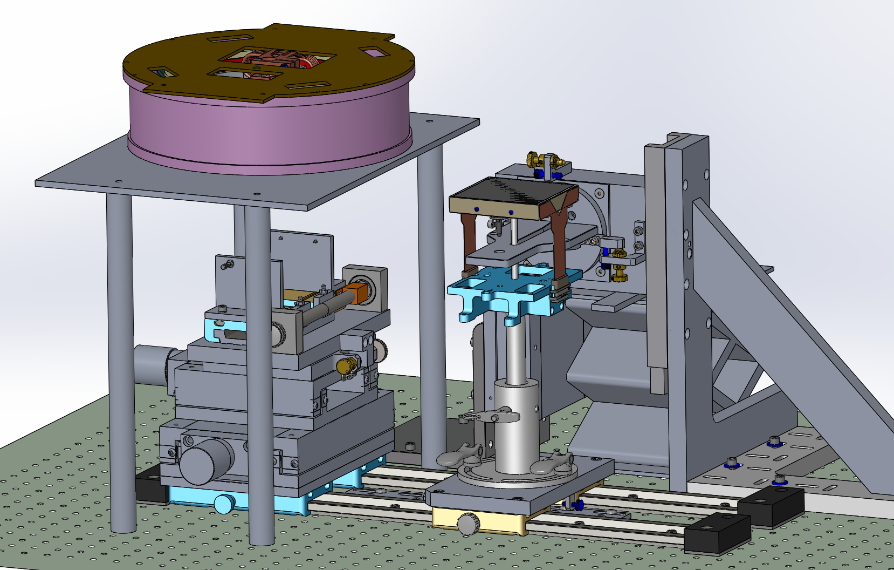
WASP CCD Assembly Fixture
Step 11: Bolt the Coupler to the rotation Stage
Tools:
- Allen wrench Size 3
Need to shim diving board 0.5mm closer to stand to eliminate binding of post.

Slide 16
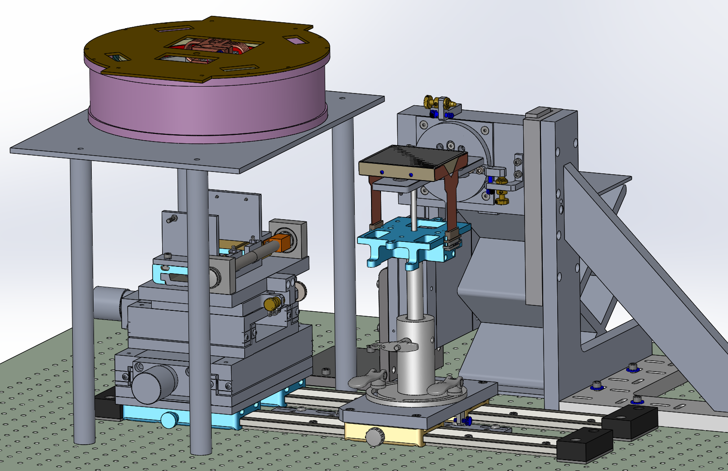
ZTF CCD Assembly Fixture
Step 12: Using the Lab Jack, Lift the coupler to the CCD Base until contact

Slide 17
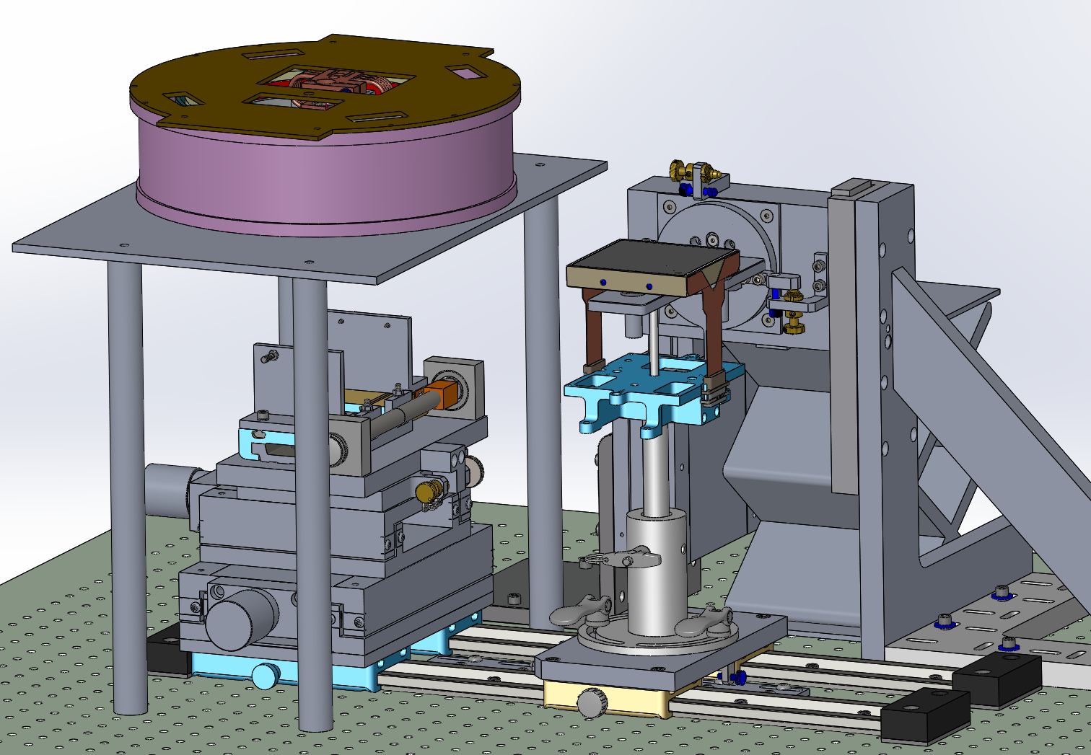
WASP CCD Assembly Fixture
Step 13: Attach the CCD to the Coupler using the Barrel Nuts only finger tight
Parts:
- Barrel Nuts

Slide 18
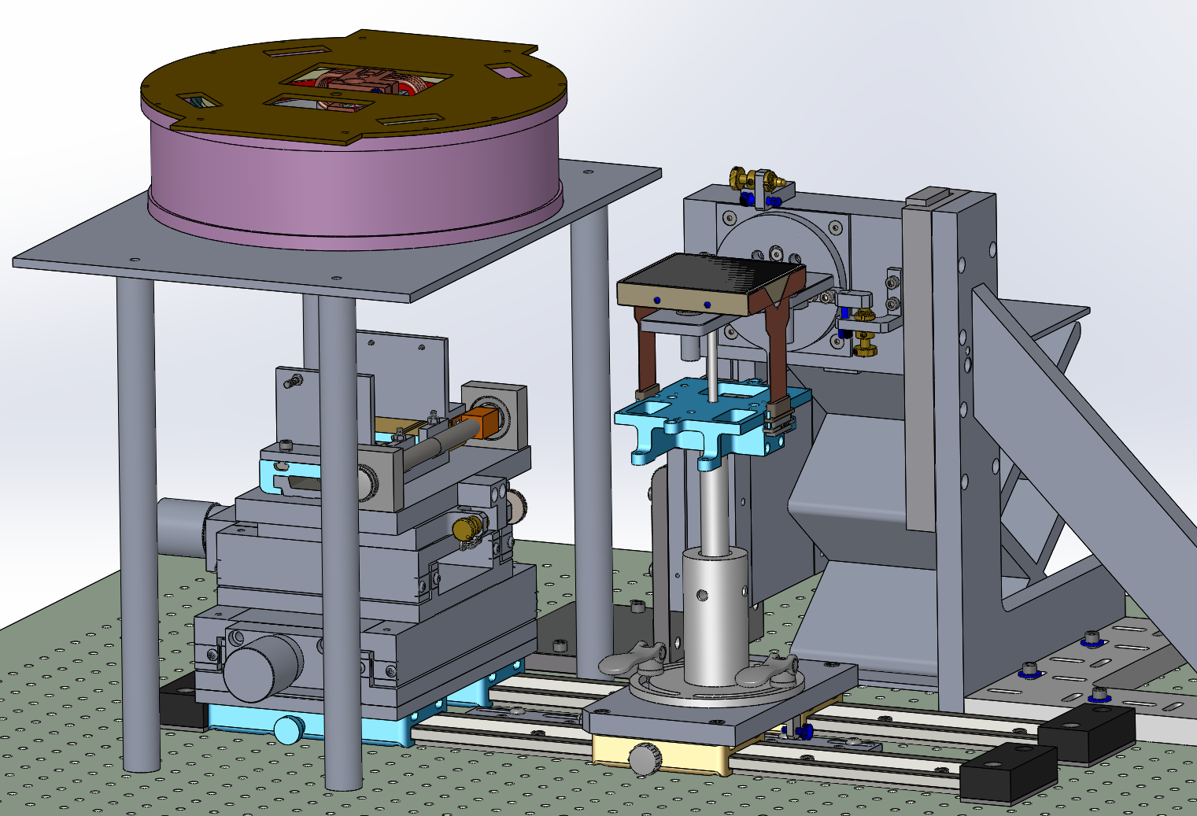
WASP CCD Assembly Fixture
Step 14: Remove the Handler Pin

Slide 19
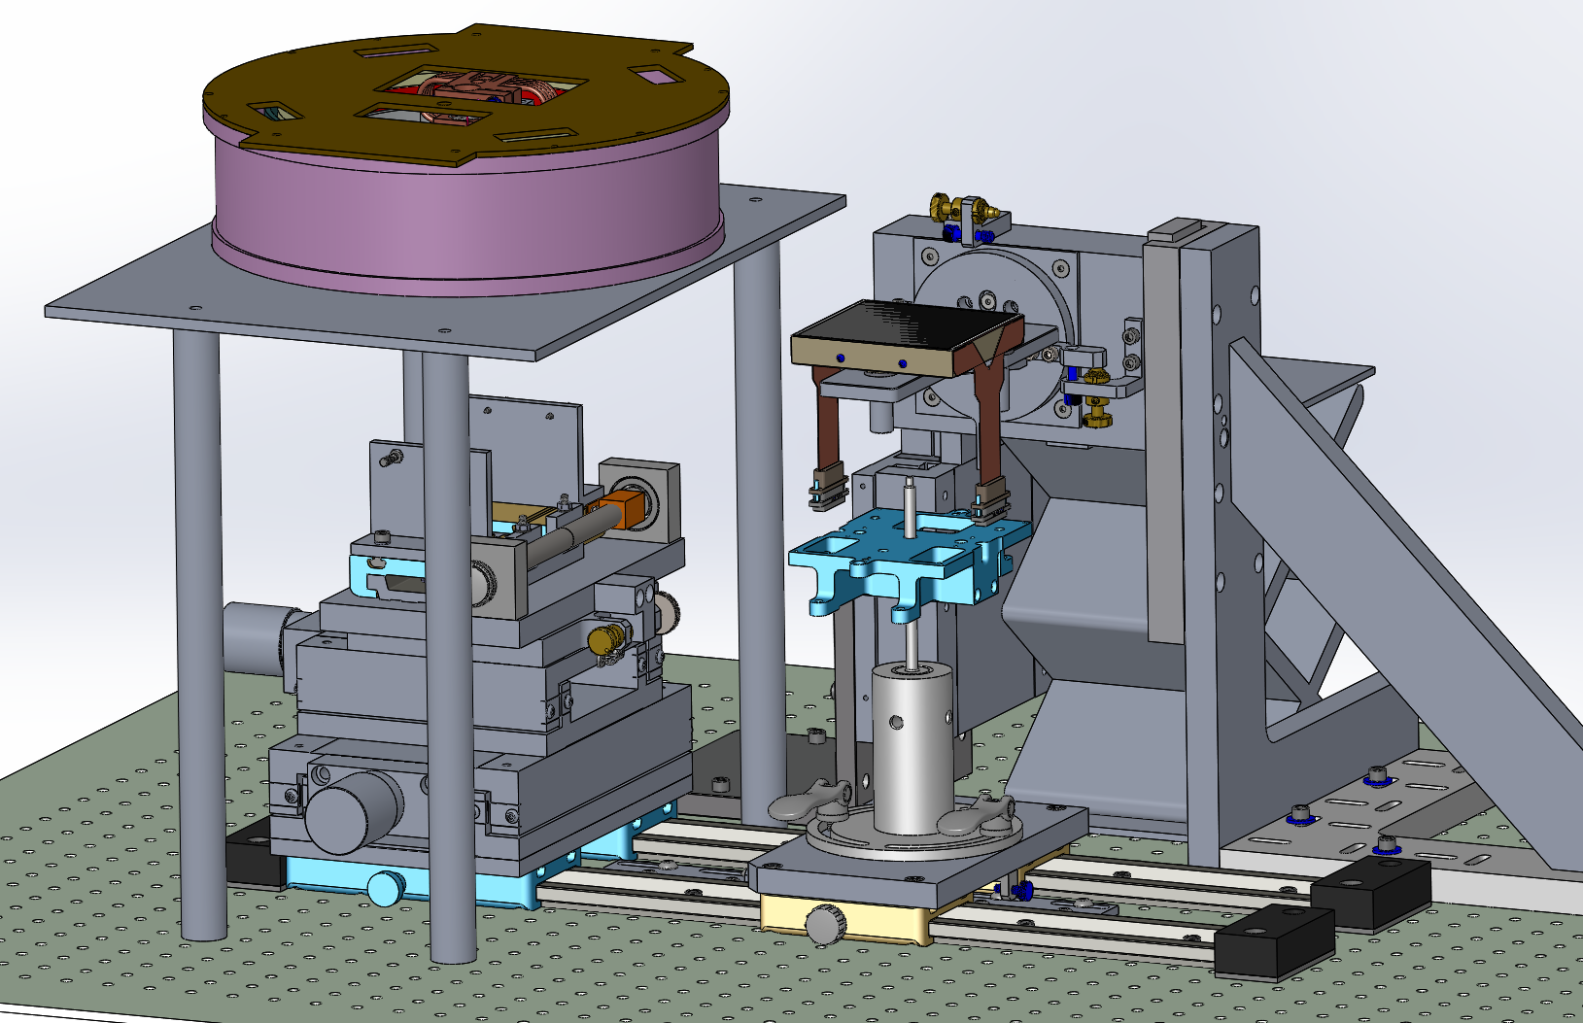
WASP CCD Assembly Fixture
Step 15: Unscrew the Handler from the CCD

Slide 20
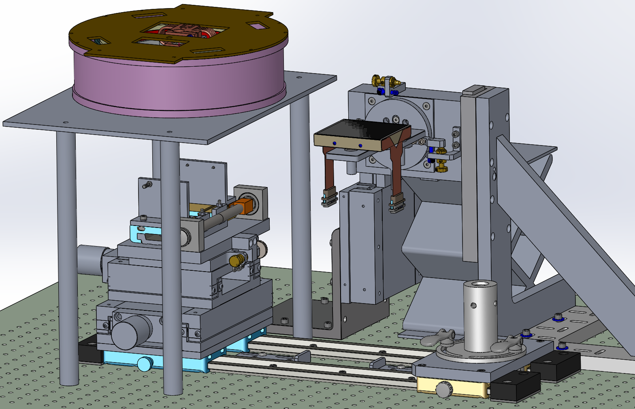
WASP CCD Assembly Fixture
Step 16: Park the Handler Assembly. Stow in CCD transport container.

Slide 21
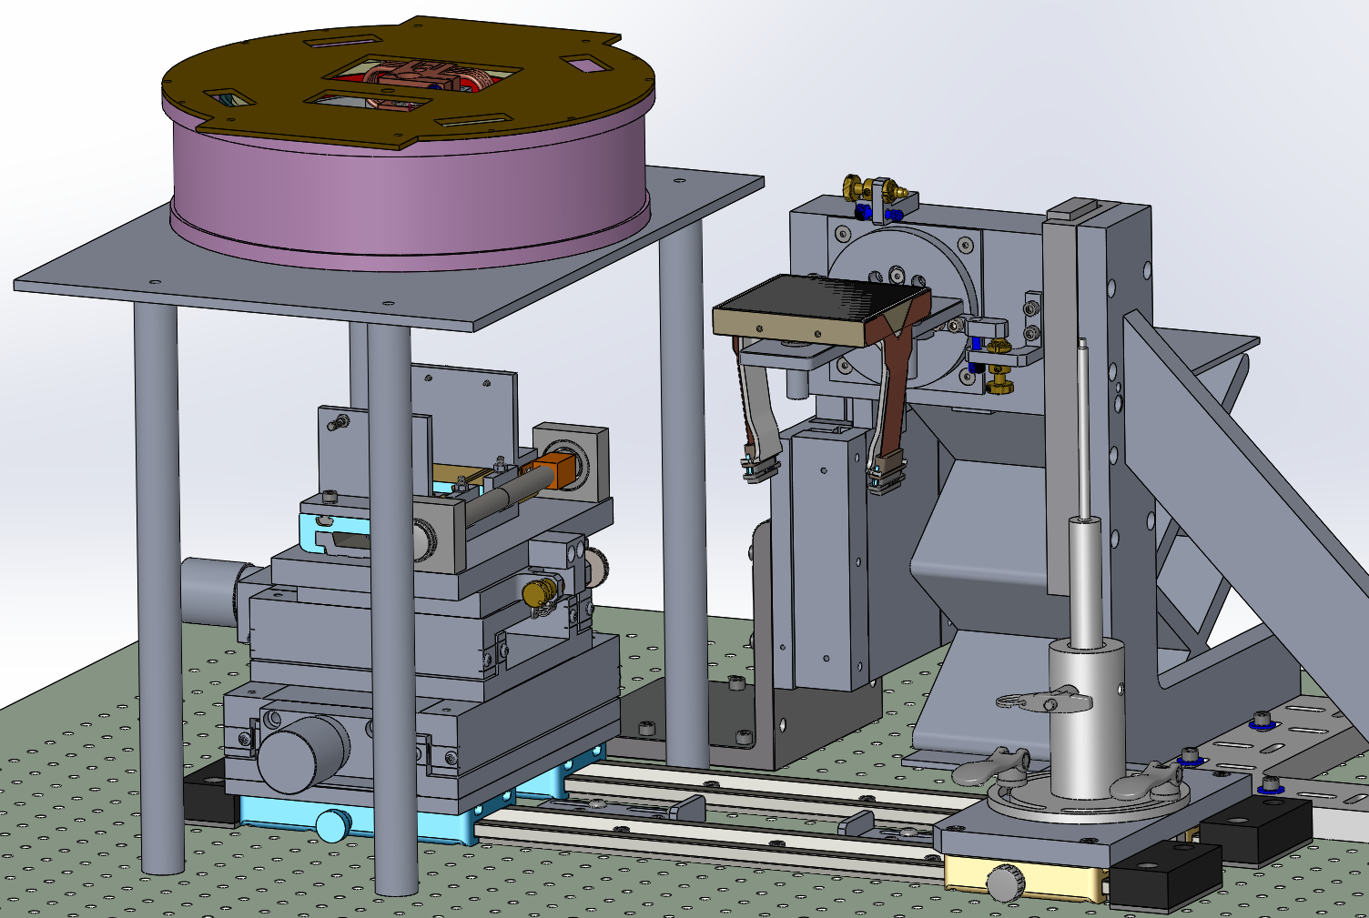
WASP CCD Assembly Fixture
Step 17:Re-tighten barrel nuts;
Install the Ribbon Holders capturing connector before attaching to CCD
Tools:
- Allen wrench Size 1.5

Slide 22
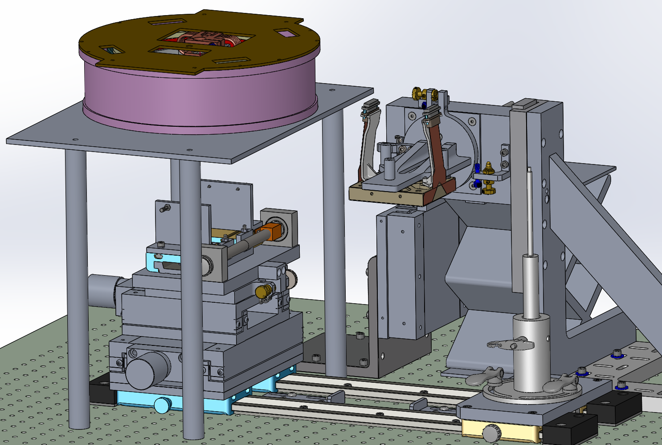
WASP CCD Assembly Fixture
Step 18: Rotate the Stage 180 deg and lock it.
Tools:
- Allen wrench Size 3/16

Slide 23
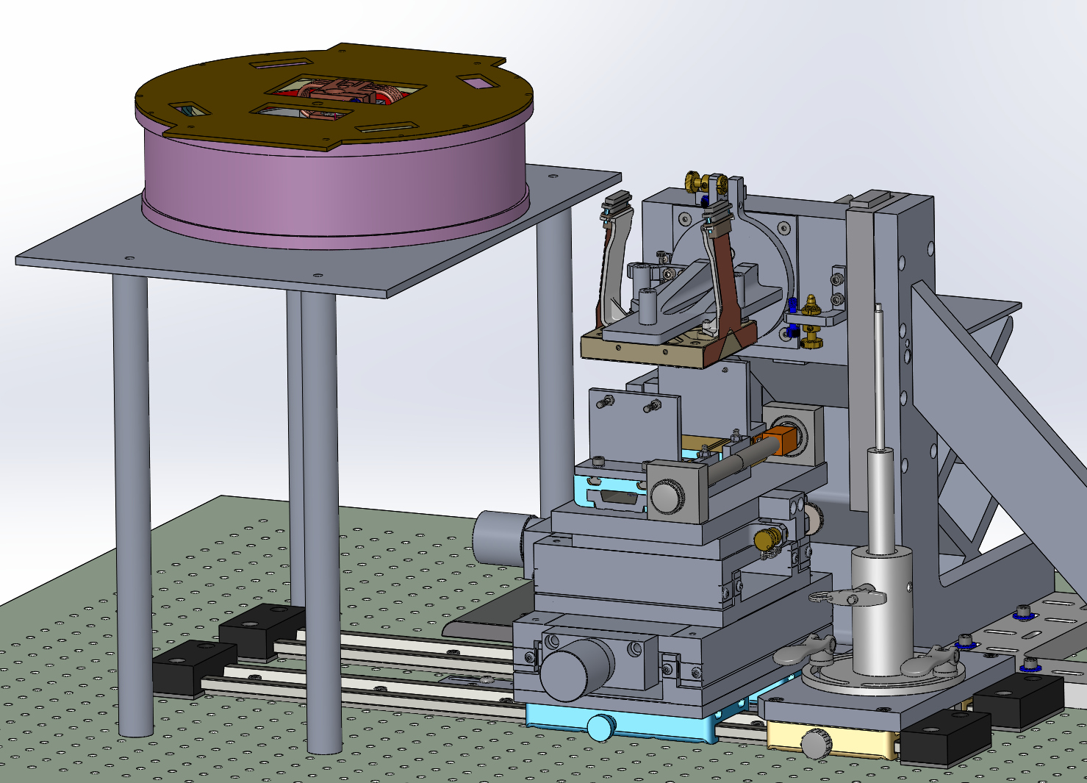
WASP CCD Assembly Fixture
Step 19: Slide the horizontal Stage into place.
CHECK Y POSITION.
CHECK PIN CLEARANCE
Stage ends ~flush

Slide 24
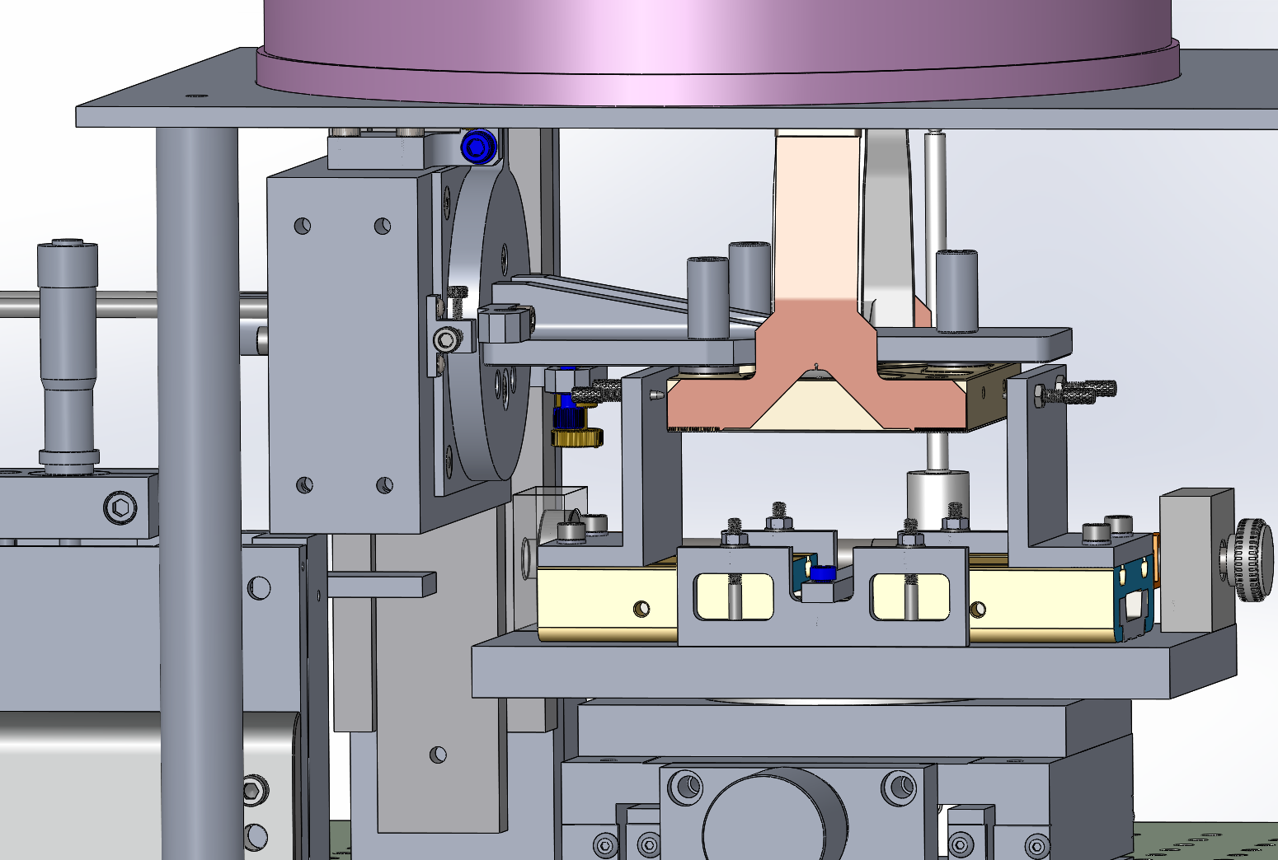
WASP CCD Assembly Fixture
Step 20: Lower the CCD into vertical position between jaws.:
WATCH PIN CLEARANCE

Slide 25
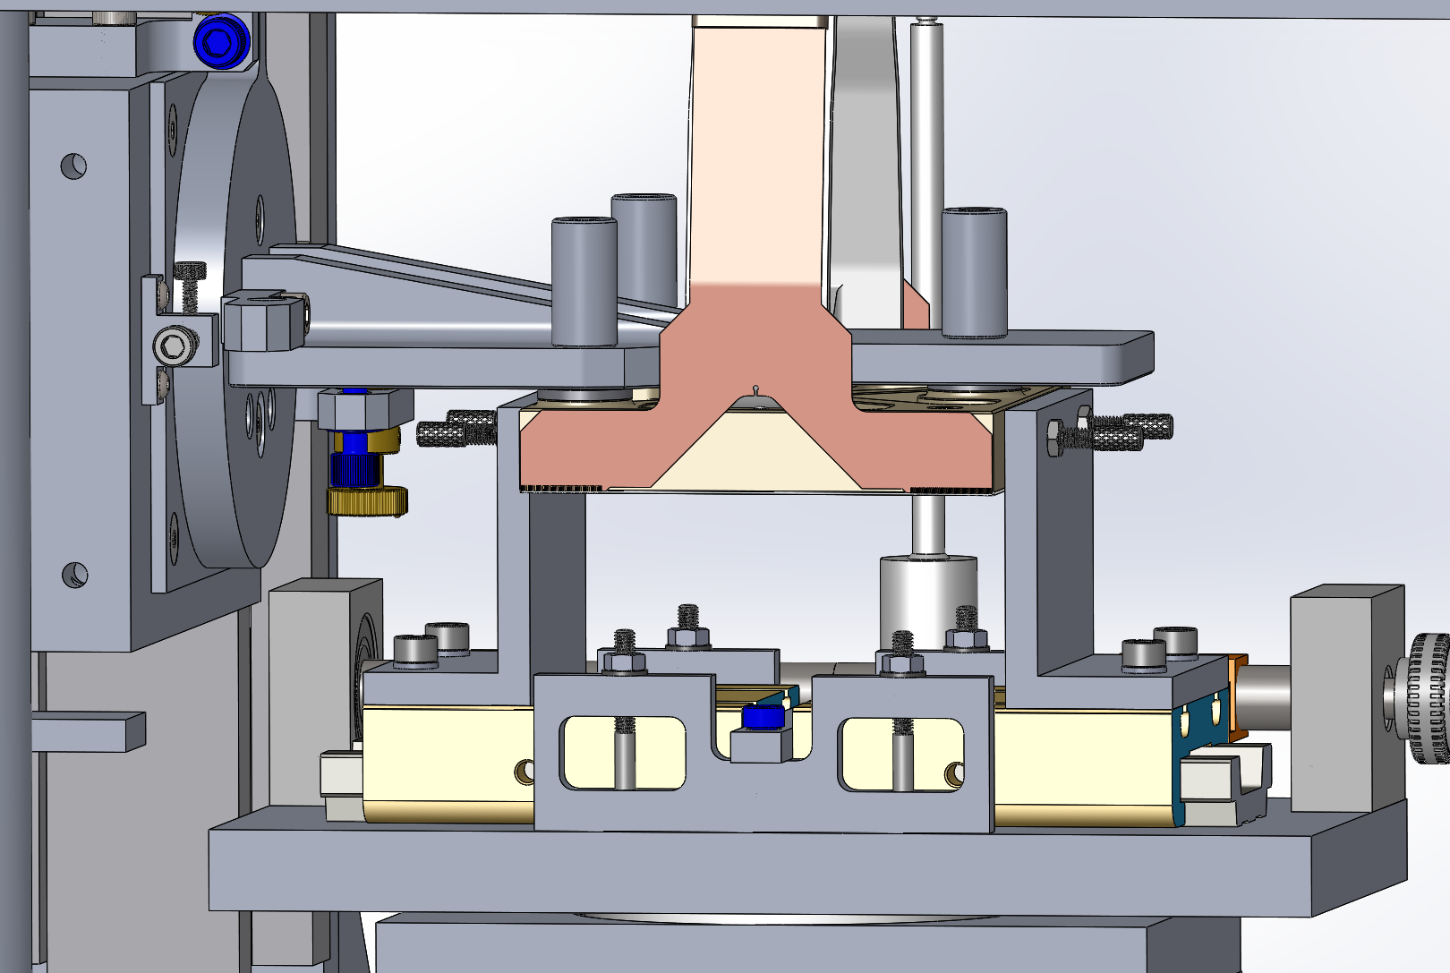
WASP CCD Assembly Fixture
Step 21: Close the jaws
Watch pin engagement

Slide 26
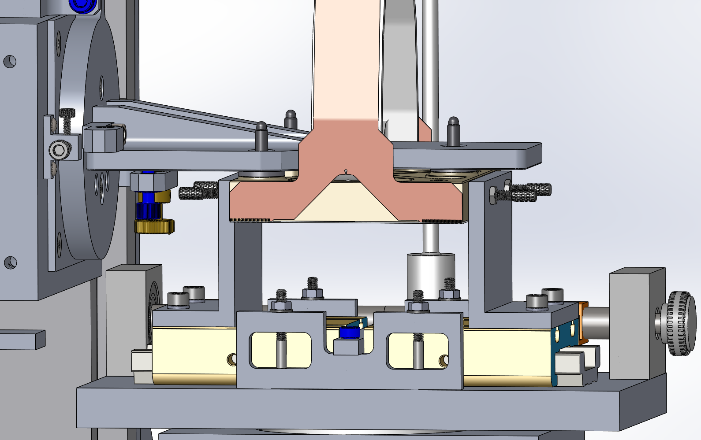
WASP CCD Assembly Fixture
Step 22: Unbolt the CCD

Slide 27
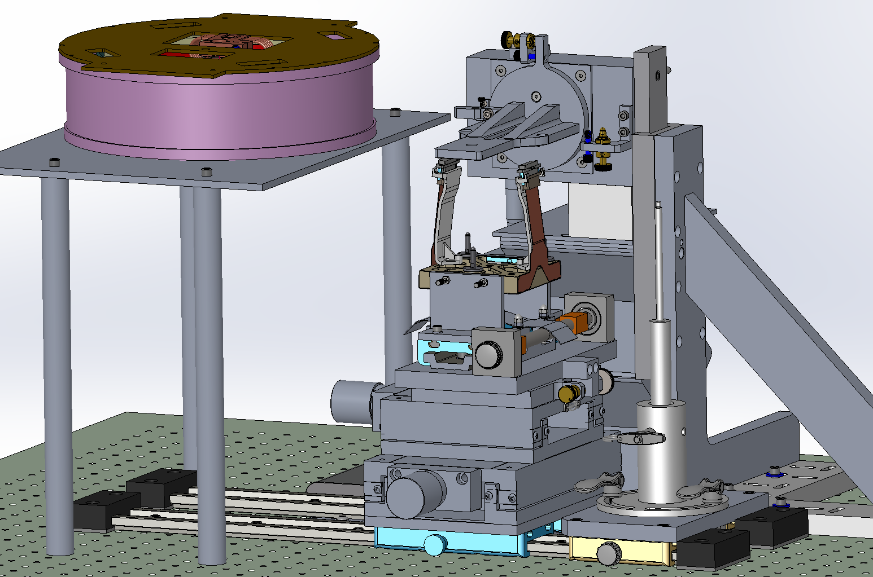
WASP CCD Assembly Fixture
Step 23: Raise the Rotation Stage Clear and add the white spacer block.

Slide 28
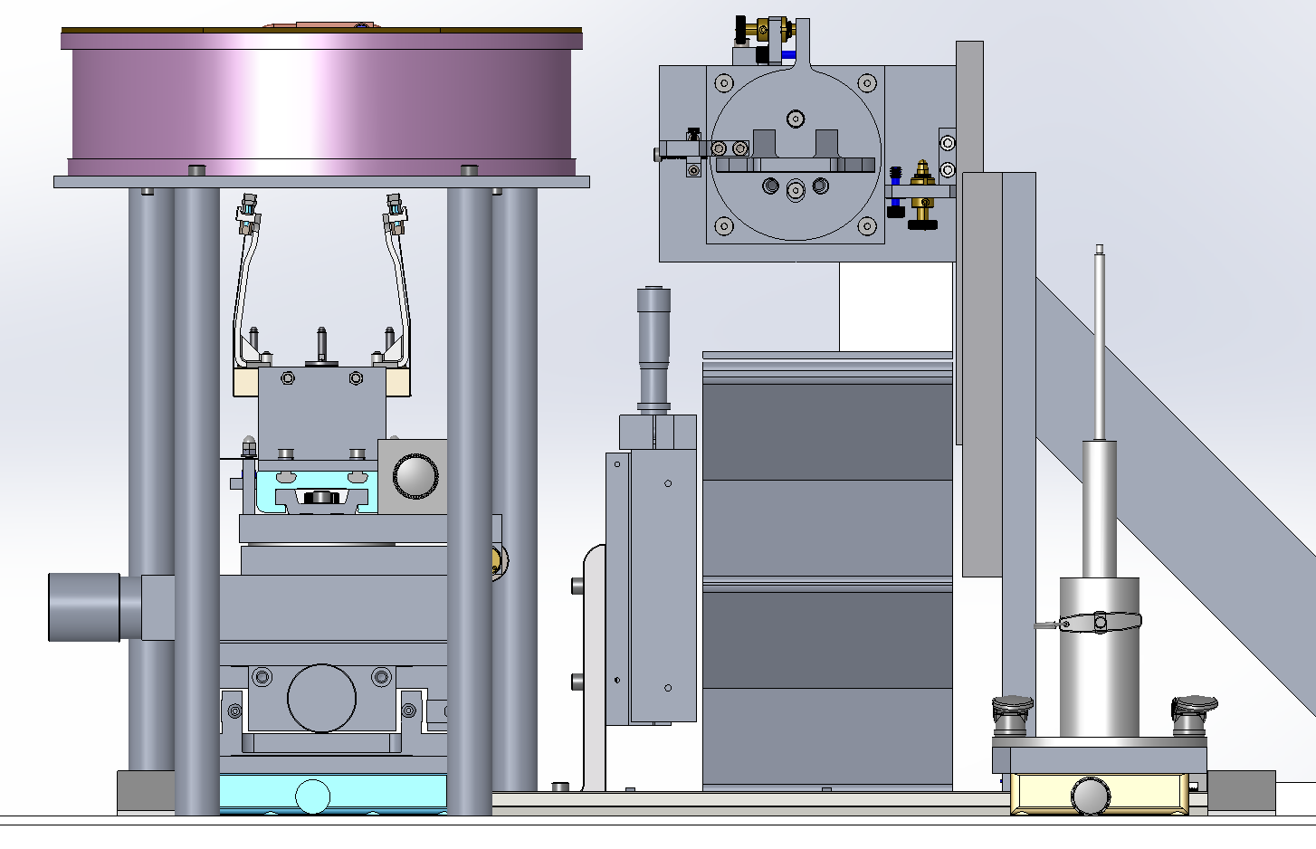
WASP CCD Assembly Fixture
Step 24: Slide the CCD under the Dewar.

Slide 29
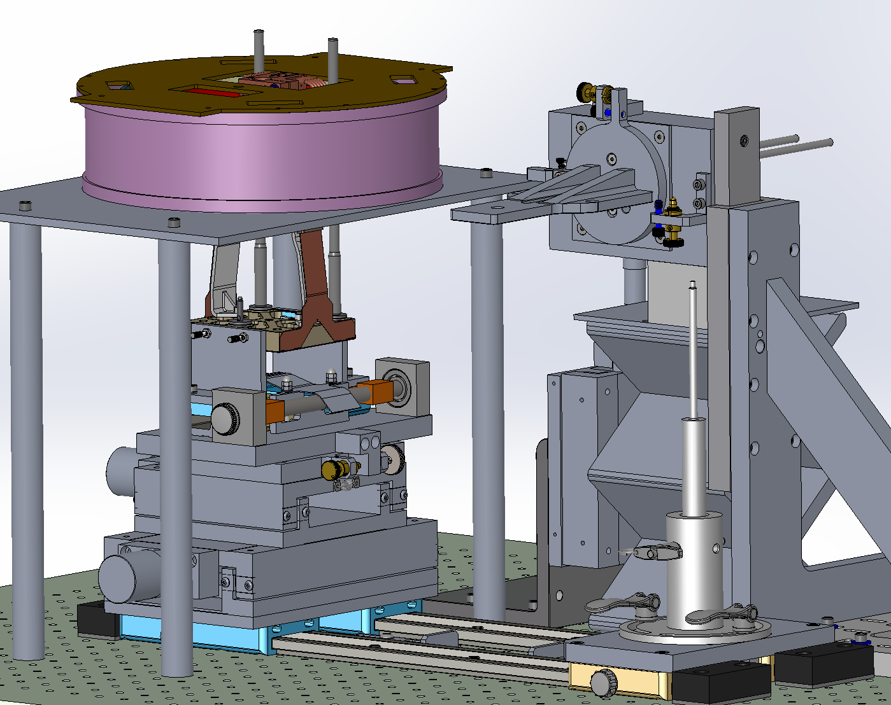
WASP CCD Assembly Fixture
Step 25: Lower the Guide rods to the CCD thru the Dewar
NB: Guide rods have O- rings under circlips to set engagement depth and cushion end stop.

Slide 30
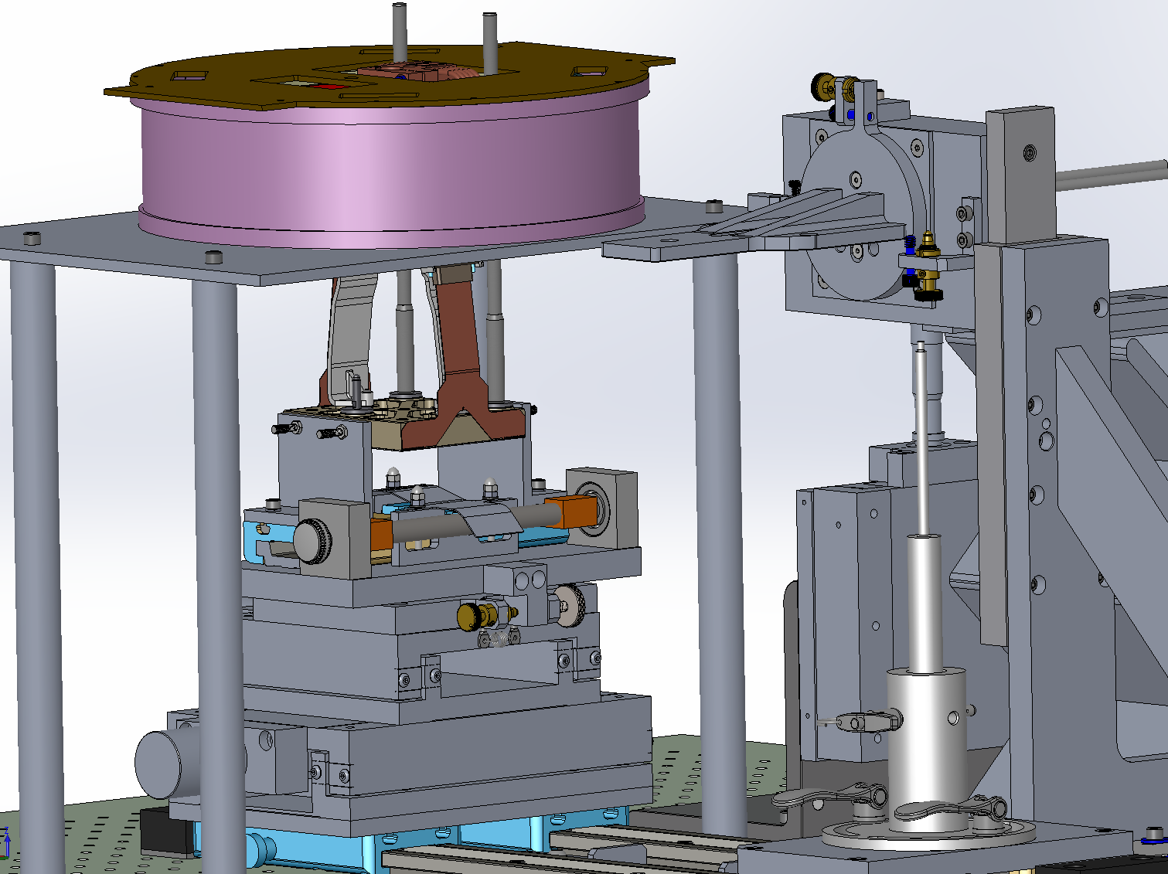
WASP CCD Assembly Fixture
Step 26: Open the Jaws very slowly easing the pins out of the holes, noting that CoG cause swing to far side which need to be compensated.
Check that circlips prevent CCD from falling before opening jaws.
Need extra slide: before raising CCD, move stage to right while CCD is in the low position, being careful to keep centerd between the jaws

Slide 31
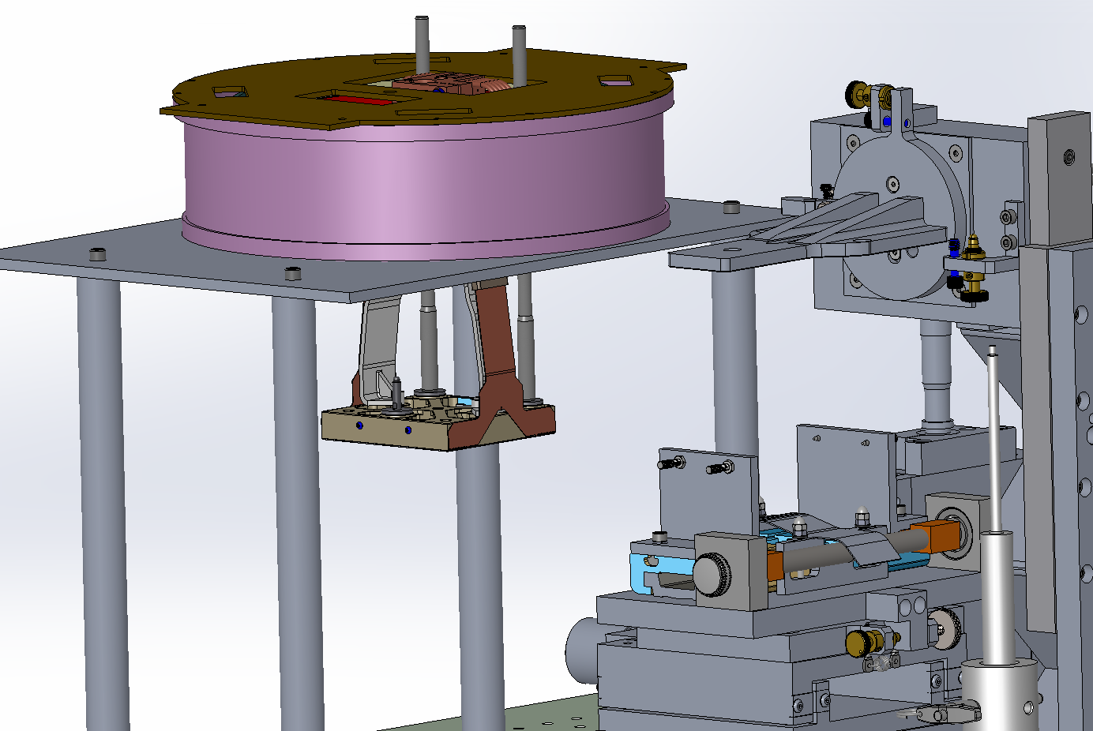
WASP CCD Assembly Fixture
Step 27: Slide the Horizontal Stage out of the way

Slide 32
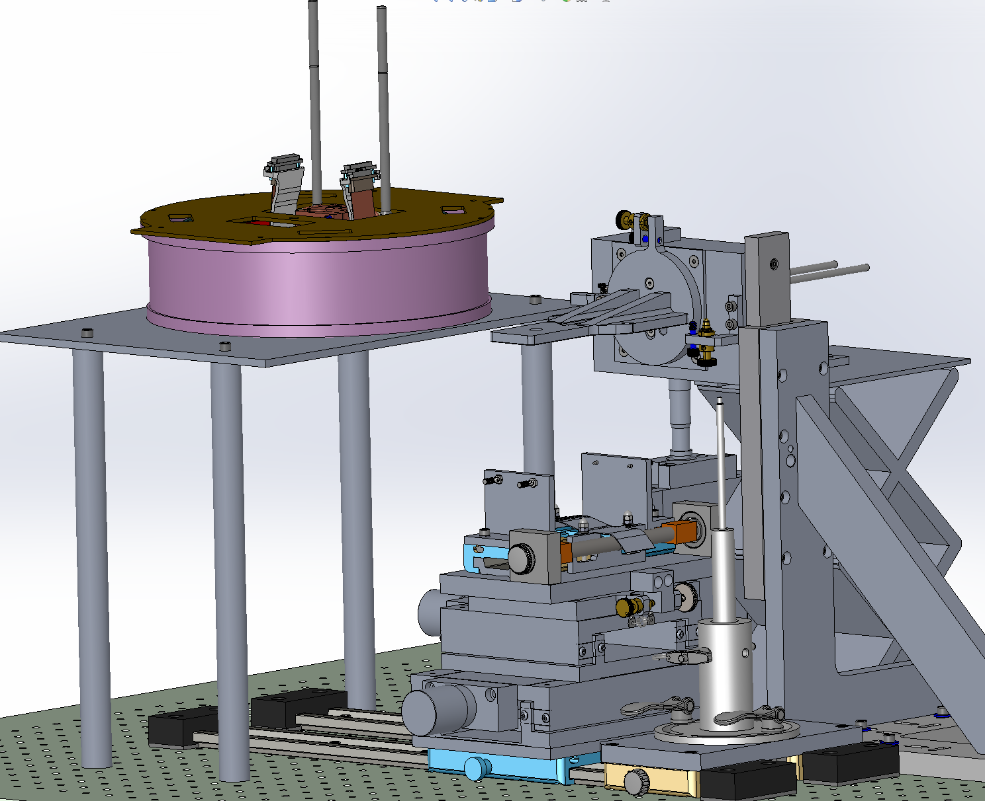
WASP CCD Assembly Fixture
Step 28: Pull the CCD Up gently
Avoid fouling wires.
Watch clearance to guiders

Slide 33
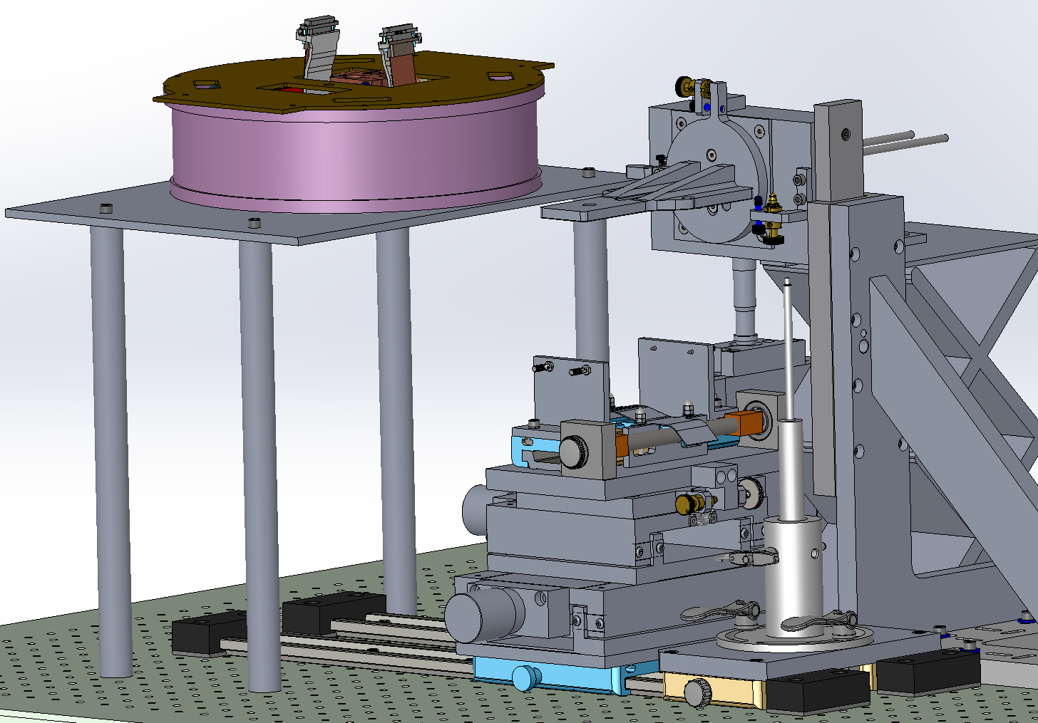
WASP CCD Assembly Fixture
Step 29: Engage Captive Fastener and Replace Guide Rods with Fasteners, one at a time. Torque to 1.3 turns from initial contact (0.3Nm)
Size 4 wrench
1.3 turns (0.3 Nm)
Check no wires trapped under fasteners

Slide 34
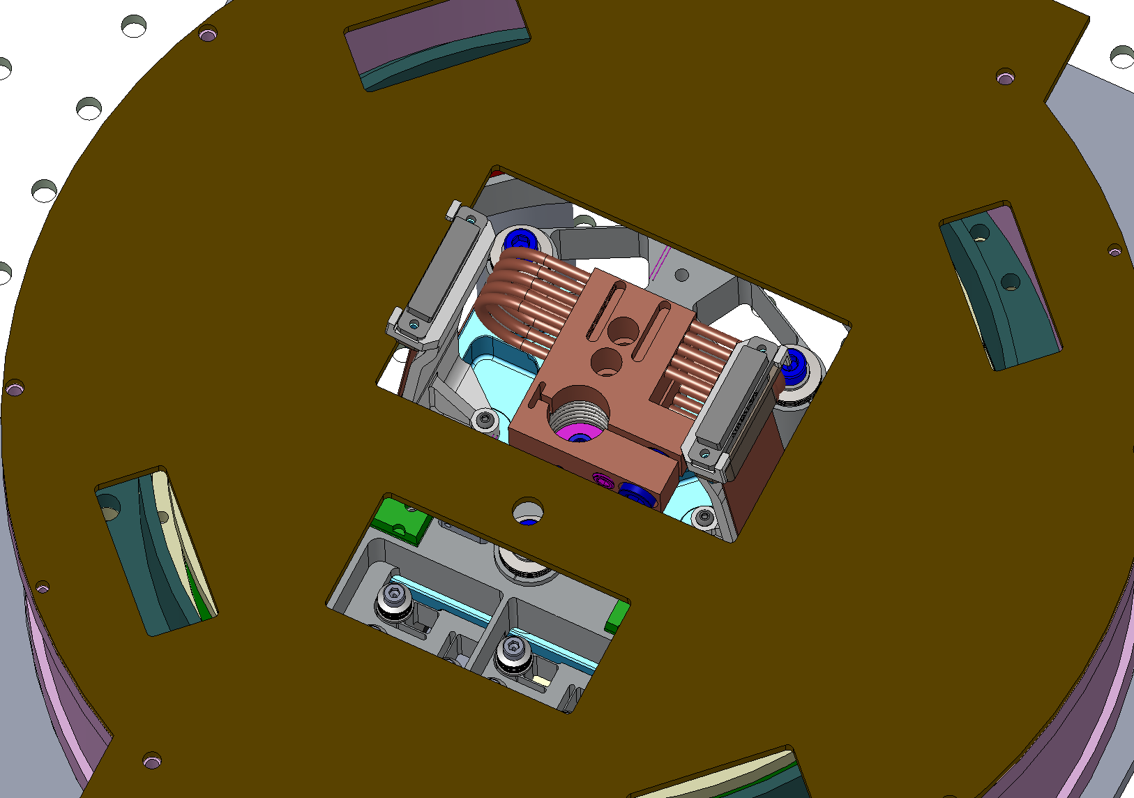
WASP CCD Assembly Fixture
Step 30: Remove stalks with shorting plugs,
engage connector in VIB; repeat for other side.
Size 1.5 allen
Attach CCD connector retention screws.

Slide 35
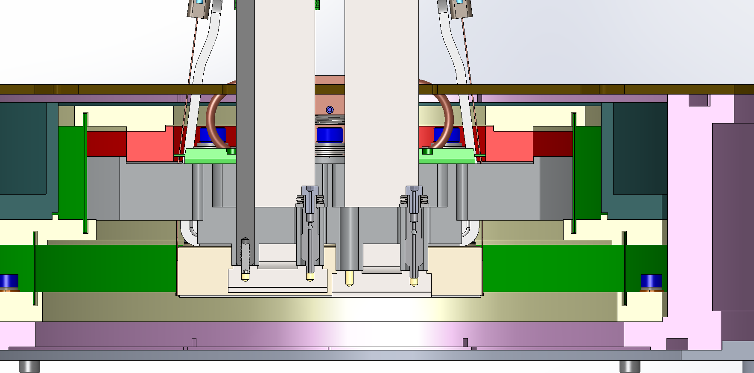
WASP CCD Assembly Fixture
PART II:GUIDE CCD INSTALLATION

Slide 36
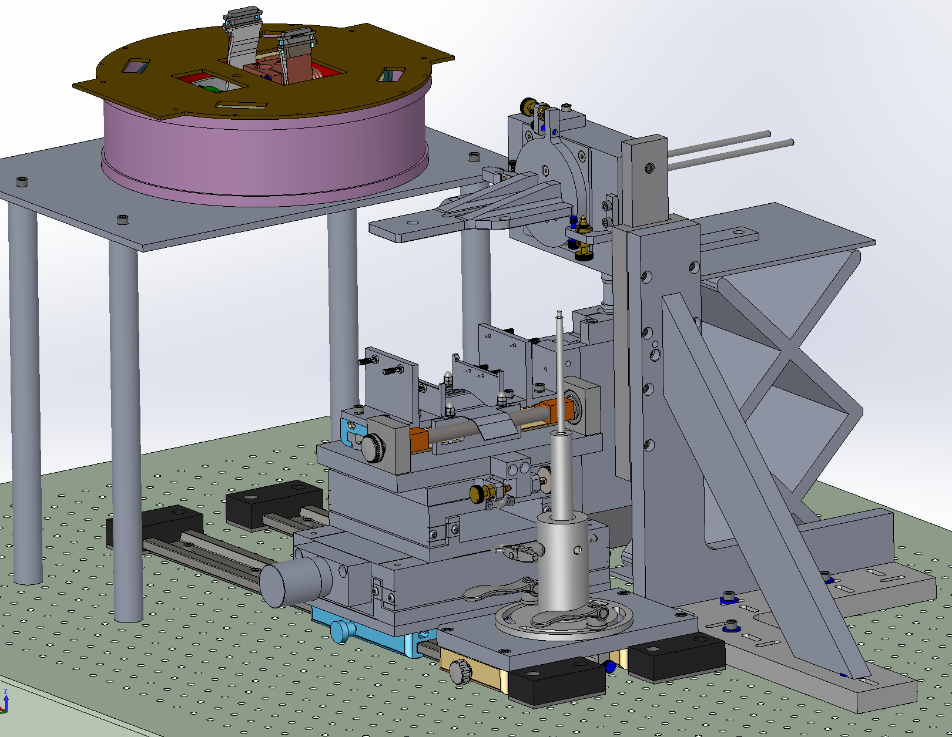
WASP CCD Assembly Fixture
Step 01: Slide the Horizontal Stage into place, open the jaws and remove the Science CCD Coupler.
Don’t touch any adjusters until called for. Some are one time alignments !!
Place dewar base, with VIB installed, in orientation shown. 4X #4-40 screws with washers secure VIB.
Take care not to pinch/trap wires.
Connect temperature sensors and heaters.
Check no dangling or unconnected wires.
Check for disat on O-ring before installing VIB.
On bottom translation stage set either:
Y=??? Mm (guider) or
Y= ??? mm (focus)
Notes:
Alex we need to update the model with correct VIB…. IT only extends on one side.
Need slide showing which sensor and heater plugs go where. How are they labeled/encoded?
In guider shipping container, place kapton tape over screws that are never removed.

Slide 37
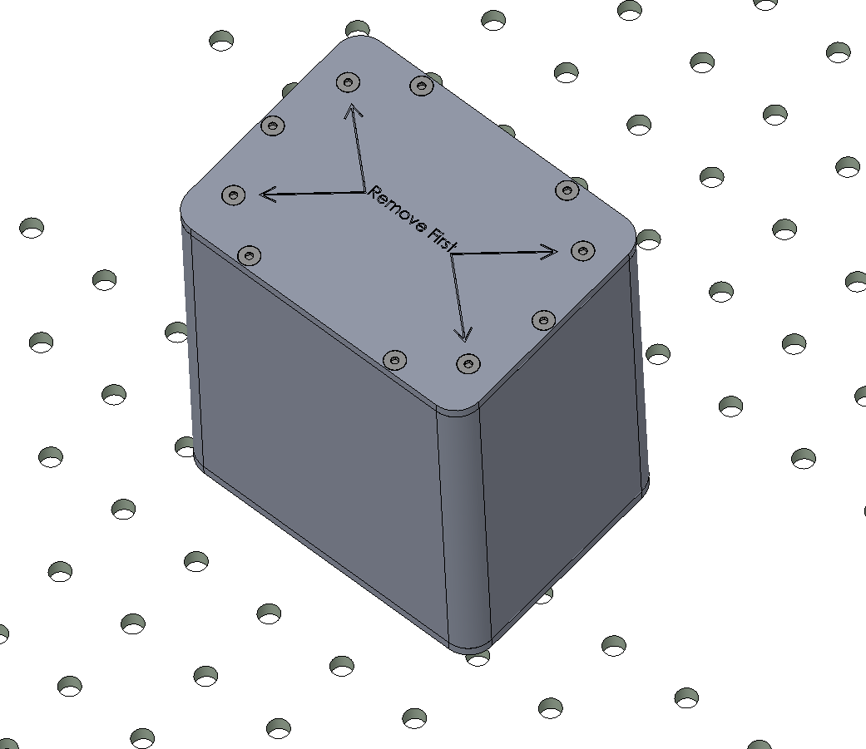
WASP CCD Assembly Fixture
Note CCD serial number being installed.
Step 02: Get the CCD Enclosure to rest on its “Remove Last” Face and remove the 4X Screws marked “Remove First”
Unclip ESD cable at wrist strap to check alarm works.
Check humidity > 30%
Ionizing blower running?
ESD matt on floor, grounded.
Tools:
- Allen wrench Size 2
Notes:
JPL-01 installed at focus (high position)
2016-05-09: humidity = 43.5%

Slide 38
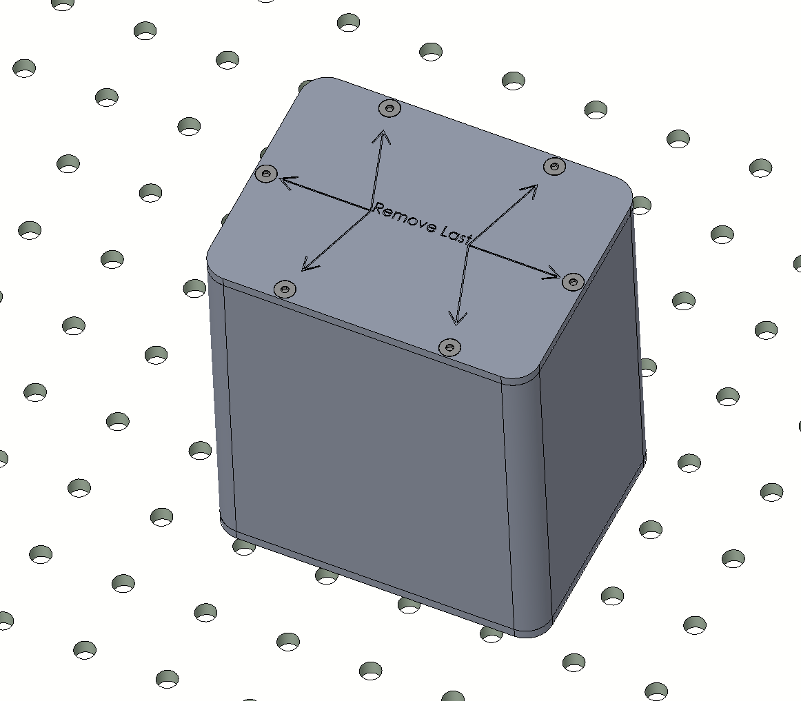
WASP CCD Assembly Fixture
Step 03: Flip the CCD Enclosure to rest on its “Remove First” Face and remove the 6X Screws marked “Remove Last”
Place on bench gently to avoid shocks to CCD within.
RE-check that jaws are fully open: align ends of moving and stationary parts of Y stage.
Note CCD serial number being installed. JPL-01 at focus (high position)

Slide 39
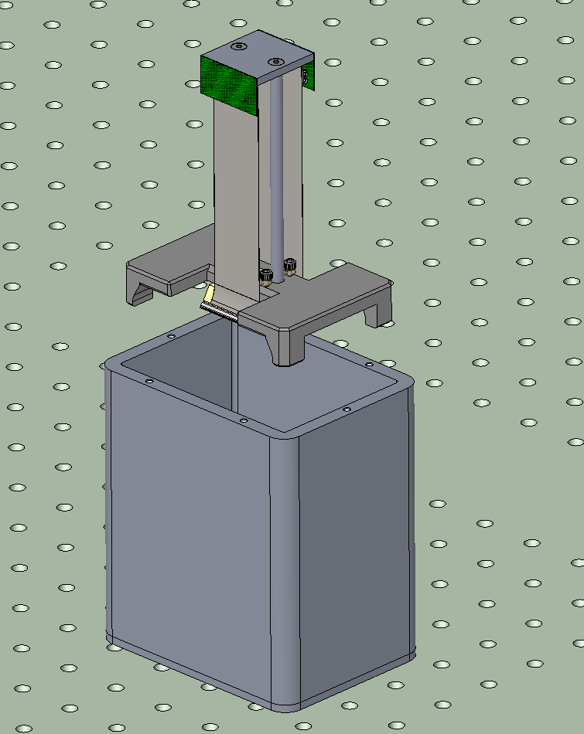
WASP CCD Assembly Fixture
Step 04: Remove lid.
Slide the CCD out of the enclosure and .. (next slide)…

Slide 40
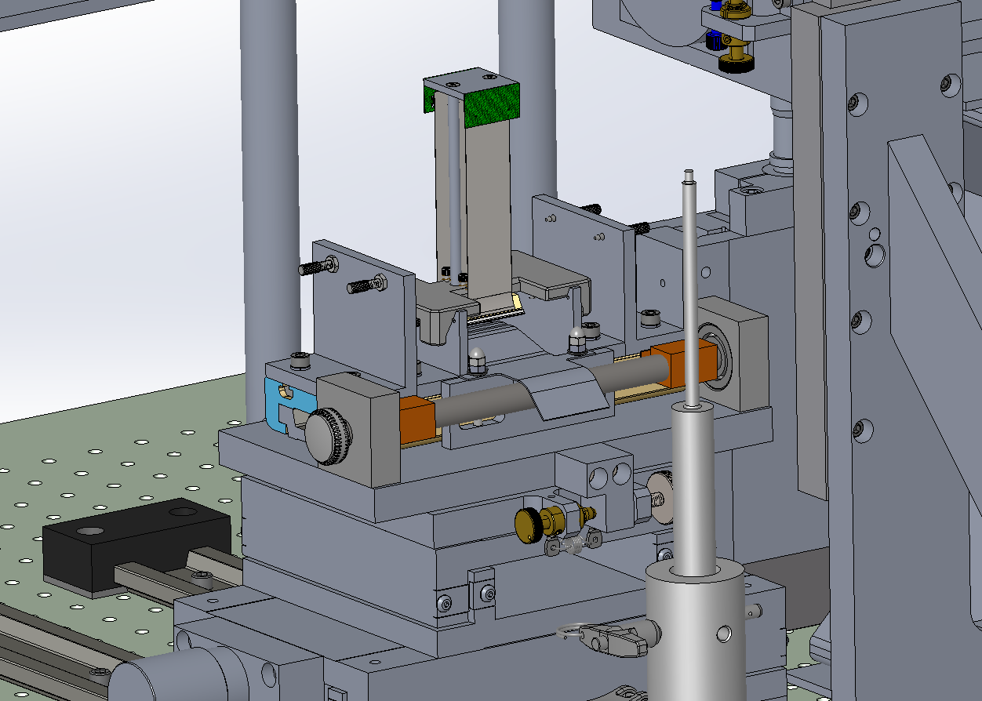
WASP CCD Assembly Fixture
Step 05: Place the Guide CCD between the Jaws
Visually check that jaws are open and cradle engages correctly while placing into jaws.

Slide 41
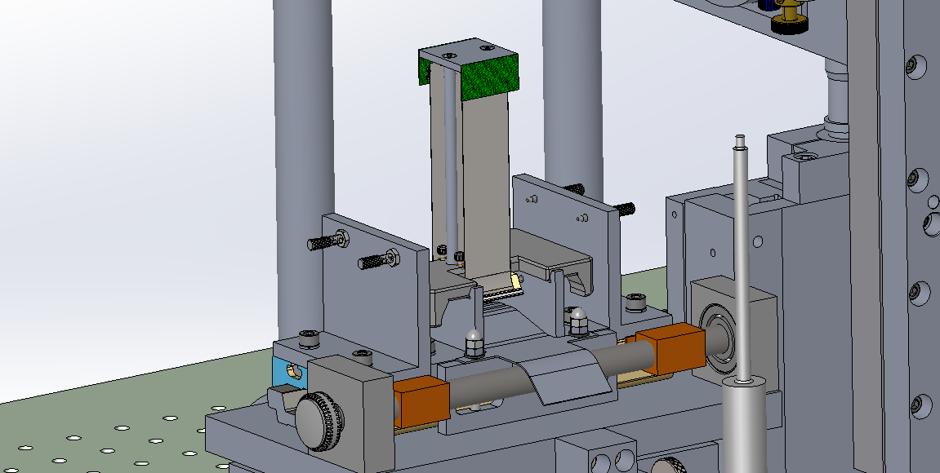
WASP CCD Assembly Fixture
Step 06: Close the Jaws gently, watching pins engagement, unplug Hirose connector (pry open with flat head screwdriver)
Undo captive screws into back of CCD. Remove the Guide CCD Installation Bracket.
Tools:
- Allen wrench Size 2.5
Use light pressure on knob at end of travel.
Take care not to tension the Flex Cable.
Check for full pin engagement

Slide 42
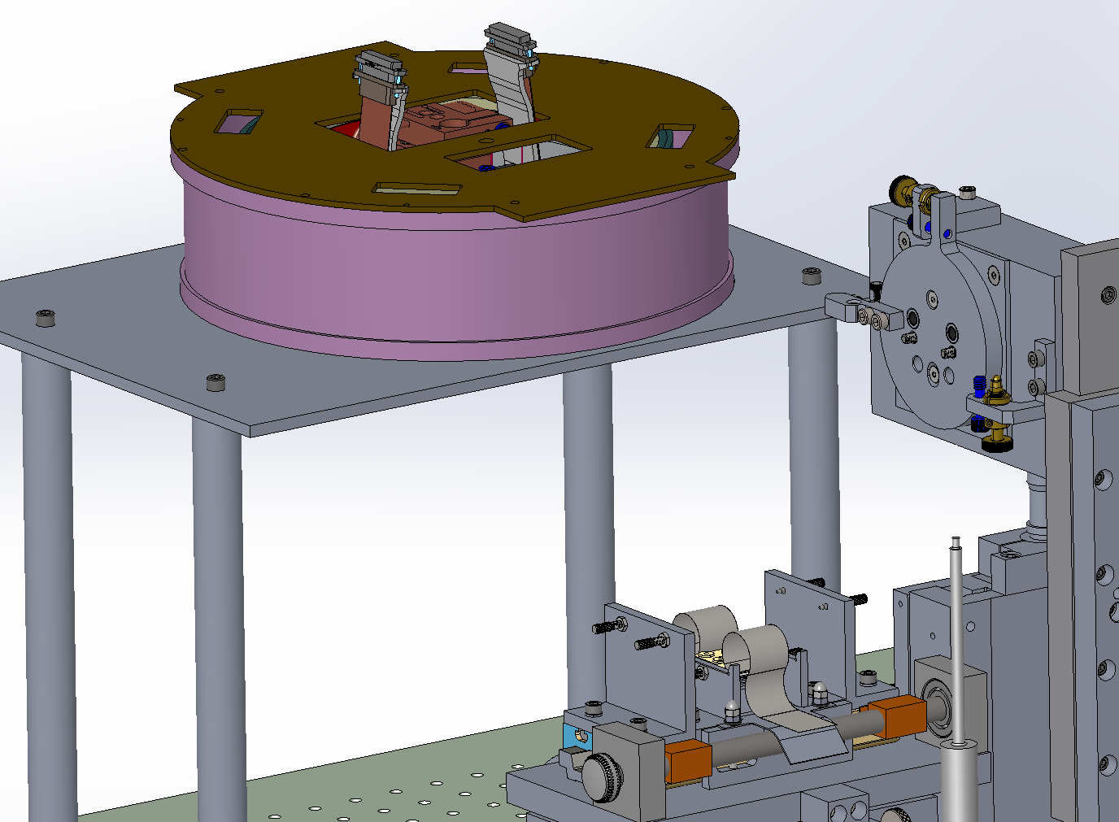
WASP CCD Assembly Fixture
Step 07: Check dewar/VIN rotation (90 deg CCW relative to science CCD install).

Slide 43
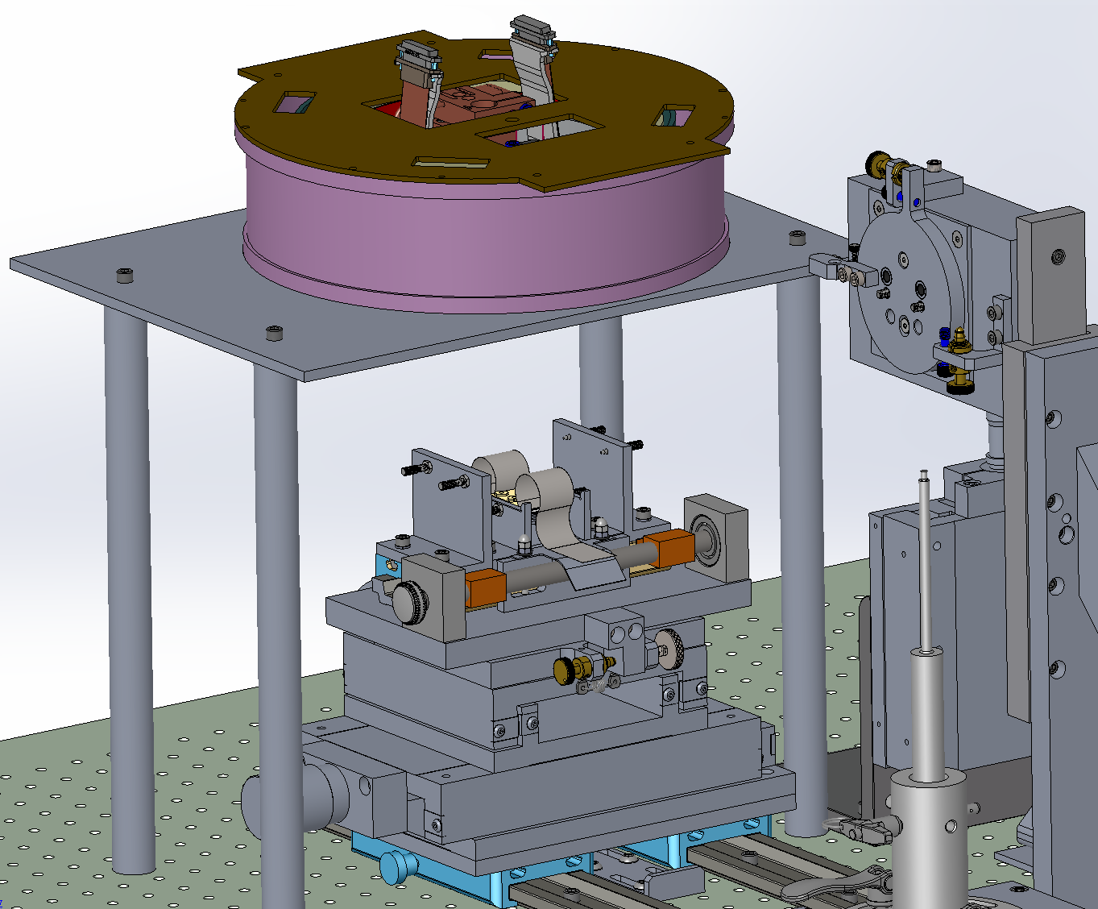
WASP CCD Assembly Fixture
Step 08: Slide the Horizontal Stage into position under the Dewar
Notes:
Need end stop for guider that is different to science CCD.
Distance from current end stop to new position = 58.5 mm

Slide 44
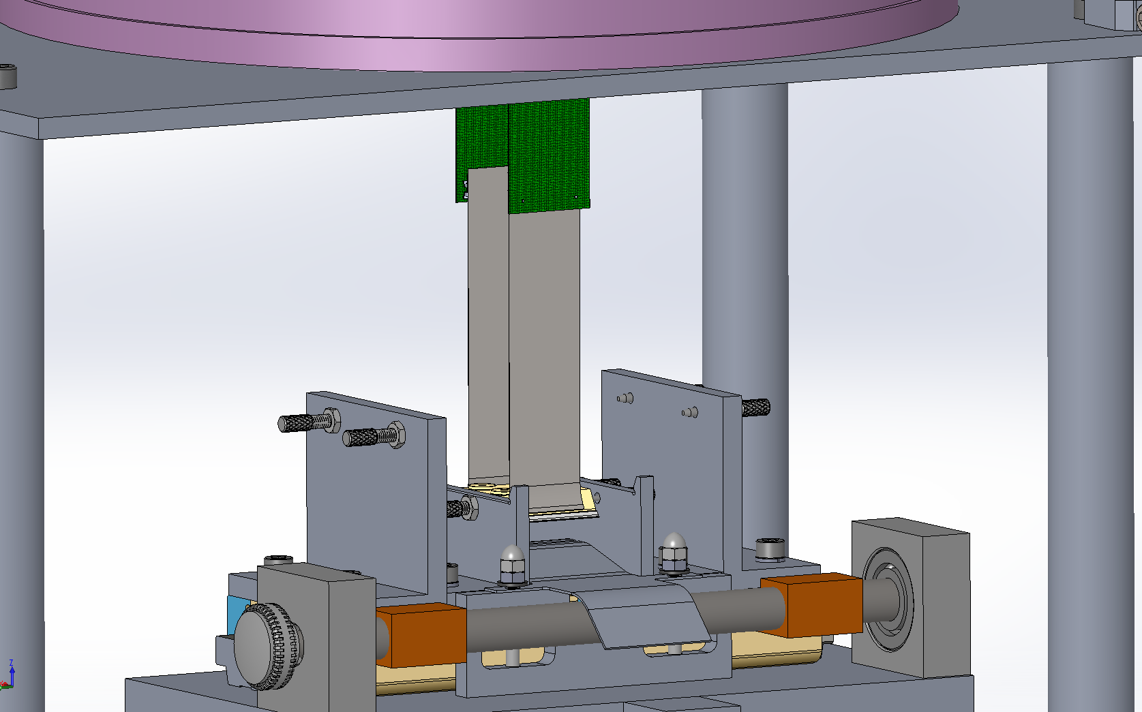
WASP CCD Assembly Fixture
Step 9: Install Cable Management Assembly; attach handling rods to CCD
then attach Hirose connectors on flex cables
Orient management fixture so rods are on the side towards to installer;
Tweak Y stage position for rod engagement.
Notes:
Cable slack is 2.53 mm in excess. =8.77-

Slide 45
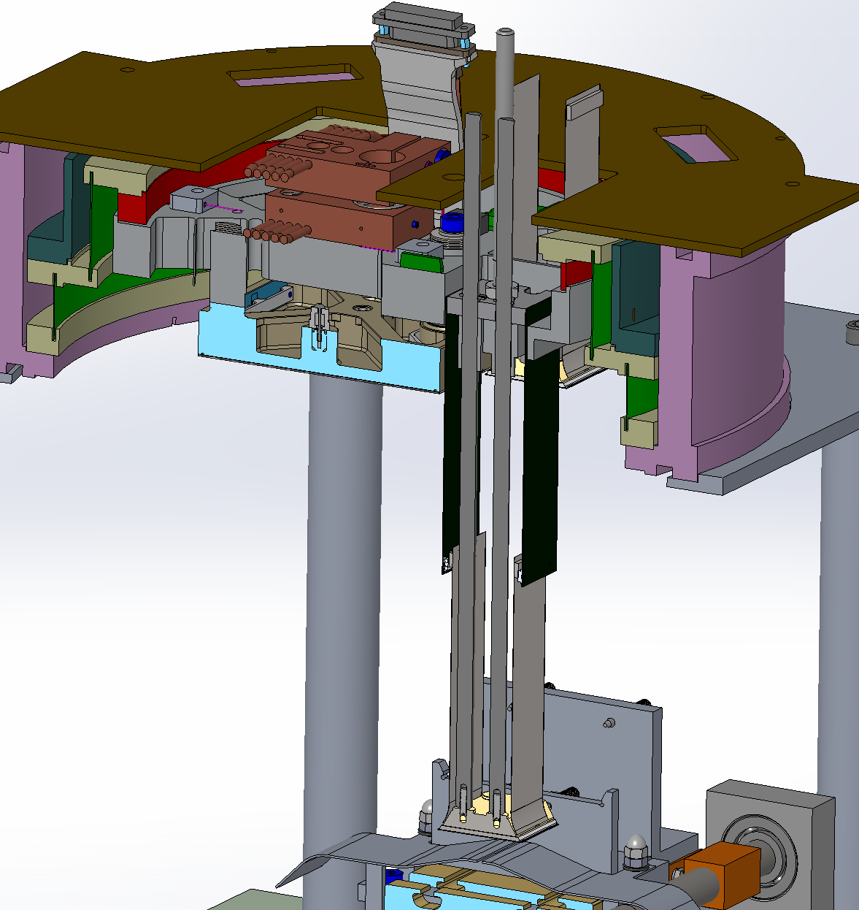
WASP CCD Assembly Fixture
Step 10: Lower the Guide rods to the CCD thru the Dewar.
ENGAGE GUIDE RODS

Slide 46
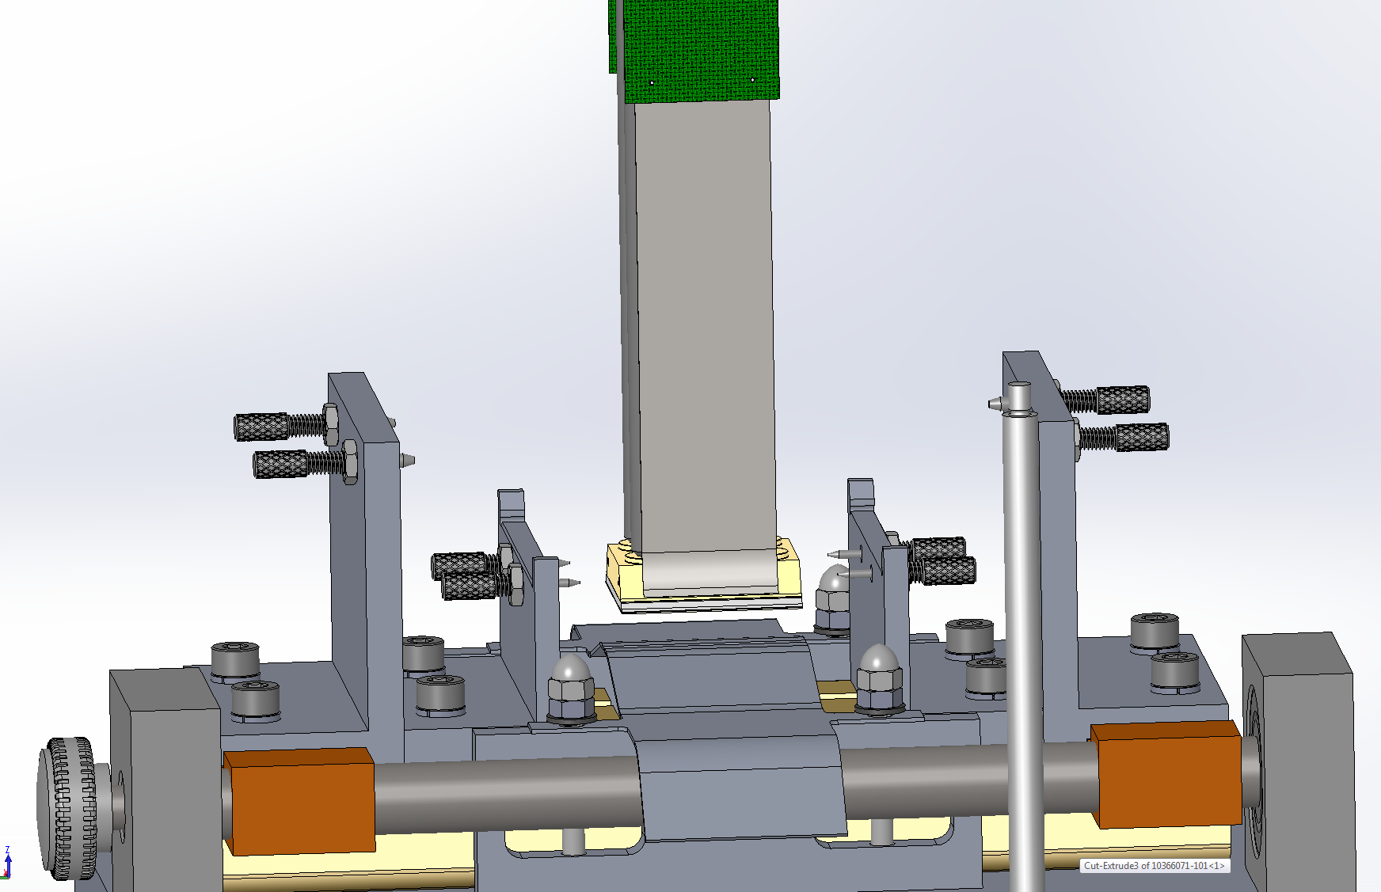
WASP CCD Assembly Fixture
Step 11:Check guide rods installed… Open the Jaws.

Slide 47
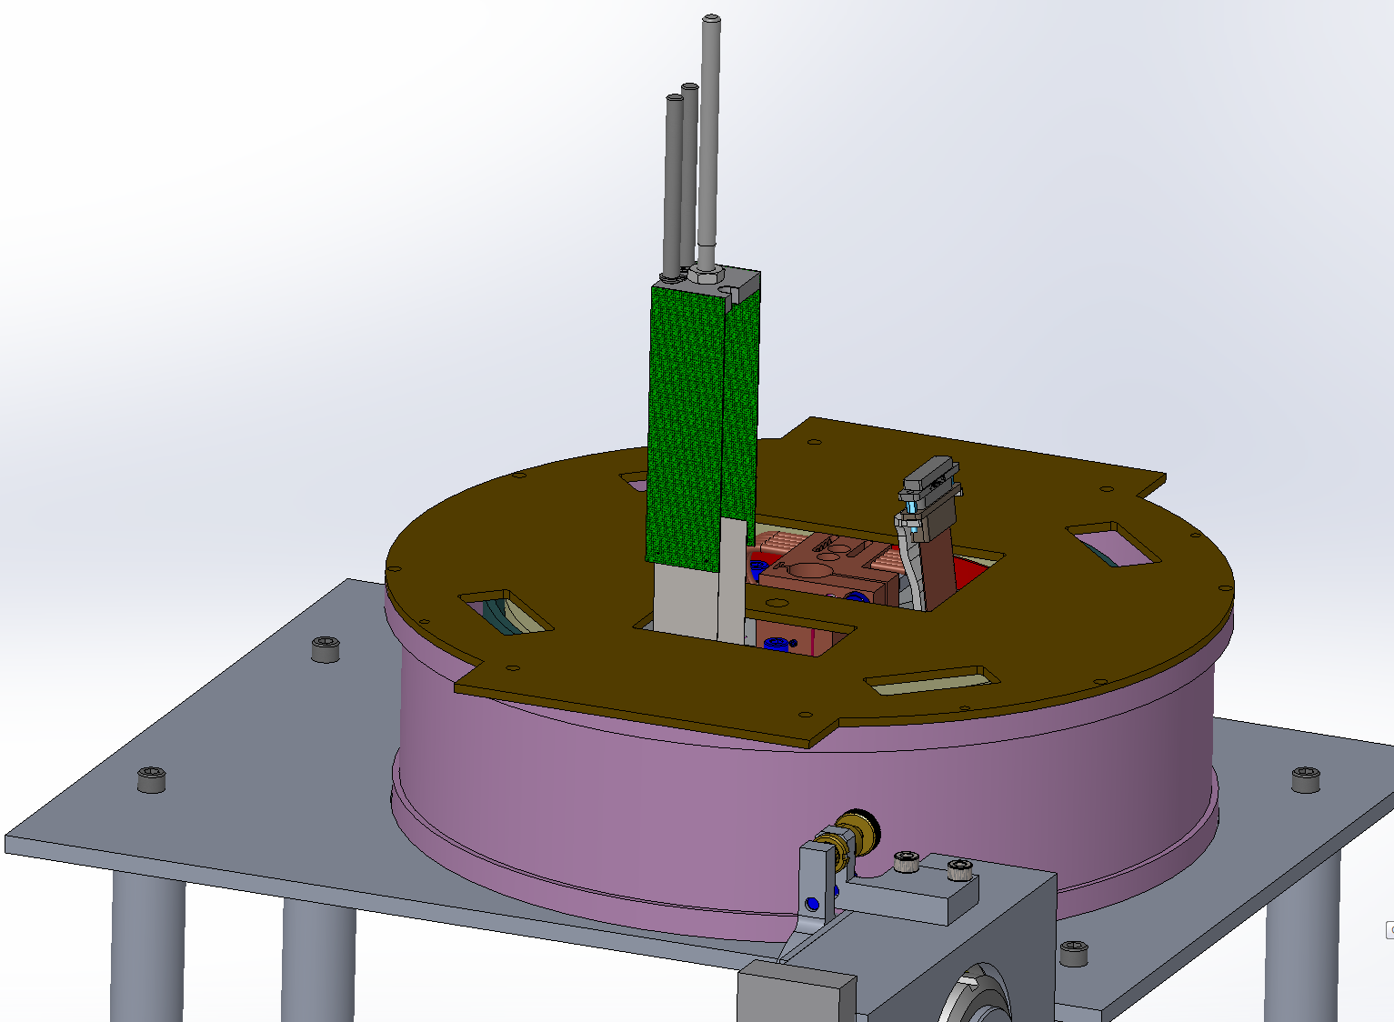
WASP CCD Assembly Fixture
Step 12:
a) Pull the CCD up, using handle not guide rod
b) Install one fastener at the available location.
c) Unplug connectors.
d) Remove guide rods and cable management tool.
e) Install remaining fasteners.
Notes:
Prop height = 85mm x 110mm x 5 mm Make 115.5x115.5x5

Slide 48
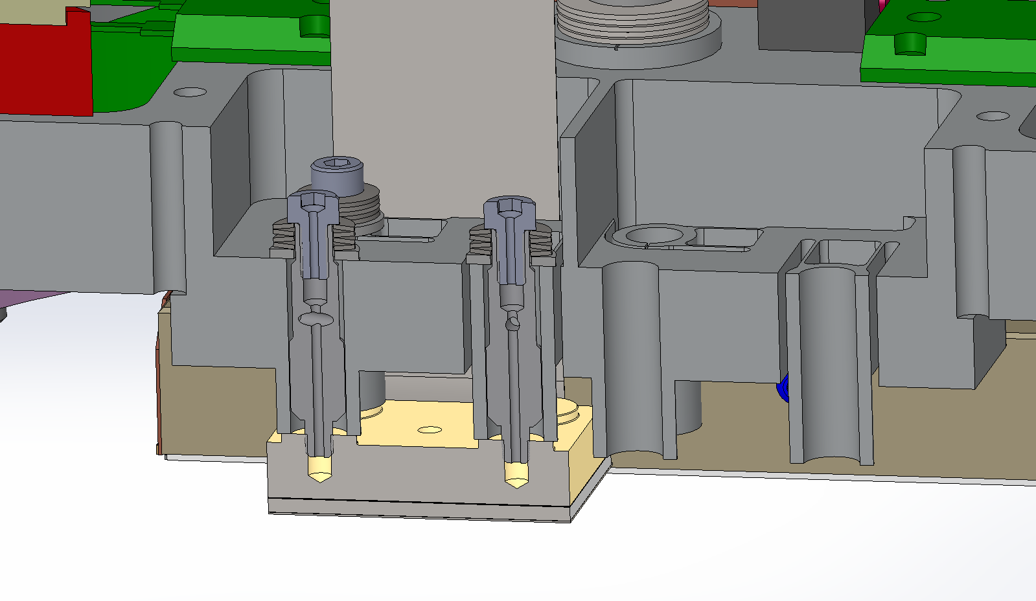
WASP CCD Assembly Fixture
Step 14: Torque the CCD Fasteners to 1.5 turns past the initial contact (0.4Nm), then engage connector to the VIB.
Tools:
Torque wrench
Allen bit Size 2.5
Notes:
Hex “bolt grabber” would be useful.
Plug cables into VIB after first fastener installed.
Cable Management tool poition is set by the new “prop”,during this operation.
Remove management tool then replace each rod with fastenr.
Need prop to hole cable management tool in position while securing CCDs.

Slide 49
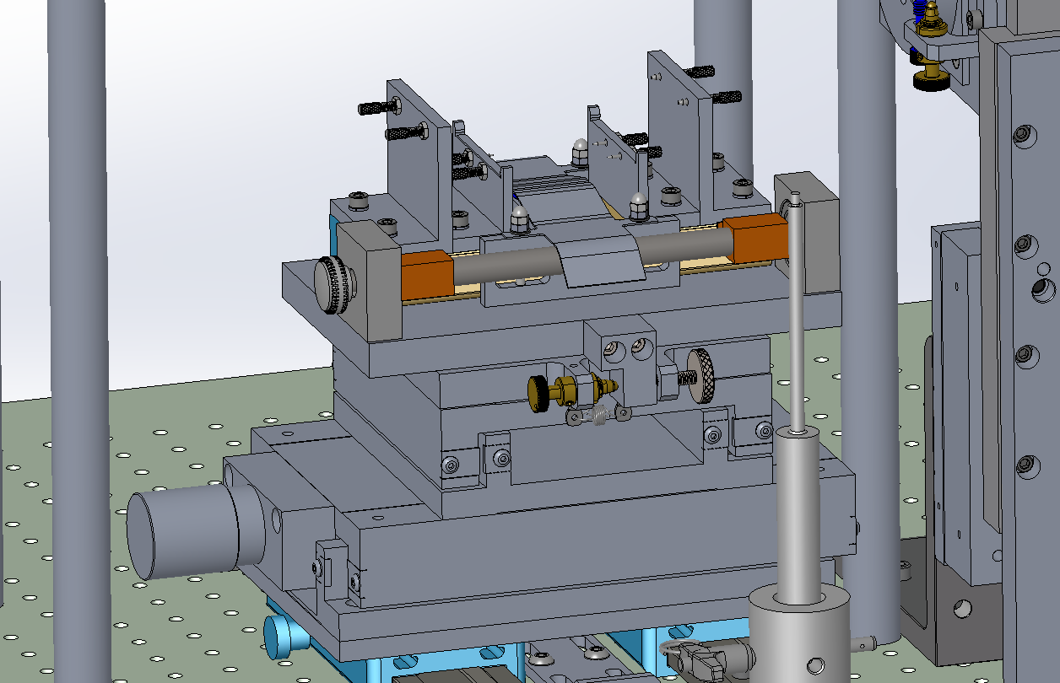
WASP CCD Assembly Fixture
Step 15: Set the Horiz Stage for the AFT CCD and repeat for the second Guider

Slide 50
WASP CCD Assembly Fixture
PART III:GUIDE CCD UNINSTALLATION

Slide 51
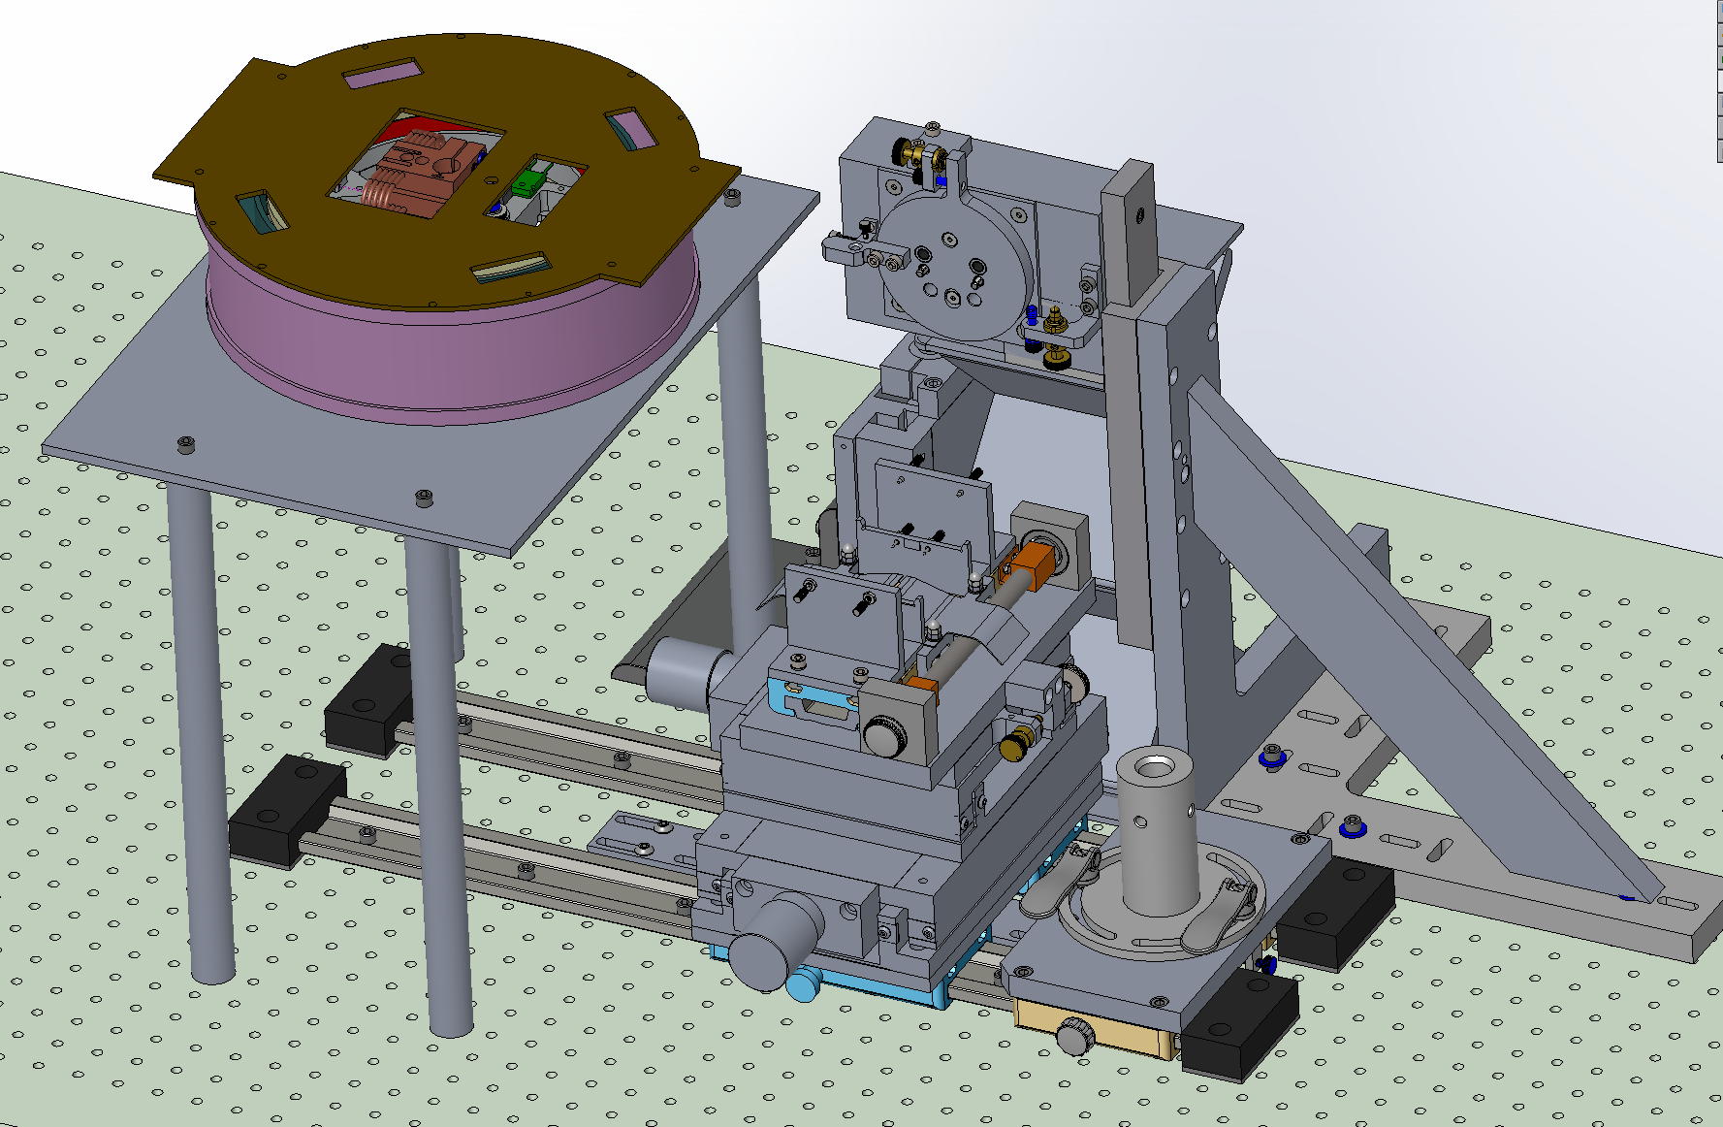
WASP CCD Assembly Fixture
Step 01: Slide the Horizontal Stage away from under the Cryostat, open the Jaws.
Place dewar base, with VIB installed, in orientation shown. 4X #4-40 screws with washers secure VIB.
Notes:
Alex we need to update the model with correct VIB…. IT only extends on one side.
Need slide showing which sensor and heater plugs go where. How are they labeled/encoded?
In guider shipping container, place kapton tape over screws that are never removed.

Slide 52
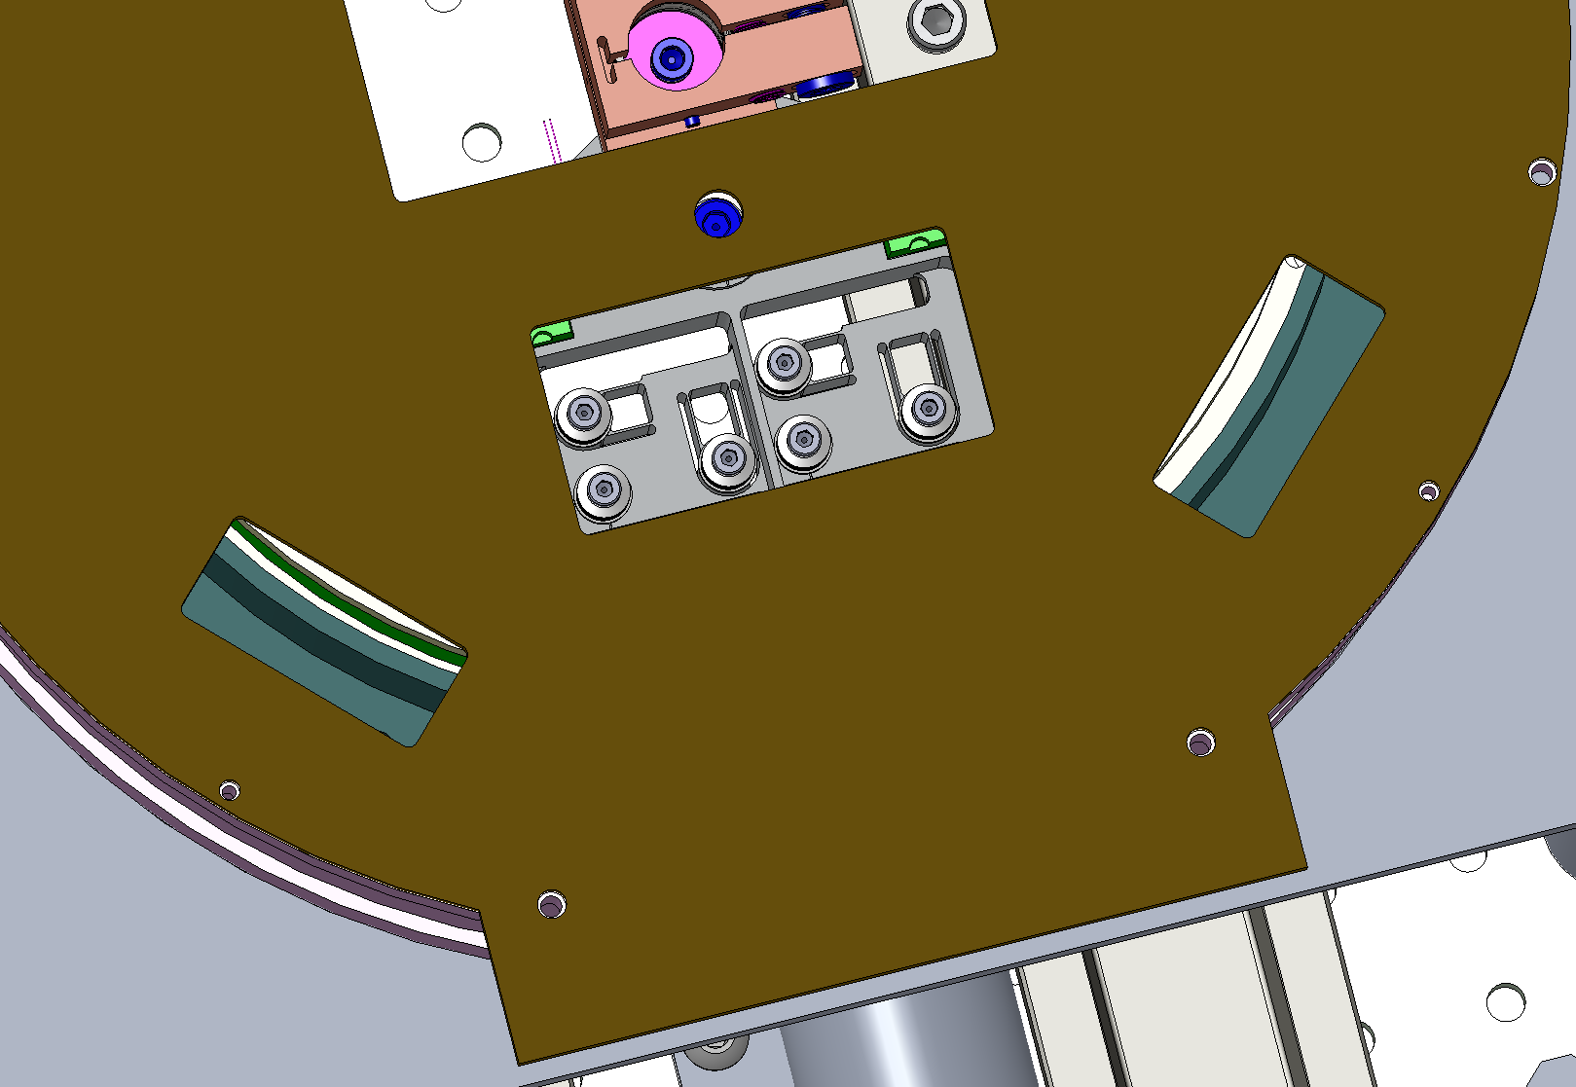
WASP CCD Assembly Fixture
Step 02: Remove the 2X aligned fasteners of the guider to be removed. Record removal torque.
Tools:
Torque wrench
Allen bit Size 2.5
Notes:
Alex we need to update the model with correct VIB…. IT only extends on one side.
Need slide showing which sensor and heater plugs go where. How are they labeled/encoded?
In guider shipping container, place kapton tape over screws that are never removed.

Slide 53
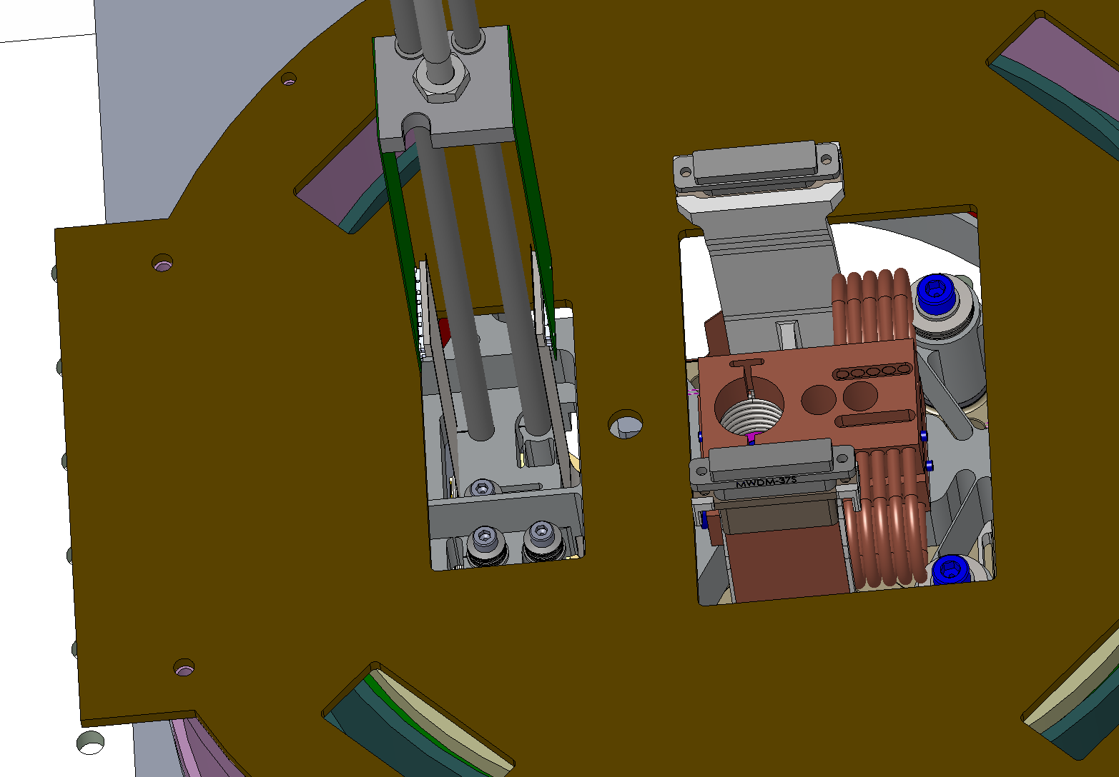
WASP CCD Assembly Fixture
Step 03:
Install the 2X Guide rods of the Pull tool WASP-F00-1100 one by one to the CCD
Disconnect the Ribbons connector from the VIB
and connect them to the Pull Tool.
Tools:
Small Flat Head Screwdriver
Notes:
Alex we need to update the model with correct VIB…. IT only extends on one side.
Need slide showing which sensor and heater plugs go where. How are they labeled/encoded?
In guider shipping container, place kapton tape over screws that are never removed.

Slide 54

WASP CCD Assembly Fixture
Step 04: Hold the Pull tool while removing the last fastener.
Tools:
Torque wrench
Allen bit Size 2.5
An assistant
Notes:
Alex we need to update the model with correct VIB…. IT only extends on one side.
Need slide showing which sensor and heater plugs go where. How are they labeled/encoded?
In guider shipping container, place kapton tape over screws that are never removed.

Slide 55

WASP CCD Assembly Fixture
Step 05: Lower the Pull Tool all the way to its hard stop
Notes:
Alex we need to update the model with correct VIB…. IT only extends on one side.
Need slide showing which sensor and heater plugs go where. How are they labeled/encoded?
In guider shipping container, place kapton tape over screws that are never removed.

Slide 56

WASP CCD Assembly Fixture
Step 06: Bring the Horizontal Stage in place verifying clearance around the CCD
Notes:
Alex we need to update the model with correct VIB…. IT only extends on one side.
Need slide showing which sensor and heater plugs go where. How are they labeled/encoded?
In guider shipping container, place kapton tape over screws that are never removed.

Slide 57

WASP CCD Assembly Fixture
Step 07: Close the jaws slowly, verifying pin engagements, adjust stage as needed, apply slight pressure against the foam.
Notes:
Alex we need to update the model with correct VIB…. IT only extends on one side.
Need slide showing which sensor and heater plugs go where. How are they labeled/encoded?
In guider shipping container, place kapton tape over screws that are never removed.

Slide 58
WASP CCD Assembly Fixture
Step 08: Disconnect the Cable Pull.
Notes:
Cable slack is 2.53 mm in excess. =8.77-

Slide 59

WASP CCD Assembly Fixture
Step 09: Slide the Horizontal Stage away from under the Cryostat.
Notes:
Cable slack is 2.53 mm in excess. =8.77-

Slide 60

WASP CCD Assembly Fixture
Step 10: Install the Guider Bracket WASP-F00-1320 Finger tight the 4X Captive Screws
Tools:
- Allen wrench Size 2.5
Notes:
Cable slack is 2.53 mm in excess. =8.77-

Slide 61

WASP CCD Assembly Fixture
Step 11: Connect the Ribbons connectors to the Installation Bracket.
Notes:
Cable slack is 2.53 mm in excess. =8.77-

Slide 62

WASP CCD Assembly Fixture
Step 12: Open the Jaws

Slide 63
WASP CCD Assembly Fixture
Step 13: Flip the CCD Enclosure to rest on its “Remove First” Face and remove the 6X Screws marked “Remove Last”
Tools:
- Allen wrench Size 2

Slide 64
WASP CCD Assembly Fixture
Step 14: Slide the CCD in the enclosure.
Note CCD serial number being stored.

Slide 65
WASP CCD Assembly Fixture
Step 15: Install the cover with the 6X Screws marked “Remove Last”
Tools:
- Allen wrench Size 2

Slide 66
WASP CCD Assembly Fixture
Step 16: Gently flip the CCD Enclosure to rest on its “Remove Last” Face, align the CCD Bracket with the holes by giggling the Allen Wrench through the screw hole and install the 4X Screws marked “Remove First”
Tools:
- Allen wrench Size 2
Notes:
JPL-01 installed at focus (high position)
2016-05-09: humidity = 43.5%

