Slide 1
Filter Wheel B Mapping
Filter Position | SW 1 Bit # | SW 2 Bit # | SW 3 Bit # | Binary Sum (SW Value) | Band | S/N
1 | 0 | 1 | 0 | 2 | Open | na
2 | 1 | 1 | 0 | 3 | Y | ED566-1
3 | 0 | 0 | 1 | 4 | J | ED564-1
4 | 1 | 0 | 1 | 5 | H | ED525
5 | 1 | 0 | 0 | 1 | Ks | ED545-1
6 | 0 | 1 | 1 | 6 | K | ED546-1
Notes:
Switches are normally closed (uncompressed); switch is open when compressed
A binary bit of 0 means the switch is compressed
A binary bit of 1 means the switch is not compressed
Filter 1 positions is the open position and moves to increasing filter position with positive motor steps
Wheel A moves CCW with positive motor steps when the motor cut-out is up
Wheel B moves CW with positive motor steps when the motor cut-out is up
Only aluminum blanks are in Wheel A as of 04/30/2010

Slide 2
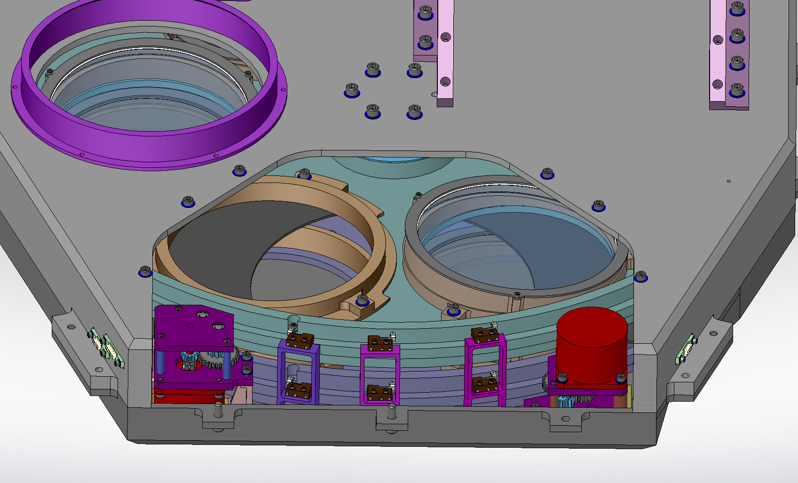
Wheel A SW 1
Wheel A SW 2
Wheel A SW 3
Wheel B SW 1
Wheel B SW 2
Wheel B SW 3
Filter Wheel Switch Layout

Slide 3
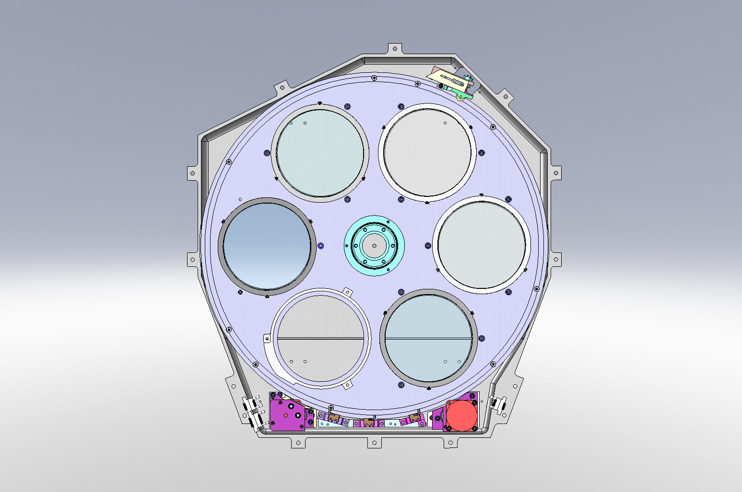
Filter Wheel B Layout
Ks
H
K
J
open
Y

